Slide 1
17th Meeting of the Capacity Building Sub-Committee
South West Pacific Hydrographic Commission Capacity Building Update

Slide 2
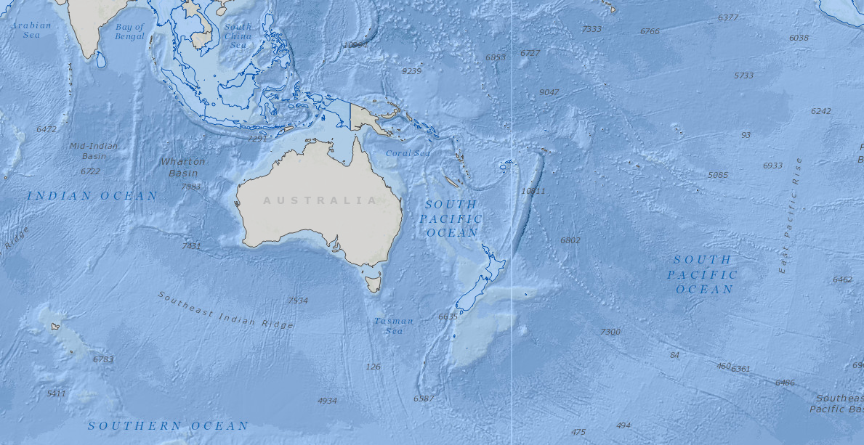
South West Pacific Hydrographic Commission

Slide 3
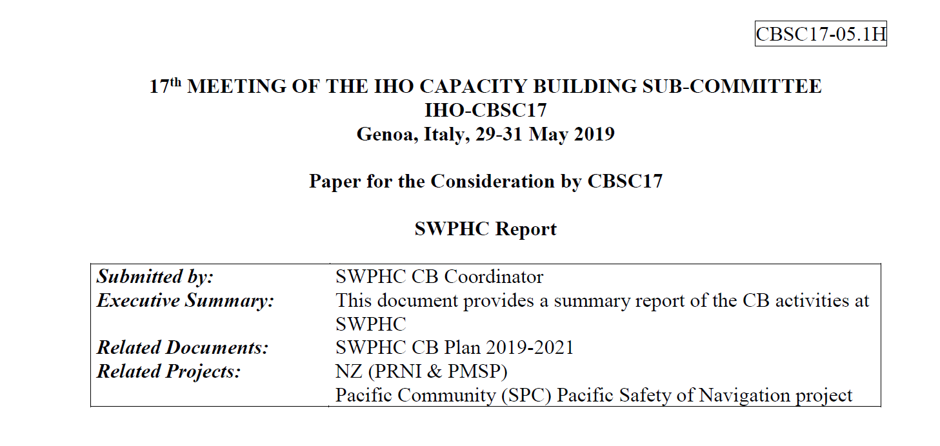
CBSC17-05.1H_2019_EN_SWPHC_Report_v1 Highlights

Slide 4
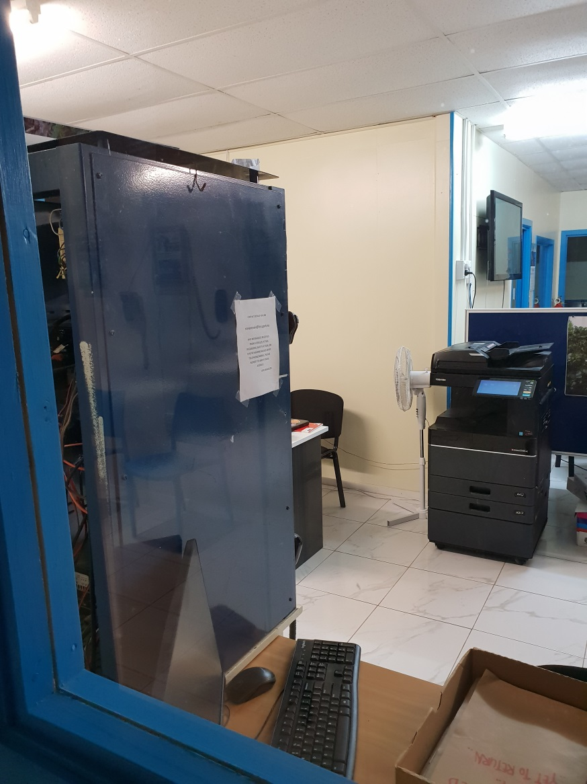
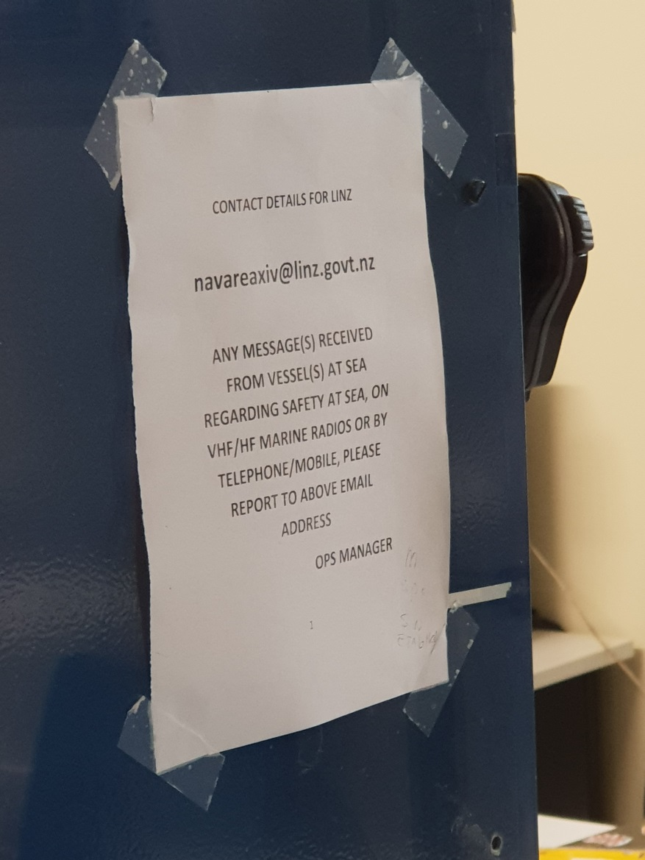
Niue MSI

Slide 5
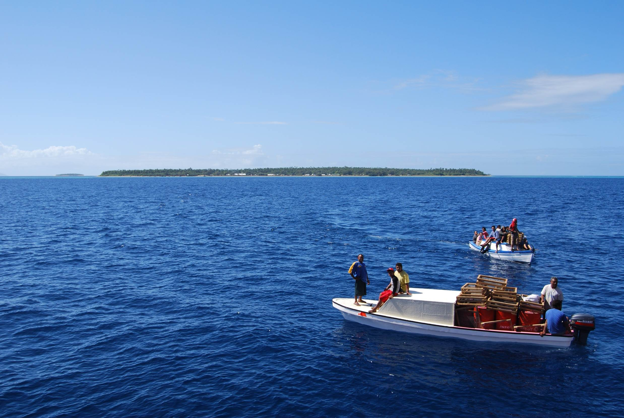
Thank you

