Slide 1
Streaming ENC (and other data) Data from a Cloud Based Open Sourced Database
Derrick R. Peyton, Ed Kuwalek
IIC Technologies
Abhishek Alla
NaAVIC

Slide 2
Overview
Nautilus Cloud – Underlying Technology behind NaAVIC
- Introduction and Principles
Summary

Slide 3
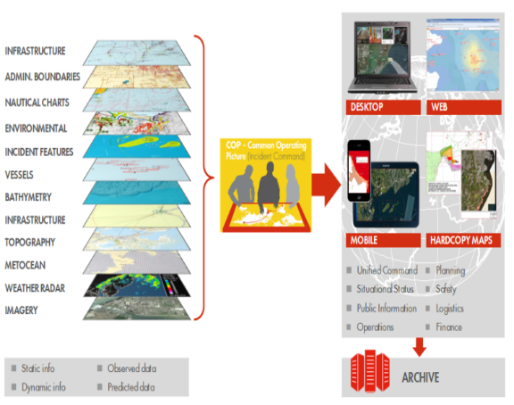
Incremento de los usos
Ejemplo: Common Operating Picture (COP) para Respuesta a Derrames de Hidrocarburos
Utiliza normas abiertas para integrar datos espaciales con otra información
Se utiliza para responder a derrames de petróleos y minimizar su impacto ³
³ IOGP, IPIECA, Resource Data Inc, OGC; Recommended practice for Common Operating Picture architecture for oil spill response – Final Report

Slide 4
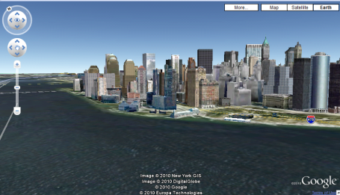
OGC and Object Oriented DB
WiMax
(Worldwide Interoperability for Microwave Access)
Oracle Spatial
CARIS HPD
OGC WMS WFS
12 Nautical Miles
Laptop Computer
2005 (MACHC), Veracruz, Mexico

Slide 5
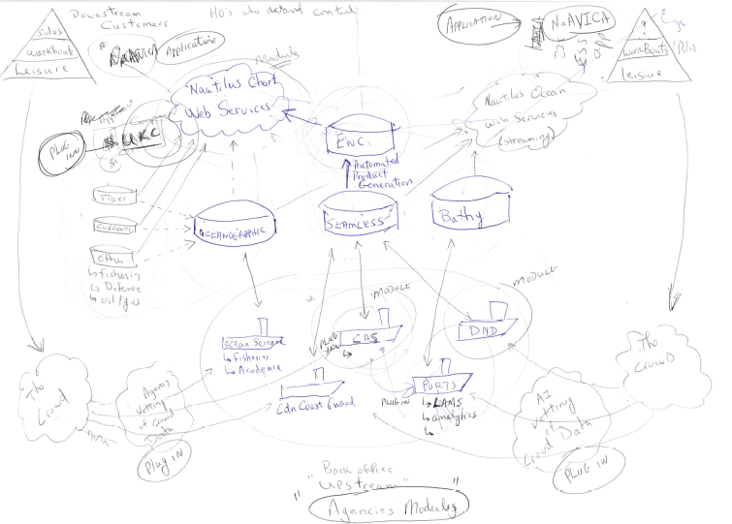
“The Brisbane Papers”

Slide 6
“The Brisbane Papers”
Workboat
Leisure
Workboat
Leisure
Nautiluc Chart
Web Service
Streaming
UKC Plug In
(PODS)
Personal
Online
Data
Store
Oceanography
ENCs
Bathymetry
Fisheries
Ocean Research
Hydrography
Navy
The Growd
The Growd
AI Vetting
Plug In
Agency Vetting
Plug In
Coast Guard
Port Authority
Contractor

Slide 7
“The Brisbane Papers”
Solas
Workboat
Leisure
Solas
Workboat
Leisure
Nautiluc Chart
Web Service
Streaming
UKC Plug In
“Nautilus Cloud”
Oceanography
ENCs
Bathymetry
Fisheries
Ocean Research
Hydrography
Navy
The Growd
The Growd
AI Vetting
Plug In
Agency Vetting
Plug In
Coast Guard
Port Authority

Slide 8
So, what is Nautilus Cloud?
Nautilus Cloud is a cloud based infrastructure for Marine Data Solutions and Services for Government Organizations, Commercial Industry and Consumers.
Government: HOs, National Institutes, R&D Organizations, Natural Resources, Environmental and Scientific Organizations, Inland Waterways
Commercial: Ports, Oil and Gas, Shipping, Dredging, Hydro Survey and Service Companies, Fishing Industry
Consumer: Leisure, Sports, Tourism

Slide 9
Basic Design Principles
Enterprise-grade and fully scalable
Native cloud solution
Platform independent
OGC compliant
Cloud or self-hosted

Slide 10
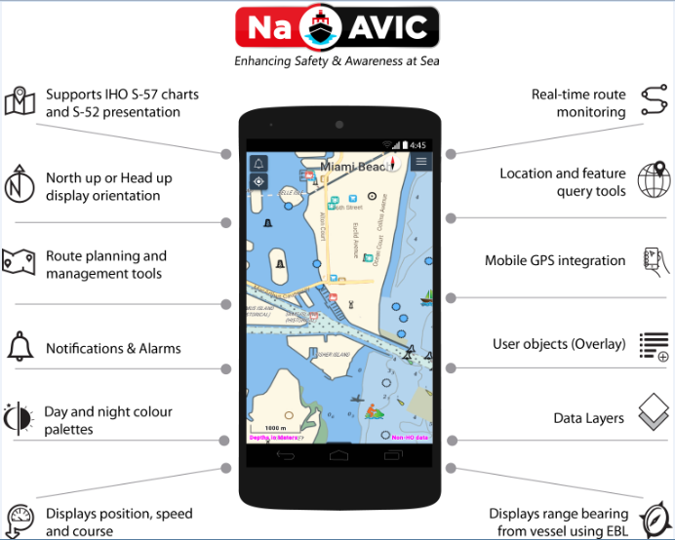

Slide 11
Underlying Principles
Enabling – the data provider
Engagement – the data user
Sharing – of data
Three important requirements for ECS data are covered;
content,
quality, and
updating.

Slide 12
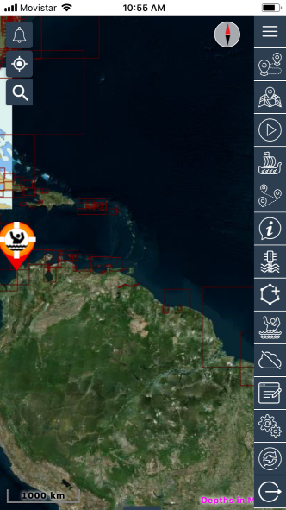
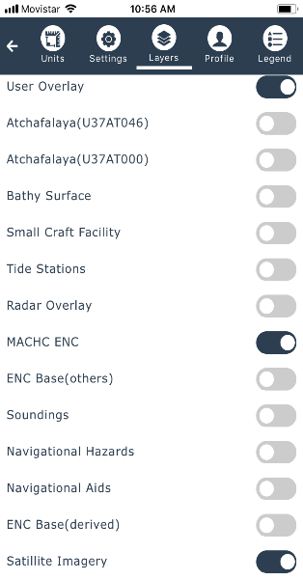
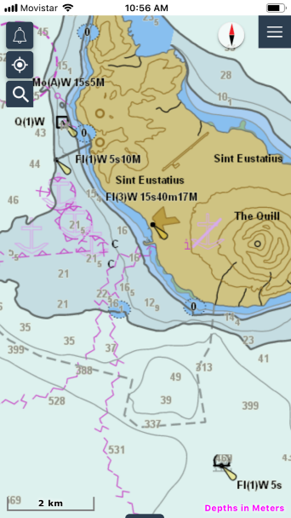
Demonstration

Slide 13
Flexible Business Model
With, both free and paid access to data the system gives organisations the ability to switch between free and cost-recovery models as their demands dictate. It allows the substitution of multiple disparate systems which may be already in place, with a system at substantially lower costs for implementation and support.

Slide 14
Summary
NaAVIC, is a free and downloadable mobile app and it represents a new approach to an ECS where the electronic chart data does not physically exist within the onboard computer.
The data for this particular form of ECS goes well beyond the traditional ENC content and consists of an output from a database consolidating many different data products currently available in the marine domain.
NaAVIC attempts to thrust the sailing experience several steps further by enabling all members of expeditions to engage in the voyage and share that voyage to fellow “marine friends”.

Slide 15
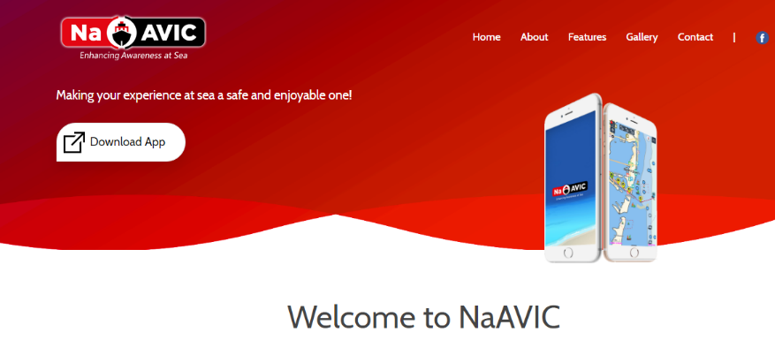
http://www.naavic.net/
All Good!

