Slide 1
Why Data Management? Because It Really Does Matter! John Pepper Director OceanWise

Slide 2
What is Data and Why it is Important?
Derived from term meaning ‘fact’
It is the new oil, the new electricity!
It is expensive so is a valuable asset
We collect it for a reason...we hope?
Used for reference or analysis
Notes:
derived from the Latin ‘datum’ meaning a fact.

Slide 3
‘Big’ Data Volumes
2.5 QUINTILLION
GRAINS OF SAND
ON EARTH
7.5 QUINTILLION
BYTES OF NEW DATA CREATED EVERY DAY
90% OF ALL DATA HAS BEEN
CREATED IN THE LAST 2 YEARS
AVERAGE BUSINESS DATA
VOLUMES DOUBLE EVERY
1.2 YEARS
Notes:
A quintillion is 1 followed by 18 zeros.

Slide 4
Beyond the data deluge!
flickr © fdecomite

Slide 5
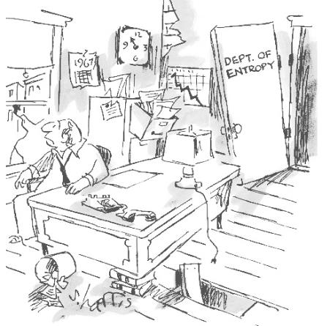
Why Data Matters!
FACT - Data is the most valuable asset in an organisation after its people
FACT - Data is critical to the running of business functions and processes
FACT- Without constant vigilance and effort to maintain order data entropy or anarchy reins!
Source: sciphilos.info
Notes:
Data is the new oil, the new electricity
Data costs money and is a valuable asset
You collect it for a reason (I hope!)
It deserves respect and constant attention – this takes effort but its worth it
Still don’t believe me – just look at most organisation’s file stores

Slide 6
The Negative Impact of Poor Data Management
Economic:
Revenues, Costs, Profits
Brand & Reputation
Customer Loyalty
Law & Regulation
Notes:
Law & Regulation - New General Data Protection Regulation (GDPR) became EU law on 12 April.
Each EU state has 2 years to pass the new regulations. So must become national law in 2018 at the latest
Purpose – to harmonize Data Protection laws across all 28 member states. Focus on how personal data (which can ID an individual) is processed.
Main stipulations:
Explicit, not implicit, marketing consent
The right to be forgotten
Notified if personal data has been compromised (e.g. Talk Talk)
And others (e.g. marketing to children banned)
Companies who breach the regulation liable to fines of up to 4% of their turnover
If UK leaves EU, still applies to any company trading in EU, so no escape.

Slide 7
So How Do You Get Started?
Make data a business priority, not an IT function
Undertake a data audit
Implement a data strategy – embrace both improvement and exploitation
Prepare and enforce a data policy to control access and usage rules
Monitor, measure and control key datasets - reference (or core) data and master data
Create and run data and process enhancement projects
Implement a system of Data Governance

Slide 8
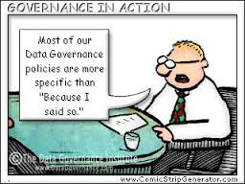
Data Governance
Definition:
A process for managing and improving data for the benefit of all stakeholders
Notes:
First, a simple definition of data governance. This is my own and is deliberately a lot less complex than many you will see.
This definition contains three key words, which are critical to any successful DG initiative. First, DG is a process. It’s not a one off project but a continuous process of data improvement. Second, and improvement is its ultimate aim. Too many DG initiatives focus exclusively on control and measurement. I do not see the point of control and measurement unless the end goal is to improve the data. Otherwise measurement and control becomes ends in themselves, and not means to an end. Finally, improvement must be real and provable. DG is not itself an end goal. It must contribute directly to better business performance, and this direct link must be shown and measured, usually in terms of benefits to the bottom line – revenue, cost, profit, productivity, efficiency and so on.

Slide 9
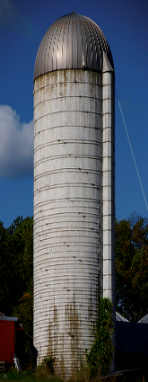
The Data Silo Problem
Sales
Despatch
Operations
Finance
Notes:
Data Silos / Stovepipes with Departments / Applications

Slide 10
Data Management Plan
http://www.oceandatapractices.net/bitstream/handle/11329/275/IOC%20Manual_Guides_73.pdf

Slide 11
The Data ‘Centric’ Solution
CUSTOMER DATA
PRODUCT DATA
Sales
Despatch
Operations
FINANCE DATA
Finance
EMPLOYEE DATA
Notes:
Have you heard the term ‘Data Centricity? This is what it means in practice!

Slide 12
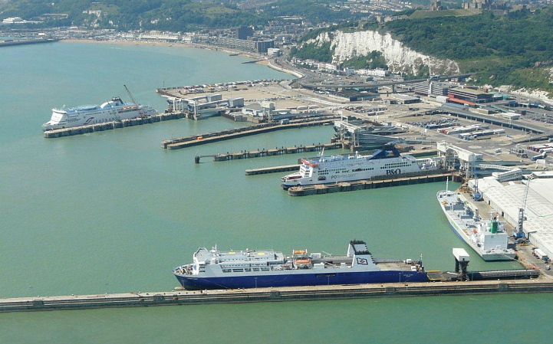
Treat Data as Infrastructure!
Treat Data as Infrastructure

Slide 13
Data Lifecycle
Create
Ingest
Store
Use
Archive
Plan
Notes:
Plan – Plan/Specify/Enable (System Architecture / Development Lifecycle / Toolsets / Infrastructure / Standards) = DM Plan = Evidence Plan
Create – capture, acquire, exchange, reuse, process stages, quality control, metadata, MEDIN Data Guidelines
Ingest – Receipt and Assessment, Extract, Transform and Load
Store – Folders v Database, data modelling
Use – Purpose, control, versioning, access
Archive – how, where, metadata, retrieval and accessibility, cost implications

Slide 14
Principle of Data Sharing
Agree what data to share and how to do it!

Slide 15
Data in Context
Wisdom???
Adapted from the well known Data-Information-Knowledge Triangle by OceanWise (2011)

Slide 16
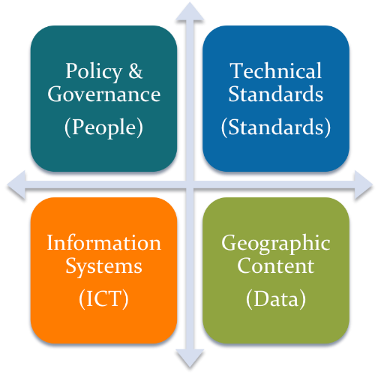
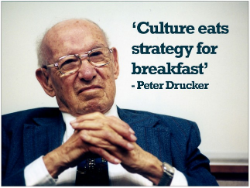
MSDI - Making the Case
The biggest
Challenge is people?
Four Pillars of Spatial Data Infrastructure (OceanWise, 2011)

Slide 17
New Data
Survey Data is now being collected and delivered in the MACHC region

Slide 18
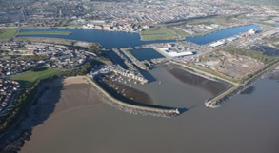
Wider Use of Hydrographic Data
Oil and Gas
Ports and Harbours
Renewable Energy
Maritime and Port Security
Policy, Planning and Regulation
Offshore Minerals
Conservation
Fisheries & Aquaculture
Architects, Engineers & Construction (AEC)
Surveying (hydrographic, seismic, habitat mapping)
Disaster Mitigation & Emergency Response
Notes:
Markets
Marine environmental data and information supports a wide range of activities offshore from site selection and planning, through engineering design and maritime operations, to asset and compliance management. Data is acquired from existing sources or captured to meet particular requirements. The knowledge, expertise and systems needed to specify, process and exchange this data and information are many and varied. OceanWise has the skills and resources to ensure its customers needs are met efficiently and with reduced risk in the following areas:
Oil and Gas
Ports and Harbours
Renewable Energy
Offshore Minerals
Fisheries and Aquaculture
Planning and Licensing
Disaster Mitigation and Response
Defense and Civil Security

Slide 19
Capacity Building/Training Topics
What is Data Management?
Data Governance
Data Life Cycle
Database Design
Master Data Register (MDR)
Standards
Metadata
Controlled Vocabularies
Glossaries
Coordinate Reference Systems
Data Quality
Data Publishing
Wider use of Marine Data
Spatial Data Infrastructures
‘Change’ Management
Organisations
Individuals
Data Challenges
Key Success factors

Slide 20
Courses, Workshops and Assistance
Capacity Building workshops, coaching and mentoring sessions to meet a range of requirements...
½-Day Briefings for Directors, Hydrographers & Senior Managers
1-Day Data Management Awareness
1-Day Fundamentals of MSDI
2-Day Data Management & MSDI for Managers
4-Day Data Management & MSDI for Practitioners
5-Day Data Management & MSDI, Policy & Strategy
2-Day Marine GIS
Data Audit
Data Governance ‘Road Map’
www.oceanwise.eu/services

Slide 21
Thank You
www.oceanwise.eu

