Slide 1




CARIBBEAN MARINE ATLAS
PHASE 2
CAROLINA GARCÍA VALENCIA
Marine and Coastal Research Institute - INVEMAR
Colombia
19th MEETING OF THE MESO AMERICAN & CARIBBEAN SEA HYDROGRAPHIC COMMISSION (MACHC 19)
30th November, Cartagena de Indias, Colombia

Slide 2
GENERAL OBJECTIVE
Since 2013, Caribbean Marine Atlas Phase 2 (CMA2) has been working on the operationalization of spatial data information by creating an online digital platform to support Integrated Coastal Zone Management – ICZM and Ecosystem-based Management - EbM for the major Caribbean ecosystems – Caribbean Large Marine Ecosystems.
Execution and financial support
IOC/IODE
Flanders government
Regional coordination
INVEMAR – (Colombia)
National coordination
National Focal Point (NFP) / Country
COORDINATION STRUCTURE

Slide 3

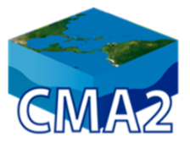
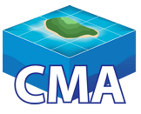











COLLABORATIVE APPROACH IN THE REGION…
Cooperation and Exchange Expertise
Phase 1
(2009-2013)
Review and planning meeting and worshop CMA (Miami, December 2013 and August 2014)
Strategic synergies
Five Southeast Pacific countries
Phase 2
(2016-2018)
ACMA
African Coastal and Marine Atlas
National portals of spatial data
Barbados – Coordinator
Cuba, Dominica, Grenada, Guyana, Jamaica, St Lucia, Trinidad & Tobago and Turks & Caicos
Regional platform with indicators. Colombia (INVEMAR) - Coordinator , 13 countries
Opportunities
CMA2 project builds upon the experience and lessons learnt in the
and
Advising from International coastal Atlas network - ICAN.
Training through regional training center at IODE Ocean Teacher Global Academy (OTGA).
Tools
CMA
Notes:
A collaborative approach between existing national, regional and international marine data and information management programs, projects or strategies of OIDE and others in the region strength capabilities through cooperation and exchange expertise, opportunities of advising, training, use of information tools and relation with expert network (Ibermar or OceanExpert).
Initiatives: the International Oceanographic Data an Information Exchange (IODE) – Ocean Data and Information Network for the Caribbean and South America (ODINCARSA) initiative, the IODE National Oceanographic Data Centres (NODCs) in the participating countries, and the IODE Ocean Biogeographic Information System (OBIS), The International Association of Aquatic and Marine Science Libraries and Information Centres (IAMSLIC) encompasses all aspects of aquatic and marine sciences and their allied disciplines. The association provides a forum to exchange and explore ideas and issues of mutual concern.

Slide 4





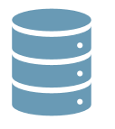
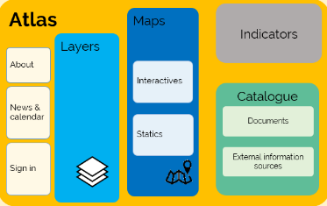

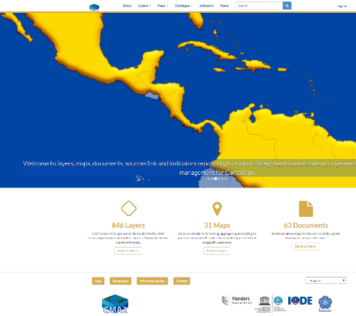





PLATFORM COMPONENTS VS PRODUCTS
TECHNOLOGY - the online platform is supported by and Power BI for the management, display of geospatial data, and data analysis and indicators display . GeoNode allows countries to manage their own content and information
E-repository of documents, static maps and links to relevant information for the Caribbean region
GIS tech people trained to manage information and permissions by country pilot
CATALOGUE
External sources information
Documents
Physical, Biotic or Anthropic environment
Metadata / Geonetwork
Structure
Collection of thematic layers from national information (country partners) and regional sources
Shapefile
Geoservices
LAYERS
MAPS
Dynamic maps
Static maps
Thematic maps for the Caribbean in process (national information from countries partners)
INDICATORS
Online Technology Platform (CMA interface)
Indicators data
Implementation of indicators
https://www.caribbeanmarineatlas.net/
Notes:
Platform supported by Geonode technology to manage spatial information using for layers and maps. Power BI f technology for indicators data and display, and SIMILE Exhibit for external sources.
This image shows the set of products that the atlas support, from data sets, shapefile, raster, documents and links from external services can be linked.
Geonode let the countries manage their own national information to achieve self-manage information with quality control and support from the project coordination

Slide 5
Collection of thematic layers from national information (country partners) and regional sources
879 layers
13 thematic to support ICZM and EbM (ecosystems, species, fisheries, oceanography and climate, climate change, socio-economy, governance, MPAs, ...)

Slide 6
TYPE OF PRODUCTS
22 interactive maps / 37 static maps
Catalogue : 64 documents and 95 external information sources(projects, countries, institutions)

Slide 7
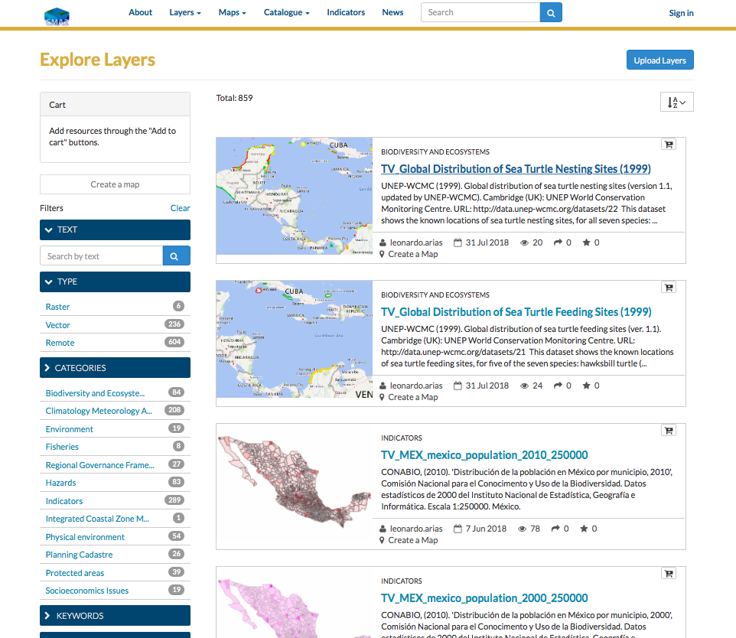
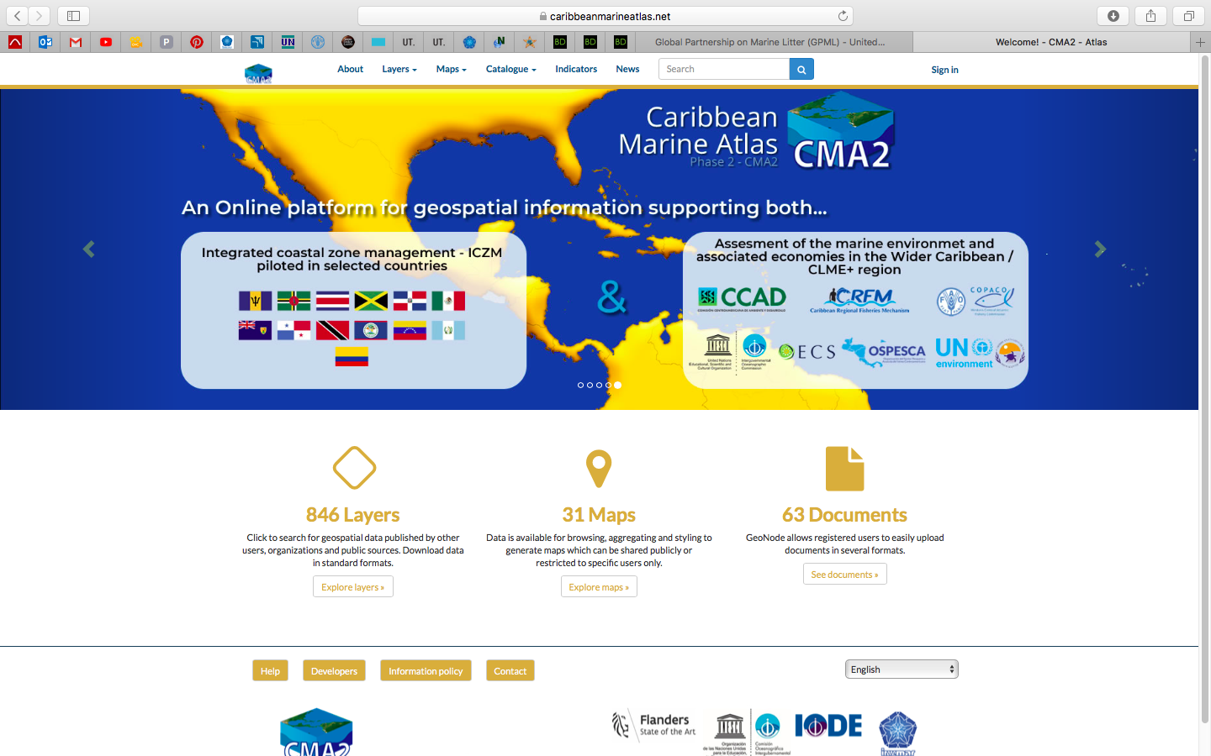
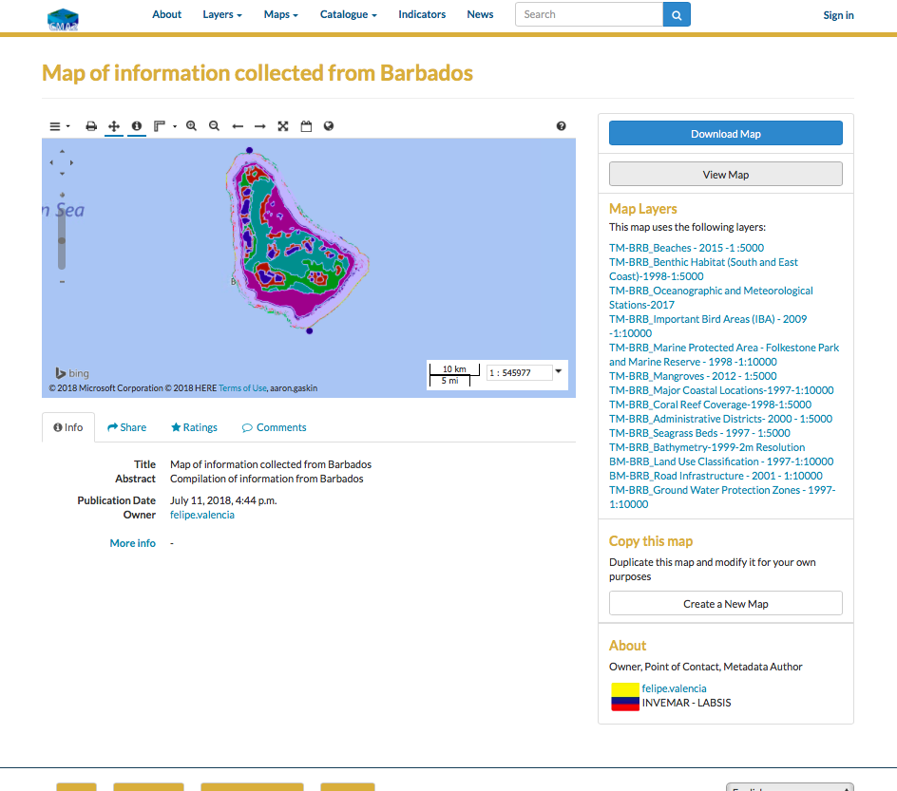
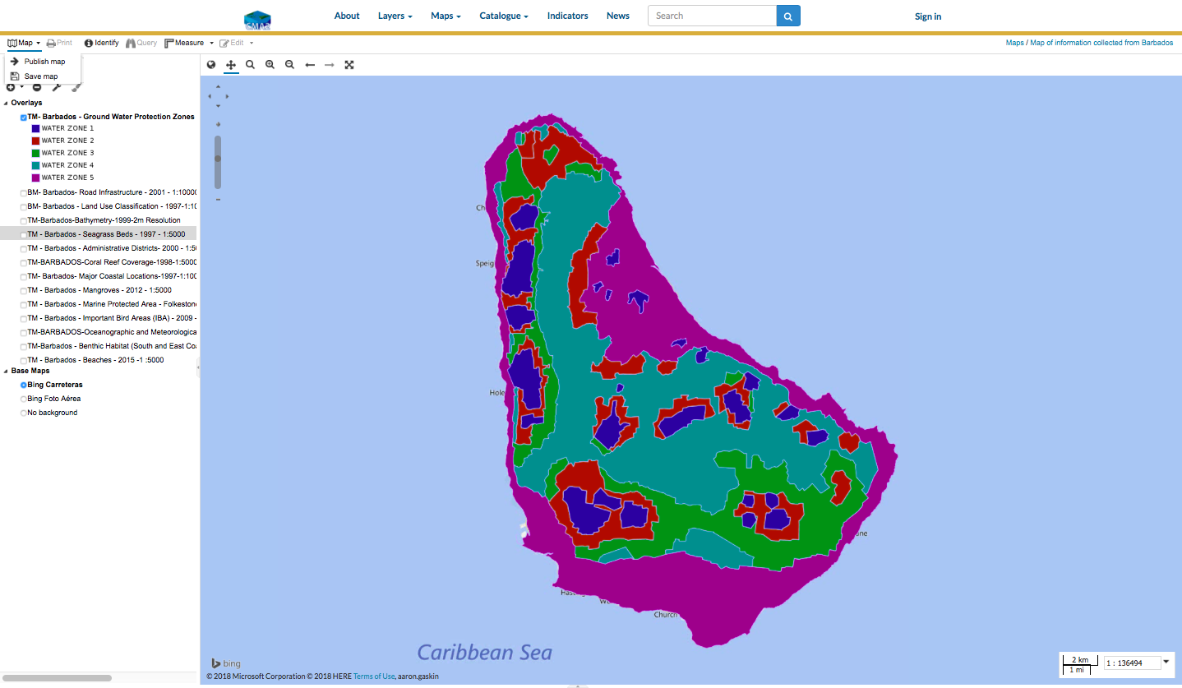
Notes:
Maps (spatial viewer for consult /creation /downloading maps and layer / Layers (shapefile, raster, WMS) / free access to data and information
Query tool for displaying and downloading layers and creating maps

Slide 8
CMA2 COMMUNITY
Communication in two languages (English – Spanish)
Institution leader in each country as National Focal Point –NFP– (national coordinator)
Implementation of information standards (metadata) and protocols, information policy (The programme "International Oceanographic Data and Information Exchange" (IODE) of the "Intergovernmental Oceanographic Commission" IOC of UNESCO information Policy) and own protocol to upload products
Quality control (metadata, file naming, etc) from Coordination (INVEMAR)
Individual countries manage the uploading of their national data (layers and maps) to the Atlas
Training courses on GeoNode (open source) platform use.

Slide 9
CMA2 PLATFORM to date…
Synergy with actions and activities of other projects and initiatives linked to the implementation of this CLME+ SAP. CMA2 contributes with the DS/M&E mechanisms at Caribbean Large Marine Ecosystem level through join efforts with CLME+
Collaborative approach: Cooperation – expertise exchange (SPINCAM project, African Coastal and Marine Atlas - ACMA), opportunities (Ocean Teacher Global Academy - OTGA, International Coastal Atlas Network - ICAN, Ocean Biogeographic Information System - OBIS, International Association of Aquatic and Marine Science Libraries and Information Centers - IAMSLIC) and use of IODE tools (OceanDocs and OceanExpert)
8 countries actively involved (Mexico, Belize, Guatemala, Dominican Republic, Jamaica; Barbados, Trinidad & Tobago, Venezuela)

Slide 10






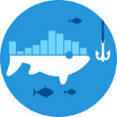









INDICATORS
Coral Health
Threatened
Species
Invasive
Species
Marine
Protected
Areas
Coastal
population
Change
Published
Sea
Level
Global
Capture
Production
Ecosystems
representativeness
Coastal
economic
activities
Natural
Hazards
Frequency
In process
CMA2 objectives
Aichi Targets
Contribution to show country advances in global strategies as SDG
http://www.caribbeanmarineatlas.net/indicatorscma2
Notes:
One the most relevant product that CMA2 offers are the set of indicator, published most of them using national data. From 10 indicators selected in the project frame, five are already published (see green boxes) . The rest are in process of design of Methodological sheets or collecting data.
CMA2 works on a voluntary contribution to Sustainable Development Strategy, more specifically to SDG 13 and 14
As part of the rules of game, a set of commitments were agreed among al the country pilots of the project, some of them are…

Slide 11
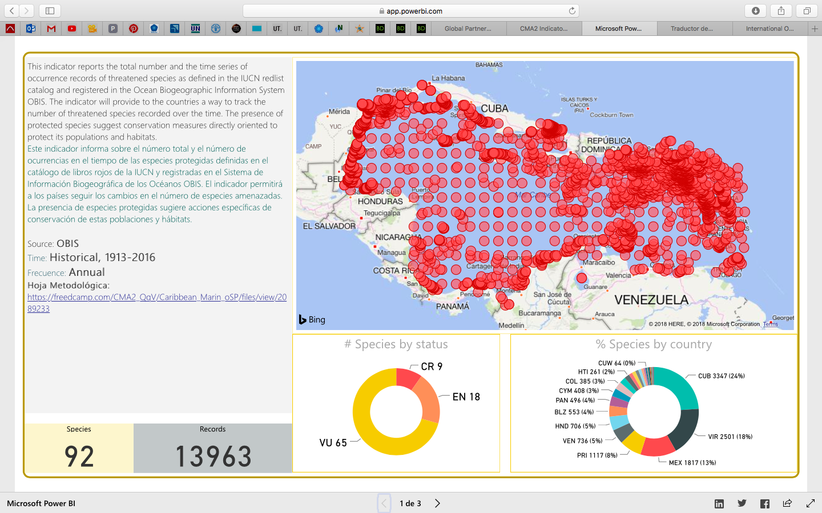
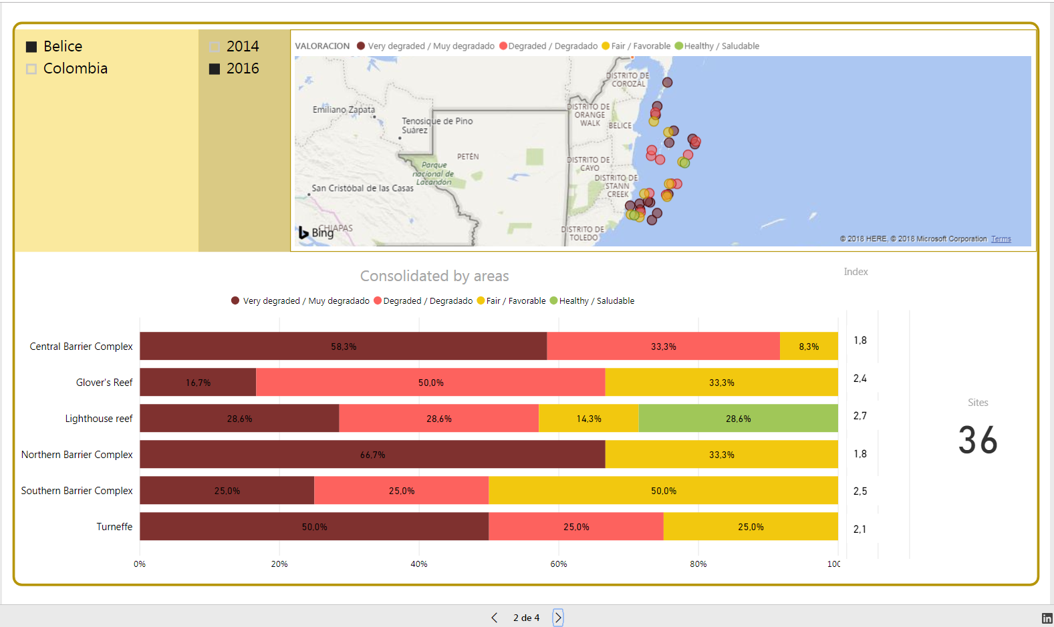

Slide 12
NEXT STEPS…
Finish implementation and display of the indicators for the Caribbean region (continue updating).
Continue with collection of quality spatial information from countries and projects for strengthening the support for decision making processes on ICZM and EbM in the Caribbean region
Continue to encourage projects and countries to compile, use, and share the highest amount of national, regional, and international marine data on different marine topics and on multiple scales
Continue to promote the collaboration through IODE initiatives (ODINCARSA, NODC, OBIS, OTGA-RTC Latin America, ICAN, OceanExpert, OceanDocs, etc.) for capacity building
Improve the interaction with other regional projects/initiatives or countries interested provide new information for enhancing the spectrum of information for the Caribbean region (spatial information E-repository for the Caribbean region…).
Continue to provide information on the country´s progress in global strategies such as the SDGs.
Latin American and Caribbean integrated ocean data and information system “prototype” contributing to SDG, clearinghouse mechanism / Transfer On Marine Technology CHM/TMT and UN Decade (regional information for production of the Global Oceanic Sciences Report GOSR).

Slide 13













CMA2 Current partner countries
Recently, Trinidad & Tobago (Institute of Marine Affairs) as responsible for undertaken activities aimed at implementing the protocol on Land-based Sources LBS for pollution at the Regional level for the English speaking islands of the Caribbean, wishes use CMA2 as spatial platform for products (data, layers and documents).
Sargassum and Oil Spills Monitoring Pilot Project for the Caribbean and Adjacent Region
Caribbean Node for Marine Litter Management
Countries that agreed to share information to support ICZM and EbM
Platform on line available (INVEMAR technical support 24/7)
Training courses for GeoNode Technology

Slide 14
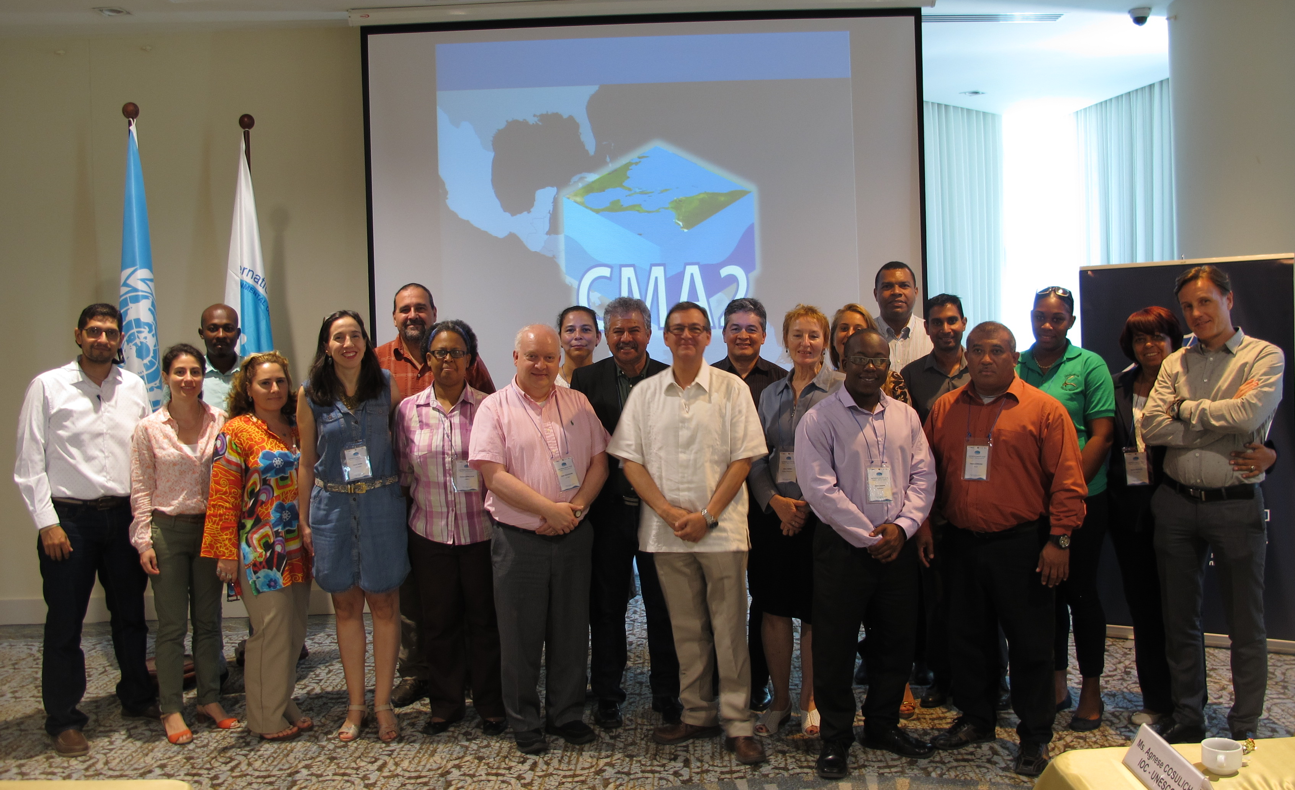
THANKS
Francisco Arias-Isaza
INVEMAR’s Director
CMA2 Project’s Director
francisco.arias@invemar.org.co
Paula Sierra-Correa
INVEMAR’s Head of Information Coordination
CMA2 Project’s Technical/Scientific Staff
paula.sierra@invemar.org.co
Carolina García Valencia
Technical coordinator
CMA2 Project
Carolina.garcia@invemar.org.co
CMA2 COMMUNITY
http://www.caribbeanmarineatlas.net

Slide 15
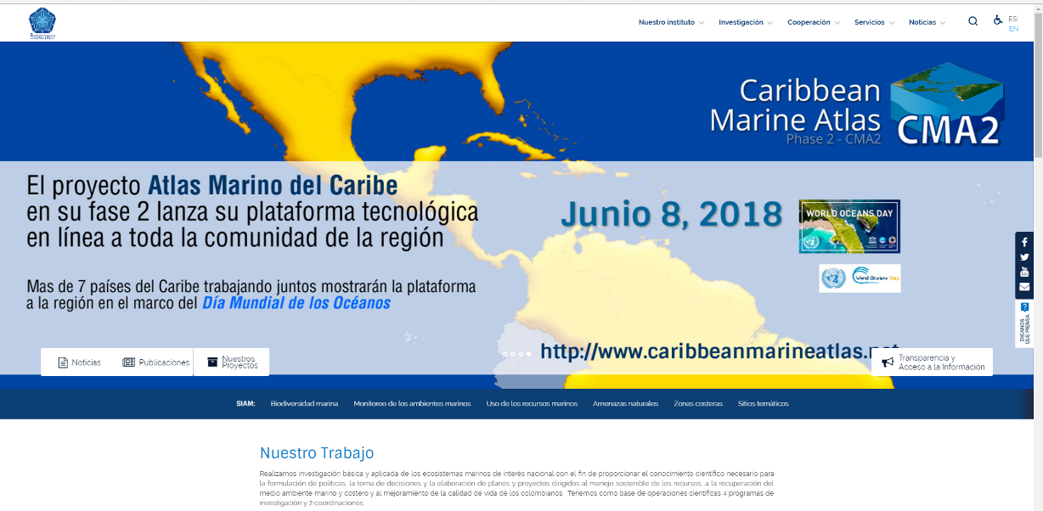
Dissemination
Project videos available on:
English (short version): https://vimeo.com/273779090
Spanish (short version): https://vimeo.com/273778826
English: https://vimeo.com/288003526
Spanish: https://vimeo.com/288003526

Slide 16
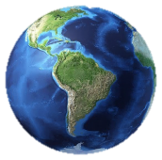
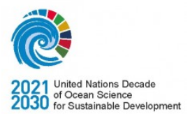

SPINCAM AND CMA2 vs SDGs – UN OCEANS DECADE
For Caribbean and Southeast Pacific regions, contribution to:
Marine ecosystems status
Marine species status
Marine resources status
Marine management status (MSP)
Adaptation strategies and science-informed policy responses to global change are urgently needed
Notes:
Sugiero poner un diagrama …parecido a esto, para ilustrar que desde los dos proyectos , se contribuye con indicadores e información espacial nacional a distintos ODS y a su vez con información para al ciencias sobre el océano a fin de respaldar toma de decisiones informada….para la región LA (Caribe y Pacifico Sudeste…). Esto dado que será el tema propuesto para el taller ICAN posterior a estas presentaciones…

Slide 17
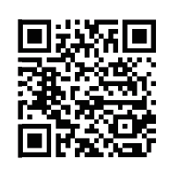
http://www.caribbeanmarineatlas.net

