Slide 1
19th Meeting of the Meso America – Caribbean Sea Hydrographic Commission Guyana National Report by
Mr Troy Clarke, Superintendent of Surveys (Ag), Maritime Administration Department
Mr. Rene Duesbury Manager of Surveys , Guyana Lands and Surveys Commission

Slide 2
Main achievements during the year
* Completion of the first phase of the CME project, that entails seabed mapping of the approaches to the Demerara River and main port of Guyana ( Georgetown)
* Formation of a National Hydrographic Coordinating Committee (NHCC) with the Guyana Lands and Surveys Commission as chairman ( GLSC has the legal authority for all surveys in Guyana) and MARAD Hydrographic Office as the Secretary
* Appointment of a National and Deputy Maritime Safety Information Coordinator
* Guyana was taken off the IALA Watch list after actions were taken as it relates to Aids to Navigation Management
* Commencement of the second phase of the CME Project, which entails equipment being installed on a platform and capacity building ( training )
* Development of a National Spatial Data Infrastructure (NSDI) of which MSDI is a critical component, especially because of significant oil discovery offshore Guyana

Slide 3
Main challenges and/or obstructions
* Lack of adequate amount of trained personnel in both Hydrography and Nautical Cartography
* Lack of knowledge amongst policy makers of the importance of the Hydrography to the economy of our country

Slide 4
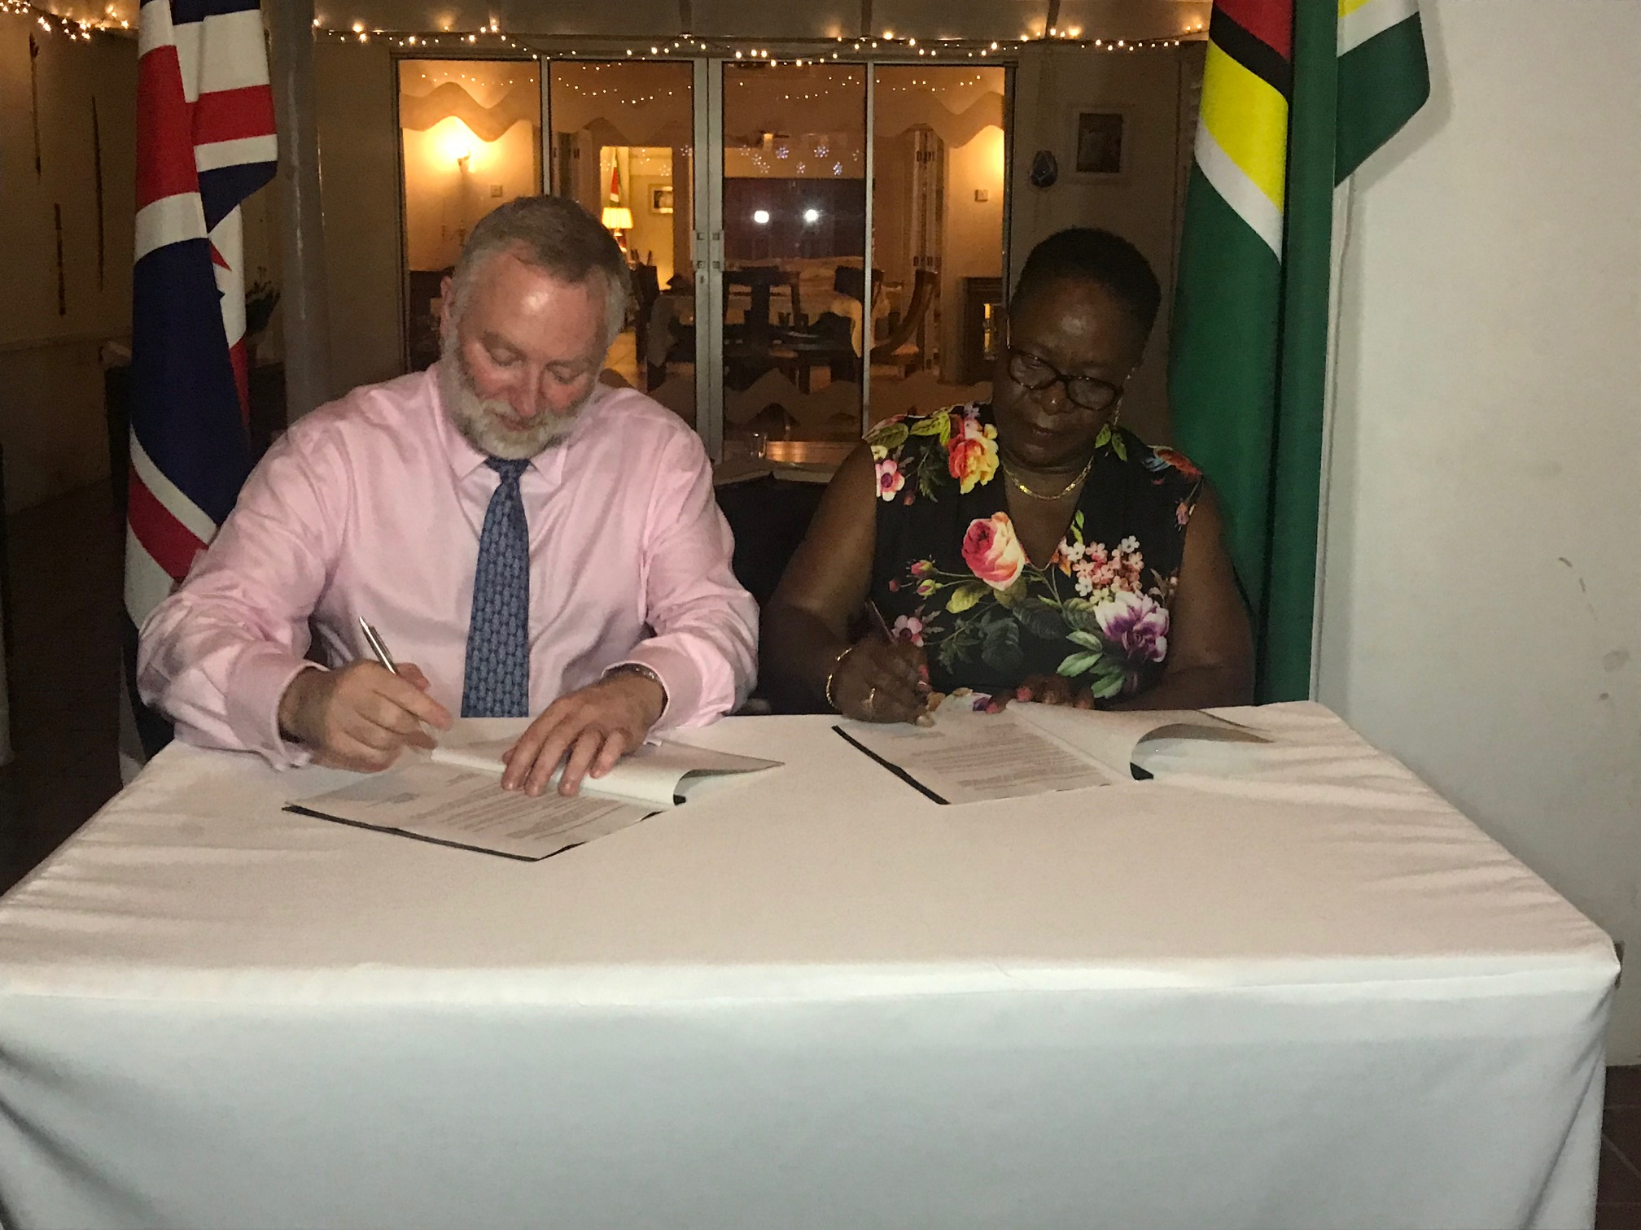
Progress on MSDI
Governance – Commencement of the CME Project was able to give stakeholders within the maritime domain of the Guyana of the multi use and benefit of hydrography to the economic development of the country
Standards – An updated Local Survey Act is in the drafting stage and would include minimum IHO recommendations for Hydrography and Nautical Cartography
Cooperation between GUYANA & UK

Slide 5
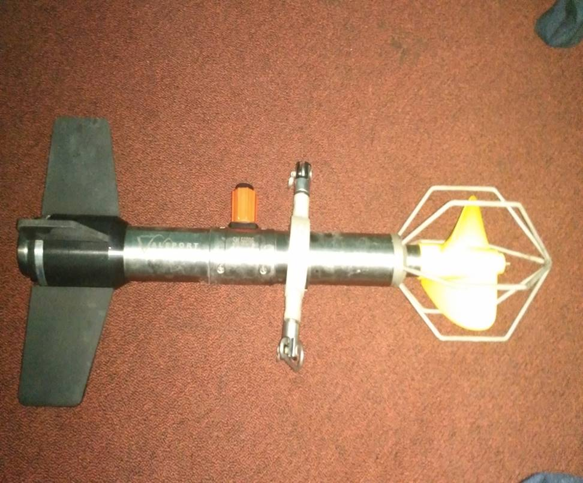
Progress on MSDI ( Cont.)
Technology - New Side Scan Sonar
- New Current Meter

Slide 6
Data - Systems are currently being put in place to receive the huge amount of bathymetric data that was acquired by the Oil Exploration Companies operating offshore Guyana

Slide 7
Plans that affect my country
Need for assistance in the following areas;
* Hydrographic Governance/Hydrographic Awareness
* Hydrography Training
* Nautical Cartography Training
* Maritime Safety Information Training (MSI)
* Maritime Spatial Data Infrastructure (MSDI)
* Hydrographic / Cartographic Database Management
* Technical Assistance
* Information Sharing Network
* Hydrographic Data Processing
* Digital Recording
* Sea/Riverbed sampling
* Lidar (Land Based ) application to hydrographic surveys

Slide 8
Thank you for your attention

