Slide 1
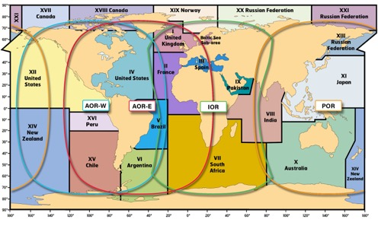
IMO/IHO World-Wide Navigational Warning Service
NAVAREA IV / XII
28 November 2018

Slide 2
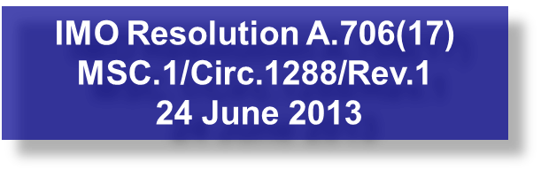
IMO/IHO World-Wide Navigational Warning Service (WWNWS)
International coordinated global service for promulgation of hazards to navigation by satellite affecting the safety of life at sea
Twenty One Navigation Areas (NAVAREAs), each with a Coordinator (Eighteen) responsible for the harmonization of navigational information in their area.

Slide 3
WWNWS-SC
Established 1973
Monitors and guides the WWNWS
Provides guidance to IHO Member States to further evolution of WWNWS
International cooperation with IMO, WMO, IMSO, IALA
Chairman represents IHO for relevant IMO Committees.
Capacity Building Assistance
Rep Regional Hydrographic Commission Conferences
MSI Training
Chairman – Peter Doherty
Commission Membership – 40 plus IHO Member States plus IMO, WMO, IMSO and Inmarsat

Slide 4
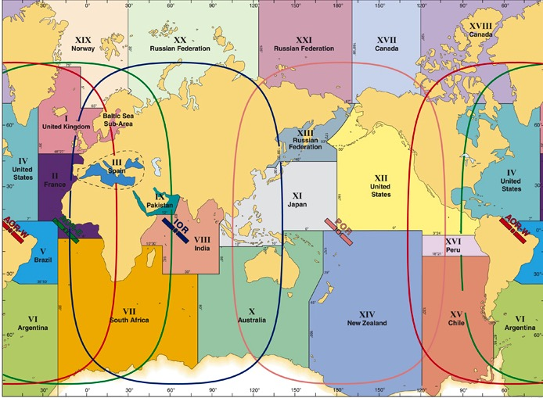
World-Wide Navigational Warning Service NAVAREAs

Slide 5
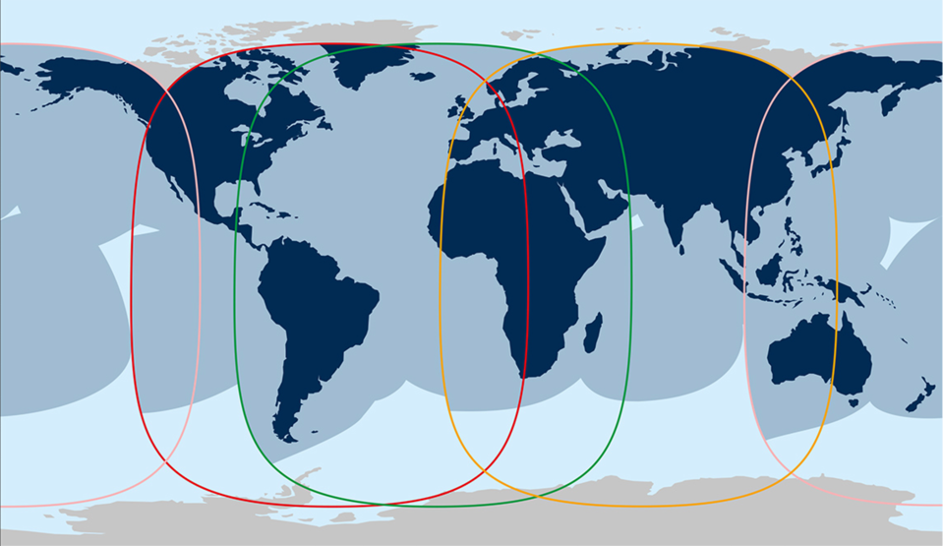
Inmarsat-C Coverage Shift
IOR
AOR-W
AOR-E
IOR

Slide 6
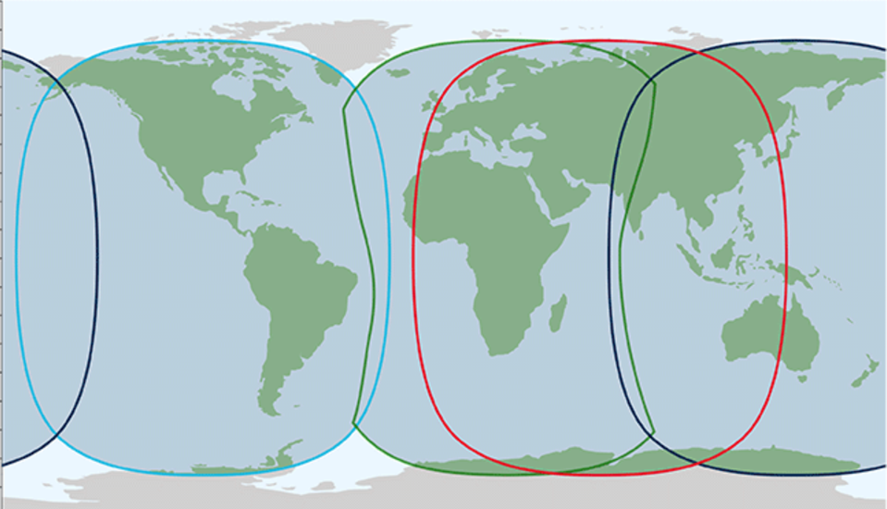
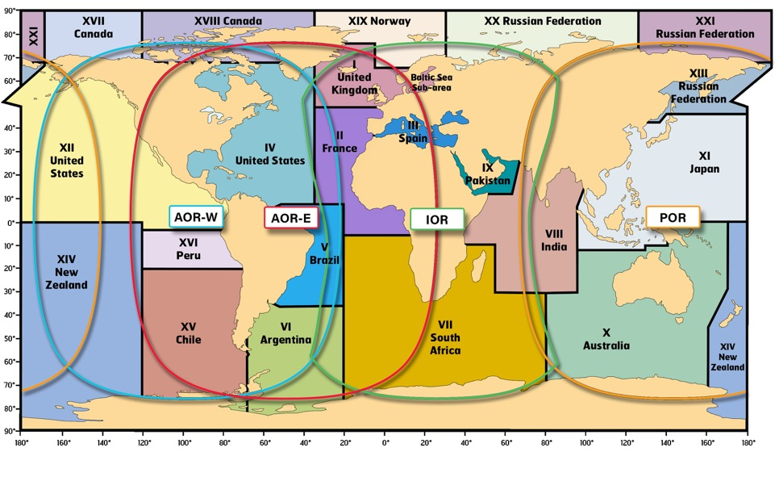
Inmarsat-C Coverage Shift
IOR
AOR-W
AOR-E
IOR

Slide 7
Definitions
NAVAREA: A geographical sea area established for the purpose of coordinating the broadcast of navigational warnings
NAVAREA COORDINATOR: The authority charged with coordinating, collating and issuing navigational warnings for a designated NAVAREA
NATIONAL COORDINATOR: The national authority charged with collating and issuing coastal warnings
within a

Slide 8
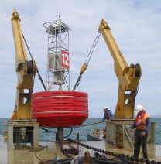
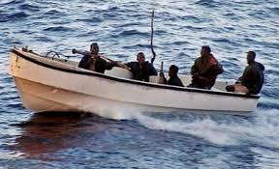
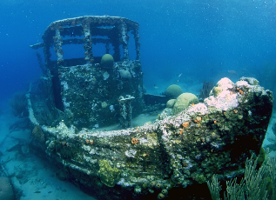
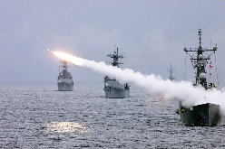
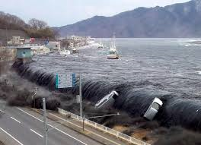
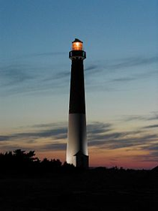
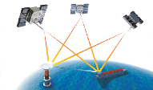
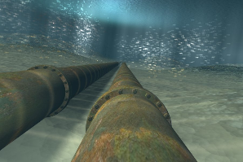
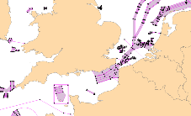
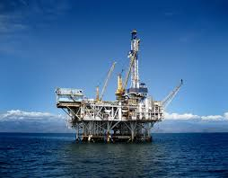
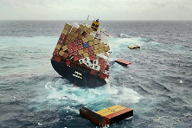
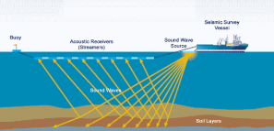
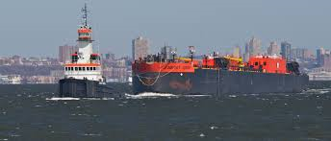
Navigational Warnings

Slide 9
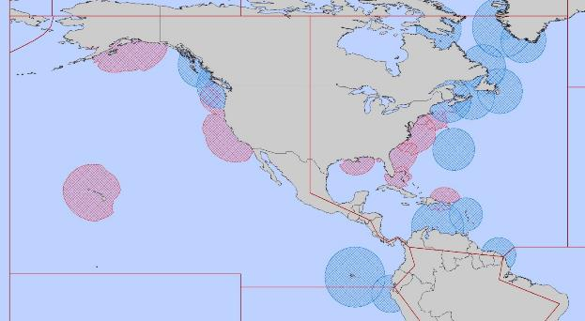
NAVAREA IV/XII Coordinator
Endeavour to be informed of all events that could significantly affect the safety of
navigation within the NAVAREA
IV
XII
IMO Resolution A.706(17) MSC.1/Circ.1288/Rev.1 24 June 2013

Slide 10
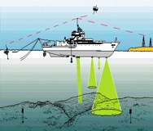
NAVAREA IV/XII Coordinator (cont.)
Assess all information immediately upon receipt in the light of expert knowledge for
relevance to navigation in the NAVAREA;
Select information for broadcast

Slide 11
National Coordinator
Endeavour to be informed of all events that could significantly affect the safety of
navigation within your national waters
IV
XII
IMO Resolution A.706(17) MSC.1/Circ.1288/Rev.1 24 June 2013

Slide 12
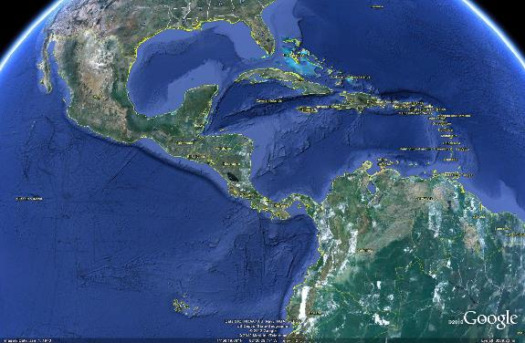
National Coordinator
Forward coastal warnings and relevant associated information for wider promulgation directly to NAVAREA Coordinator
navsafety@nga.mil
IMO Resolution A.706(17) MSC.1/Circ.1288/Rev.1 24 June 2013

Slide 13
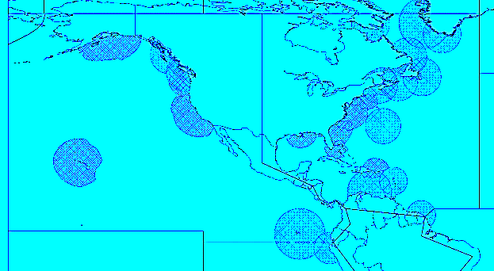
National Coordinators in the MACHC
 | Guyana
Anguilla (UK) | Haiti
Antigua and Barbuda | Honduras
Aruba (Kingdom of the Netherlands) | Jamaica
Bahamas | Martinique (France)
Barbados | Mexico
Belize | Montserrat (UK)
British Virgin Islands (UK) | Nicaragua
Caribbean Netherlands (Kingdom of the Netherlands) | Panama
Cayman Islands (UK) | Puerto Rico (US)
Colombia | Saint Barthélemy (France)
Costa Rica Cuba | Saint Kitts and Nevis
Curaçao (Kingdom of the Netherlands) | Saint Lucia
Dominica | Saint Martin (France)
Dominican Republic | Saint Vincent and the Grenadines
Ecuador | Saint Maarten (Kingdom of the Netherlands)
El Salvador | Suriname
French Guiana | Trinidad and Tobago
Grenada | Turks and Caicos Islands (UK)
Guadeloupe (France) | United States Virgin Islands (US)
Guatemala | Venezuela
IV
XII

Slide 14
IHO Capacity Building
The first phase of capacity building is the collection and circulation of nautical information
Allows for real time integration of your national maritime safety information to be part of the World-Wide Navigational Warning Service (WWNWS)
Understand your roles and responsibilities
Establish links with NAVAREA Coordinator

Slide 15
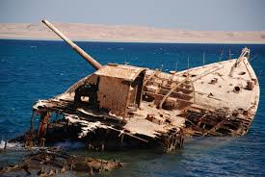
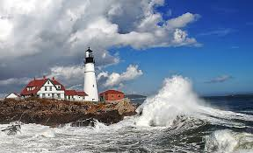
Maritime Safety Information Training
3 day comprehensive training course held with region
Led by WWNWS-SC
Sponsored by IHO CBC
Endeavour to be informed of all events that could significantly affect the safety of navigation within your coastal region.

Slide 16
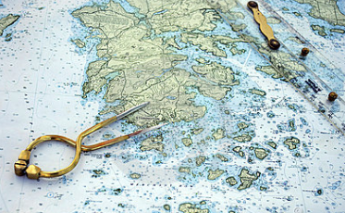
Maritime Safety Information Capacity Building Course Outcomes
Assess all information in the light of expert knowledge for relevance to navigation in the coastal region.
IV
XII

Slide 17
Maritime Safety Information Capacity Building Course Outcomes
Draft navigational warnings in accordance with the
Joint IMO/IHO/WMO Manual on Maritime Safety Information
Pass NAVAREA warnings for further promulgation to the NAVAREA Co-ordinator

Slide 18
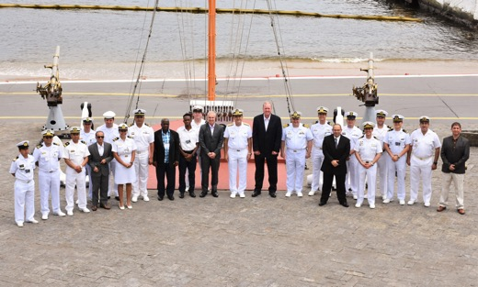
IHO MSI Training Courses (22)
2007 Jamaica (MACHC)
2007 Mozambique (SAIHC)
2008 Spain (MBSHC)
2009 Ghana (EAtHC)
2009 Oman (NIOHC / RSAHC)
2010 Namibia (SAIHC)
2010 Australia (SWPHC)
2011 Brazil (SWAtHC/SEPHC/MACHC)
2013 Trinidad (MACHC)
2013 South Africa (SAIHC)
2014 Oman (NIOHC / RSAHC)
2014 New Zealand (SWPHC)
2014 Ivory Coast (EAtHC)
2015 Japan (EAHC)
2015 Turkey (MBSHC)
2016 Saint Lucia (MACHC)
2016 New Zealand (SWPHC)
2017 Barbados (MACHC)
2017 South Africa (SAIHC)
2018 Turkey(MBSHC)
2018 New Zealand (SWPHC)
2018 Brazil (SWAtHC, SEPHC & MACHC)
2018 – Niteroi, Brazil

Slide 19
MSI Training Course Data

Slide 20
MSI Training Course - MACHC
89 students trained from 33 countries
Anguilla
Antigua and Barbuda
Barbados
Belize
Bermuda
British Virgin Islands
Cayman Islands
Colombia
Costa Rica Cuba
Curacao
Dominica
Dominican Republic
Ecuador
El Salvador French Guiana
Grenada
Guatemala
Guyana
Haiti
Honduras Jamaica
Mexico
Montserrat
Nicaragua
Panama
Saint Kitts
Saint Lucia
Saint Vincent and the Grenadines
Suriname
Trinidad & Tobago Turks and Caicos
Venezuela

Slide 21
National Coordinators in NAVAREA IV and XII
Send MSI to NGA and NAVAREA IV/XII will disseminate a navigational warning for your waters….
AT NO COST TO YOU !!
Mariners will be able download your warning as a text file or as a Google Earth KMZ from NGA’s Maritime Safety Information website!
http://msi.nga.mil/NGAPortal/MSI.portal
Select the Broadcast Warnings link
navsafety@nga.mil

Slide 22
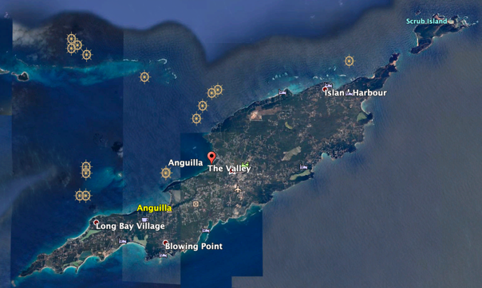
Anguilla
Sent 1 MSI report to navsafety@nga.mil
Promulgated 1 NAVAREA warning
1 warning currently in force

Slide 23
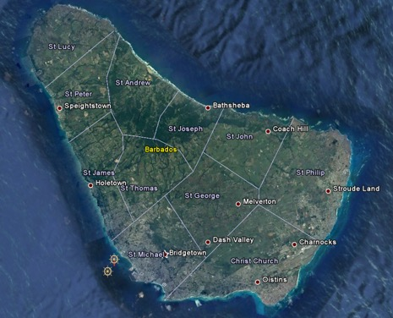
Barbados
Sent 2 MSI reports to navsafety@nga.mil
Promulgated 2 NAVAREA warnings
No warnings currently in force

Slide 24
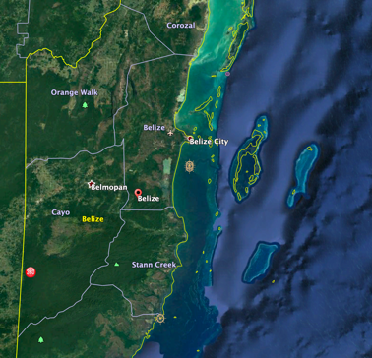
Belize
Sent 2 MSI reports to navsafety@nga.mil
Promulgated 0 NAVAREA warnings
No warnings currently in force

Slide 25
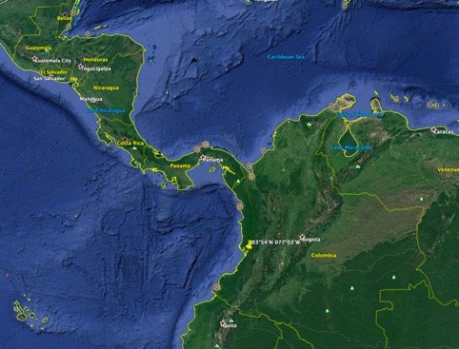
Colombia
Sent 256 MSI reports to navsafety@nga.mil
Promulgated 47 NAVAREA warnings
4 warnings currently in force
NAVTEX
Santa Marta
11°03′.33N 074°13′.10W
Range: 300nm
B1: K
Buenaventura
03°54′.18N 077°03′.77W
Range: 300nm
B1: C
Santa Marta
Buenaventura

Slide 26
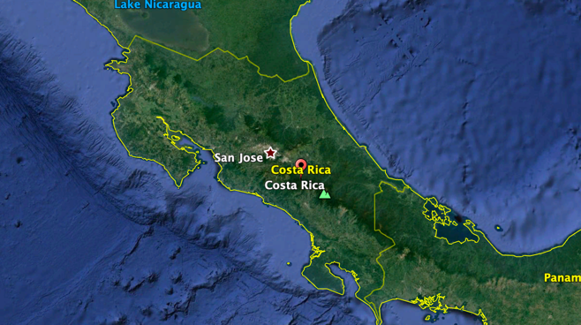
Costa Rica
Sent 1 MSI report to navsafety@nga.mil
Promulgated 1 NAVAREA warning
No warnings currently in force

Slide 27
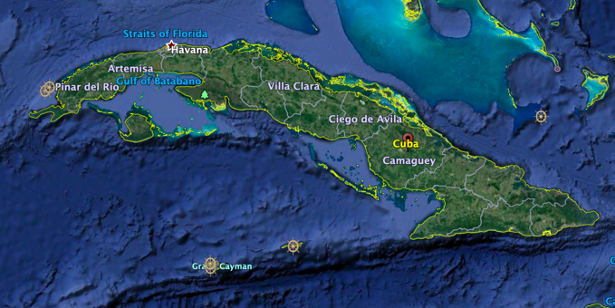
Cuba
Sent 4 MSI reports to navsafety@nga.mil
Promulgated 4 NAVAREA warnings
1 warning currently in force

Slide 28
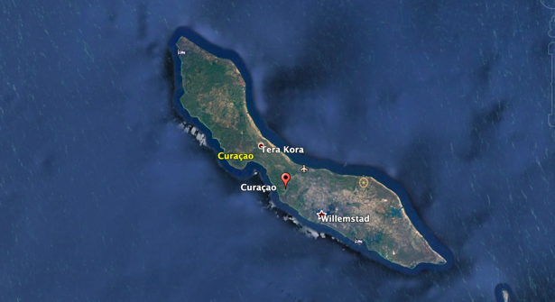
Curaçao
Sent 1 MSI report to navsafety@nga.mil
Promulgated 1 NAVAREA warning
No warnings currently in force

Slide 29
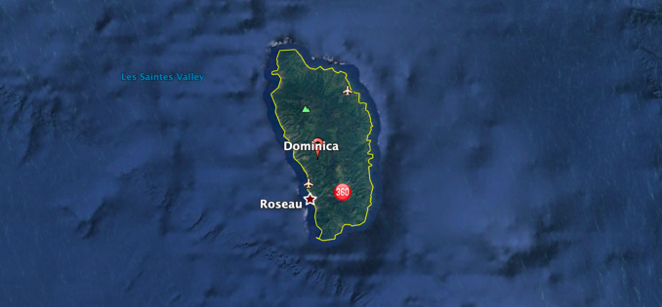
Dominica
Sent 2 MSI reports to navsafety@nga.mil
Promulgated 0 NAVAREA warnings
No warnings currently in force

Slide 30
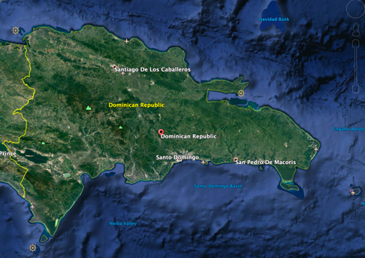
Dominican Republic
Sent 9 MSI reports to navsafety@nga.mil
Promulgated 5 NAVAREA warning
3 warnings currently in force

Slide 31
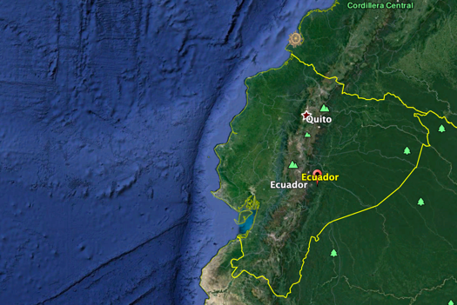
Ecuador
Sent 4 MSI reports to navsafety@nga.mil
Promulgated 0 NAVAREA warnings
No warnings currently in force

Slide 32
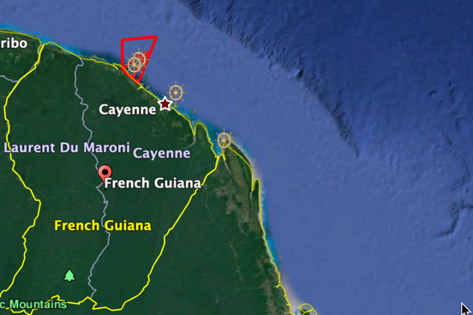
French Guiana
Sent 29 MSI reports to navsafety@nga.mil
Promulgated 27 NAVAREA warnings
3 warnings currently in force

Slide 33
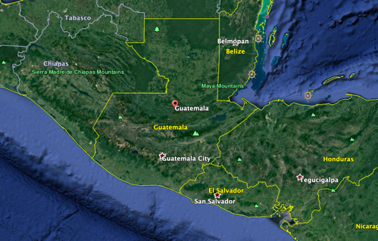
Guatemala
Sent 2 MSI reports to navsafety@nga.mil
Promulgated 1 NAVAREA warning
No warnings currently in force

Slide 34
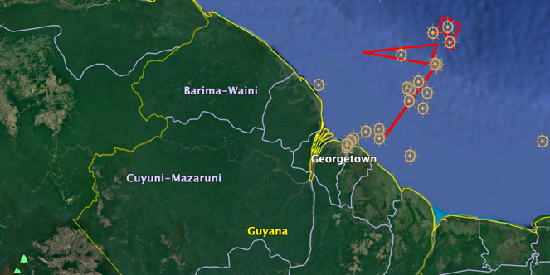
Guyana
Sent 23 MSI reports to navsafety@nga.mil
Promulgated 7 NAVAREA warnings
3 warnings currently in force

Slide 35
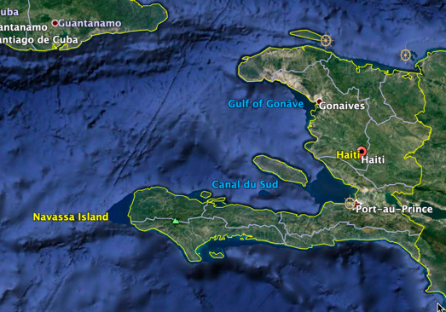
Haiti
Sent 10 MSI reports to navsafety@nga.mil
Promulgated 5 NAVAREA warnings
1 warning currently in force

Slide 36
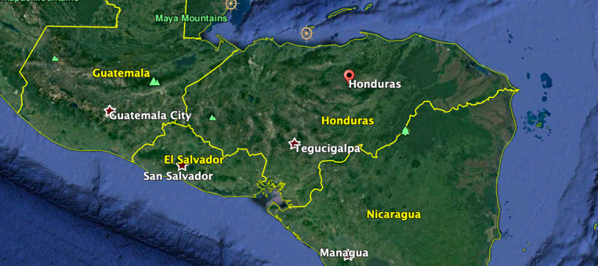
Honduras
Sent 1 MSI report to navsafety@nga.mil
Promulgated 1 NAVAREA warning
No warnings currently in force

Slide 37
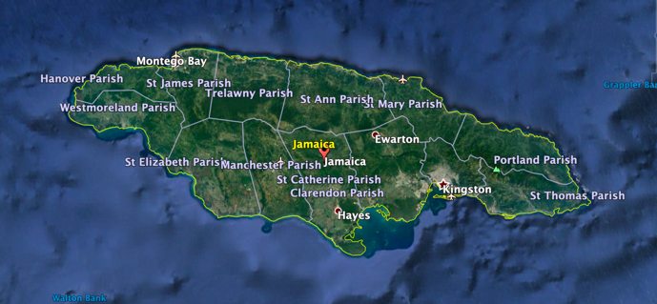
Jamaica
Sent 5 MSI reports to navsafety@nga.mil
Promulgated 1 NAVAREA warning
No warnings currently in force

Slide 38
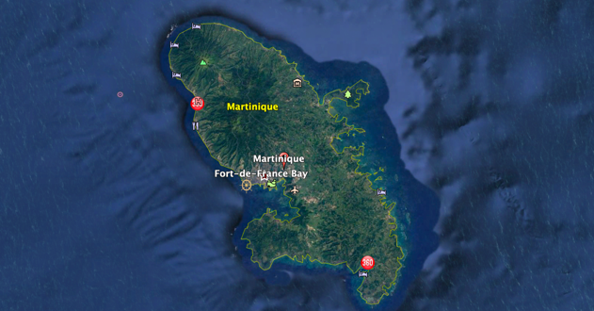
Martinique
Sent 31 MSI reports to navsafety@nga.mil
Promulgated 19 NAVAREA warnings
1 warning currently in force

Slide 39
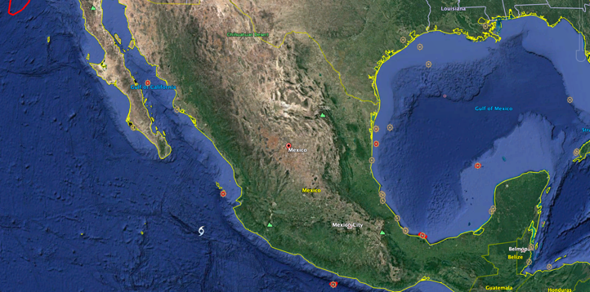
Mexico
Sent 188 MSI reports to navsafety@nga.mil
Promulgated 99 NAVAREA warnings
15 warnings currently in force

Slide 40
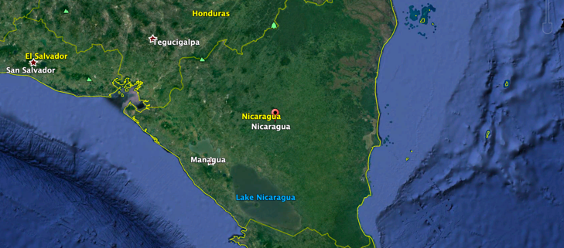
Nicaragua
Sent 1 MSI report to navsafety@nga.mil
Promulgated 1 NAVAREA warning
No warnings currently in force

Slide 41
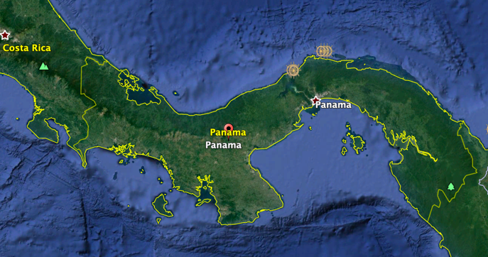
Panama
Sent 8 MSI reports to navsafety@nga.mil
Promulgated 7 NAVAREA warnings
4 warnings currently in force

Slide 42
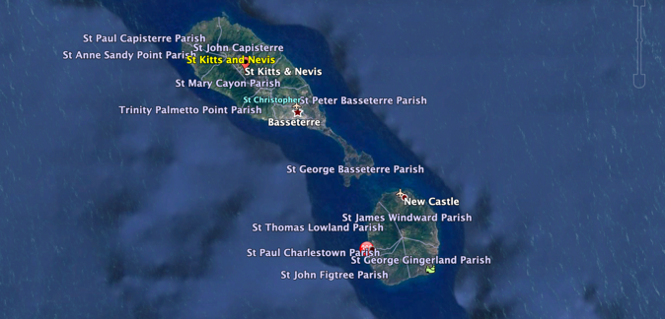
Saint Kitts and Nevis
Sent 5 MSI reports to navsafety@nga.mil
Promulgated 3 NAVAREA warnings
No warnings currently in force

Slide 43
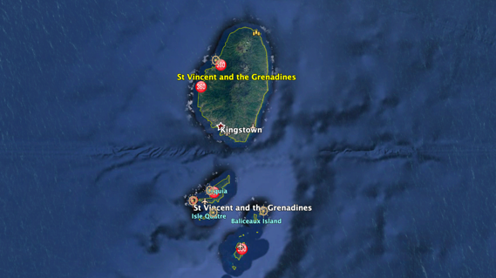
Saint Vincent and the Grenadines
Sent 6 MSI reports to navsafety@nga.mil
Promulgated 1 NAVAREA warning
1 warning currently in force

Slide 44
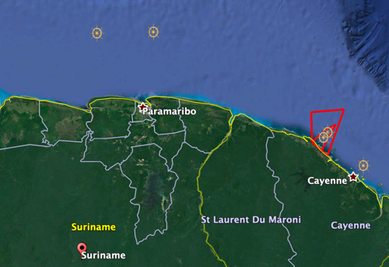
Suriname
Sent 29 MSI reports to navsafety@nga.mil
Promulgated 23 NAVAREA warnings
1 warning currently in force

Slide 45
Trinidad and Tobago
Sent 67 MSI reports to navsafety@nga.mil
Promulgated 30 NAVAREA warnings
6 warnings currently in force

Slide 46
Venezuela
Sent 49 MSI reports to navsafety@nga.mil
Promulgated 22 NAVAREA warnings
4 warnings currently in force

Slide 47
NAVAREA IV/XII Thank you for your support!!
IV
XII

