Slide 1
The IMO
MEMBER STATE AUDIT SCHEME
(Adapted from the presentation made by Mr Colin Young at MACHC18)

Slide 2
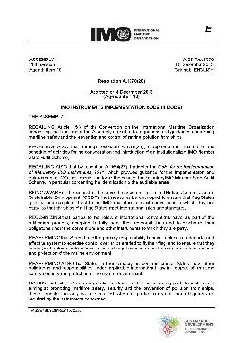
Coastal State Obligations
Scope of audit for coastal State activities is given in Part 3, paragraphs 45 – 51, of the III Code, resolution A.1070(28)
Implementation
Enforcement
Evaluation and review

Slide 3
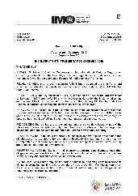
Coastal State Obligations
Implementation:
Enact national legislation
Develop policies and guidance which will assist in implementation and enforcement of their obligations
Assign responsibilities within their Administration to update and revise any relevant policies
Make available appropriate resources (human, financial, equipment, etc.)
Effectively implement all relevant requirements of the mandatory IMO instruments

Slide 4
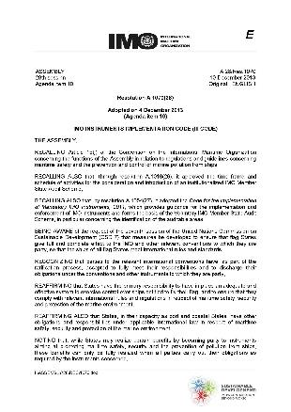
Coastal State Obligations
Implementation obligations:
radiocommunication services
meteorological services and warnings
search and rescue services
hydrographic services
ships' routeing
ship reporting systems
vessel traffic services
aids to navigation
Non-exhaustive list of obligations – Annex 3 resolution A.1077(28)

Slide 5
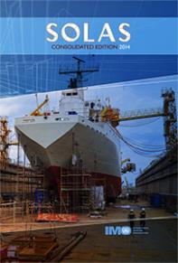
Obligations of Interest
SOLAS 1974 Chapter V/9:
Paragraph 1
Collection and compilation of hydrographic data
publication, dissemination and keeping up to date of all nautical information
Paragraph 2
co-operate in carrying out, as far as possible, the nautical and hydrographic services:
hydrographic surveying
prepare and issue nautical charts, sailing directions, lists of lights, tide tables and other nautical publications
promulgate notices to mariners
provide data management arrangements

Slide 6
Obligations of Interest
SOLAS 1974 Chapter V/9:
Paragraph 3
ensure the greatest possible uniformity in charts and nautical publications
take into account, whenever possible, relevant international resolutions and recommendations
Paragraph 4
co-ordinate their activities to the greatest possible degree

Slide 7
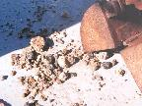
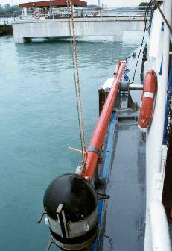
Hydrographic Services
Hydrographic surveys - IHO standards in use (S-44)
Annex to document MSC 81/24/4 provided for guidance to Member States and auditors

Slide 8
Hydrographic Services
Nautical Charts
Paper charts, RNCs, ENCs
IHO Chart Specifications in use to meet SOLAS 1974, regulation V/9
Nautical publications
Notices to Mariners

Slide 9
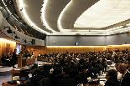
Strategy Development
An effective mechanism for the State to evaluate its effectiveness
“Maritime administration” is not a single corporate entity, but various responsibilities that are spread across many participating entities
Establish close co-operation among all entities
A clear description of responsibilities should be set for each entity
Audit should be seen as a mechanism which provides an opportunity to identify areas for improvement

Slide 10
Strategy Development
MINISTRY OF TRANSPORT
TRANSPORT POLICY/IMO
OVERALL STRATEGY
MINISTRY OF ENVIRONMENT
MINISTRY OF JUSTICE
MINISTRY OF
DEFENCE
POLLUTION PREVENTION
AND CONTROL
LAWS & ENFORCEMENT
MARITIME ADMINISTRATION
RESCUE & HYDROGRAPHY

Slide 11
IMSAS DEVELOPMENTS

Slide 12
Audit Schedule
173 IMSAS Audits to be implemented
7-year cycle for Member State Auditing
MACHC members to be audited in 2019: Dominica, Guatemala and Haiti
Introduces the concept of a quality management system for governments

Slide 13
GISIS – MSA Module
A new GISIS Module on Member State Audits developed
Can display all reports
Reports displayed or released based on the authorization by the Member State
One individual per Member State must be designated to receive reports

Slide 14
twitter.com/imohq
facebook.com/imohq
youtube.com/imohq
flickr.com/photos/ imo-un/collections

