Slide 1
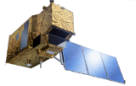
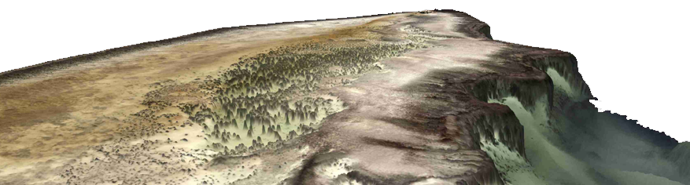
Satellite Derived Bathymetry
- Irma impact and integration with acoustic surveys -
2017-12-01
Dr. Knut Hartmann
hartmann@eomap.de
EOMAP GmbH & Co.KG
Germany | Australia| USA
www.eomap.com

Slide 2
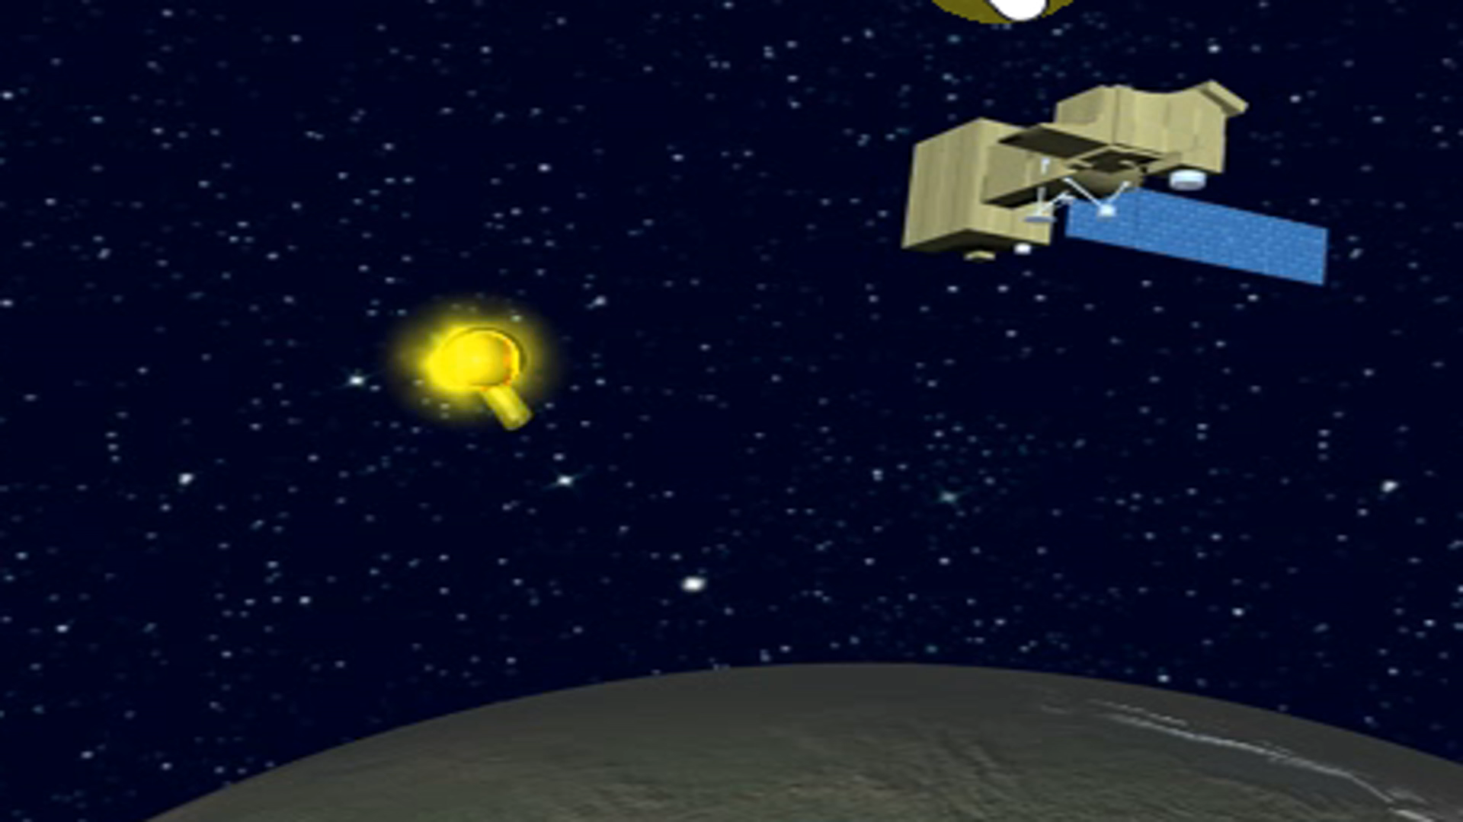
Satellite derived information
Remote measure
Global coverage of imagery
Rapid access to data
Satellite measure all parameters from sun to surface to satellite sensor (atmosphere, surface properties, etc)

Slide 3
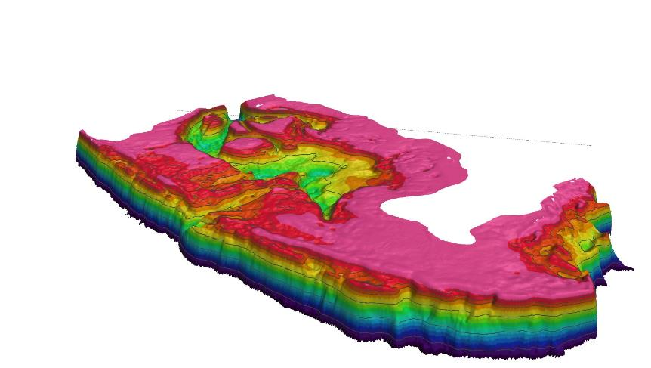
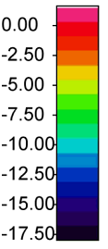
Satellite Derived Bathymetry
Mtwarba region, Tanzania
Satellite data = f(atm., adjacency, water surface, aborbers and backscatterers of the water column, seafloor, water depth, seastate, sun and sensor geometry, SNR ratio)
35km
18m

Slide 4
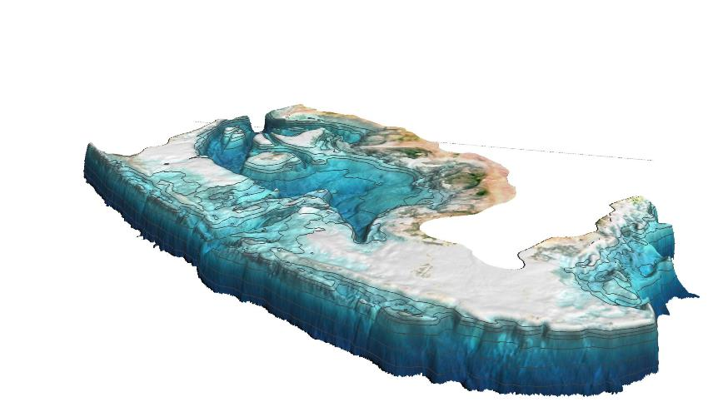
Seafloor reflectance
drapped over Satellite Derived Bathymetry
Satellite data = f(atm., adjacency, water surface, aborbers and backscatterers of the water column, seafloor, water depth, seastate, sun and sensor geometry, SNR ratio)
35km
18m

Slide 5
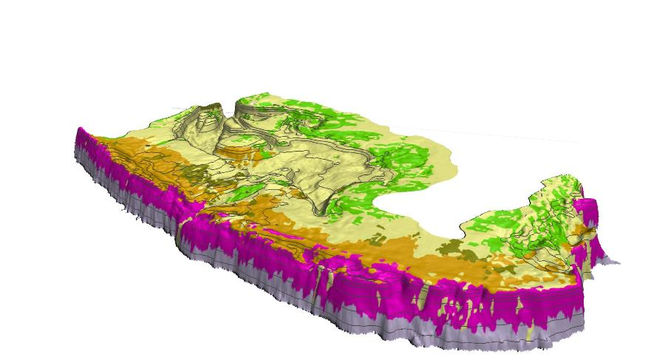
Seafloor habitat classification
drapped over Satellite Derived Bathymetry
Object based classification considering texture, shape and spectra of seafloor reflectance in addition to seabed morphology.
seagrass
sediment
corals
Coral rubble
macroalgal

Slide 6

Impact assessment of “Irma” and satellite information as rapid response tool

Slide 7
Irma, Sept 2017
Image courtesy: The Economist, 2017. Image modified

Slide 8
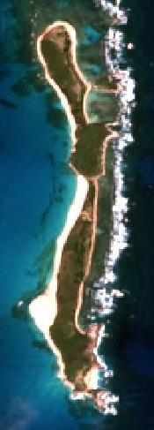
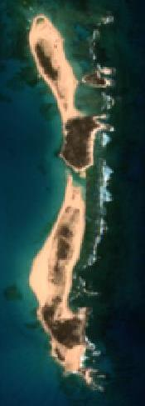
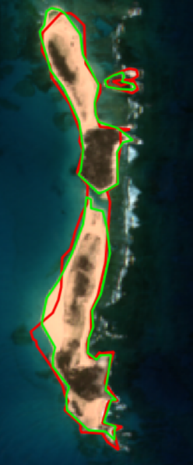
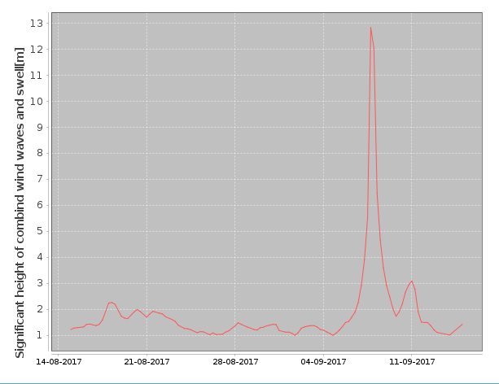
Turks and Caicos, Big Sandy Cay
Before
After
Changes in very shallow water bathymetry with sandy bottom
Changes in coastline
Island was split into 2 parts now
Coral structure and geomorphology not significantly impacted
After
Before
Irma

Slide 9
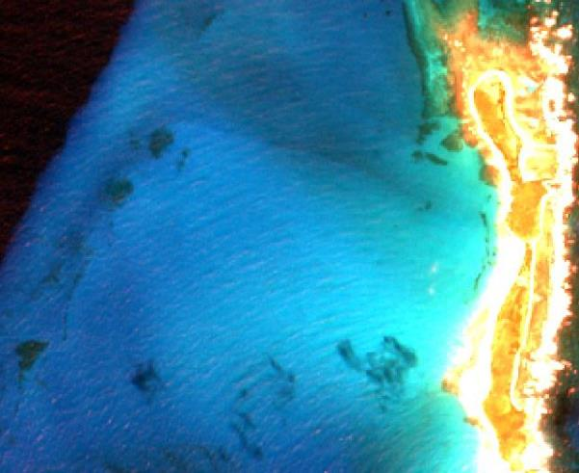
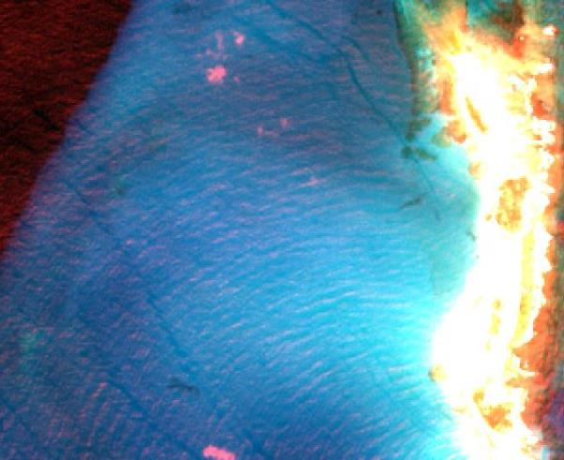
Turks and Caicos, Big Sandy Cay
Before Irma
After Irma
Decrease of seagrass cover

Slide 10
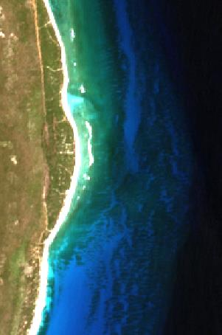
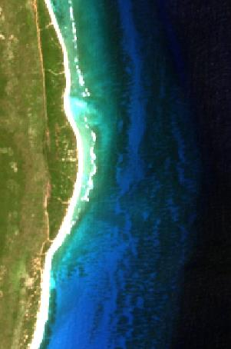
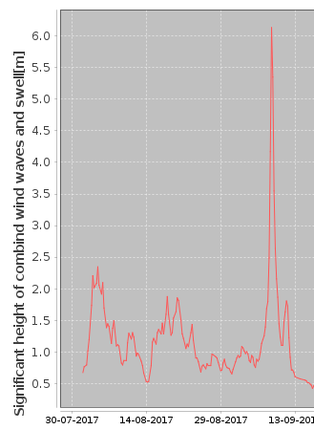
Punta de Maisi, East Cuba
Coral/hardbottom seafloor and bathymety areas were not impacted by Irma
Natural dynamic of seafloor dominates Irma impacts
before
after
Irma
Decrease of seagrass cover forereef
Small changes in coral structure

Slide 11
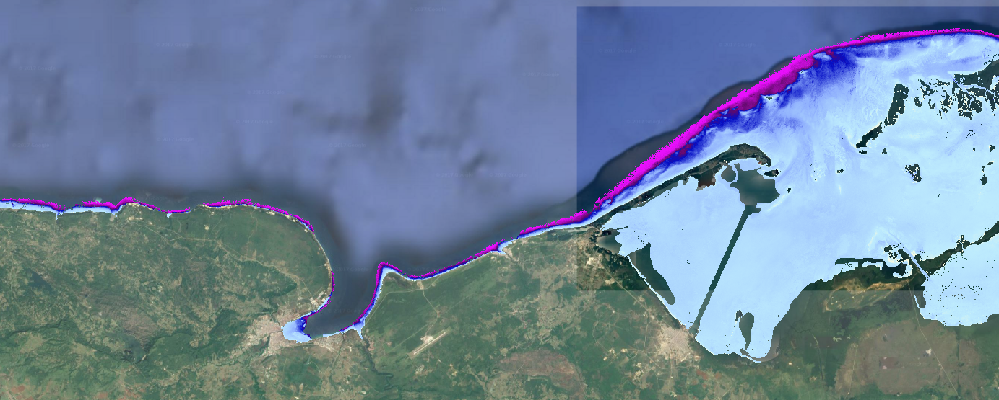
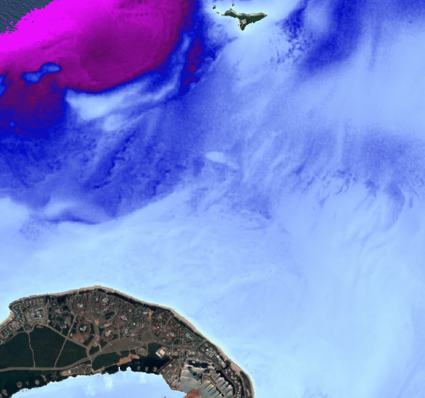

Varadero Peninsula, Cuba
Satellite Derived Bathymetry: Rapid provision of up-to date bathymetric data grids
We‘re
here

Slide 12
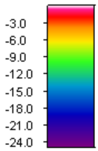
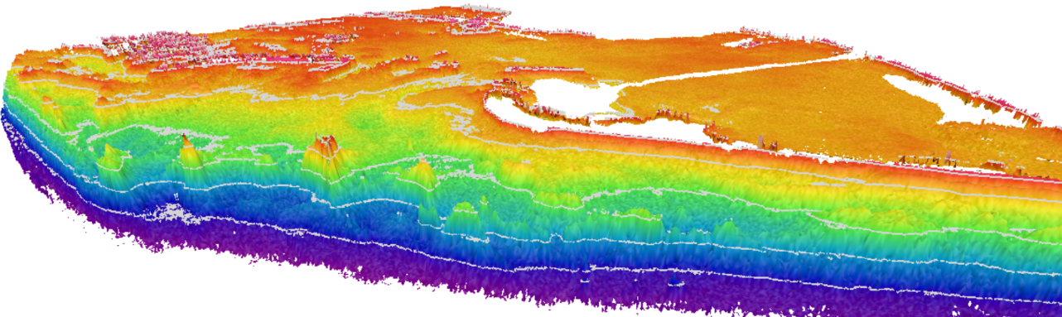
Varadero Peninsula, Cuba
Satellite Derived Bathymetry: Generation of shallow water bathymetry for Varadero region in <24 hours
We‘re
here

Slide 13
Key messages
Satellite Derived Bathymetry allows rapid assessment of changes in coastline, seafloor cover / benthic habitats and shallow water bathymetry.
Method can work remote as rapid assessment tool but can also be integrated in survey concepts with acoustic data -> next section

Slide 14
Integration of Satellite Derived Bathymetry with acoustic survey data

Slide 15
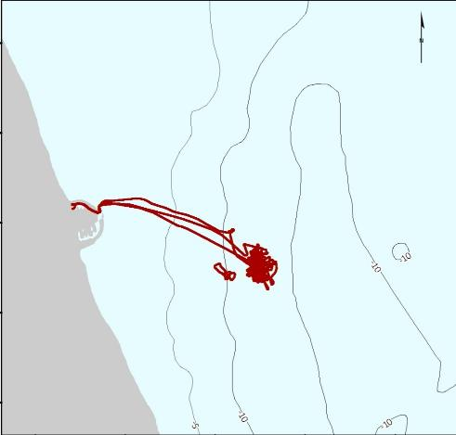
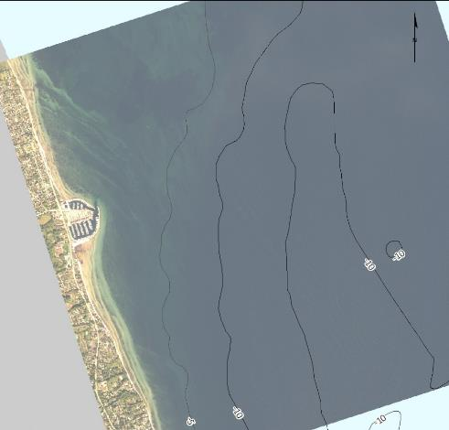
Integrated approach of using SDB and Single Beam
Single Beam transects (AUV)
Very high resolution satellite image

Slide 16
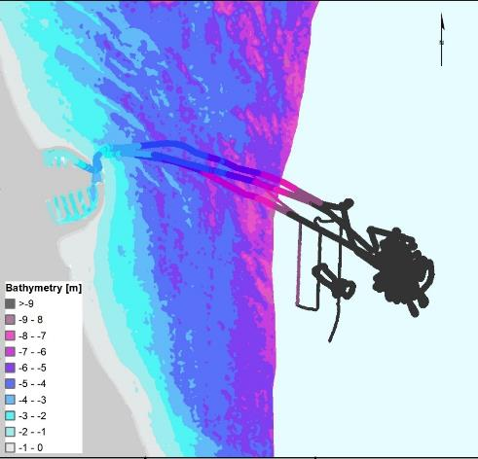
Integrated approach of using SDB and Single Beam

Slide 17
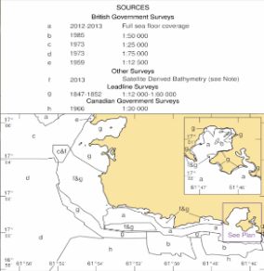
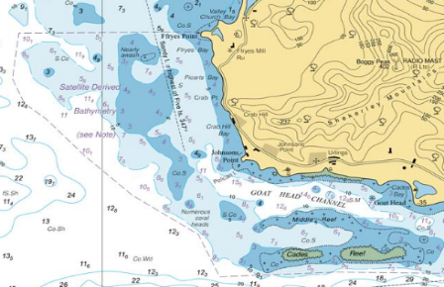

Integrated approach of using SDB and MBES
Overlapping region
Calibration & Validation area
Satellite Derived
Bathymetry
British Admiralty Chart BA 2066
Southern Antigua
MBES survey
0m
20m
X m

Slide 18
Key messages
Combining SDB and single beam transects allows to provide a validated bathymetric dataset with full seafloor coverage, including very shallow waters.
→ This combination allows to minimize survey work while improving spatial coverage. High potential for rapid response surveys.
Combining SDB and MBES surveys allows to calibrate and validate SDB in the overlapping regions and results in a validated bathymetric dataset from deep waters to shoreline
→ This combination allows to minimize cost intensive very shallow water surveys, reduces HSE risks while generating seamless bathymetric datasets from deep waters to shoreline

Slide 19
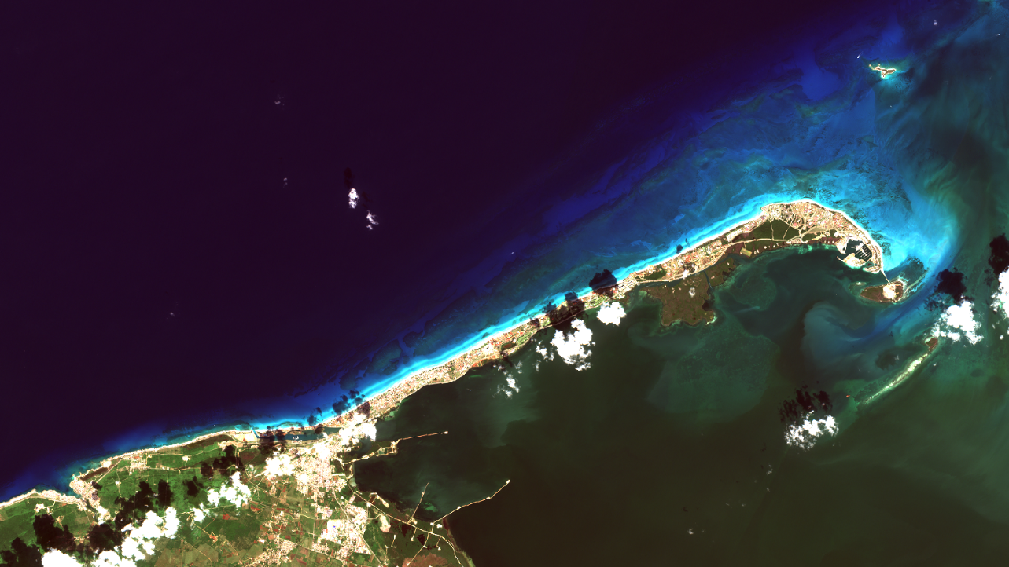
Muchas gracias!
Dr. Knut Hartmann
hartmann@eomap.de
www.eomap.com
Satellite data recorded Nov. 2017, Varadero area, Cuba

