Slide 1
Report of the MACHC Integrated Charting Committee (MICC)
Chair: Mr. John Nyberg (NOAA) Vice-Chair: Cdr. Paulo Matos (DHN/BR) DOC MACHC 18-09.1
Meso-American - Caribbean Sea Hydrographic Commission (MACHC)

Slide 2
Introduction
MICC purpose, target goal and work plan for 2017:
The purpose of the Meso American and Caribbean Sea Hydrographic Commission’s (MACHC) Integrated Chart Committee (MICC) is to provide consistency in the development and maintenance of regional charting schemes, including the monitoring of INT Chart and ENC production, and to promote standardization of charting activities of the IHO.
2017 effort was concentrated at identifying needs and resolving gaps in ENC coverage. Similar efforts are being dedicated to completing the INT Chart coverage within the MACHC Region. This Report provides a summary of activities of the MICC during 2017.
Work Plan count on quarterly Conference Calls and one face-to-face meeting.

Slide 3
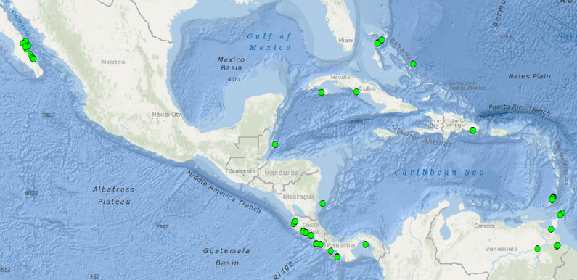
Port Analysis Evaluation
Cruise Ships help appreciated: 46 ports initially identified, 43 confirmed, 14 will be addressed within the next 2 years:
Notes:
The ports analysis included evaluating 18 months of data of Cruise Ships destinations. The Ports
of Call were compared to the availability of Bands 4, 5, and 6 ENC coverage of those ports. The
ports identified were sent to all MACHC members for review and acceptance. During the past
year, MACHC members finalized the Cruise Ship Ports list analysis. There were 3 ports identified as having no port significance and were removed. Currently 14 of the remain 43 ports identified will have large scale ENC coverage. Plans include coverage:
6 ports in Mexico will have band 4 or 5 ENCs
2 ports in Cuba will have band 4 or 5 ENCs
4 ports in Venezuela will have large scale ENCs
2 ports in Bahamas will have band 5 or 6 ENCs

Slide 4
INT charts
 | 2014 | 2015 | 2016 | 2017
SCHEMED CHARTS | 82 | 82 | 82 | 82
READY CHARTS | 30 | 41 | 43 | 46
PERCENTAGE | 36,6 | 50 | 52,4 | 56,1
NEW CHARTS | 11 | 2 | 3 | 0
NEW EDITIONS | 0 | 0 | 0 | 2
Notes:
The numbers are slightly different from what presented yesterday by IHO due to some updates on the coverage of VEM INT charts. ADCS on IHO was contacted and advised about the changes will be done on the INT Catalogue.

Slide 5
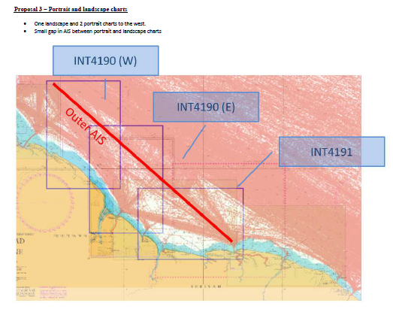
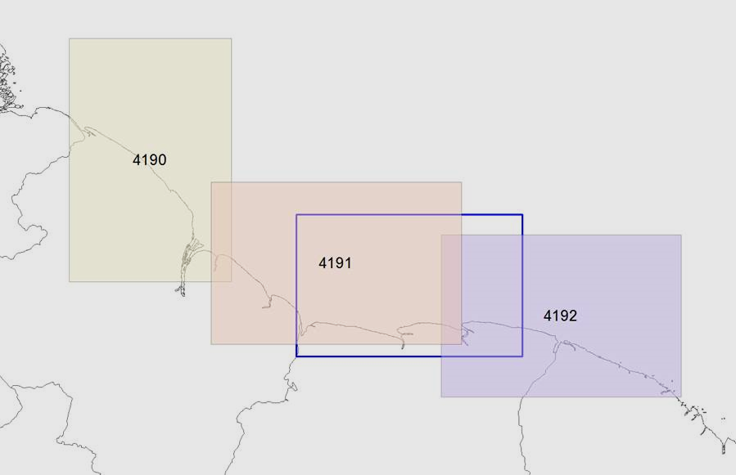
INT charts

Slide 6
ENC charts
Notes:
During the past year, the MICC addressed and resolved the Band 2 overlaps between the US
and Mexico. Two US cells were revised based on the Exclusive Economic Zone (EEZ) boundary
shared with Mexico. Additionally Mexico has created 8 new band 2 cells that will be available at
the end of 2017. With the availability of an increasing number of ENCs, other overlaps are often introduced and are continuously being addressed as they arise. The new approach of using
results of the Port analysis to determine adequate ENC coverage clearly identified the
requirement for additional ENCs. The MICC Technical Coordinator is closely working with the
impacted Member States to resolve this. The goal of attaining the required number of ENC cells
to achieve adequate coverage as per the WEND Principles is progressing.

Slide 7
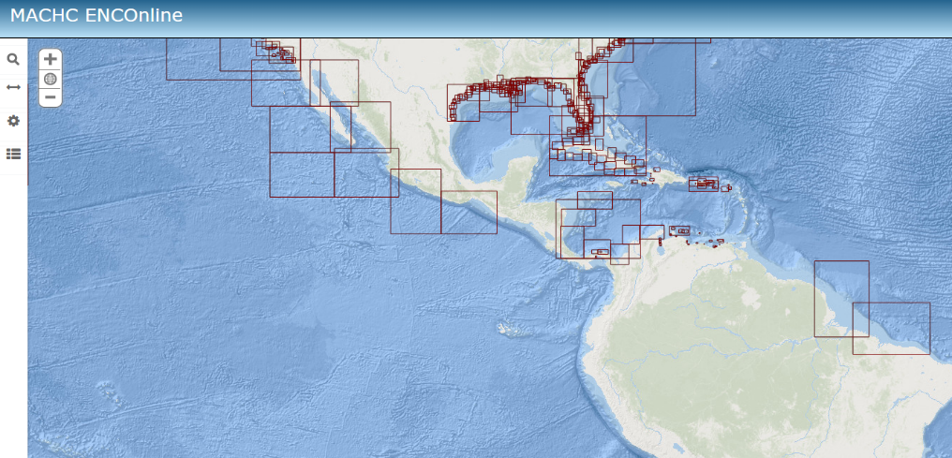
MACHC ENC Online
8 MACHC members contribute to ENC Online: US, MX, CU, CO, NL, VE, BR. Suriname added this year
Notes:
The MACHC ENCOnline is a viewer that uses Esri's Maritime Chart Server Technology, providing a seamless view of ENC datasets as viewed through an ECDIS. The viewer allows for certain parameters to be modified, changing such display properties as color scheme, depth contours (shallow, safety and deep), depth units, depth shades, point and area symbolization, and cell extents. We are grateful about the MS contribution and also remark the introduction of Suriname data this year.

Slide 8
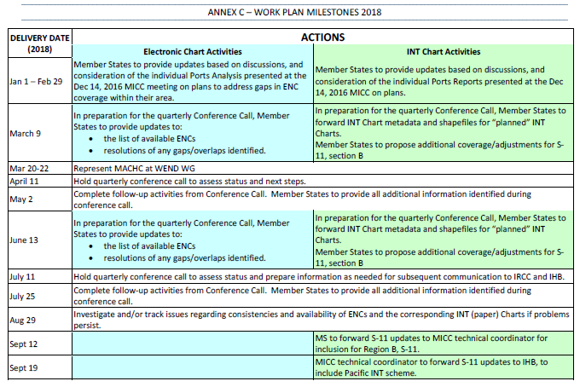
Work Plan for 2018

Slide 9
Work Plan for 2018

Slide 10
Action requested of MACHC
Note this report;
Approve the Work Plan;
Endorse the progress on ENC production throughout the region; and
Encourage MACHC ENC Online participation.
Notes:
I kindly ask the plenary of MACHC to take note of this report, to...

