Slide 1
United Nations Development Program
Bathymetric Measurements of the Rio Indio,
Panama, Province of Colón
MACHC 2017
Hydrographic Awareness
November 2017
Cuba

Slide 2
Overview
Funding Organizations and Project Framework
Mobilization, System Configuration, Geodesy, Calibration
Vertical Reference
Operations
Quality Control
Conclusions and Challenges

Slide 3
Funding Organizations and Project Framework

Slide 4
Key Agencies
The United Nations Development Program (UNDP) was created in 1965 by the General Assembly of the United Nations. It belongs to the United Nations system and it function is to contribute to the improvement of the quality of life of nations. The UNDP promotes change and connects the knowledge, experience and resources needed to help people build a better life.
…. http://www.undp.org
The Republic of Panama Ministry of Environment is a State lead agency for the protection, conservation, preservation and restoration of the environment and sustainable use of natural resources to ensure compliance and enforcement of laws, regulations and the National Policy Environment.
….. http://www.miambiente.gob.pa
The Panama Canal Authority (ACP) is an autonomous legal entity of the Republic of Panama, with exclusive charge of the operation, administration, management, preservation, maintenance, and modernization of the Panama Canal, as well as its activities and related services, pursuant to legal and constitutional regulations in force, so that the Canal may operate in a safe, continuous, efficient, and profitable manner.
…. www.pancanal.com

Slide 5
Project Framework
The Panama National Water Security Plan has the objective is to guarantee the fair and equitable access of water to the entire population.
The Panama Ministry of Environment and the Panama Canal Authority (ACP) have an agreement for the management of watersheds adjacent to the Panama Canal Watershed.
One of the actions of the National Water Security Plan is to determine the environmental flow and water balance of those areas where the potential has been identified to construct multipurpose reservoirs that consider local needs.
The purpose of this project was to carry out bathymetric measurements from the mouth of the Rio Indio to a distance approximately 30 km inland along the river. These data will be useful for assessing the river's environmental flow, navigational capacity, pollution prevention, flood control and other relevant geo-hydrological studies.

Slide 6
Project Scope and Specifications
IIC Technologies was contracted by UNDP to conduct the bathymetric survey.
IIC was required to carry out the planning, measurement, processing, revision, quality control and delivery of the bathymetric data. This involved the carrying out a hydrographic survey, establish control stations for the accuracy of the position, collection, processing and presentation of requested data and reports.
All activities were to be carried out with the approval of a work plan and coordination of the Project Management Unit (UG), the Panama Canal Authority (ACP) and the United Nations Development Program (UNDP).
The bathymetric study must comply with the "IHO International Hydrographic Organization Standards for Hydrographic Surveys" (S-44). The hydrographic survey must be executed in Order 1b or better, as established by this same standard.

Slide 7
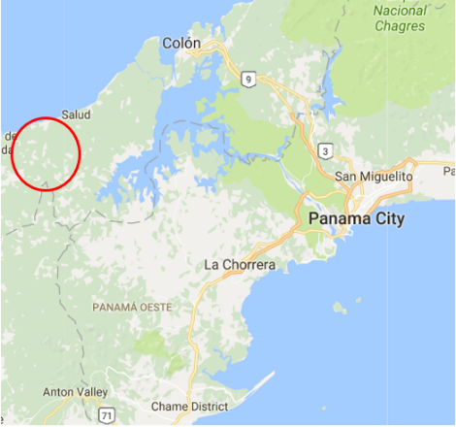
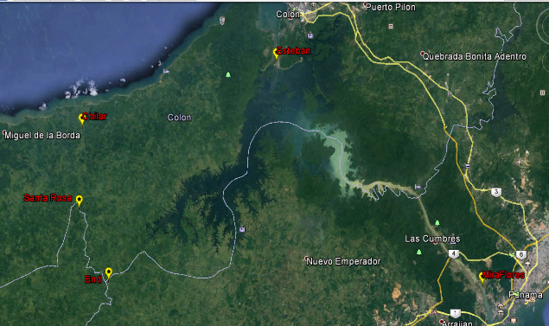
Rio Indio Survey Location & Description
Length approx = 33 km
Width at Mouth = 80m
Width at Southern Extend = 20m

Slide 8
Mobilization, System Configuration, Geodesy, Calibration

Slide 9
Mobilization and System Test
Meeting with UNDP Project Officer for debriefing on surveying in the area
Meeting with Land & Sea as local partner for surveying support and logistics
Mobilization of 14 foot skiff in Panama City and testing in MiraFlores locks

Slide 10
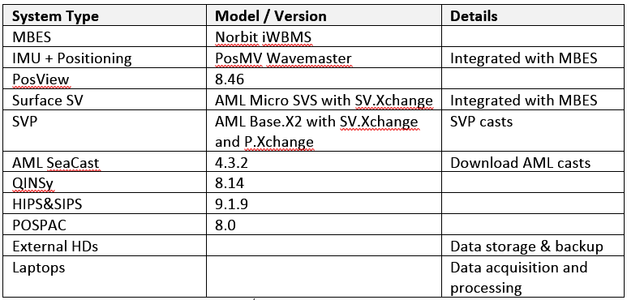
Equipment List

Slide 11
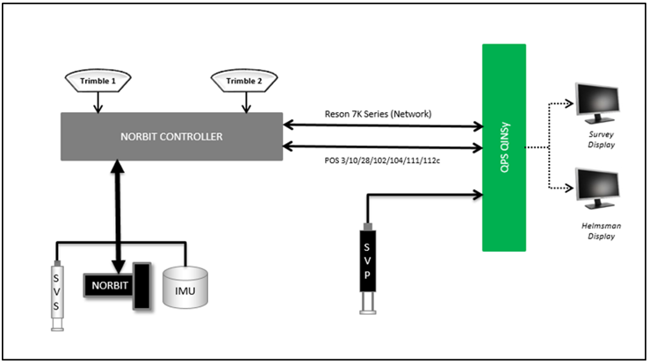
System Configuration

Slide 12
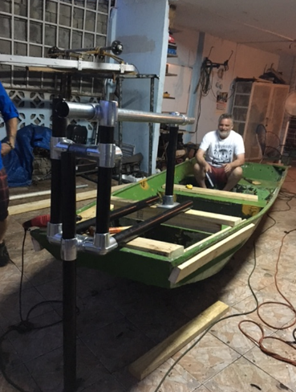
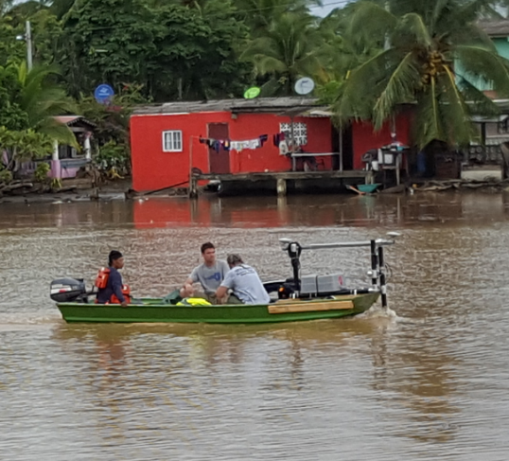
System Configuration

Slide 13
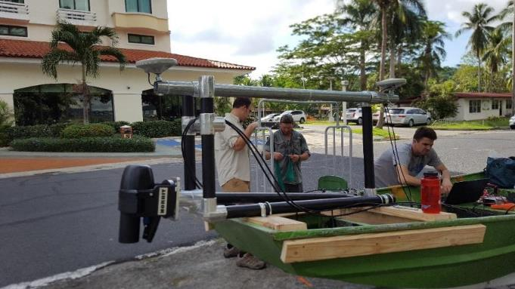
System Configuration

Slide 14
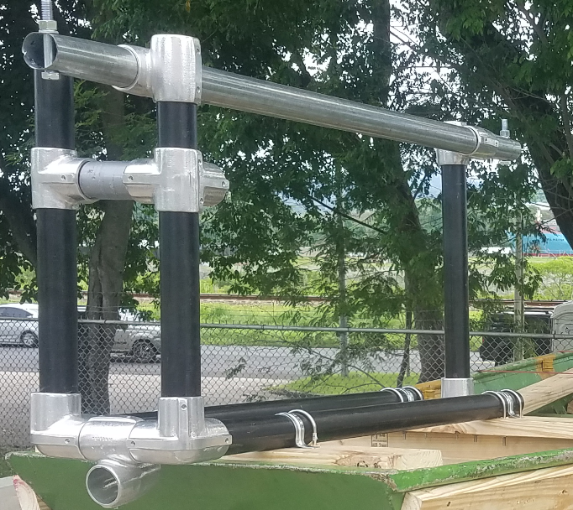
System Configuration

Slide 15
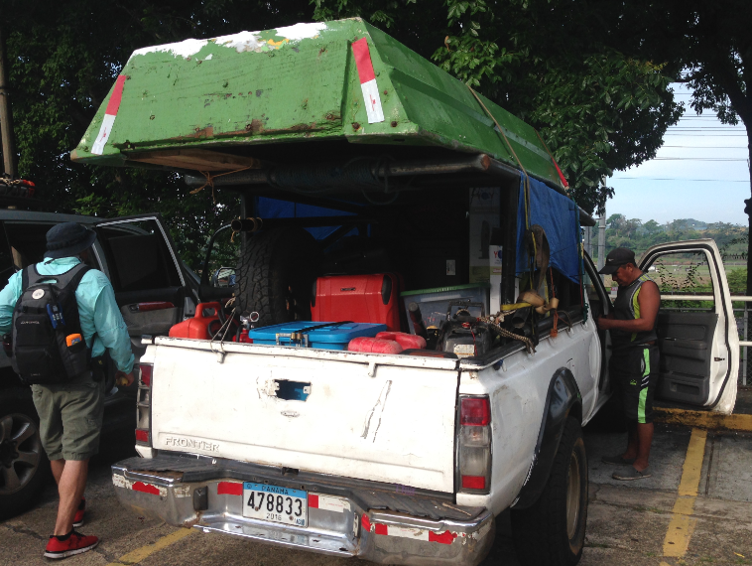
System Configuration

Slide 16
Offsets
Offsets Relative to Acoustic Reference Point
The vessel (RP) was located at the acoustic RP of the Norbit, which was 26 cm below the water line
POS View online lever arm configuration

Slide 17
Geodesy
The survey was conducted using GNSS post-processed positioning techniques. All data collection and processing was completed in WGS84. Final data were delivered in NAD 27, ACP.

Slide 18
Geodesy
The following table summarizes the geodetic parameters required for translation from WGS 84 to NAD27, ACPGeodetic Parameters – Deliverables
Horizontal Datum | NAD27 - ACP
Spheroid: | Clarke 1866
Semi major axis: | a = 6378206.400m b = 6356583.800m
Inverse Flattening: | ¹/_{f} = 294.9786982138982
7 parameters transformation from WGS84 SPECIFIC TO NAD27-ACP Coordinate Frame Rotation convention | Trans X(m): 22.876415 Trans Y(m): -99.350159 Trans Z(m): -140.532555 Rot X(sec) : -2.0948687 Rot Y(sec) :0.79563677 Rot Z(sec) :0.59689367 Scale Factor (ppm) : 5.00006
Vertical Datum
Hydrography: | PLD – Precise Level Datum
Projection Parameters
Map Projection: | Universal Transverse Mercator
Grid System: | UTM
Central Meridian: | 81°E, UTM Zone 17N
Latitude of Origin: | 00° 00′ 00″ North
False Easting: | 500 000 m
False Northing: | 0 m
Scale factor on Central Meridian: | 0.9996
Units: | Metre

Slide 19
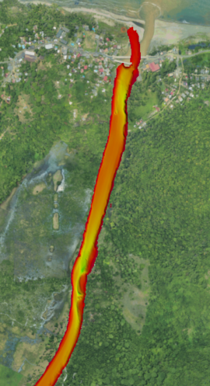
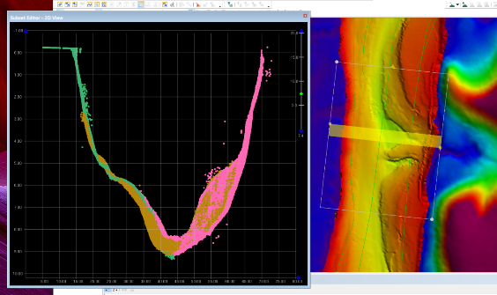
Calibration
Two calibration surveys were conducted, one prior to survey operations, and the other at the end of survey operations.

Slide 20
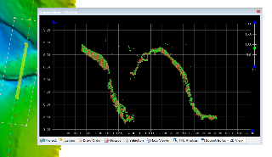
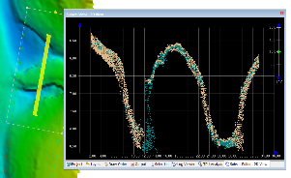
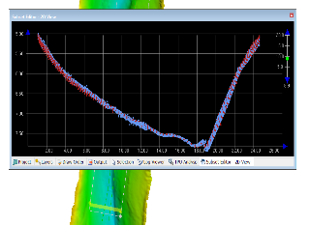
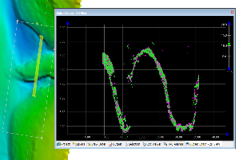
Calibration
Pitch
Yaw
Roll
Time
The final surface was compared to the topographic LiDAR to verify bank
alignment and to ensure vertical consistency.

Slide 21
Vertical Reference

Slide 22
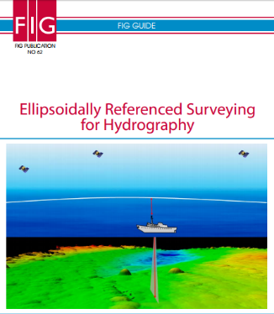
Vertical Reference
Ellipsoidally Referenced Surveying techniques were used to help establish the water surface relative to the PLD (Precise Level Datum) vertical datum. The PLD is the level surface to which all heights are referred. For the Panama Canal, the 0.00 PLD adopted was mean sea level as determined at pre-construction time.
https://www.fig.net/resources/publications/figpub/pub62/Figpub62.pdf

Slide 23
Vertical Reference
A separation model, provided by ACP, was used to determine the difference between the WGS84 ellipsoid and PLD at locations within the survey area. These locations included the water level monitoring sites at Chilar and Santa Rosa, as well as the locations on the river where GNSS coverage was sufficient for high-accuracy results.
A water level file was created to translate the water level at the vessel to PLD. This information was applied to the bathymetry during processing as a tide file.
The final water level file was created from the following, in order of preference:
Chilar and Sanata Rosa water level measurements, relative to PLD
GNSS heights at the vessel, translated to PLD (when high-accuracy GNSS results were good enough
Topo LiDAR water level interpolation, relative to PLD

Slide 24
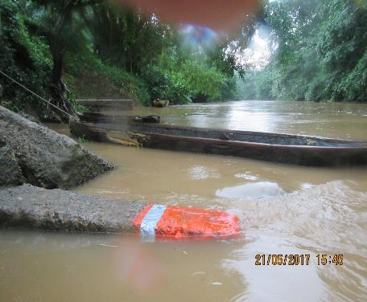
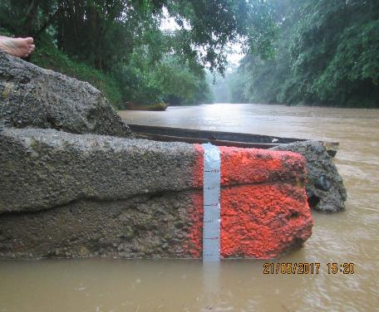
Water Level file creation Priority 1: Santa Rosa
Water level measured relative to spray painted concrete slab. Used duct tape with graduations for tide staff. Water went from 0.4 m below to level in 20 minutes, then to 1.5 m above in another 30 minutes. This occurred after a significant rain event

Slide 25
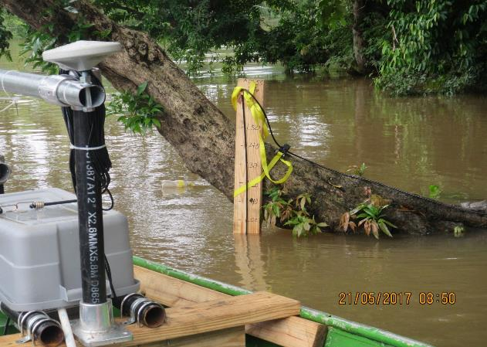
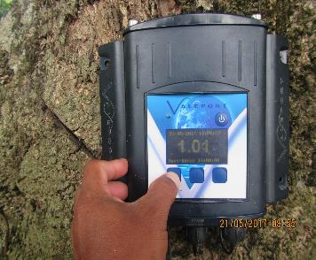
Water Level file creation Priority 1: Chilar
Tide staff strapped to tree. Water level gauge transducer on the bottom.

Slide 26
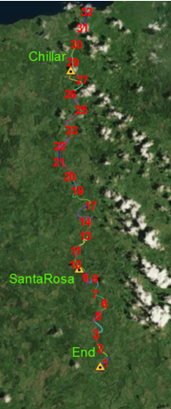
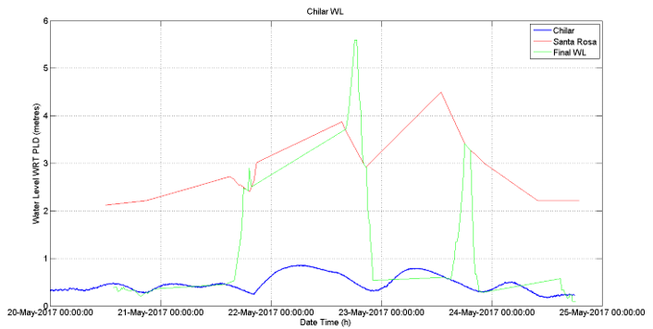
Water Level file creation Priority 1: Santa Rosa and Chilar
Chilar and Santa Rosa water level measurements, relative
to PLD
Vessel at south end of Rio Indo
Vessel at Santa Rosa
Vessel at Chilar

Slide 27
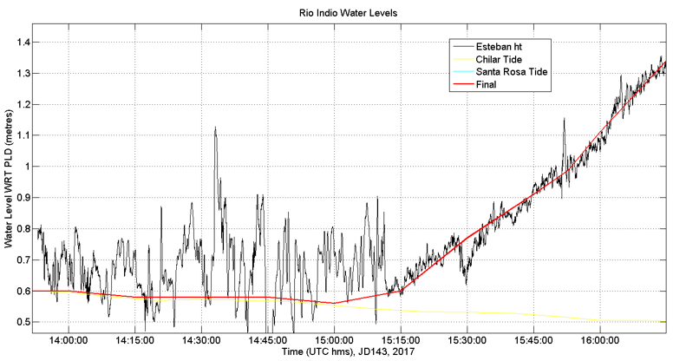
Water Level file creation Priority 2: GNSS heights at vessel
GNSS check at Chilar Water Level
GNSS heights at the vessel, translated to PLD
(when high-accuracy GNSS results were good enough)
Chilar Tide

Slide 28
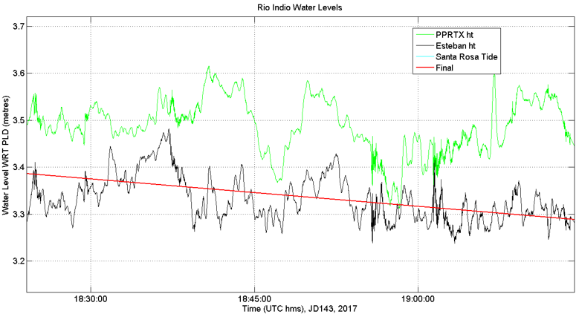
Water Level file creation Priority 2: GNSS heights at vessel
GNSS checks at Santa Rosa Water Level
GNSS heights at the vessel, translated to PLD
(when high-accuracy GNSS results were good enough)

Slide 29
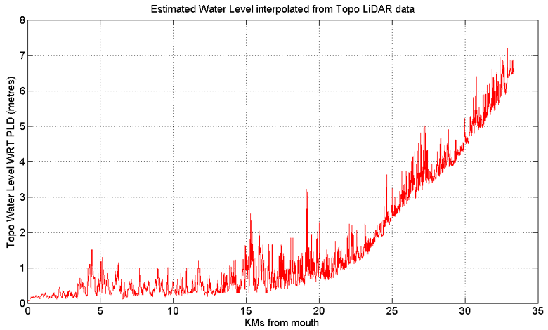
Water Level file creation Priority 3: Topo Lidar water level
Topo LiDAR water level interpolation, relative to PLD

Slide 30
Operations

Slide 31
Operations Summary
Lines were run along the river centre line. In narrow areas, the centre line was run in both directions. In wider areas, two more lines were run along the banks.
Sound velocity profiles were collected throughout the day, as well as the beginning and end of day.
In total, approximately 33 linear kilometers of the river were surveyed with depths ranging from 0.5 m to 15m. The river width ranged from 80 m at the mouth to 20 m at the southern extent.
The river stage during the survey was slightly above PLD (0.2 to 0.9m above) at the Chilar water level gauge location and from 2 to 3.4m above PLD at Santa Rosa.

Slide 32
Operations
There were two significant rain events during survey operations. These events increased the river level by 2m in Santa Rosa and 0.7 m in Chilar.
One event occurred just before the Southern extent was surveyed. This increase in water level made the last 10 km stretch of river less challenging to survey.
Multibeam bathymetric data were collected from bank to bank with at least 100% coverage, and often more than 200%. Post-processed kinematic (PPK) techniques were used to determine horizontal positions.
Due to the canopy coverage over most of the river, high-accuracy GNSS vertical positioning was not possible in many locations. Therefore, the water surface was used as the reference for data collection and initial processing. During final processing, a model of time varying surface-to-PLD was developed.

Slide 33
Quality Control

Slide 34
Quality Control
“ so we don’t have to go back”
The following quality control procedures are discussed here:
Real-time QC
Preliminary field QC
Calibrations
Data processing results review
Uncertainty Assessment:
Evaluation of system capabilities using a reference surface
Final surface uncertainty assessment
Crosscheck analysis
Horizontal positioning evaluation and verification
Vertical positioning evaluation and verification

Slide 35
Real time Quality Control
SV comparison between the real-time sensor and the SV profile. When the difference between the two exceeded 2 m/s, a new SV cast was performed.
A timing alarm to monitor the system. This alert monitored the PPS, GNSS time and computer clock. The alert turned red whenever a discrepancy of more than 10 milliseconds occurred
Logging alert to ensure all systems were logging data
In addition, the coverage and data quality were evaluated through a 1m real-time bathymetric grid. This grid was created by using all of the real-time observations, including depth, heading, motion, SV and positioning.
Any gaps in the data were immediately obvious in the surface and filled in.
The tide gauge and GNSS water level heights were verified using independent water level measurements through water level staffs and leveling.

Slide 36
Preliminary field QC
Data were processed at the field office on the day of and following the day of data collection. This preliminary processing took the information all the way to a surface, ensuring all data were valid. Any gaps or inconsistencies were resurveyed.

Slide 37
Calibration
Two calibration surveys were conducted, one prior to survey operations, and the other at the end of survey operations. Several lines were run for the system calibration patch test. Two over a flat area for roll calibration and the remainder over a significant object to evaluate the timing, pitch and yaw offsets.
A roll offset of -0.28° was measured and accounted for in post-processing. Timing, pitch and yaw were all found to be zero on the pre-survey calibration. The transducer struck an obstacle on May 21. A subsequent calibration determined that a 2° yaw was introduced. This was removed from the data in post-processing.

Slide 38
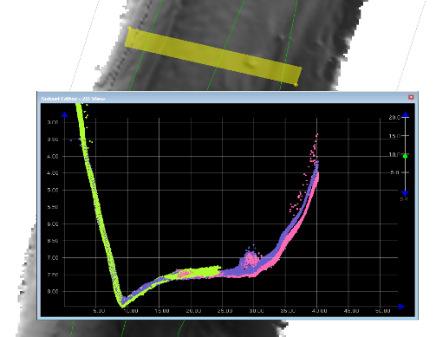
Data Processing Quality
The final base surfaces generated were reviewed by an independent operator and checked for gaps, missed outliers and general data quality (artifact, misalignment etc.). Any suspected artifacts were investigated. All results were found to be within project specifications.

Slide 39
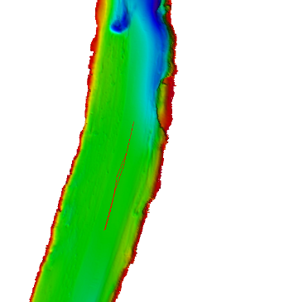
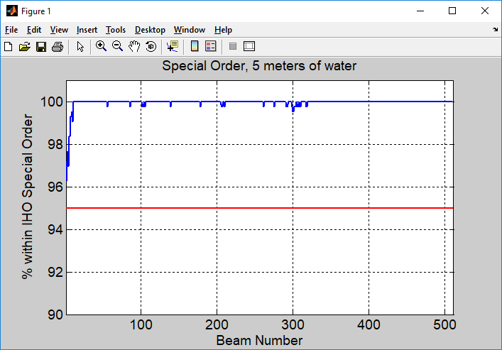
Uncertainty Assessment
Uncertainty capabilities of the system were checked in 4m of water, 500 m south of the river mouth. A 50cm CUBE surface was created from pre-survey calibration and production data. Two lines from the post-survey calibration were evaluated against that surface to compare the lines to the surface, relative to IHO S44 standards. Results showed that all 512 beams were capable of meeting IHO special order and order 1b at 95%.

Slide 40
CSAR Surface Statistics
Surface statistics were generated using the CARIS “QC Report …” and “Compute Statistics…” CSAR surface tools. The 2σ standard deviations of the grid points for all surfaces were within IHO order 1a. The results indicated that 100% of the bathymetric surface met IHO order 1b.

Slide 41
Crossline Comparison
Crosslines were collected at regular intervals throughout the survey area.
Crosslines in the southern section were limited by the narrowness of the river; therefore, “crosslines” were run as continuous lines that zig-zagged across the river.
The vast majority of the crossline results met the 1b criteria at 95%. However, in areas of rough seabed or significant slopes (alone the bank), some of the outer beams were reduced to 90% or lower. Crosscheck QC reports were generated using across track distance with 1m steps.
The line quality control report used the following uncertainty limit for Order 1b
$$Uncertainty=\sqrt{{0.5}^{2}+({{depth}_{CD} × 0.013)}^{2}}$$

Slide 42
Horizontal Position Verification
Data were collected and processed in the WGS84 reference frame. Final results were transformed to NAD 27 ACP at the final step of data processing.
Horizontal positions were determined using post-processed GNSS in Applanix PosPac. Two processing types were used, PP-RTX and single baseline. PP-RTX is a Trimble product that does not require base station data from the user.
A comparison was made between positions determined using PP-RTX, single baseline from the ACP station Esteban, the IIC base stations at Chilar and Santa Rosa (Nivel).

Slide 43
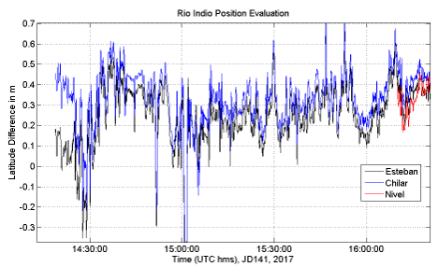
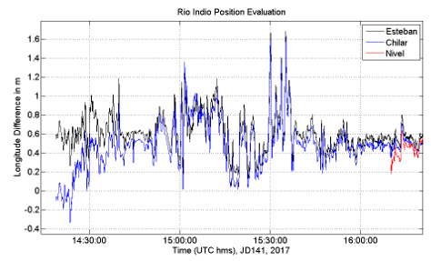
Horizontal Position Verification
- Chilar
Difference Between PP-RTX and Esteban Baseline
Latitude
Longitude
The comparison at Chilar, with the boat stationary. Plots are in metres and are the result of differencing the single baseline solutions from the PP-RTX solution.

Slide 44
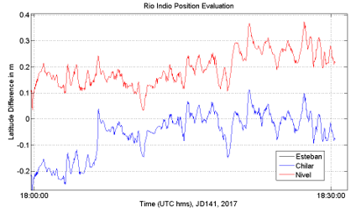
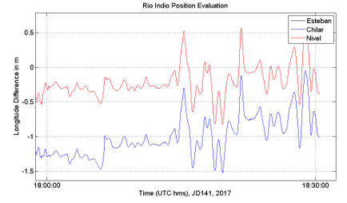
Horizontal Position Verification
- Santa Rosa
Difference Between PP-RTX and Esteban Baseline
Latitude
Longitude
Latitude and longitude difference results for the boat while stationary in Santa Rose. Results show that the horizontal positioning meets the requirements for IHO order 1b (5m).

Slide 45
Vertical Position Verification
- Approach
The vertical position was verified at both of the water level monitoring locations, Chilar and Santa Rosa. The water level measurements, relative to PLD, were assumed to be true and were used to verify the GNSS derived water levels measured at the boat. This verification was performed when the boat sat still for a period of time.
In the area between Chilar and Santa Rose, the tree coverage interfered with satellite reception, which degraded the height solution, making it unusable for water level determination.

Slide 46
Vertical Position Verification
- Vessel at Chilar
Vessel at Chilar
Moving to Santa Rosa
Plot of heights, relative to PLD, while the boat sat in Chilar, before heading for Santa Rose. The Chilar water level measurement (tide) is shown in yellow, with the green representing the PPRTX derived height, the black representing the Esteban base station derived height and the blue representing the Chilar base station derived height. Chilar GNSS and Esteban GNSS heights show good agreement with Chilar water level measurements (with in 0.1m) while the boat is in Chilar. Both remain in agreement as the vessel moves towards Santa Rosa.

Slide 47
Vertical Position Verification
– Vessel at Santa Rosa
Vessel at Santa Rosa
Plot of heights, relative to PLD, while the boat is stationary in Santa Rosa. The Nivel GNSS heights are in good agreement with the measured water level.

Slide 48
Vertical Position Verification
– Analysis
In both cases (at Chilar and Santa Rosa) the PPRTX GNSS results follow the general trend of the other observations, but have deviations of up to 0.5 m at times. This is why the PPRTX results are useful for verifying the general trend of the water level, but was not good enough to define the water level everywhere.
In the area between Chilar and Santa Rose, the tree coverage interfered with satellite reception, which degraded the height solution, making it unusable for water level determination.
These results indicated that the GNSS heights were suitable for deriving the water surface under certain conditions, but not in others. Therefore, GNSS heights could not be used in the project to derive soundings relative to PLD, but could be used to help derive a model of the river surface, relative to PLD. This information was used to help derive the water surface model (tide model) used to reduce soundings to PLD.

Slide 49
Conclusions, Challenges

Slide 50
Conclusions
The field work component of the project took less time than expected; however, due to GNSS positioning challenges under dense foliage, the post-processing took longer than anticipated. One hundred percent of the river was covered from bank to bank, except in areas where trees and other debris were in the water, blocking the signal from reaching the bank.
The vessel and equipment used for this project were ideal. The small boat made for easy maneuvering around obstacles and its shallow draft allowed for access to the end of the project area. Ideal weather conditions facilitated operations as well. Two high-volume rain events increased the river level, providing easy access to the southern end of the survey area.

Slide 51
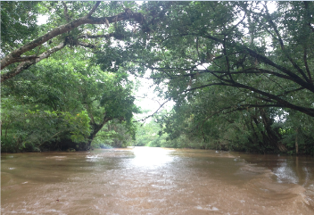
Challenges
Trimble 4600 hard reset. Goes to 5 seconds. Old firmware, all dates set to 1996.
For river surveys with canopy issues, you need many water level gauges, surveyed to the ellipsoid.

Slide 52
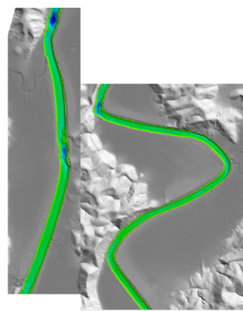
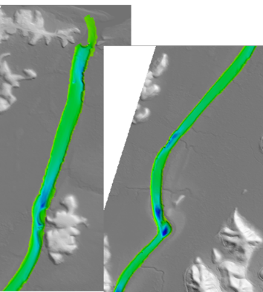
Thank you !
A
C
B
D

