Slide 1
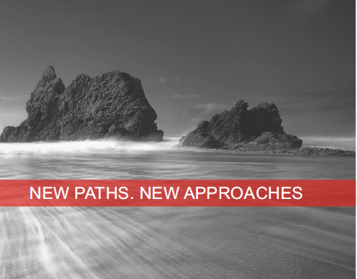
The MACHC Hydrographic Certification
Program?

Slide 2
Overview
Overview of IBSC Cat A & B … S5 & S8 Program
Canadian Hydrographic Certification Program
Candidates Handbook
Canadian Certification Scheme
Case Studies
Papua New Guinea
New Zealand
Brazil
Summary

Slide 3

IBSC Cat A & Cat B Overview
Category A
S5 (Hydrographic Operations)
S8 (Nautical Cartography)
Category B
S5 (Hydrographic Operations)
S8 (Nautical Cartography)
Portable: Deliverable at customer site
(Marine Geospatial Information Program)

Slide 4

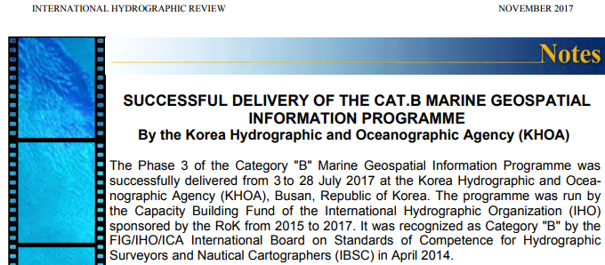
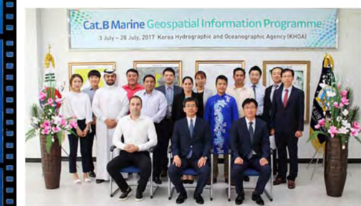
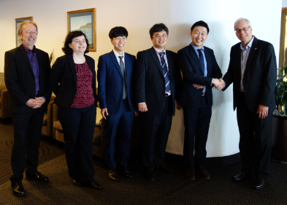
Korea Cat B S5 & S8 Programs
Cat B S8
Cat B S5

Slide 5
Hydrographic Certification

Slide 6

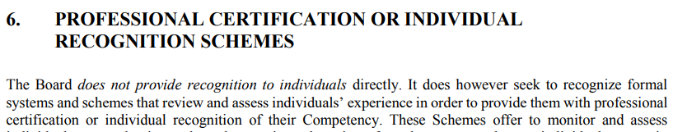

Slide 7
Hydrographic Certification
Why Individual recognition is important

Slide 8

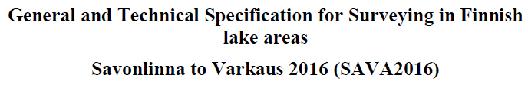
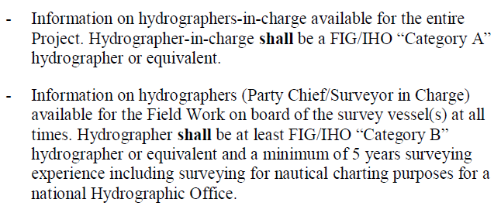
Finnish Transport Authority

Slide 9
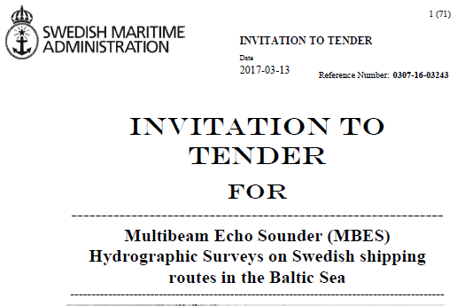
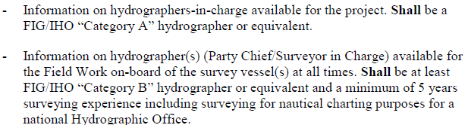
Swedish Maritime Administration

Slide 10
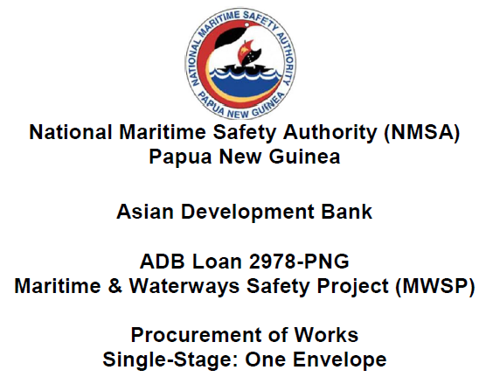
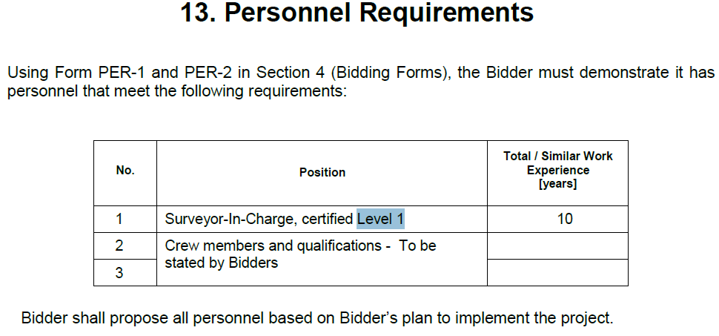
Papua New Guinea $13M

Slide 11


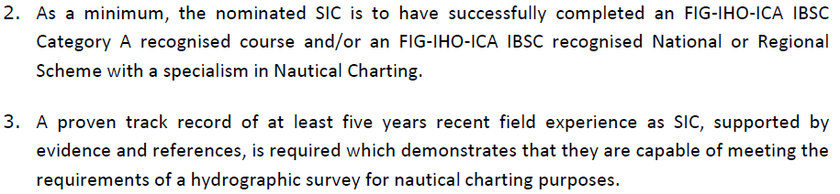

Slide 12
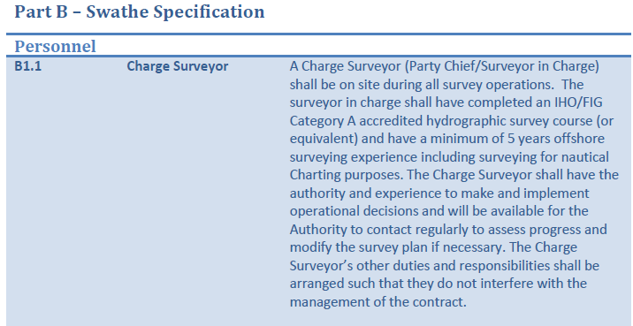
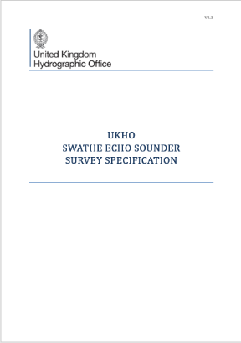
Commonwealth Marine Economic
Program

Slide 13
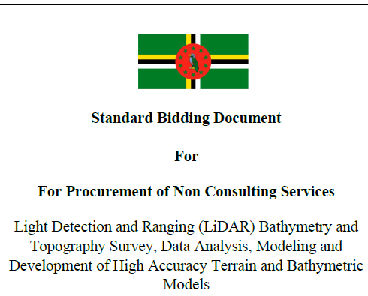
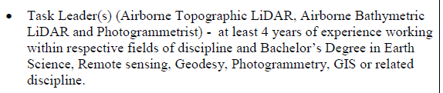

Slide 14
Introduction:
Canadian Hydrographic Certification Program

Slide 15
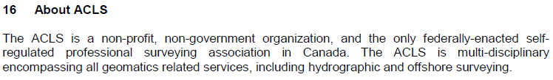
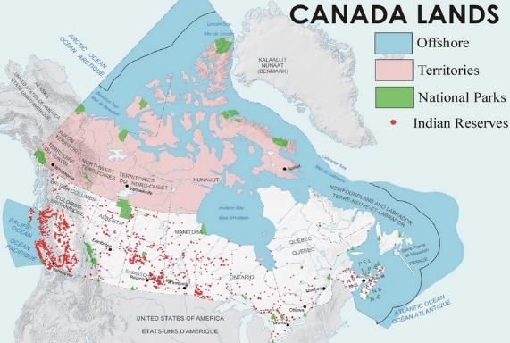
ACLS Administration
Association of Canada “Land’s” Surveyors

Slide 16
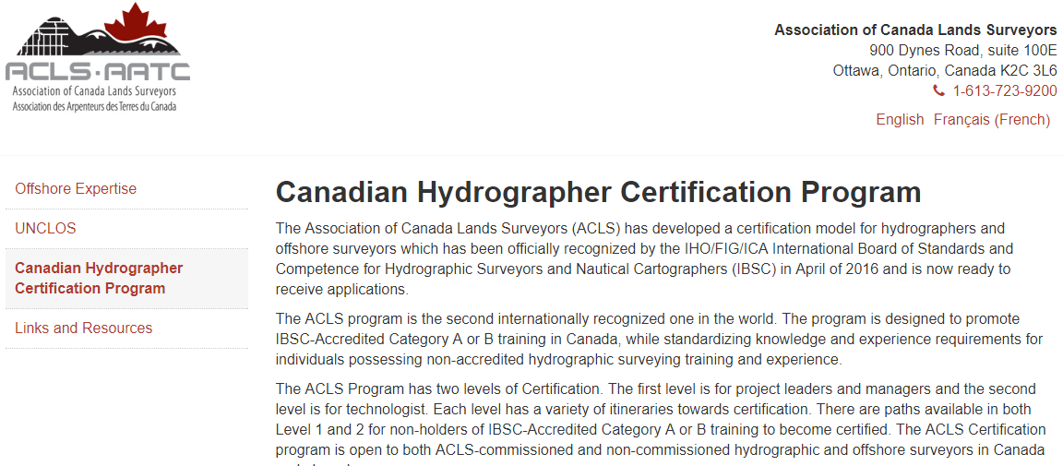
Introduction
https://www.acls-aatc.ca/offshore-expertise/canadian-hydrographer-certification-program/

Slide 17
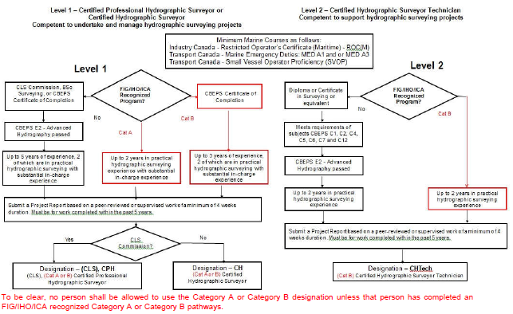
Certification Scheme for Individuals

Slide 18
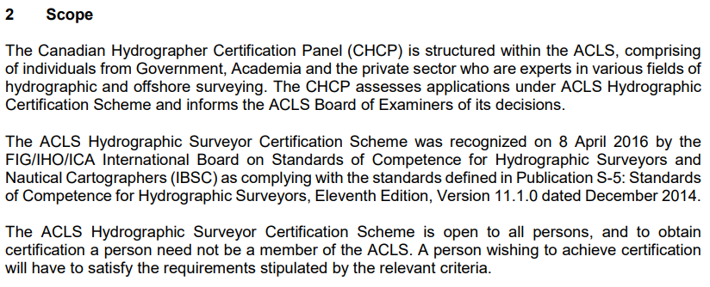
Hydrographic Certification Panel

Slide 19
Canadian Hydrographic Certification Panel 2017
Denis Hains | CHS (Permanent Position) | Government Hydrographic Surveys
Dr. Jonathan Beaudoin | Industry | Academia, Industry
Dr. David Dodd | Industry | Academia, Industry
Julian Goodyear | Private Consultant | Government, Hydrography, Seafarer
Robert Lyall | Industry | Legal Surveys
Andre Roy | Marine Institute (Cat B S5) | Academia
Derrick R. Peyton | Industry | Industry
Dr. Ian Church | University of New Brunswick Academia
Dr. Jose M'Bala | Natural Resources Canada | Legal Surveys, Oil and Gas Surveys
David Matthews | Public Works Canada | Ports and Harbours

Slide 20
Candidates Handbook
Procedure for Submission

Slide 21
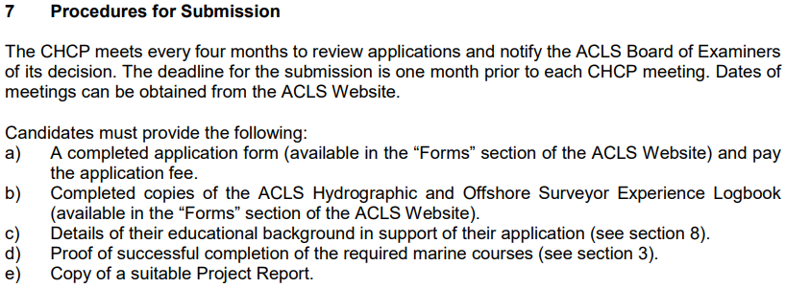
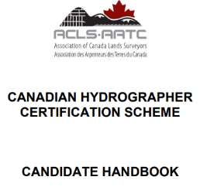
Candidate Handbook
https://acls-aatc.ca/files/english/forms/
CHCP%20Candidate%20Handbook%20March%202017.pdf

Slide 22
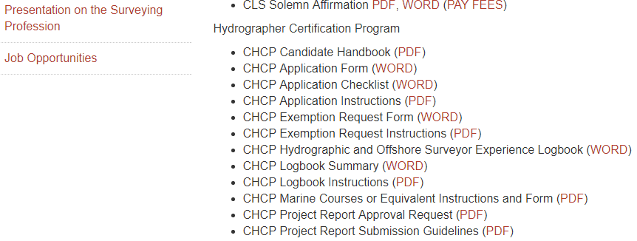
Forms
https://www.acls-aatc.ca/members-home/forms/

Slide 23
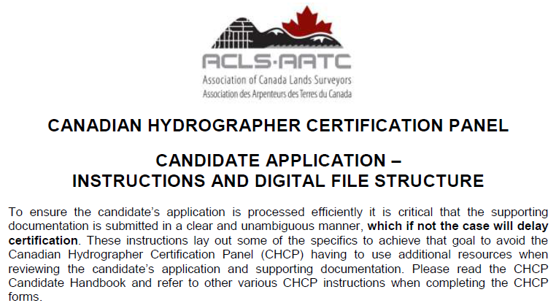

Application Form

Slide 24
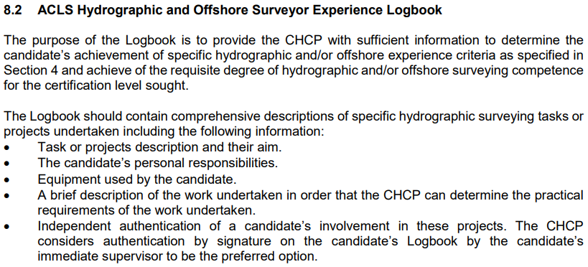
Logbook

Slide 25
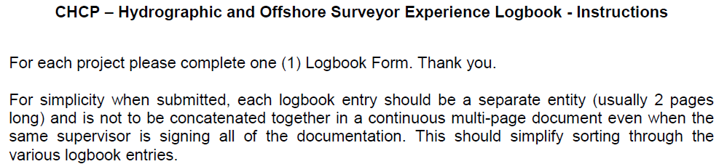
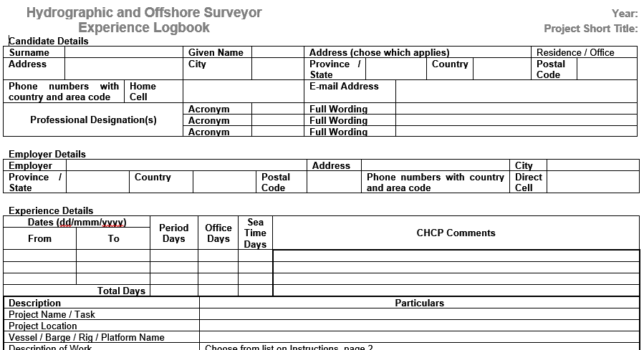
Surveyor Experience Logbook

Slide 26
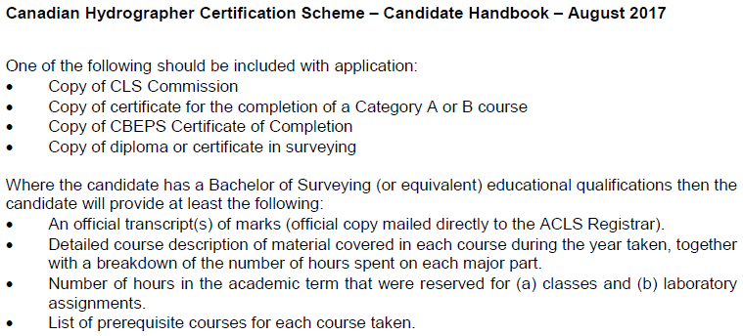
Academic Qualifications

Slide 27
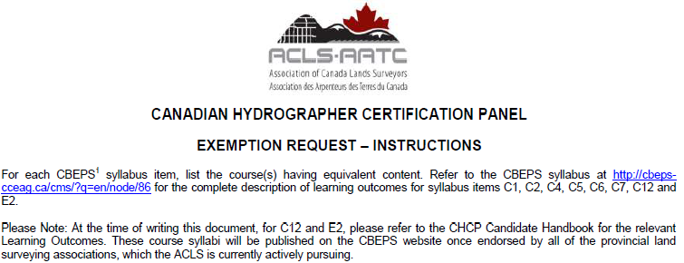
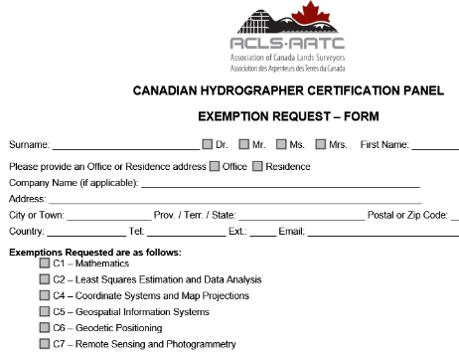
Exemptions Request

Slide 28
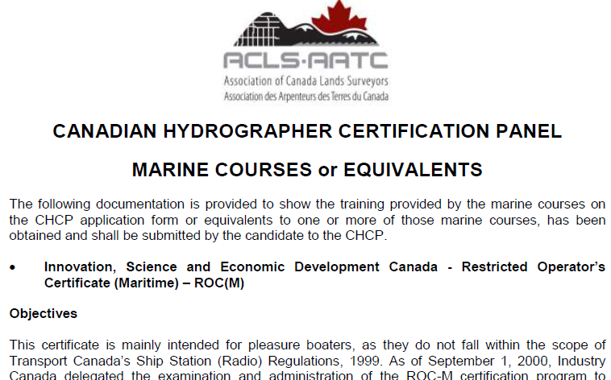
Proof of Marine Courses

Slide 29
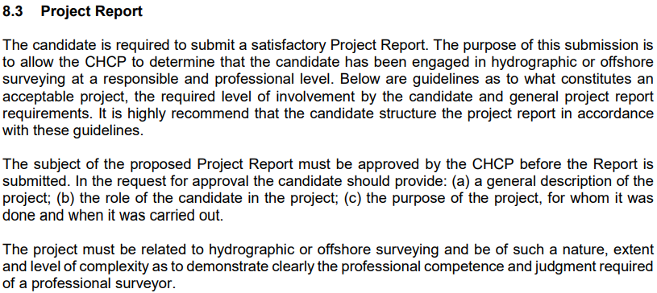
Project Report

Slide 30
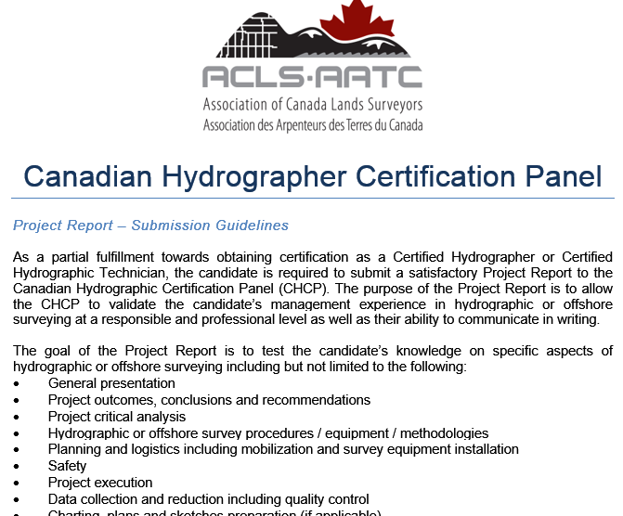
Project Report Guidelines

Slide 31
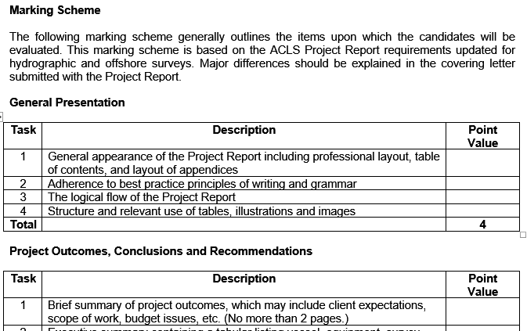
Project Report Marking Scheme

Slide 32
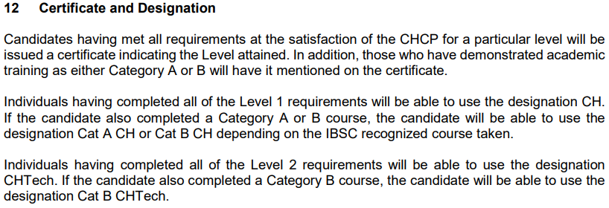
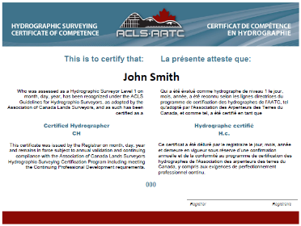
Certification

Slide 33
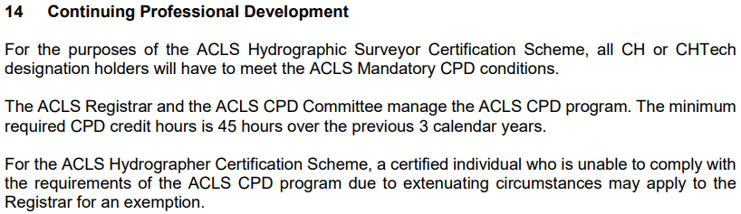
Continuous Professional Development

Slide 34
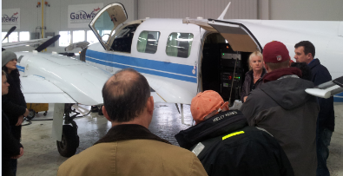
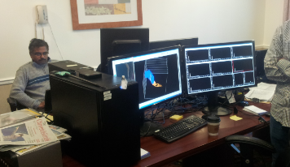
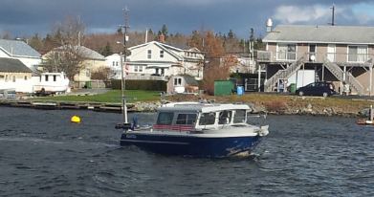
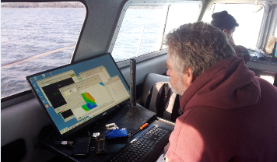
Continuous Professional Development
In all cases mandatory CPD required:
  Focused on hydrographic and/or offshore surveying.
  45 hours over 3 calender years.
  Minimum of 5 hours per year of formal Courses and Seminars.

Slide 35
So why not the
MACHC Hydrographic Certification Scheme?
A MACHC Hydrographic Scheme Sub-Committee to explore a way forward?

Slide 36
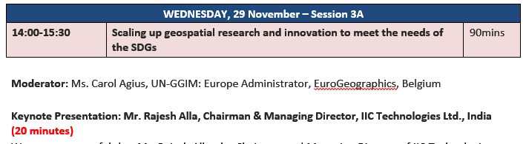

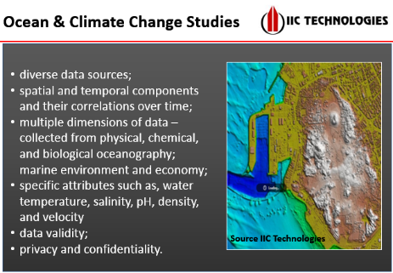
Thank You

