Slide 1
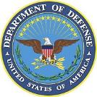
United States of America
Meso-American and Caribbean Sea Hydrographic Commission (MACHC)
National Oceanic and Atmospheric Administration
Naval Meteorology and Oceanography Command
National Geospatial-Intelligence Agency
December 2017

Slide 2
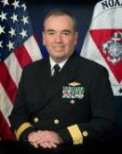
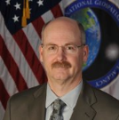
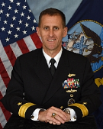
U.S. Hydrographic Leadership
NOAA
U.S. National Hydrographer & Director, Office of Coast Survey and U.S.
Rear Admiral Shep Smith
Deputy Director, Office of Coast Survey
Katie Ries
NGA
Chief Hydrographer
John Lowell
Director Maritime Safety Office
Captain Brian Conon
Navy
Commander Naval Meteorological and Oceanography Command (CNMOC) Oceanographer of the Navy, Hydrographer of the Navy, and Navigator of the Navy
Rear Admiral John Okon
Deputy Hydrographer of the Navy
Stanley Harvey
Notes:
Note:
Rear Admiral John Okon has replaced Admiral Tim Gallaudet this past year. Admiral Gallaudet is now the Acting Under Secretary of Commerce for Oceans and Atmosphere within NOAA.

Slide 3
Main Achievements
Nautical Information System (NIS) Data Base Load Completed
National Charting Plan
New NOAA CAT B Cartography Program
International Chart Adequacy Workshop
MSI Training Course (Barbados)
Capacity Building Efforts in Haiti
Post-Hurricane Assistance—Disaster Response Website
Notes:
NIS Load:
Four years ago, NOAA began the task of loading the entire portfolio of over 1,000 electronic navigational charts (ENC) into the Nautical Information System database – this is now complete
Used to store and update all of the information used to produce the weekly ENC updates,
National Charting Plan: This plan describes a strategy to make comprehensive improvements across the entire suite of NOAA nautical chart products. Part I describes the current set of NOAA nautical chart products and their distribution. Part II describes some of the steps we are taking to improve those products, including changes to chart formats, scales, data compilation, and symbology. At the end of Part II, some thoughts are presented about the long-term future of NOAA navigational products.
New NOAA CAT B Cartography Program: NOAA was recently certified by the IBSC to run a Cartographic Category B program and is in the middle of its first class. We currently have 10 NOAA employees in the training and will be offering it again next year.
Chart Adequacy Workshop: (Also addressed in subsequent slides)
In the first Chart Adequacy training in 2015. U.S. hosted representatives from 10 nations, including 2 from MACHC
In the second course in 2016, the U.S. hosted representatives from 13 nations, including 4 from MACHC.
In the course in July this year, the U.S. hosted 12 students from Egypt, Israel, Japan, Madagascar, Mauritius, Nigeria, Panama, Philippines, Russia, Spain, Taiwan, and Thailand.
MSI Training:
An MSI Training Course was held in Barbados this year.
U.S. provided one of the instructors.
Such courses are coordinated between the CBSC and the Regional Hydrographic Commission (RHC).
Technical Visit to Haiti in June 2017-- (and Slide 12)
Disaster Response Website (discussed in more detail on next Slide and on Slide 13)

Slide 4
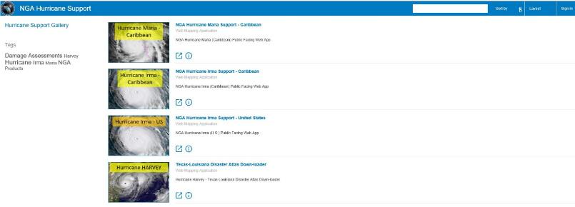
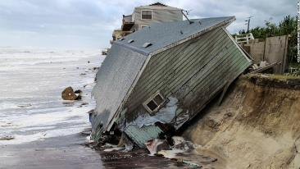
Post-Hurricane Assistance
U.S. NGA Disaster Response Site-
http://nga.maps.arcgis.com/apps/MapAndAppGallery/index.html?appid=85c45e071293405ba0926b75d740f83e
Notes:
NGA Disaster Response Site:
This site provides consolidated tools and situational awareness to assist in understanding the extent of damage caused by the 3 recent Hurricanes and essential information to protect and secure lives and infrastructure. This website is open to the public and requires no passwords.

Slide 5
Main Challenges/Obstacles
Challenging Post Hurricanes (Harvey, Irma, and
Maria) Assistance https://www.nga.mil/Pages/default.aspx
SeaBed 2030 http://seasket.ch/OwJiQE0h0k
New Survey Prioritization Model
Notes:
Post Hurricane Assistance:
NGA has created a Post-Hurricane Harvey, Irma, and Maria Assistance website to support all the ongoing recovery operations throughout the region affected by the multiple Hurricanes this season
The webpage has a number of tabs containing Products, Maps/Charts, and Data to support operations by first responders in hurricane recovery efforts.
SeaBed 20130:
U.S. mapping agencies are assessing how they may contribute to the global Seabed 2030 initiative, which has a goal to achieve the complete mapping of the ocean floor by the year 2030.
NOAA conducted a preliminary assessment of coverage based on bathymetric holdings at its National Centers for Environmental Information
Gap analysis to be used by partners to determine where additional existing data can fill in gaps, and/or where data acquisition efforts will have the most impact. The gap analysis can be viewed at the website indicated.
New Survey Prioritization Model:
NOAA is presently developing a new survey prioritization model based on a thorough risk analysis of all U.S. waters, which will incorporate, among many factors, modern vessel and port usage data sets. This risk-based model will be implemented in 2018.

Slide 6
Update on C-55
Hydrographic Surveys-U.S. portion of the MACHC Region
Charts published by the U.S. in the MACHC region (See Report)
Coverage of charts published by the U.S. in the MACHC region
 | A | B | C
Depths < 200m | 13% | 55% | 32%
Depths > 200m | 59% | 41% | .05%
Purpose/Scale | A | B | C
Offshore passage/Small | 100% | 100% | 100%
Landfall and Coastal passage/Medium | 100% | 100% | 100%
Approaches and Ports/Large | 100% | 100% | 100%
Percentage of Group A showing depths in metres | <1.0%
Percentage of Group A referenced to a satellite datum | 100%
Purpose/Scale | A | B | C
Offshore passage/Small | 100% | 100% | 100%
Landfall and Coastal passage/Medium | 100% | 100% | 100%
Approaches and Ports/Large | 100% | 100% | 100%
Percentage of Group A showing depths in metres | 3.0%
Percentage of Group A referenced to a satellite datum | 100%
Notes:
Hydrographic Surveys in MACHC:
The status of hydrographic surveys of navigable waters in the U.S. portion of the MACHC Region (Gulf of Mexico and Puerto Rico) out to the limits of the EEZ are as follows:
A = percentage which is adequately surveyed
B = percentage which requires re-survey at larger scale or to modern standards
C = percentage which has never been systematically surveyed
Charts published in MACHC: (Charts produced in the Region are in Report)
Coverage of charts published by the U.S. in the MACHC region (Gulf of Mexico Coast of the Continental U.S), where:
A = percentage covered by INT series, or a paper chart series meeting the standards in M-4
B = percentage covered by Raster Navigational Charts (RNCs) meeting the standards in S-61
C = percentage covered by ENCs meeting the standards in S-57

Slide 7
Non-U.S. Regional Chart Coverage
Four New Paper Chart Editions
One new INT Chart to be Produced in 2018
Two New ENCs in Progress
Chart | Chart Title | Edition Date | Distribution
24502 | Barranquilla, Colombia | March 2017 | LIM DIS
27085 | Bahia de la Habana, Cuba | April 2017 | LIM DIS
24465 | Sint Anna Baai and Schottegat, Curacao, Netherland Antilles | July 2017 | LIM DIS
24462 | Curacao, Netherland Antilles | August 2017 | LIM DIS
Cell Name | Title | Posted
US3HTI01 | Haiti Coast | In Progress
US511060 | Puerto de Haina, Dominican Republic | In Progress
Notes:
Four New Paper Charts -- listed above:
One new INT Chart -- noted above
Two New ENCs -- noted above are in progress

Slide 8
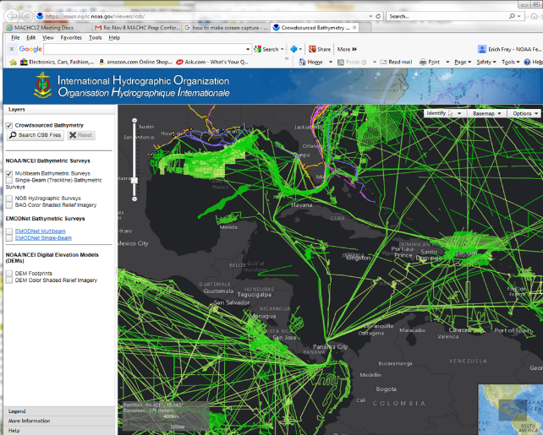
Bathymetric Data made available to GEBCO
Notes:
The U.S. States participates on the IOC-IHO Guiding Committee for GEBCO and chairs the IHO IRCC Crowdsourced Bathymetry Working Group.
The U.S. also hosts both the IHO Data Centre for Digital Bathymetry (IHO DCDB) and the online GEBCO Gazetteer of Undersea Features at NOAA’s National Centers for Environmental Information (NCEI).
Also support the IHO Data Centre for Digital Bathymetry (IHO DCDB).
IHO DCDB, co-located with NOAA's National Centers for Environmental Information (NCEI)
Building the infrastructure necessary to provide
archiving,
discovery,
display and
retrieval of global crowdsourced bathymetry data from mariners around the world.

Slide 9
Plans that affect the Region
Fourth International Chart Adequacy Workshop –
July 2018
For interest in 2018 course, contact: Dr. Shachak Pe’eri at shachack.peeri@noaa.gov
Tide and Water Levels Training
Planned for late 2018 - Contact Peter Stone at Peter.Stone@noaa.gov
Notes:
Chart Adequacy Workshop for 2018:
To be held in Silver Spring, USA
Tide and Water Levels Training
Being planned for late 2018 with location to be determined.

Slide 10
Capacity Building Activities
2017
International Chart Adequacy Workshop
July 2017 in Silver Spring, MD (12 Nations)
For interest in 2018 course, contact: Dr. Shachak Pe’eri at shachack.peeri@noaa.gov
MSI training in FY 2017 in Barbados
MSI Coordinator – Peter Doherty at: Peter.M.Doherty@nga.mil
Other Training Opportunities
The International Hydrographic Science Applications Program (CAT A) at the University of Southern Mississippi
Course Identifier: MASL# PP-169265 – Contact US Naval Attaché at US Embassy
Notes:
Chart Adequacy Workshop:
In the 2017 Chart Adequacy training, the U.S. hosted representatives from 12 nations: Egypt, Israel, Japan, Madagascar, Mauritius, Nigeria, Panama, Philippines, Russia, Spain, Taiwan, and Thailand.
Anyone interested in the 2018 Chart Adequacy training should contact Dr. Peeri.
MSI Training in 2017:
Hosted by Barbados—Thank you very much Barbados
CAT A (Navy) Training: Is open to both civilian and military as long as they belong to the partner nations hydrographic service or military institutions. Applicants should make the request through the Navy Attaché at the U.S. Embassy in their country and reference the course identifier number in the slide. U.S. Navy has some funding to support applicants. Contact Eric Villalobos for further information and assistance: eric.villalobos@navy.mil

Slide 11
Other Opportunities (continued)
The International Hydrographic Management and Engineering Program (CAT B)
Course Identifier: MASL# PP-169265 - Contact US Naval Attaché at
US Embassy
CAT A certified hydrographic programs
University of New Hampshire
Contact: Andy Armstrong at: andy.armstrong@noaa.gov.
U.S. Navy standing by with a Fleet Survey Team in response to recent Hurricanes
Support safety of Navigation
Analyzed Imagery
Contact: Naval Attaché at US Embassy
Notes:
CAT B (Navy) Training: Just as for CAT A Training, CAT B training is open to both civilian and military as long as they belong to the partner nations hydrographic service or military institutions. Applicants should make the request through the Navy Attaché at the U.S. Embassy in their country and reference the course identifier number in the slide. U.S. Navy has some funding to support applicants. Contact Eric Villalobos for further information and assistance: eric.villalobos@navy.mil
CAT A certified hydrographic programs:
Funding opportunities for these and other CAT A and B Programs are available from GEBCO/the Japanese Nippon Foundation and Korea—these opportunities are announced through IHO Circular Letters. For information on the University of New Hampshire Program, contact: Andy. Armstrong@noaa.gov
Fleet Survey Team:
Fleet Survey Team (FST) has the capacity to conduct a quick survey over critical areas for navigation for beach landings or otherwise with their Rapid Littoral Survey Vessel (RLSV= Jet skis with single beam, SSS, DGPS) to investigate hazards to navigation for go/no-go decisions.

Slide 12
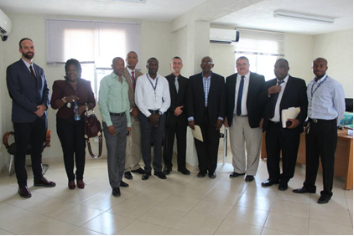
Capacity Building Activities
Technical Visit to Haiti
Assess Current Capacity and Capability
Support efforts to become full Member of IHO
Notes:
Capacity Building Efforts in Haiti:
The US supported the IHO Capacity Building Sub-Committee (CBSC) Technical Visit to Haiti in June of 2017 with colleagues from Brazil and France.
The Technical Visit was successfully conducted the week of 19-23 JUN 2017.
Purpose:
To assess the current setup and capabilities of the various Haiti Hydrographic organizations.
Provided an opportunity to assist Haiti in finalizing what needed to be completed in order to become full members of the IHO.
Highlighted the importance of hydrography in Haiti to the various levels of the Haitian Government. The Technical Visit Delegation also illustrated some of the benefits as well.
Met with the Haitian Prime Minister SEMANAH, National Port Authority (APN), Haitian Coast Guard, and National GIS Center (CNIGS) during the Technical Visit.

Slide 13
Lessons Learned
The Disaster Response website, while useful, could be improved with more interactive options
(http://nga.maps.arcgis.com/apps/MapAndAppGallery/index.html?appid=85c45e071293405ba0926b75d740f83e)
Notes:
Disaster Response:
The Disaster Response website provides a good starting point to support things like the Hurricane Recovery efforts.
First Responders need the best available information to support their operations and help them make timely informed decisions.
Ultimately, this website is about critical and timely information.
This information in large part comes from geospatial organizations within the US Government.
However, it can be greatly enhanced with the addition of information from other partners within the region.
Some partners have provided support to this effort.
Collaboration between partners to improve information sharing could be enhanced with the development of two way engagement tools like ArcGIS Hub.
Better communication could be established by providing contact information for the website to the various partners during the crisis.

Slide 14
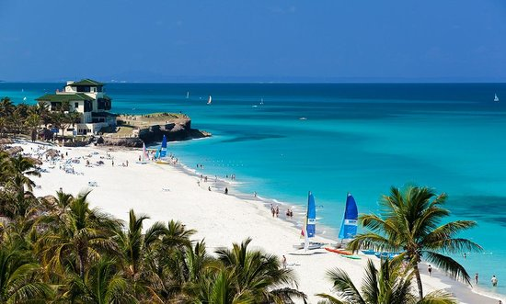
Thank you! (Wish we were here!)

