Slide 1
UKHO International Hydrographic Development Projects
2016 Update
Sam Harper, UKHO International Hydrographic Projects Manager

Slide 2
Overview
UKHO approach to International Hydro Projects and Capacity Building
Positioning Hydrography within the bigger picture
Commonwealth Marine Economies Programme
Overseas Territories Seabed Mapping Programme
Observations and Lessons Learnt

Slide 3
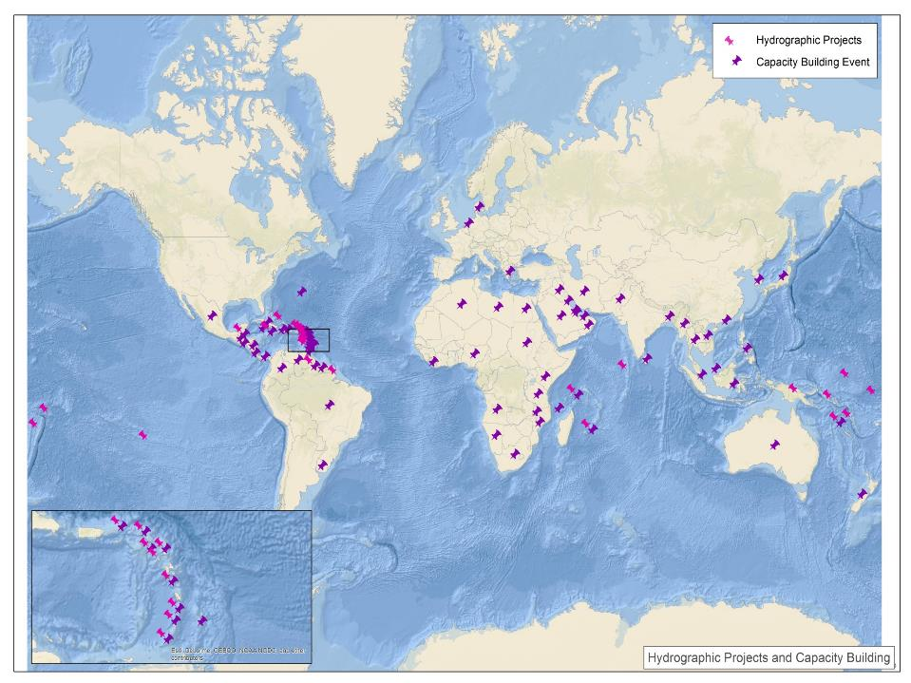
UKHO International Hydro Projects and CB Portfolio
Going forward – looking to take a more integrated approach

Slide 4
Hydrography and the Bigger Picture
Habitat Mapping
Inundation mapping
MPAs
Disaster preparedness
Fisheries Management
Disaster mitigation
Coastal Zoning
Coastal land use planning
Hydrography
A keystone data type
Oceans Governance
Climate change resilience
Notes:
Speaking Note
The data was collected in August using acoustic survey techniques.
Note the warning on the chart about the inadequacy of existing data.
The resolution of the data is far higher than that previously available
This data will be processed and used to update the charts produced by the UKHO

Slide 5
Hydrography and the Bigger Picture
2014 Collaboration with CEFAS
Darwin Plus funded survey of the British Virgin Islands
Focused on biodiversity
CEFAS and UKHO working in collaboration
Notes:
Speaking Note
The data was collected in August using acoustic survey techniques.
Note the warning on the chart about the inadequacy of existing data.
The resolution of the data is far higher than that previously available
This data will be processed and used to update the charts produced by the UKHO

Slide 6
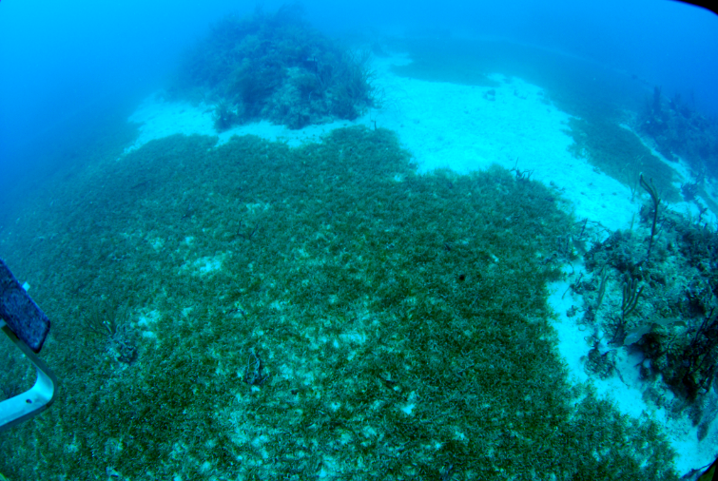
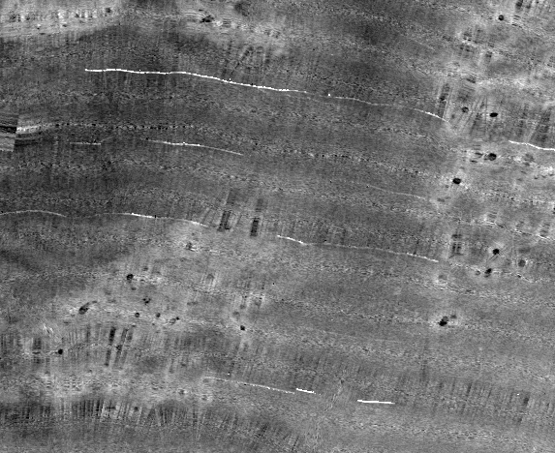
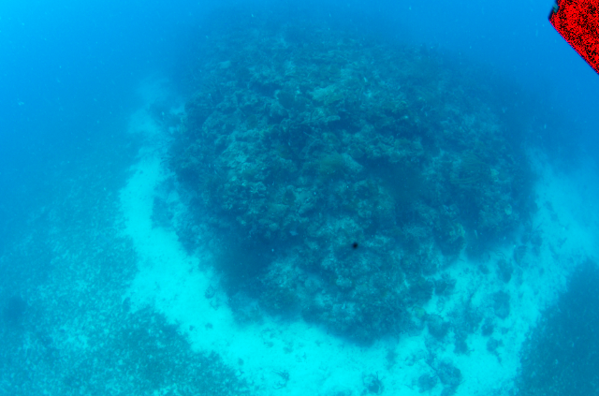
Collection depth data for charting
800% more seagrass discovered
Seagrass 35 times more efficient at storing carbon than rainforests
Used same data to deduce bottom type

Slide 7
Clear link between shipping activity and biodiversity

Slide 8
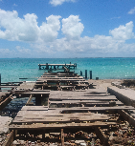
CME Programme
The first time bringing together world-leading UK marine expertise
Providing capabilities across a whole end to end process, survey and science
UKHO. UK’s agency providing hydrographic and geospatial data to mariners and maritime organisations across the world.
Cefas. Executive Agency, Department for the Environment, Food and Rural Affairs (Defra) providing scientific solutions to support blue growth and food security,
NOC. The UK’s leading institute for integrated ocean research and technology.

Slide 9
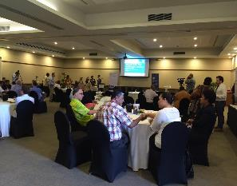
The UKHO Component of the CME Programme
UKHO Five Year Objective: To provide each SIDS with the data required to (a) maximise their maritime trade potential and (b) facilitate development of their Blue Economies
Year One Objective: To develop with each SIDS a National Hydrographic Plan that identifies hydrographic needs and knowledge gaps leading to:
Targeted survey activity,
Capacity Building,
Sustainable Hydrographic Governance
Support to CEFAS and NOC objective delivery
UKHO Pilot: Hydrographic survey in St Vincent and the Grenadines and Grenada in Summer 2016
Note for the diary: Caribbean Regional Workshop 24th-26th January

Slide 10
Nations in Scope for the CME Programme
MACHC Region Nations in scope:
Antigua and Barbuda
Belize
Dominica
Grenada
Guyana
Jamaica
St Lucia
St Vincent and the Grenadines

Slide 11
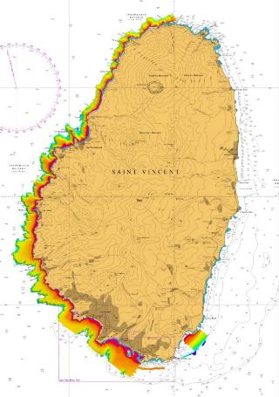
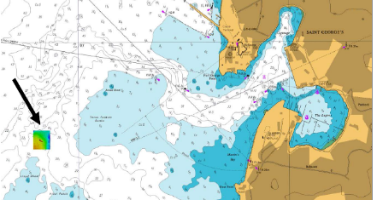
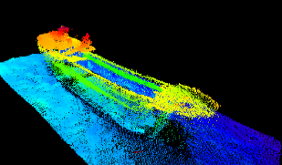
SVG and Grenada – Initial Results
Highest priority areas surveyed with MBES
70km2 in SVG
38km2 in GRD

Slide 12
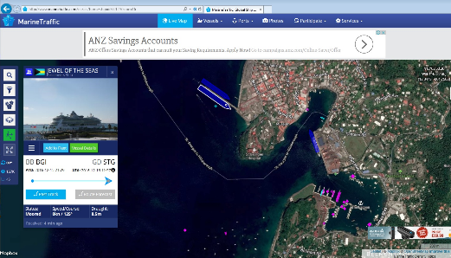
SVG and Grenada – Initial Results
Least depth over wreck = 7.7m
Jewel of the Seas Draught = 8.5m

Slide 13
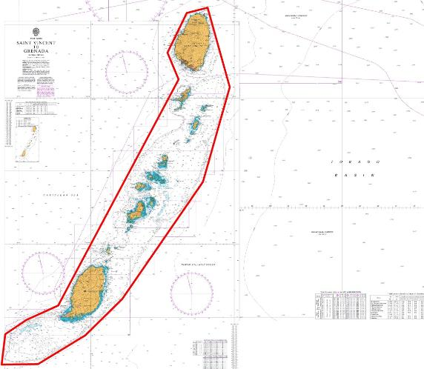
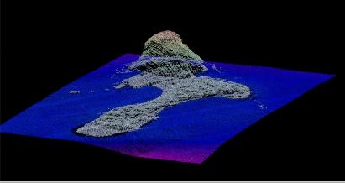
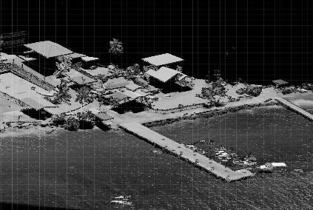
SVG & Grenada - Lidar
Approx. 5800 km2 survey area covering entirety of optically shallow waters

Slide 14
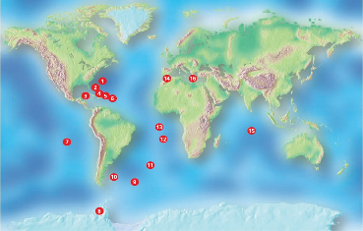
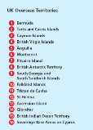
Overseas Territories Seabed Mapping Programme
Cross government fund focusing on a range of subject areas
UKHO programme within the international obligations theme
Four year programme
Yr 1 allocation of approx. £1m
Approx. £6m for years 2-4
Year 1 Activity
Tech Assessments of all OTs
Lidar Survey of Anguilla

Slide 15
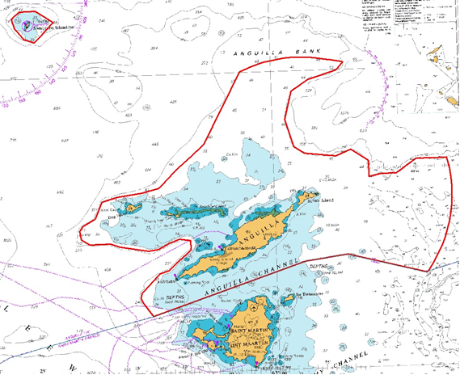
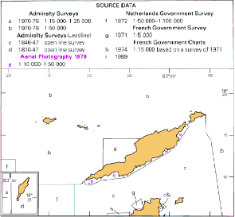
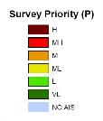
Anguilla - Lidar
Approx 1500 km2 survey area

Slide 16
Observations and Lessons Learnt
There is funding out there but we need to be creative to access it
General need to raise awareness of how hydrography fits into the bigger picture
Number of projects and programmes coming on line requires careful coordination
We need to review how we provide Technical Assistance
Be careful what you wish for!!

Slide 17
Thank You

