Slide 1
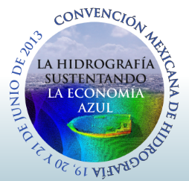
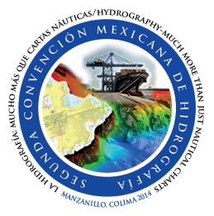
CONVENCIÓN MEXICANA DE HIDROGRAFÍA.
Diciembre de 2016.

Slide 2
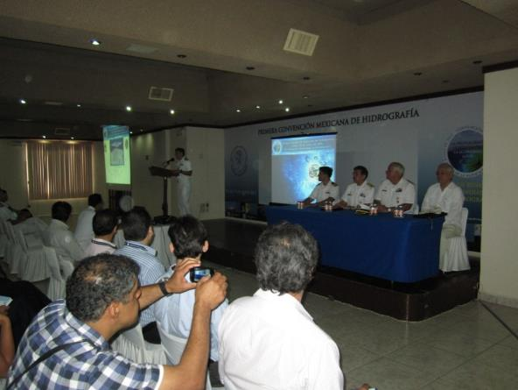
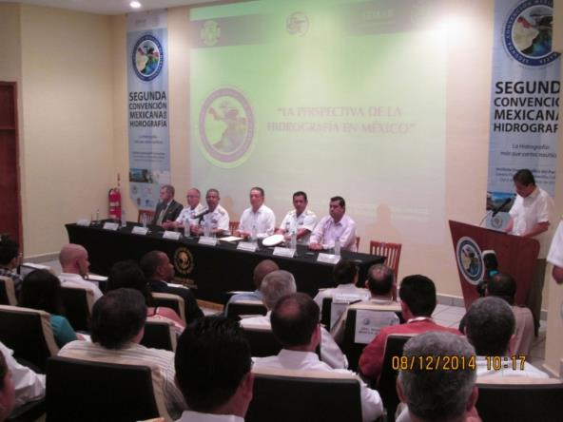
Mexican Hydrographic Conference
The Secretary of the Navy agree to organize the Mexican Hydrographic Convention in 2013.

Slide 3
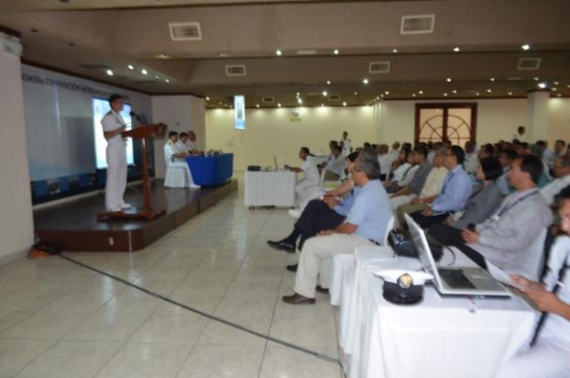
FIRST MEXICAN HYDROGRAPHIC CONFERENCE.
It was conducted on June 19 to 21 2013 at the Naval Club in Veracruz.

Slide 4
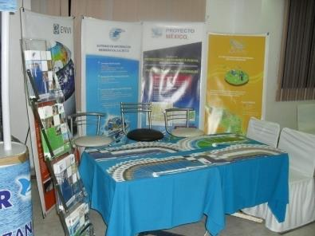
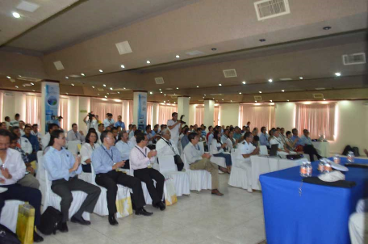
ACHIEVEMENTS OF THE FIRST MEXICAN HIDROGRAPHIC CONFERENCE
150 Participants
29 Technical Conferences.
04 Hydrographic training workshops.
08 Demonstrations at sea of Hydrographic equipment and software.
23 Stands for exhibition of Hydrographic products and services, by governmental agencies, private sector and academia.

Slide 5
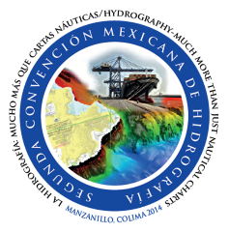
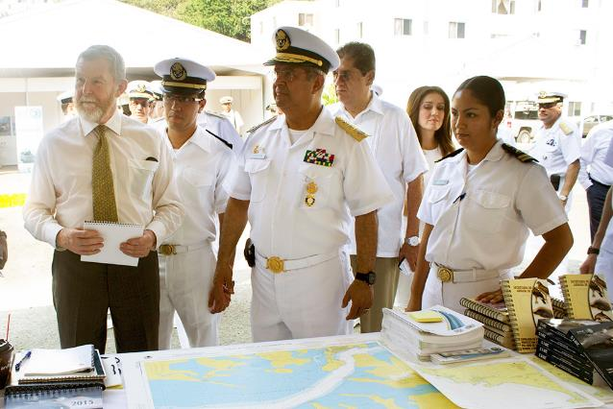
SECOND MEXICAN HYDROGRAPHIC CONFERENCE
It was conducted on December 8 to 10 2014 held at Manzanillo in the Oceanography Institute of the Pacific.

Slide 6
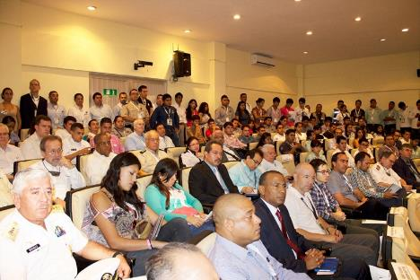
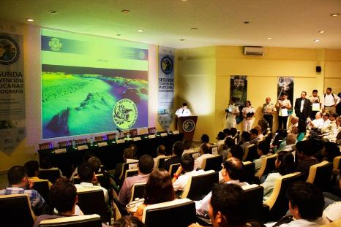
ACHIEVEMENTS OF THE SECOND MEXICAN HIDROGRAPHIC CONFERENCE
315 Participants
35 Technical Conferences.
03 Hydrographic Training Workshops.
05 Demonstrations at sea of Hydrographic equipment and software.
32 Stands for exhibition of Hydrographic products and services, by governmental agencies, private sector and academia.

Slide 7
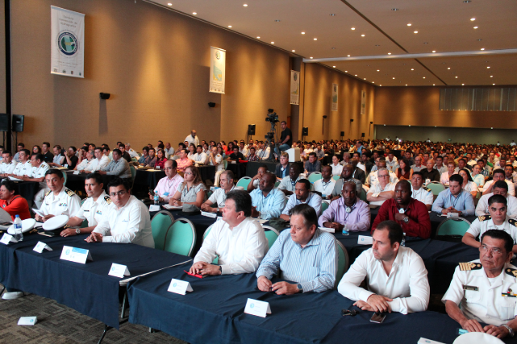
THIRD MEXICAN HYDROGRAPHIC CONFERENCE
It was conducted on March 27 to 29 2016, held at the Convention Center of Ciudad del Carmen, Campeche.

Slide 8
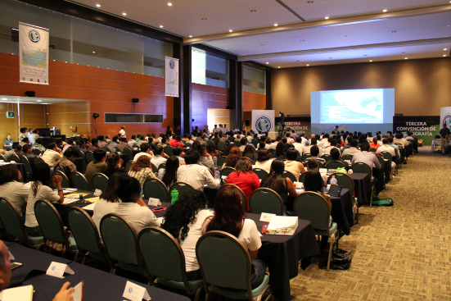
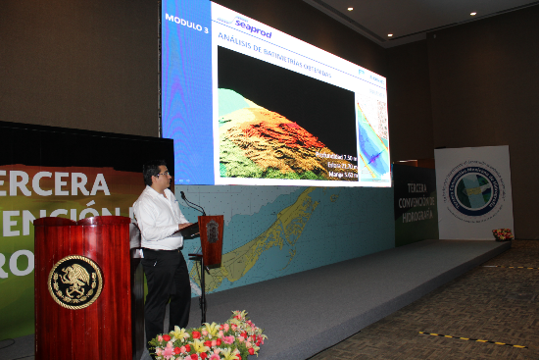
ACHIEVEMENTS OF THE THIRD MEXICAN HIDROGRAPHIC CONFERENCE
The Secretary of the Navy, the industry and interested sectors conducted surveys with their own technology at a chosen area in the proximities of Ciudad del Carmen during the months of February and March this year, to present the results on the Conference, they highlighted the scope and benefits of the used systems
The access was free for the people who wanted to attend.
730 persons attended and got training on Spanish on different hydrographic topics.

Slide 9
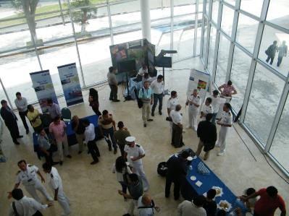
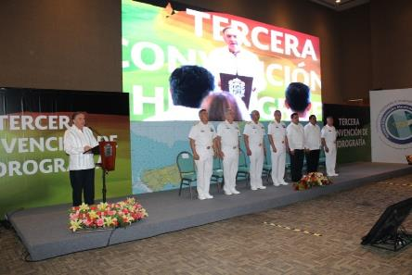
ACHIEVEMENTS OF THE THIRD MEXICAN HIDROGRAPHIC CONFERENCE
There were an exhibition of equipment to obtain hydrographic information of sea areas, computer programs for processing the information and for the production of cartographic products, with the participation of 27 companies.
Delegates from 16 member states of the MACHC were invited by AMEXCID as part of the FOCAHIMECA project, and 10 IHO Member States, including Argentina, United Kingdom, United States of America, Spain, Colombia, Venezuela and Uruguay.

Slide 10
CONVENCIÓN MEXICANA DE HIDROGRAFÍA.
Diciembre de 2016.

