Slide 1

Inland Electronic Charts
Vs
Electronic Charts

Slide 2
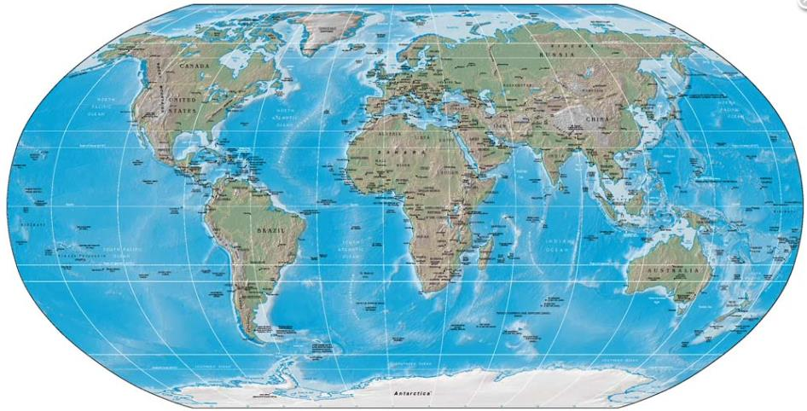


IIC Technologies
Notes:
Global project present in 8 different locations
3 Production Offices
4 Assistance Offices
2 Consulting Offices (R&D)
1 Training Academy
Specialists able to assist locally all over the globe in several languages
Permanent Remote assistancesolutions

Slide 3
Content
Specific characteristics of Waterways
Major diferences between ENCs and IENCs
  Various clients
  Different usages
  Chart scheeming and scales
  Buoyage systems
Inland ENC Harmonization Group
IIC Technologies
  IENC projects
  DHN colaboration

Slide 4
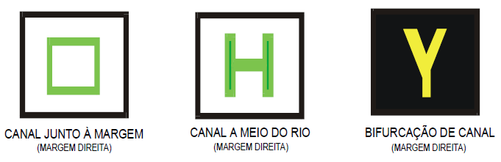
Specific characteristics of Waterways
Vessels using waterways are both inland and maritime
Inland waterways navigation is regulated by national or regional institutions
National and regional symbology applied for specific signals, signs and marking
Notes:
No SOLAS or COLREG regulation.
SOLAS vessels are also users lower parts of waterways.
Images from Paraguay River specific signals and symbology.

Slide 5
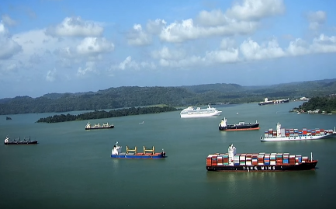
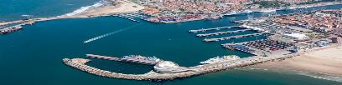
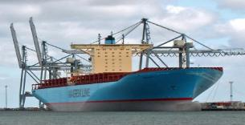
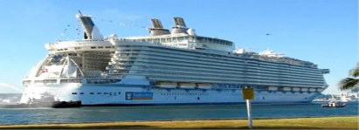
ENCs Vs IENCs – Users
Maritime navigation vessels
Inland navigation vessels
Cargo ships
Leisure crafts
Small cruisers
Notes:
Importance of keel clearance
Tourism increasing with both cruisers and leisure vessels – Amazonia branding

Slide 6
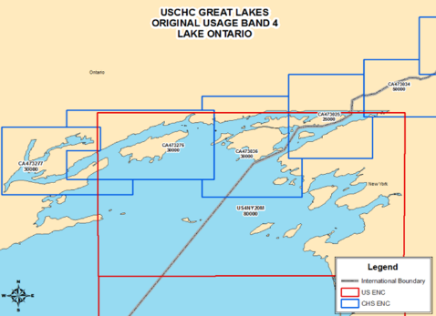
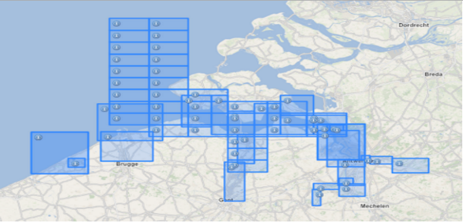
ENCs Vs IENCs – Usages and Scale
Different usages
  7 – River
  8 – River Harbour
  9 – River Berthing
Larger scale charts

Slide 7

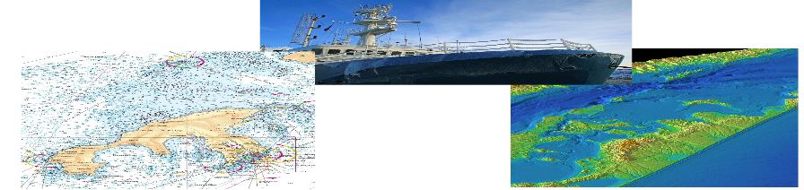
ENCs Vs IENCs – Dynamic Enviorment
Dynamic environment
  Fluvial currents produce faster erosion, sediment moving and considerable depth variations
  Metheriologycal and climatolgycal factors are also determinant
  Constantly mutating dynamic environment requires great effort from authorities to ensure safe navigation routes
Notes:
Dynamic river environment results in constant changing of depth values and different specifications on water level definition.
Authorities have to perform more surveys to keep information up to date to ensure safe navigation.
Keel clearances of less than a metre are common in an effort to keep up with fluvial transportation and economy needs.

Slide 8
ENCs Vs IENCs – Compilation
Detailed Encoding Guide for Inland ENCs
  IENC exclusive acronyms identified by lower case letters
  Additional features, attributes and enumerations to complement and adequate S-57 objects
Specific encoding needs in key objects
  Metadata
  Bridges and Overhead Obstructions
  Damns
  Buoys, Beacons, Daymarks, Notice Marks
  Etc.
S-101 product will allow homogenization, replacing lower case elements by HYDRO elements
Notes:
Lower case acronym example:
m_vdat (vertical datum)
bridge

Slide 9
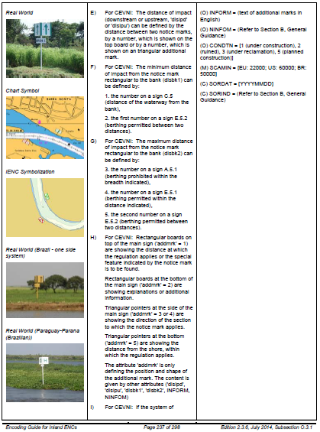
Encoding Guide IENC – Navigation Aids
Notes:
Brazilian national symbology pages on the Encoding Guide For Inland ENCs
Specific buoyage system
Symbology for rivers Paraguay
Double faces signs

Slide 10
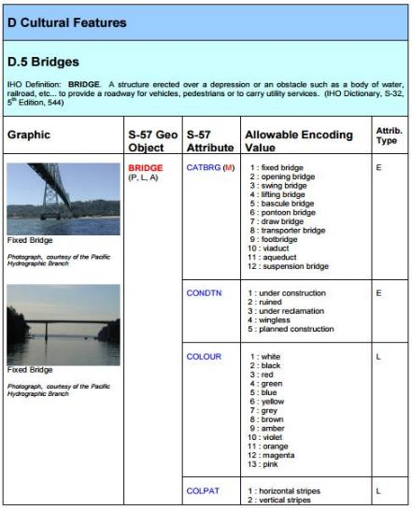
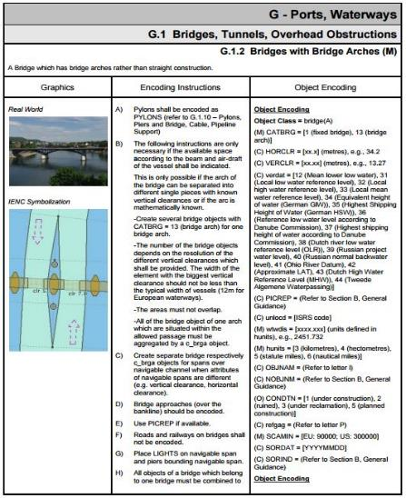
IENC Compilation – Bridges
Notes:
Encoding guide includes
sketches of the encoding
encoding instructions
object encoding atributes and enumerations

Slide 11
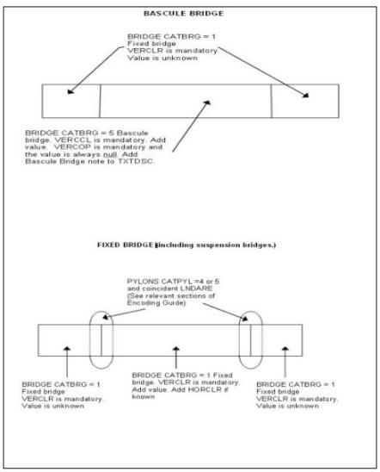
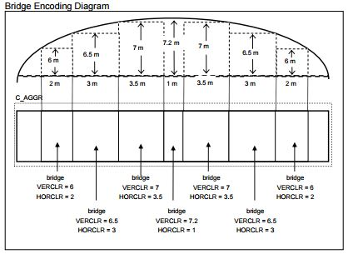
IENC Compilation – Bridges

Slide 12
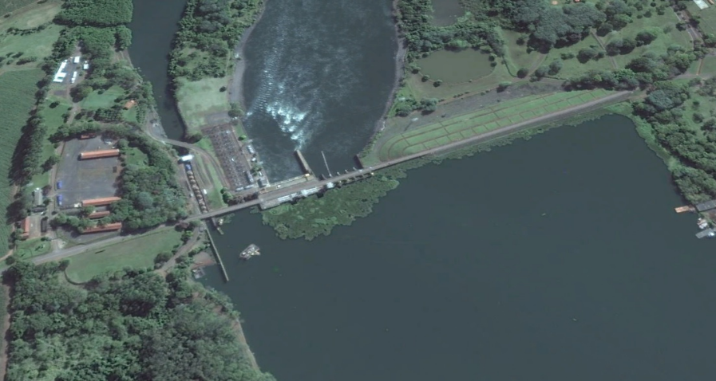
IENC Compilation – DHN
Areal image of the Bariri Damn on the Tietê River

Slide 13
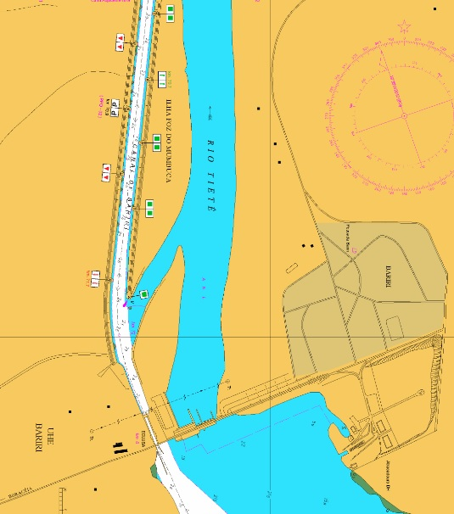
IENC Compilation – DHN
Bariri Damn on the Tietê River as presented on Paper Chart

Slide 14
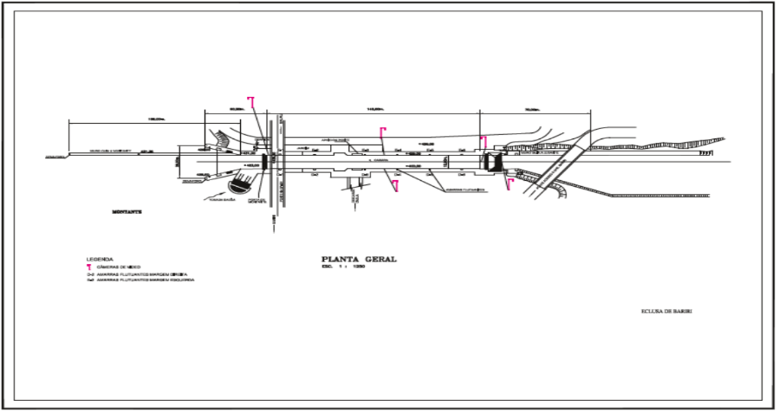
IENC Compilation – DHN
Detailed image of the Bariri Damn on the Tietê River
Notes:
Identification of Damn and Bridge structure and positioning for the national navigation aids

Slide 15
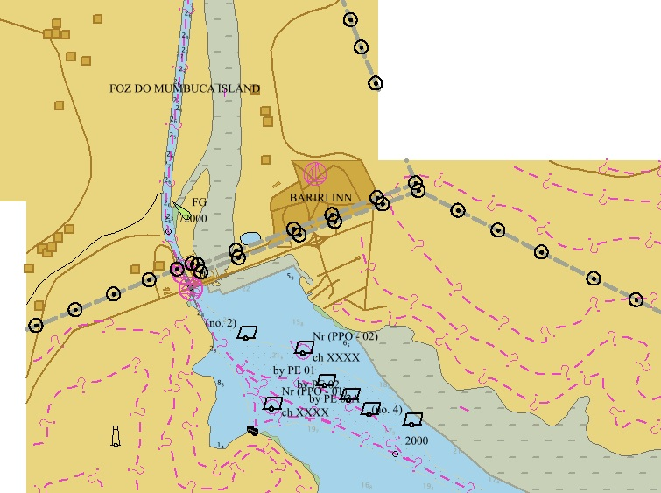
IENC Compilation – DHN
Bariri Damn on the Tietê River encoded as per IENC
Notes:
Notice blank areas exist because object is at the limit of the cell

Slide 16
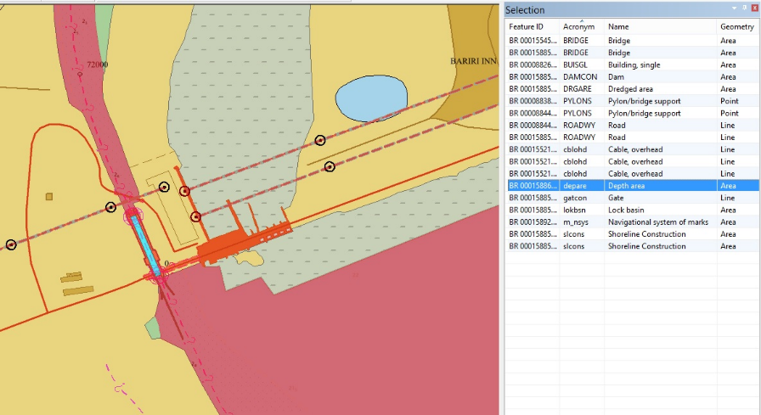
IENC Compilation – DHN
List of the objects encoded for the Bariri Damn area
Notes:
On the image not all the objects that could be encoded as per IENC are due to lack of information and project decisions
Emphasis on the objects below:
m_sys – Navigational system marks
cblohd – Cable overhead
gatecon – Gate
slcons – shoreline construction

Slide 17
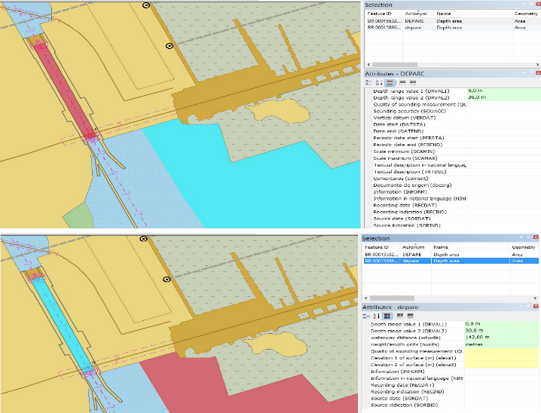
IENC Compilation – DHN
Encoding DEPARE
Encoding dpare
Notes:
Attribute of waterway distance (wtwdis) – 142
Height/length units (hunits) – meters
Elevation 1 of surface (m) (elave1) – no information at the time of the encoding
Elevation 2 of surface (m) (elave2) – no information at the time of the encoding

Slide 18
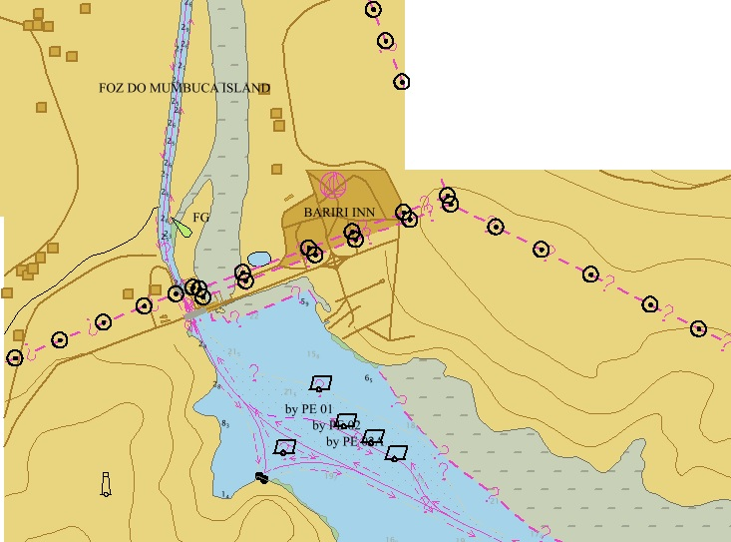
IENC Compilation – DHN
Bariri Damn on the Tietê displayed on an ECDIS (S-52)
Notes:
Notice blank areas exist because object is at the limit of the cell

Slide 19
Inland ENC Harmonization Group
2003 – Establishment of IEHG
2009 – Recognition by IHO as a Non Governmental International Organization (NGIO)
Main object to develop and maintain standardized product specification for Inland ENCs
  Feature Catalogue
  Encoding Guide
IEHG “advises and provides input” regarding IENC technical standards development, implementation and maintenance
Notes:
The Objective of IEHG is to develop and to maintain a harmonized standard for Inland Electronic Navigational Charts (IENCs) suitable for inland navigation that is based on the standards of IHO for ‘maritime’ ENC
The Goal is to agree upon specifications for Inland ENCs that are suitable for all known inland ENC data requirements for safe and efficient navigation. At the moment all European countries with a connected inland waterway network, the Russian Federation, the United States of America, Brazil, the Peoples Republic of China and the Republic of Korea are actively participating in IEHG.
It is further intended that IENC standards meet the basic needs for Inland ENC applications, worldwide.

Slide 20
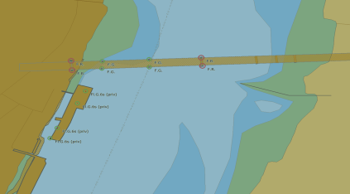
IIC Technologies and IENCs
Support to the USACE Programme
  Production of IENCs for over 10.000 Km of waterways
  Monthly maintenance of 61 IENCs coordinated by 11 districts
  Continuous automatic updating of the Mississippi River
2015/2016
  Production of
  standardized charts
  of Arkansas and
  Atchafalaya River
Notes:
USACE Programme
Atchafalaya River – After Katrina Urricane had to be remap

Slide 21
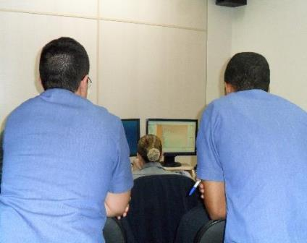
DHN and IIC Technologies
Production
  151 Paraguay River Paper Charts
  Paper Charts of the Trombetas River
  Update of the source for all the 675 Km of Tocantins River
    Encoded accordingly to the IENC Encoding Guide
  Creation and population of 16 IENC cells
  10+ Costal Charts, both Paper Chart and ENC

Slide 22
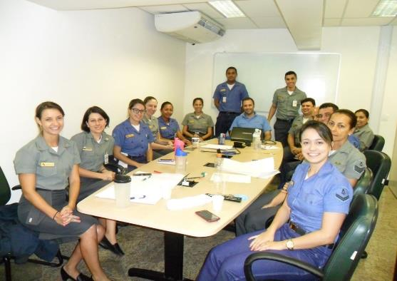
DHN and IIC Technologies
Capacity building
Taylor fit training for DHN personnel
  Workflow understanding
  Team work
  Nautical Cartography best practices
  Quality Control
Continues in 2017…

Slide 23
Credits
Derrick Peyton, IIC Technologies,Canada derrick.peyton@iictechnologies.com
Nuno Silva, IIC Technologies, Portugal nuno.silva@iictechnologies.com
Flávia Mandarino, DHN, Brazil flavia@chm.mar.mil.br
Vanessa Hilleshein, DHN, Brazil vanessa.hilleshein@marinha.mil.br

Slide 24
Thank You

