Slide 2
MACHC17 - RENC Update James Harper IC-ENC General Manager December 2016

Slide 3
Agenda
RENC / ENC Update to the MACHC
The importance of ENC co-ordination:
National
Regional
Global
3

Slide 4
National Progress - MACHC ENCs

Slide 5
An example: Panama Canal ENCs

Slide 6
The importance of regional co-ordination…

Slide 7
IC-ENC Regional Offices

Slide 8
Latin America & North America ENC validators

Slide 9
IC-ENC ENC Validation training – Panama, September 2016
“Assistant Trainer” delivery in Spanish

Slide 10
The importance of global ENC co-ordination…

Slide 11
Global Co-operation
IC-ENC Headquarters office (UK):
Central QA policies and technology, training and assessment
Quality Management
Distribution to Value Added Resellers – getting the ENCs to ships
Technical Conference

Slide 12
2016 Technical Conference
ENC schemes, Data quality and encoding
S101 – timeline and resource considerations for Producers

Slide 13
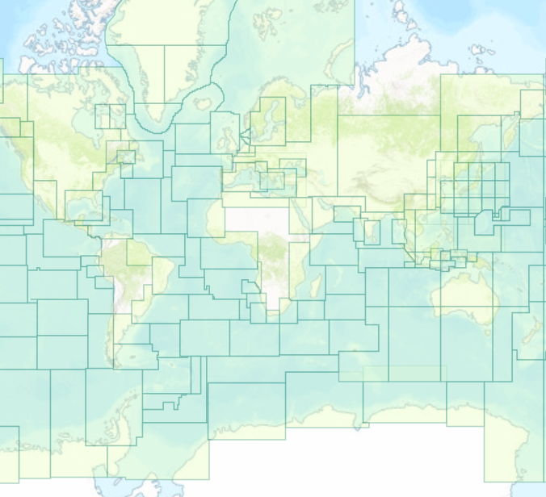
Building the WEND
Each MACHC ENC…
…is just one small (but crucial!) piece…

Slide 14
Summary
The MACHC region ENCs continue to grow
An excellent WG, the MICC
IC-ENC regional support – in time zone, in English, Spanish and Portuguese
Any ‘new’ Producers, please remember the WEND:
ENC Quality
ENC Consistency
ENC Availability

Slide 15
Introduction to IC-ENC
15

