Slide 1

Marine Cadastre as an
Application of MSDI
Derrick R. Peyton
David Dodd
John Conyon

Slide 2

MSDI/MC Discussion
Marine Spatial Data Infrastructure
What an MSDI could (should?) be
What an MSDI would likely be – in more practical terms
Marine Cadastre

Slide 3

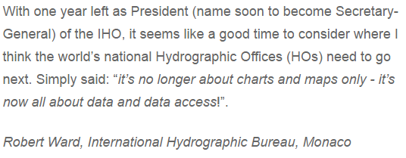
Hydro International, Sept 27, 2016
“its no longer about charts and maps only – it’s now all about data and data access”

Slide 4
What is an MSDI
Spatial data management system provides
  Interdepartmental access to information
  Global access to information
  Easy access to information for other uses
    Analysis
    Products
    etc.
Enabler of Blue Economy
NOT a data storage system
NOT a product storage system

Slide 5
Realization of an MSDI Four Pillars
Data and Metadata
  The data exists
Information System and Technology
  Technology exists (e.g. SLGO)
Standards (ISO, HNAP, S100)
  Some in place, some coming – slow but sure
Policy and Governance
  Getting all parties to the table – and to agree…
Notes:
SLGO - Sindh Local Government Ordinance

Slide 6
MSDI Management
Official Authority maintains management responsibility of their own databases and metadata
  Conforming to MSDI standards
MSDI Overseer
  Hydrographic Office
MSDI Management Group
  HO lead
  Multi-departmental group
MSDI management entity maintains links and monitors database updates by monitoring metadata

Slide 7
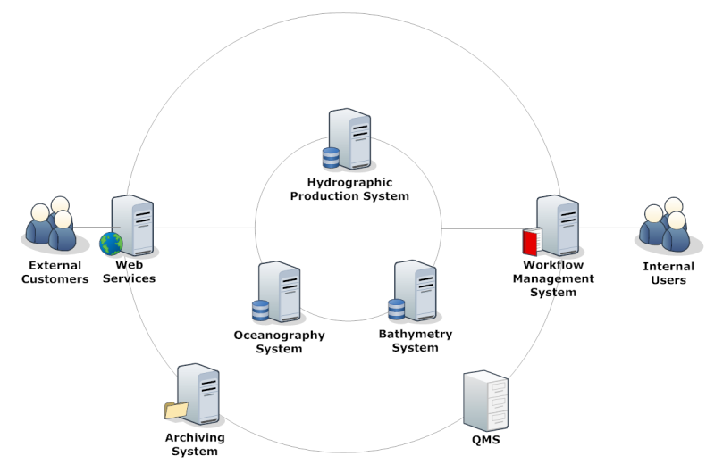
Hydrographic Data Management (HDM)

Slide 8
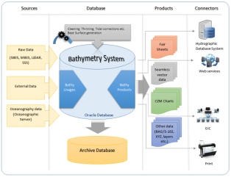
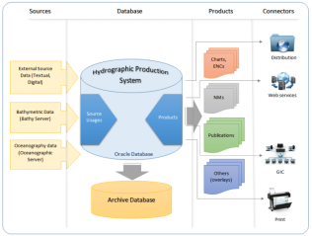
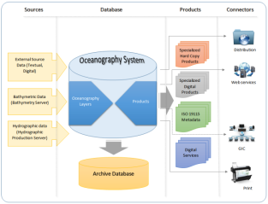
Hydrographic Data Management (HDM)
Geoportal
(supporting MSDI)
QA /QC & Workflow Management Software
Bathymetric Database
S102
Hydrographic Database
S101
Oceanographic Database
S1??

Slide 9
Coastline example
Many groups require coastline information
  Oceanographers, environment managers, mappers, HOs, land cadastre, marine cadastre, etc.
Users should collaborate to create authoritative coastline
  High water, low water (CD), MSL, etc.
Official authority(ies) responsible for maintaining the coastline features, with input from users
  Updates/changes
MSDI management team (i.e. HO) responsible for
  Ensuring information correctly coded with proper metadata
  Maintaining the link to the data and metadata
Updates must be reflected in the metadata
  Monitored by the MSDI management system

Slide 10
Maritime Boundary Component of MC
High Water Boundary
  End of private ownership
  Start of governing body stewardship
  In Canada: Federal, Provincial, Aboriginal, etc.
Low Water Boundary
  Used to derive baseline for UNCLOS
Territorial Sea
  Country has sovereignty
  Other countries have right of innocent passage
Exclusive Economic Zone
  Country has sovereign right to manage renewable resources
  Country has sovereign right to manage non-renewable resources
Notes:
High Water Boundary
End of private ownership
Start of governing body stewardship – In Canada Federal, Provincial, Aboriginal, etc.
Low Water Boundary
Used to derive baseline for UNCLOS - United Nations Convention on the Law of the Sea
Territorial Sea
Country has sovereignty
Other countries have right of innocent passage
Exclusive Economic Zone
Country has sovereign right to manage renewable resources – fisheries
Country has sovereign right to manage non-renewable - Oil and Gas

Slide 11
Ideal MSDI ???
MSDI Management System
Products and Metadata DB
Data and Metadata DB
eNav
Web Interface
MSDI Tracking
Chart Source
Substrate
Bathy DB
Charts
DB/Product Update Notification
Imagery DB
CZM
Power Users
Models
Boundaries
Data Entry
MC and RRR Registration
Information Validation
Coastline
Casual Users
Query
Ocean DB
User Built
Product Development
Downloads
…
…
Notes:
MSDI Management
Establish and maintain links to databases
Manage levels of access, from casual user to database manager
Monitor metadata for changes
Facilitate connection between Web interface and databases.
Facilitate presentation of database information in Web interface through interpretation of the metadata
Track Data and metadata changes
Track user usage
Provide link to applications for (power users):
DB entry and validation
Product creation (e.g. ENC, RNC, CZM, …)
Facilitate datum and format conversions, as per user needs
Databases:
Data and metadata remain with official authority. Updates performed by that authority through the MSDI or in-house processes
Product databases and metadata maintained by official authority through the MSDI or in-house processes
Value added products from users should be managed by the MSDI management system as a service. Provide a location for new layers derived from analysis of existing data and products (crowd sourcing). For example, fisheries researchers may create new habitat layers for specific species based on bathymetry, substrate, current etc.
Data in database does not have to be s-100, but the data format and metadata must have enough information for the MSDI to be able to create S-100 objects for data transfer
Web Interface
Require registration, including contact info, for update notification
Create user profile containing level of access and information of interest
Provide map interface for database searches, based on metadata
Do not present actual data in interface, only a representation derived from the metadata and web-friendly rendition of actual data
Interface to be clean and simple:
Only provide options available to user
Only show layers of interest to user
Keep mapping graphic uncluttered (i.e. google maps).
Provide information from metadata in clear and understandable form
Provide interface for format and datum conversions
Users:
Power users
Casual users (grade 5 geography or science class)
Tracking:
Track all actions within the MSDI
Tracks all changes made to data, metadata and products
Provides casual user with history of their queries and downloads
Provides MSDI Management system with information on what data/products are used by the clients. These clients can then be notified of any updates or change

Slide 12
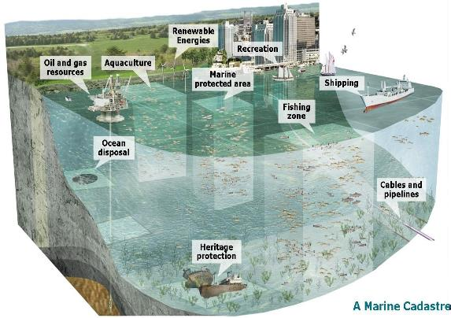
What is a Marine Cadastre (MC)?
A system of registries that allows for the systematic recording of all recognized legal rights, restrictions and responsibilities (RRR) in the offshore area
  Answers questions
Who holds the rights, responsibilities and restrictions?
What is the nature of these interests?
Where are the interests located?
M’Bala 2016

Slide 13

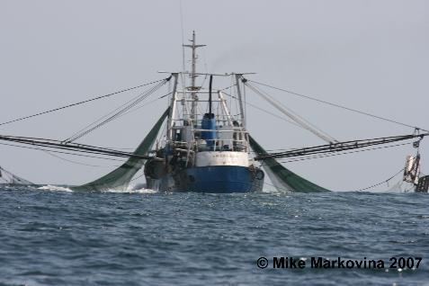
MC Administration
RRR administered by proper authority
  Through legislation
Oil and Gas
  Location and duration of exploration or production
Fisheries
  Location, Depth, Season, Duration, Fishing License
Notes:
RRR – Rights, Restrictions and Responsibilities

Slide 14
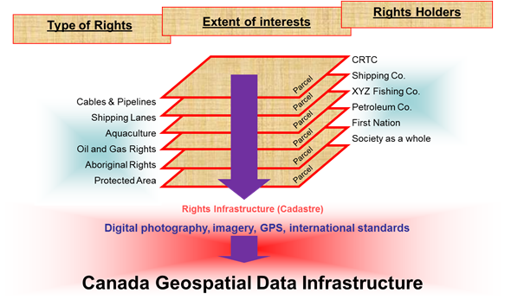
Information Integration
M’Bala 2016

Slide 15
MSDI Management System Components - MC
Web Interface
MSDI Management System
Metadata
Data Bases
Format and Datum Transformation
DB Management
Chart Production
Marine Cadastre
eNav Portal
MSDI Tracking
Notes:
Marine Cadastre
Core component of MSDI
Maritime boundaries, navigation routes and restrictions, renewable energy, offshore resources, sensitive habitats, MPAs, pipelines and cables, heritage, aquaculture, military, coastal infrastructure
Authority for different aspects of MC reside with different government entities
3D + time (e.g. fisheries regulations based on location, season and location in the water column
Rights, Responsibilities and Restrictions (RRR) – how to encode, how to register
There will be overlapping RRR

Slide 16
Marine Cadastre Schematic
Web Interface
MDSI Management System
MC Data Base
Coastlines
Fisheries
Shipping Routes
MC
MSDI Tracking
Boundaries
MPAs
Heritage
Registration of
Rights,
Restrictions,
Responsibilities
3D + Time
Recognised Authority Granting RRR
Oil & Gas Infrastructure
DB/MC update Notification
Military
Notes:
Marine Cadastre component of MSDI
Registration of RRR to marine “parcel” by proper authority.
Same authority manages metadata
MC component of MSDI provides
description of RRR through metadata
spatial and temporal extents
links to RRR and authority (legislation) under which RRR are granted

Slide 17
Questions
Should the HO be the MSDI manager?
Should all MSDI data be S-100 compliant?
Should the MC component of the MSDI be the official MC registry?
Should web viewer render source data for display only (generalize, reformat and re-project), or access a pre-transformed representation?
Who should MSDI serve?
  Professional (power) users only (interdepartmental information exchange)?
  Everyone?
Should MSDI manage products or only data?
Should MSDI provide datum and format translations? (i.e. to s-100 series for eNav etc.)

Slide 18
Take Home Message
Access to information should be easy
Key to effective MSDI is the Metadata
Metadata MUST be
  Standardized (ISO 19115, HNAP)
  Comprehensive
  Up-to-date
  Monitored by the MSDI and any changes reported to users
Metadata standards must be strictly adhered to
Information entered into the Metadata records must be reasonable
  “Unknown” should be used only if the information is truly unknown

Slide 19
Future Thinking
Ontology in Ancient Greece
  Metaphysics of Nature, Reality and the Existence of Beings
Ontology Today
  To share common understanding of the structure of information among people
  To enable reuse of domain knowledge
  To separate domain knowledge from the operational knowledge
Enable Eternal Return

Slide 20
Thank You

