Slide 1
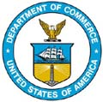
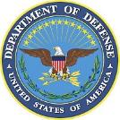
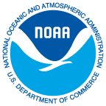
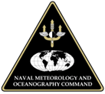
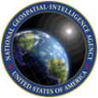
United States of America
Meso-American and Caribbean Sea Hydrographic Commission (MACHC)
National Oceanic and Atmospheric Administration
Naval Meteorology and Oceanography Command
National Geospatial-Intelligence Agency
Katie Ries, Deputy Director, NOAA’s Office of Coast Survey
December 2016

Slide 2
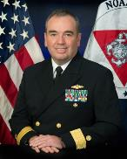
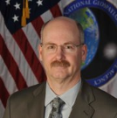
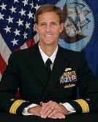
U.S. Hydrographic Leadership
NOAA
Director of the Office of Coast Survey and U.S. National Hydrographer
Rear Admiral Shep Smith
Office of Coast Survey, chief of the Marine Chart Division
John Nyberg
NGA
Chief Hydrographer
John Lowell
Director Maritime Safety Office
Captain Brian Conon
Navy
Commander Naval Meteorological and Oceanography Command (CNMOC) and Hydrographer of the Navy and Navigator of the Navy
Rear Admiral Timothy Gallaudet
Deputy Hydrographer of the Navy
Stanley Harvey

Slide 3
Capacity Building Activities
International Chart Adequacy Workshop
July 2016 in Silver Spring, MD (12 Nations)
2017 planned and is full.
For interest in 2018 course, contact: Dr. Shachak Pe’eri at shachack.peeri@noaa.gov
Satellite derived bathymetry
Dec 2016 in Belém (prior to MACHC)
The International Hydrographic Science Applications Program (CAT A) at the University of Southern Mississippi
Course Identifier: MASL# PP-169265 – Contact US Naval Attaché at US Embassy
The International Hydrographic Management and Engineering Program (CAT B)
Course Identifier: MASL# PP-169265 - Contact US Naval Attaché at
US Embassy
Notes:
Chart Adequacy Workshop:
In the first Chart Adequacy training (2015), U.S. hosted representatives from 10 nations: Indonesia, Israel, Japan, Kenya, Malaysia, Philippines, South Korea, Sri Lanka, United Kingdom, and Venezuela
In the second Chart Adequacy training (2016), U.S. hosted representatives from 13 nations: Thailand, Barbados, Brazil, Canada, Japan, Malaysia, Mexico, Netherlands, Pakistan, Peru, Russia, Thailand, Vietnam.
In the third Chart Adequacy training (2017), U.S. Expects to host at least 13 representatives: From GEBCO: Egypt, Madagascar, Russia, Thailand, Mauritius, and Japan
Invites: Taiwan, Cuba, Argentina and Panama.
The 2017 course is already full, but contact Dr. Peerii for interest in the 2018 course.
CAT A and CAT B (Navy) Training: They are open to both civilian and military as long as they belong to the partner nations hydrographic service or military institutions. Applicants should make the request through the Navy Attache at the U.S. Embassy in their country and reference the course identifier number in the slide. U.S. Navy has some funding to support applicants. Contact Eric Villalobos for further information and assistance: eric.villalobos@navy.mil

Slide 4
Capacity Building Activities
CAT A certified hydrographic programs
University of Southern Mississippi
University of New Hampshire
MSI training (16-18 August, 2016) Rodney Bay, St. Lucia
20 Students from 16 countries
MSI Coordinator – Peter Doherty at: Peter.M.Doherty@nga.mil
MSI training planned for 2017 at a location TBD
Enrollment via IHO Capacity Building Sub-committee
Tide and water levels training
Planned for 2018 - Contact Peter Stone at Peter.Stone@noaa.gov
Notes:
Funding opportunities for these and other CAT A and B Programs are available from GEBCO/the Japanese Nippon Foundation and Korea—these opportunities are announced through IHO Circular Letters. For information on the University of New Hampshire Program, contact: Andy. Armstrong@noaa.gov
MSI Training in 2016:
20 students from the following 16 countries
Anguilla, Guatemala, Belize, Haiti, Barbados, Saint Kitts, Panama, Grenada, Suriname, Jamaica, Antigua and Barbuda, Bermuda, Saint Vincent, Dominican Republic, Costa Rica and Saint Lucia

Slide 5
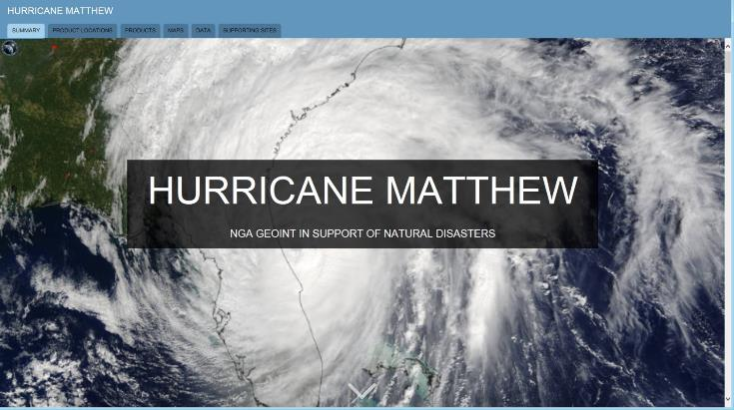
Post-Hurricane Matthew Assistance
NGA Disaster Response Site
Notes:
NGA Disaster Response Site:
This site provides consolidated tools and situational awareness to assist in understanding the extent of damage caused by Hurricane Matthew and essential information to protect and secure lives and infrastructure. This website is open to the public and requires no passwords

Slide 6
Post-Hurricane Matthew Assistance
Navy Fleet Survey Team
Support safety of Navigation
Analyzed Imagery
Contact: Naval Attaché at US Embassy
Provided:
ENCs of Haiti
MSI Support
Notes:
Navy Fleet Survey Team:
As a response to Hurricane Mathew, the U.S. Navy Oceanography Office supports navigation safety with a Fleet Survey Team (FST) which has capacity to conduct a quick survey over critical areas for navigation for beach landings or otherwise with their Rapid Littoral Survey Vessel to investigate hazards to navigation for go/no-go decisions. It can serve as an investigative tool to detect potential hazards to navigation supporting disaster relief efforts for units going ashore.

Slide 7
Charting Activities
ENCs
221 existing ENCs (206 along the U.S. Gulf Coast and Puerto Rico)
9 ENCs in work
2 ENCs cancelled (Panama)
DNCs
Available through bilateral agreement
Paper Charts
5 New Editions in the MACHC Region
1 available
4 available via bilateral agreement
IC-ENC Agreement
Notes:
ENCs:
Panamanian Charts:
US509860 Panama Canal Northern End, Panama and US515390 Panama Canal, Panama were cancelled by the US with the release of the Panama Canal Authority ENCs.
Additionally, US515410 Panama Canal Southern End, Panama was reduced in size to only cover the area outside of the Panama Canal Authority ENC coverage to prevent an overlap.
Paper Charts-5 New Editions:
Costa Rica, French Guiana, Brazil, and Panama; some of the charts are Limited Distribution
IC-ENC:
The International Centre for Electronic Navigational Charts (IC-ENC) agreed to accept NOAA as a member of its organization through the establishment of an IC-ENC regional office, “IC-ENC North America”.

Slide 8
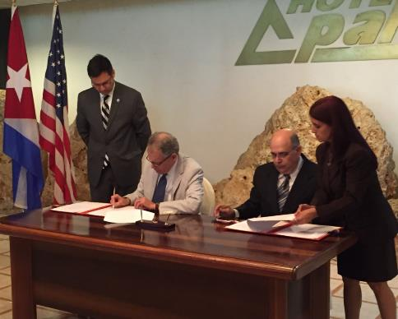
International Charting Activities
Memorandum of Agreement (March 2016)– NOAA and ONHG
4 technical exchanges
Work program 2017
charting
tides & water levels
geodesy
MSI

Slide 9
INT Chart Activities
New INT Chart 4149
U.S. produced; data from Cuba and UKHO
Straits of Florida, eastern part (covering Bahamas/Cuba/U.S.)
Scale: 1:500,000

Slide 10
Crowd-Sourced Bathymetry
NCEI & IHO Digital Center for Digital Bathymetry
IHO initiated/NOAA supported
Two databases
IHO Crowdsourced Bathymetry database
NCEI Bathymetry database
Focusing on data pipeline and public access
Partnerships
Association of Arctic Expedition Cruise Operators, Rose Point, SealID, TeamSurv, Olex…
CSBWG & Guidance Document
New Chair: Jennifer.Jencks@noaa.gov
February 13-14, 2017 (New Hampshire USA)

Slide 11
Other Strategic Activities
UN-GGIM
Establish of the United Nations Expert Group on Marine Geospatial Data (UN-EG-MGD).
OGC Maritime Domain Working Group
U.S. Hydro Conference – March 20-23, 2017, Galveston, TX
International Cartographic Association – July 2-7, 2017, Washington, DC
GEBCO Seabed 2030 Project

Slide 12
Publications
United States Coast Pilot
Sailing Directions
Enroute
Planning Guides
Notice to Mariners
List of Lights
World Port Index

Slide 13
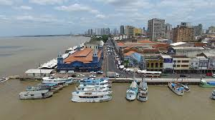
Thank you

