Slide 1
UK National Report
17th Meso American and Caribbean Sea
Hydrographic Commission
Belém, Brazil, 14 – 17 December 2016

Slide 2
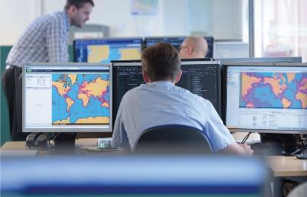
UKHO Activity 2015-16
Chart Production
ENC Production
Publications and Products
Primary Charting
Survey Activity
British Overseas Territories

Slide 3
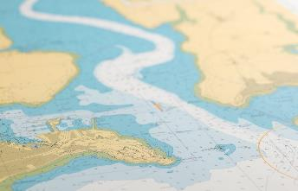
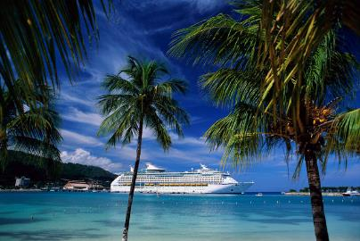
Paper Chart Production
2015-16 Working with our partners:
44 New Editions and New Charts

Slide 4
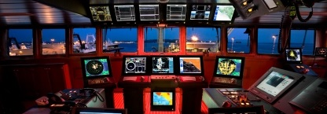
ENC Production
UKHO has published 188 ENC cells in the MACHC region.
Overview: 8
General: 21
Coastal: 36
Approach: 45
Harbour: 73
Berthing: 5

Slide 5
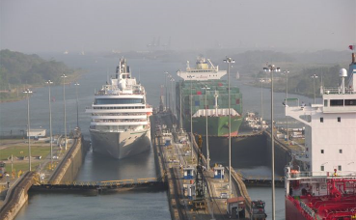
Publications and Products
10 Port Approach Guides published 2015/16
Port Approach Guides - contains information from:
Standard navigation charts
Sailing Directions
Tidal Publications
Radio Signals
Lights
Digital products, to support mandation;
Admiralty Digital Publications (ADLL, ADRS, ATT),
E – Nautical Publications

Slide 6
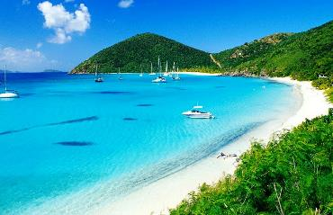
Support to Coastal States
UKHO acts as the Primary Charting Authority (PCA) for 17 coastal states/territories in the MACHC region.
As PCA, UKHO provides assistance to states to deliver SOLAS Chapter V, Regulation 9 which ensures that:
‘hydrographic and nautical information is made available on a worldwide scale as timely, reliably and unambiguously as possible.’

Slide 7
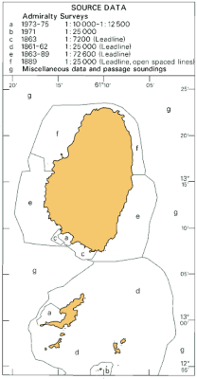
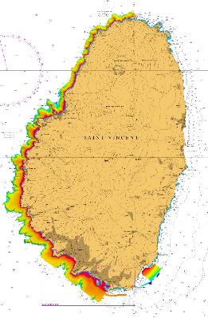
Survey Activity
Commonwealth Marine Economies Programme
£5.6 million invested
Supporting SIDS to make best use of their maritime resources
St Vincent and the Grenadines 58km² survey, Grenada 29km²
Largest airborne LIDAR survey in the Caribbean

Slide 8
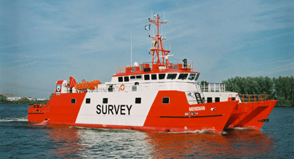
British Overseas Territories
Overseas Territories Seabed Mapping Programme
Increased investment in the Overseas Territories:
Anguilla
British Virgin Islands
Cayman Islands
Montserrat
Turks and Caicos Islands
Technical assessments, data gathering & capacity building

Slide 9
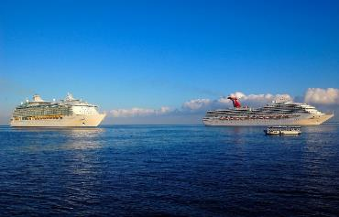
Looking Ahead
UKHO activity 2016/17 and beyond:
Approximately 40 New Editions or New Charts
Increased engagement in MACHC region
Surveys
Technical Assessments

Slide 10
Thank You

