Slide 1
Current Situation of the Hidrographyc Matters, Nautical Charts Updates and ENC
Eng. Adalberto Alguero December 2016
Surveyor Category¨B¨

Slide 2
Memberships and Not Memberships
Panama Situation
IALA
IC ENC
No Member of IHO

Slide 3
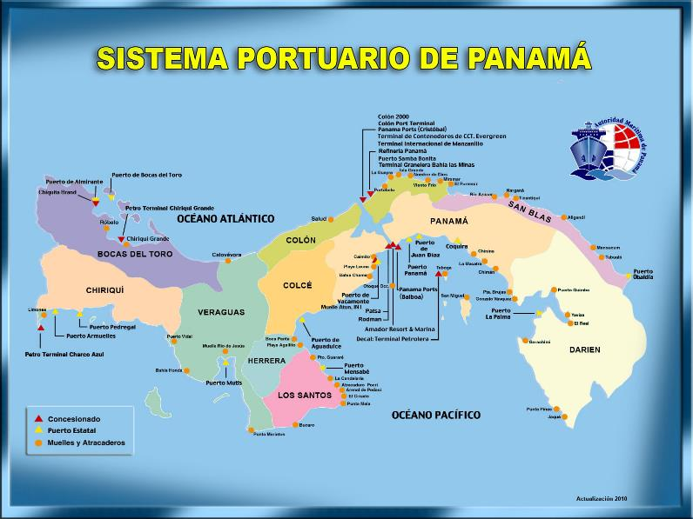

Slide 4
PUERTOS CONCESIONADOS
Panama Ports Company Balboa
PSA Panama International Terminal
Decal Panama – Taboguilla
Fuerte Amador Resort and Marina
Petro Terminal de Panama – Charco Azul
Petro America S.A.
Muelle Internacional Atun
Melones Oil Terminal
Petro Terminal de Panama – Chiriqui Grande
Terminal Granelera Bahía Las Minas
Boca Fruit Company - Almirante
Refinería Panamá - Chevron
Panama Ports Company Cristobal
Manzanillo International Terminal
Colon Container Terminal
Colon Port Terminal
Colon 2000
Coral Minera
Muelle 3 Colón
PUERTOS Y MUELLES ESTATALES
Puerto Armuelles
Vacamonte
Aguadulce
Pedregal
Puerto Panamá
Boca de Parita
Mensabe
Mutis
Vidal
Búcaro
Pedasí
Isla Colon
Chiriquí Grande
Almirante
El Porvenir
Puerto Obaldía
Atlántico Pacifico

Slide 5
OUR WORK - TIMELINE SINCE 2009
2009 – Start to looking for information to send WWNWS
Start sending information for NTM and Nautical Charts Updates
2010 – Designing new Anual Budgets for equipment, Softwares, etc.
Start to analyze the UKHO Agreement
2011 - Start Getting information and data from private hydrographic companies
(outsourcing Services)
Aids to Navigation transfered to DOP
2012 – Membership in IALA (2 Meetings, 1 Training)
2013 - Surveys of Navoceano
2014 – Negotiation of the UKHO Agreement / New Aids to Navigation of Colon
Scheme of the ENC Nautical Charts Code for ACP
2015 – Signing of UKHO Agreement ---Royalties—Training
TSS
CHOPAN Restart Regular Meetings Presided by AMP
IHO Meetings
2016 – Reception of budget from IC-ENC
Request of new survey equipment with UKHO agreements.

Slide 6
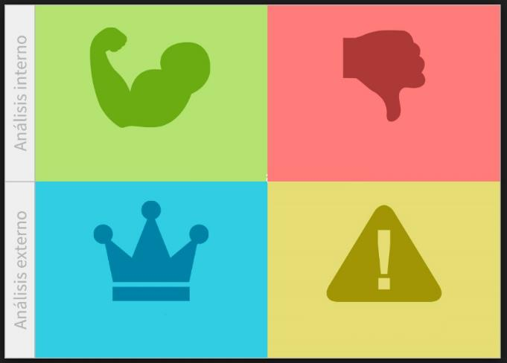
Strength
Panama Canal Experience
Private Ports
Weakness
Budget
Training
Human Resource
Opportunities
Keep Panama as a Leader in the Maritime Sector
Better Products More users
Incomes and Business Opportunities
Threats
Accidents
No Time
Comfort area

Slide 7
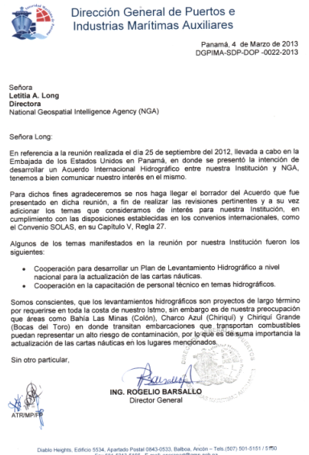
First approaches with NGA for agreement

Slide 8
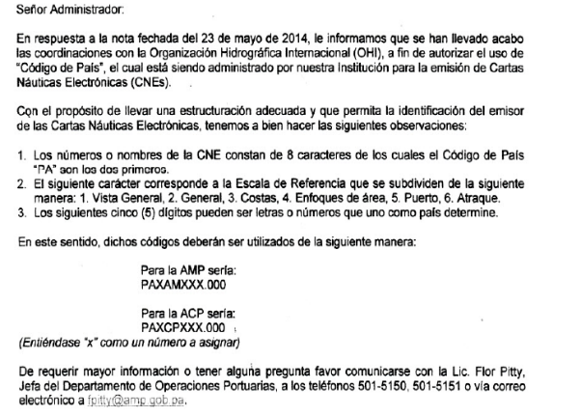
Sharing the country code for ENC´s

Slide 9
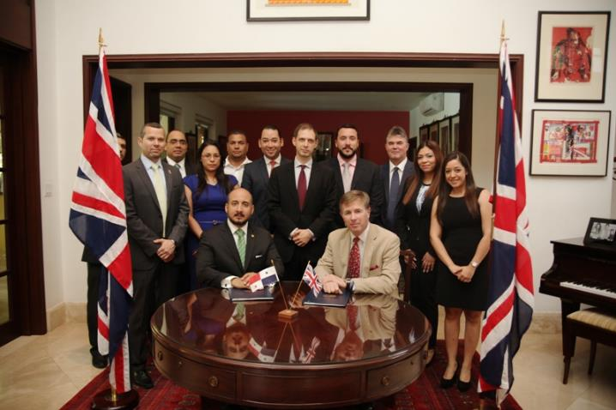
Agreement with UKHO

Slide 10
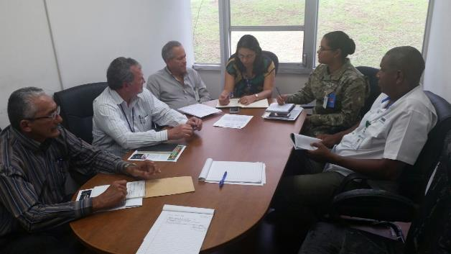
CHOPAN – Comisión Hidrográfica y Oceanográfica de Panamá
ReStart Regular Meetings - March 2015

Slide 11
Department of Hydrography and Nautical Cartography
Submit for aprovation of MEF the establishment of the Department
Look for adquisition of survey Equipment
Look for training and certifications

Slide 12
List of equipment request
Equipment | Unidad | Cantidad
Ecosonda de doble frecuencia | unidad | 1
Equipo de GPS, con corrección de radio integrado | unidad | 1
Compensadores inerciales (MRU) para los sistemas de Multi Beam | unidad | 1
Compensadores inerciales (MRU) para los sistemas de single Beam | unidad | 1
Software para colectar data y procesarla en sistemas de Single Beam utilizamos HYPACK, AutoCAD (Hidrográfico) | unidad | 1
Lanchas para realizar los estudios hidrográficos | unidad | 1
Equipo Multi Beam | unidad | 1
Equipo Single Beam | unidad | 1
Plotter | unidad | 1
Mesa para la lectura de planos | unidad | 1
Compás de punta seca | unidad | 3
Escuadra | unidad | 3
Regla Paralela | unidad | 2

Slide 13
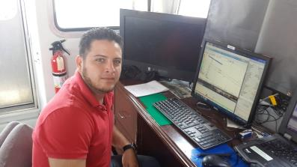
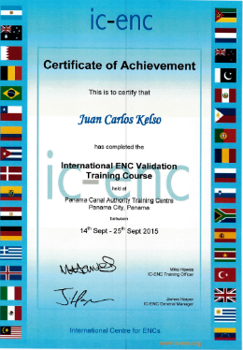
Trainings and Courses.
ADQUISICION Y PROCESAMIENTO DE DATOS BATIMETRICOS MULTIHAZ (CARIS y KONGSBERG)
INTERNATIONAL ENC VALIDATION TRAINING COURSE (IC-ENC)
PROGRAMA DE FAMILIARIZACION HIDROGRAFICA Y CARTOGRAFICA,
Taller Fortalecimiento de Capacidades Hidrográfica en Mesoamérica y Mar Caribe
III Convención Mexicana de Hidrografía y Taller de Batimetría
MSI CourseS

Slide 14
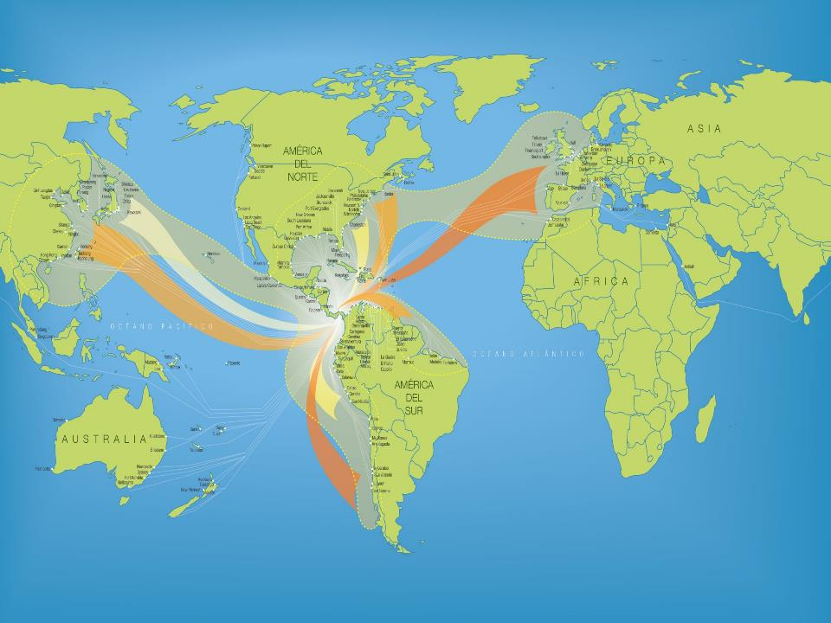
NAVAREA WARNINGS AND
PANAMA NTM

Slide 15
TYPES OF NAVAREAS HAVING
BEEN PUBLISHED BY PANAMA
Temporary inactive Aids to Navegation
Permanent inactive Aids to Navegation
Changes in Access Channels
Bad Weather
Ships Adrift
Shipwrecks
Large Scale Exercises or Drills

Slide 16
TYPES OF NTM PUBLISHED
IN PANAMA
Permanent Corrections in CN
Temporary or Preliminary Corrections in CN
Permanent Changes in Access Channels
New Depths After Dredging Activities
Fixed Sea Installations (In example, Power Generation)

Slide 17
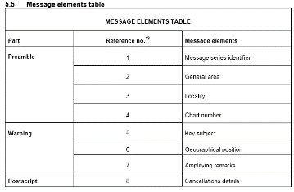
How have we done it, and how do we presently do it?
In 1998, Aids to Navigation were granted by way of a concession to a
Private concern. Therefore, the NTM and Navarea warnings were sent through PECC.
This contract was cancelled in the year 2000, and their issuance were discontinued.
Restructuring of the new Aids to Navigation Section was re-instated in 2008.
They started to issue NTM and to publish Navarea through NGA.
The Maritime Safety Information (MSI) Manual’s Special Edition S-53, began to be
used in 2012.

Slide 18
Thank you !

