Slide 1
Antigua and Barbuda
National Presentation to the Meso - American and Caribbean Hydrographic Commission
Wayne Mykoo - Manager Maritime Affairs and External Relations
The Department of Marine Services and Merchant Shipping (ADOMS)
Notes:
Having submitted the country report in the standard format I will use this opportunity to focus on areas we consider very important to the development of hydrographic resilience.
Just in case you are wondering neither Jeff nor Alberto asked me to do this but I am hoping that when I am finished Antigua and Barbuda will most certainly be remembered…as good example of capacity building in action.
In fact the ideal came to me whilst sitting in on the Hydrographic Awareness Seminar and reflected on the my first participation at the MACHC 10 in Barbados in 2009 having joined in administration earlier that year and given the task to prepare Antigua and Barbuda for the VIMSAS audit in 2012.
…And with IMSAS, which has replaced VIMSAS, being mandatory, my colleagues from the other Caribbean island states will have to utilize the MACHC in meeting their obligations under SOLAS.

Slide 2
Notes:
Slide depicts Antigua and Barbuda’s experience with the MACHC Capacity Building Program…MACHC provides and awareness…you determine the direction you want to proceed in and the MACHC and its members will support your endeavors.
MACHC 10 – Barbados 2009: established our NHO – VIMSAS Audit:
Hydrographic Course hosted in 2011 -… UKHO/MACHC: Surveyed St. John’s Harbour: Spawned the concept of OECS Hydrographic Initiative.
UKHO surveying English and Falmouth Harbour…modern data, re-schemed charts (happy yachting community): have the only chart so far in Caribbean with satellite derived bathymetry.
US Navy Surveying St. John’s Harbour and its approaches.
Mexico through the Association of American States offer some capacity building.
Our CARICOM partner Suriname offer technical capacity which are yet to take advantage of.
Strengthened our relationship with our PCA: “Our marriage is doing well”.

Slide 3
Notes:
We are now at the stage where we feel this comfortable as an associate member of the MACHC.

Slide 4
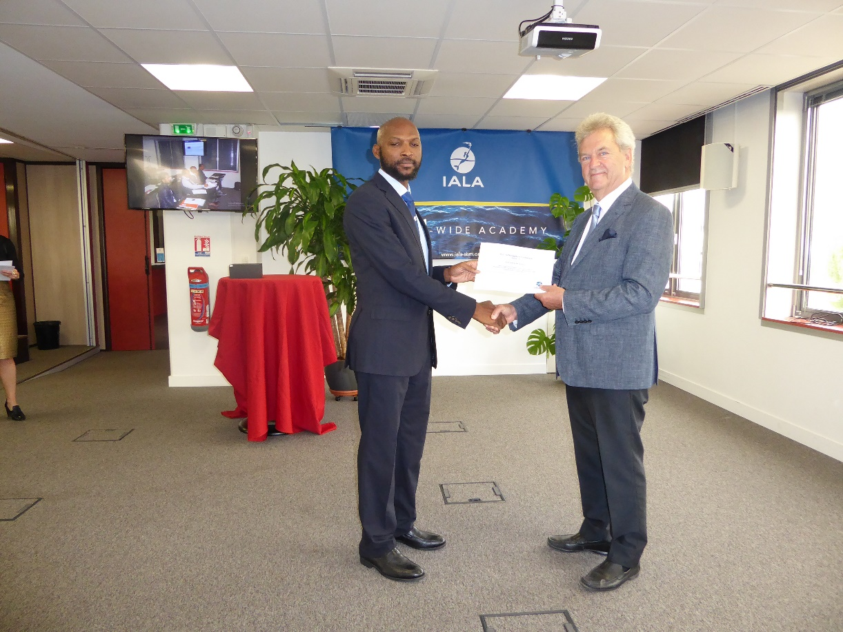
Capacity Building 2016
Antigua and Barbuda participated in:
3rd Mexican Convention on Hydrography and Bathymetry Workshop – Ciudad del Carmen, Campeche, Mexico, 27th – 29th April, 2016.
Level 1 AtoN Manager Course, IALA Academy, Paris, France,
16th May – 10th June 2016.
Notes:
Strengthening Hydrographic Capacities in Mesoamerica and the Caribbean (FOCAHIMECA) Project.
The candidate passed all three examinations and was awarded an international certificate of competency in aids to navigation management – the first person from the Caribbean region to achieve such recognition.

Slide 5
Capacity Building 2016
Antigua and Barbuda participated in:
Introductory Workshop to Bathymetric Data Processing – Veracruz, Mexico, 13th – 15th July, 2016
MACHC MSI Training Course, Rodney Bay, St. Lucia
16th – 18th August, 2016.
Notes:
Strengthening Hydrographic Capacities in Mesoamerica and the Caribbean (FOCAHIMECA) Project.

Slide 6
Capacity Building
Antigua and Barbuda was invited to participate in:
Maritime Spatial Data Infrastructure Workshop, Veracruz, Mexico,
3rd - 7th October, 2016 (Unable to participate…)
Notes:
Strengthening Hydrographic Capacities in Mesoamerica and the Caribbean (FOCAHIMECA) Project
Was unable to participate due to very short notice.

Slide 8
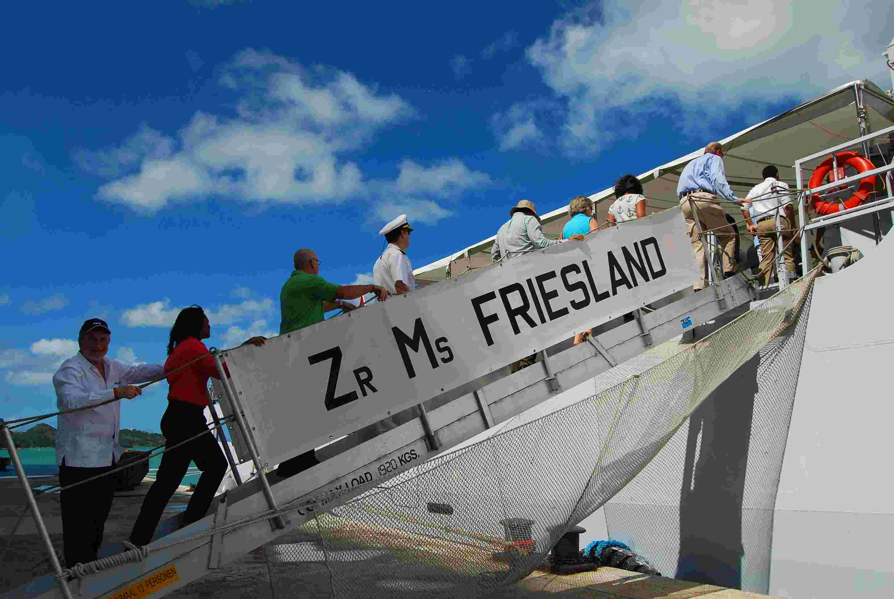
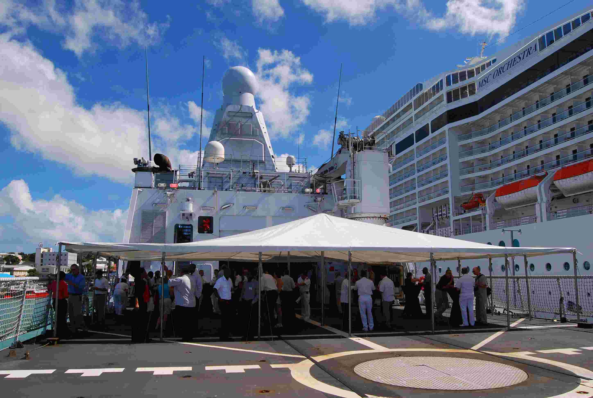

Slide 9
Notes:
1. Construction work to extend the Heritage Quay Pier and install of a number of dolphins began in June 16 with a view of attracting Quantum Class cruise ships to Antigua.

Slide 10
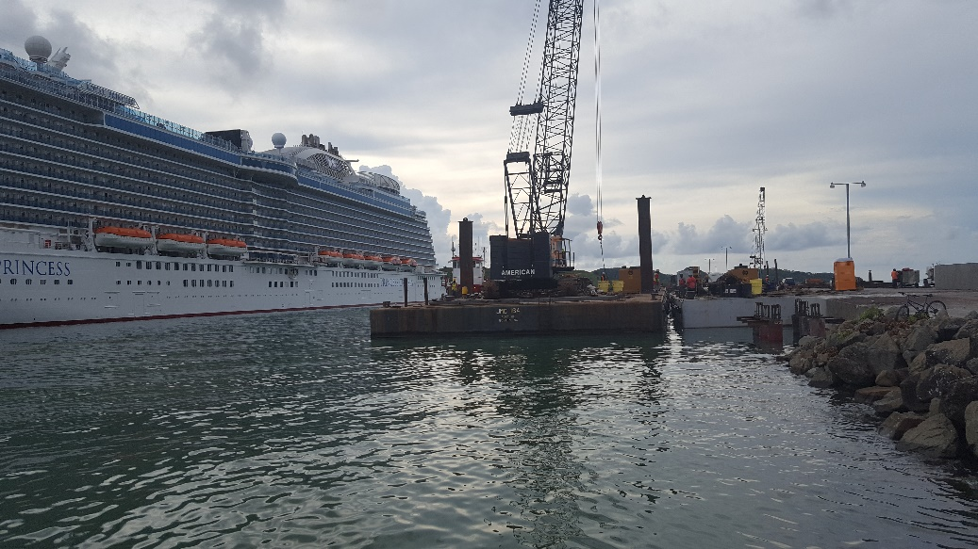
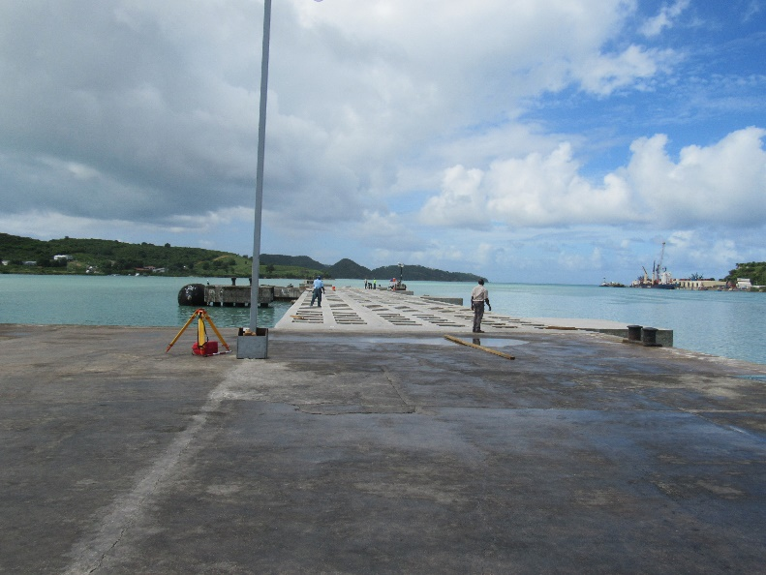
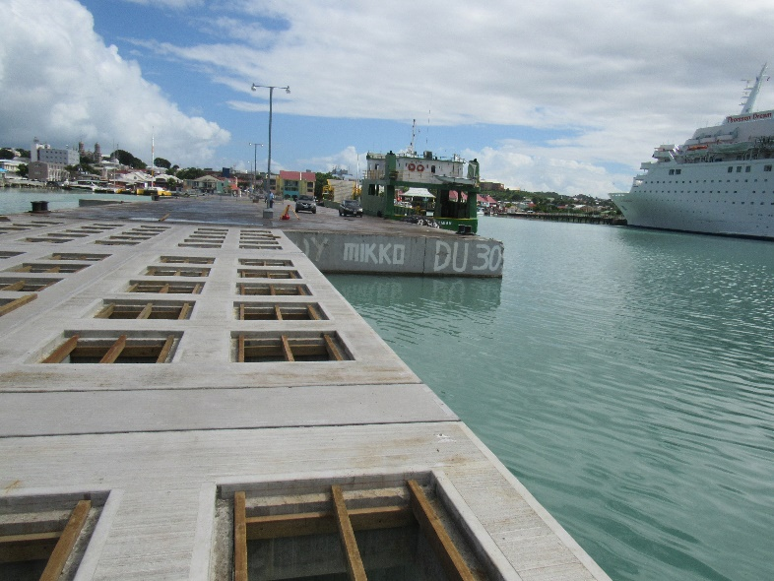
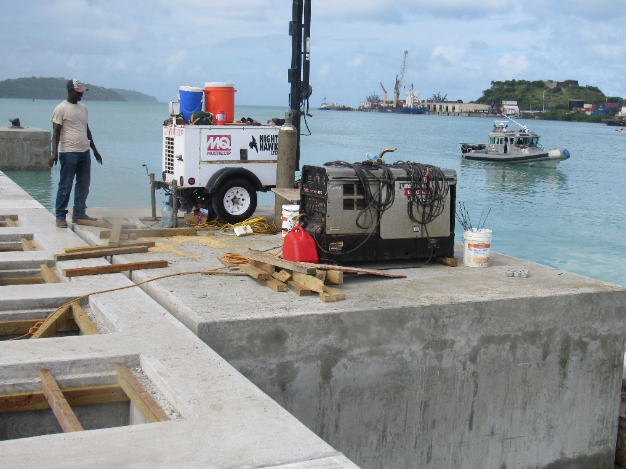
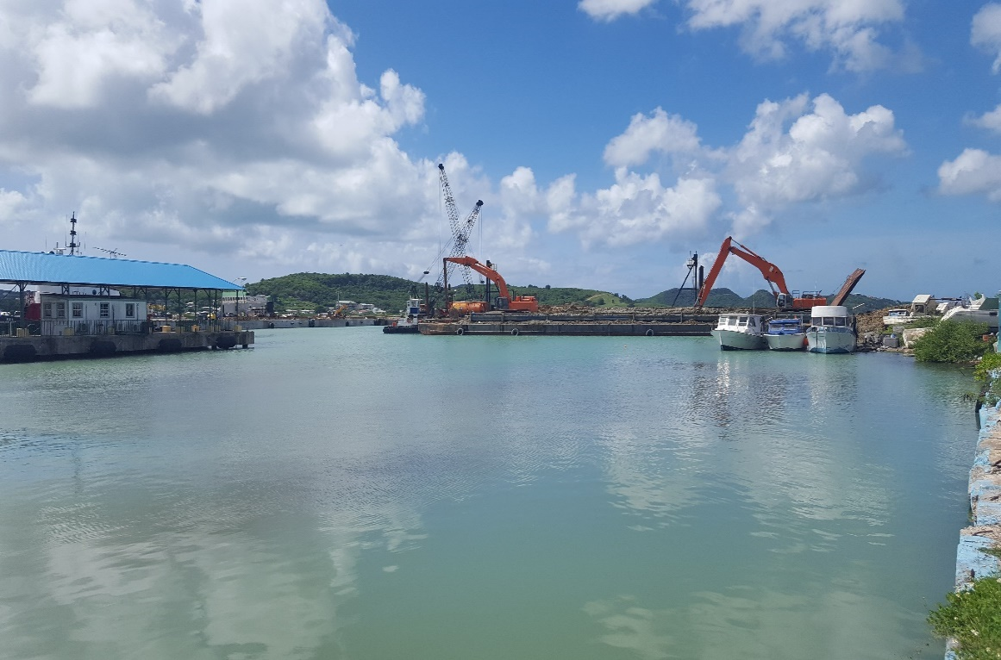
Port Facilities Development
Heritage Quay Pier
Notes:
Speak to slide.

Slide 11
Notes:
1. The result is a pier extension of approximately 400 feet.
2. Work entails the erection of a number of dolphins going seaward after the extension to a distance of approximately 300 feet from the edge of the new section.

Slide 12
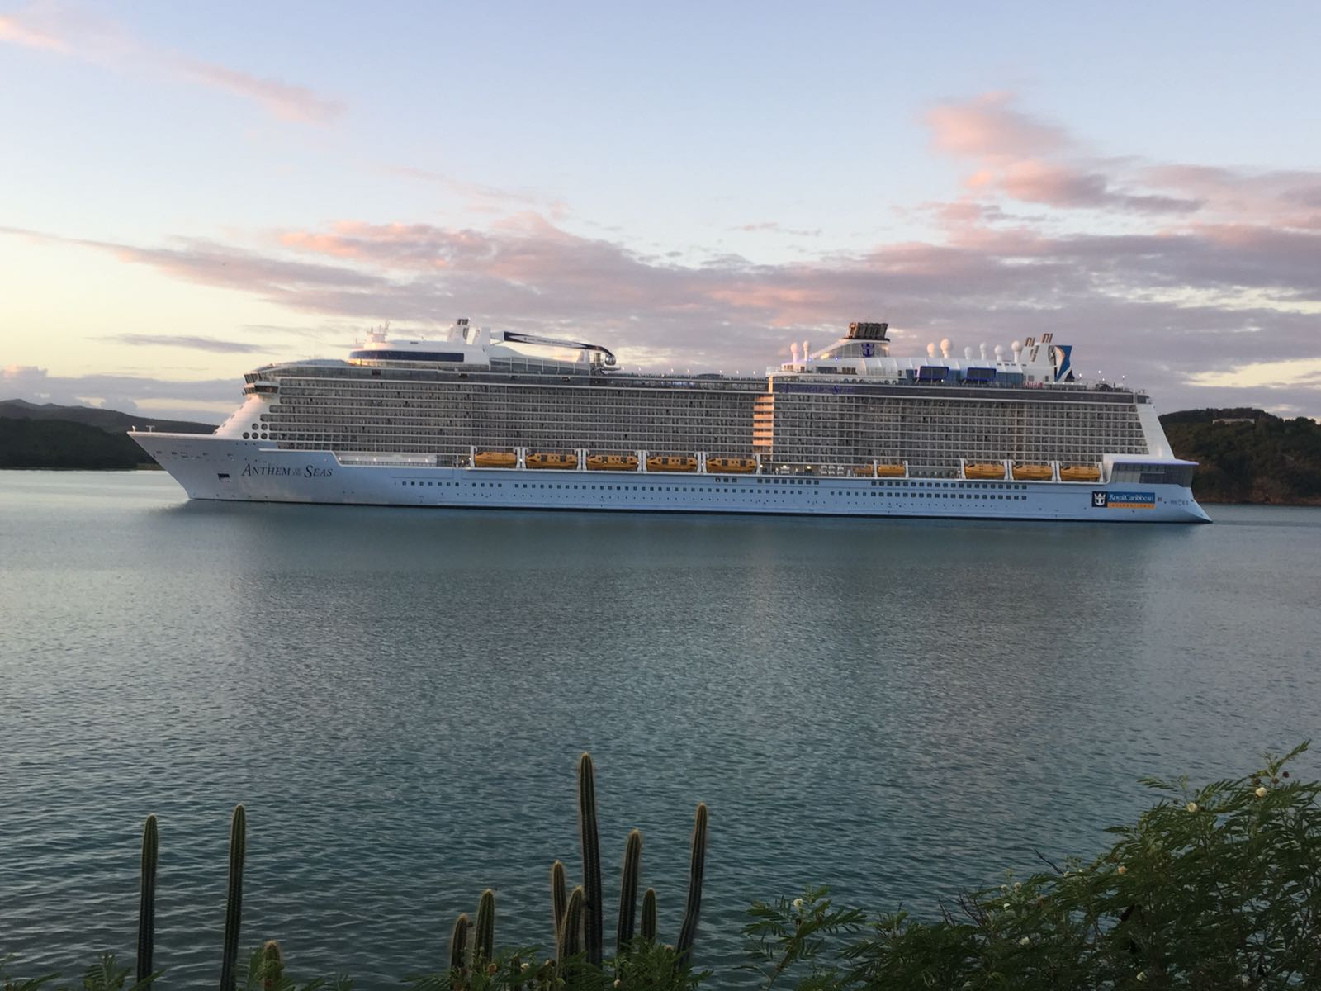
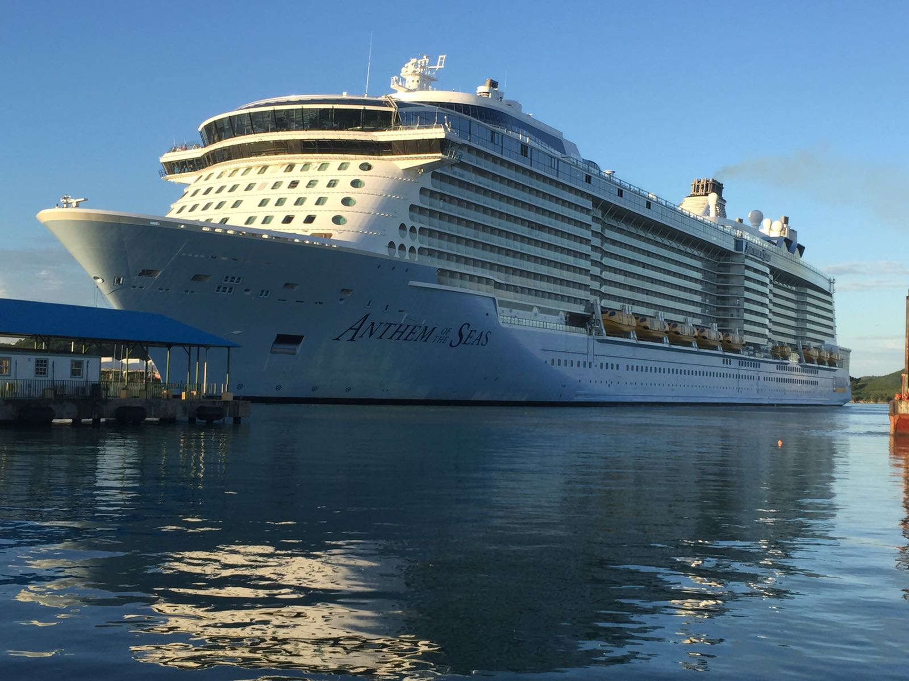
Notes:
The Anthem of the Seas, a Quantum Class, is the first vessel of this size called on the 2 December 2016.
Quantum Class: Tonnage: 167,800; Passengers: 4,180; Decks: 16
Tonnage:168,666 GT Length:348 m (1,142 ft) Beam:49.4 m (162 ft) (max)
41.4 m (136 ft) (waterline) Draught:8.8 m (29 ft) Decks:18 (16 passenger-accessible)
Oasis Class: Tonnage: 225,282: Passengers: 5,400: Decks: 18

Slide 13
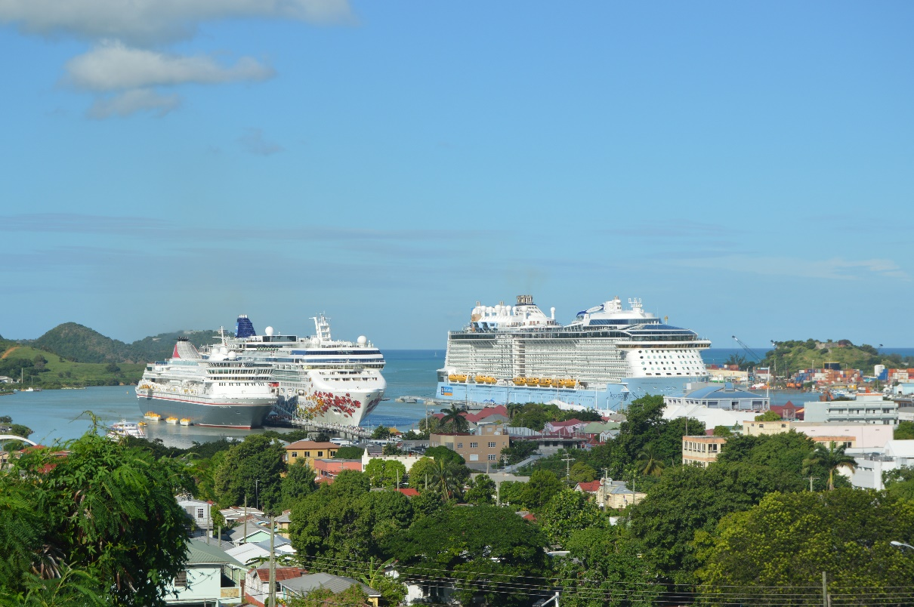
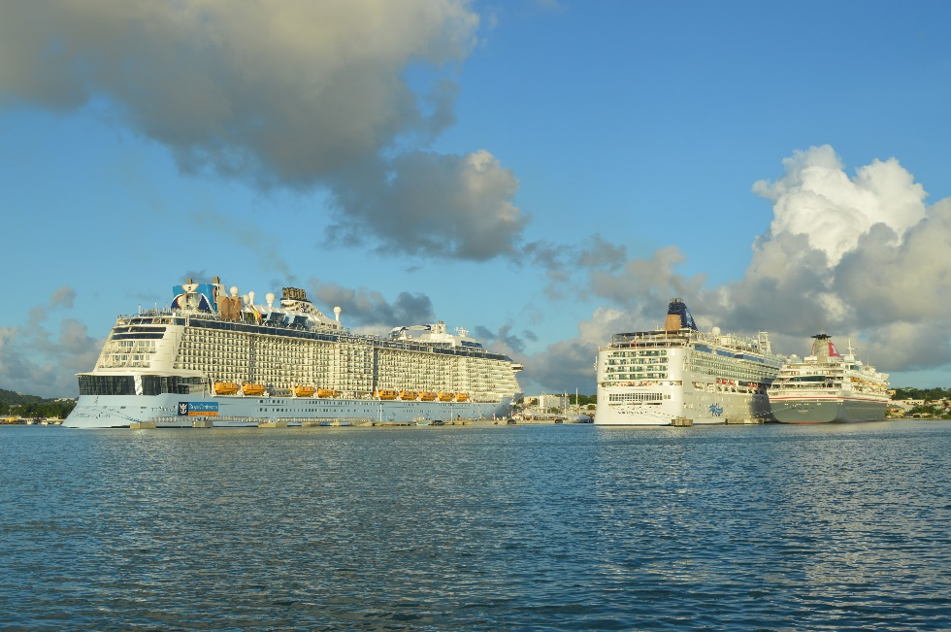
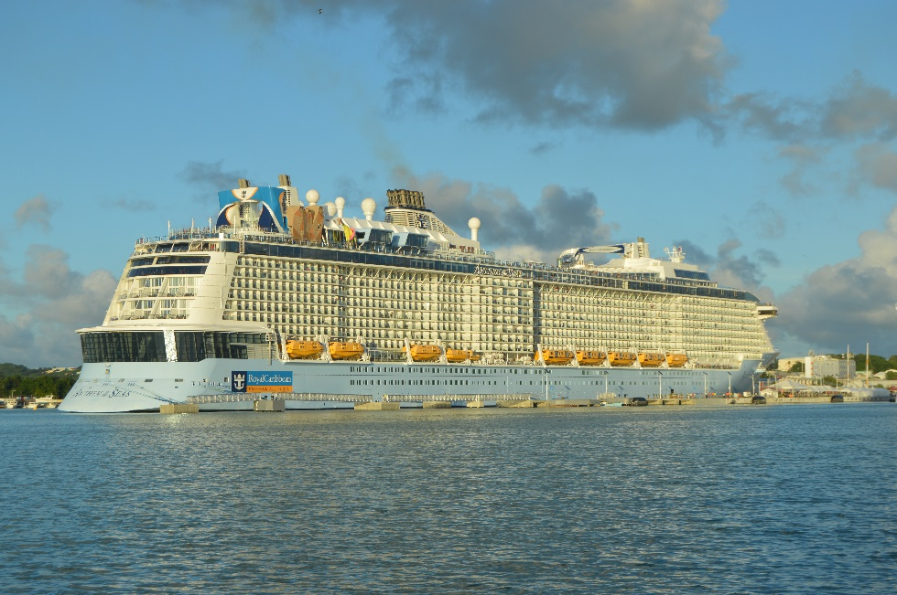
Port Facilities Development
Heritage Quay Pier
Notes:
Show the pier extension!

Slide 14
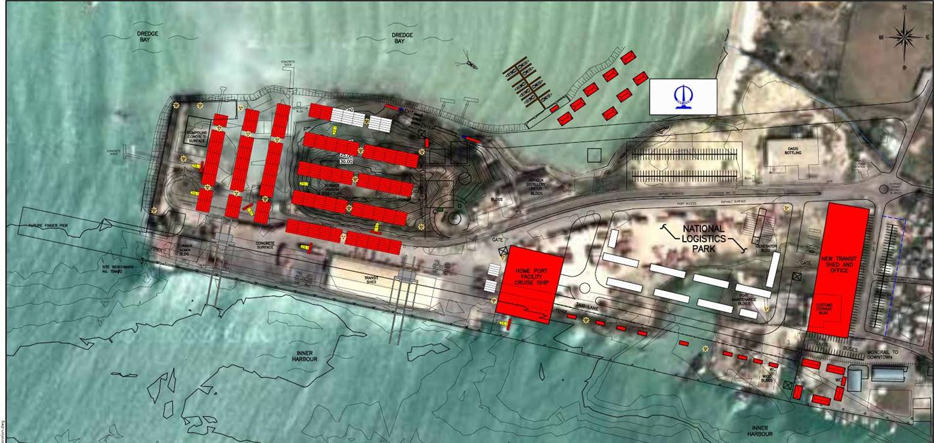
Port Facilities Development
Deepwater Harbour Commercial Port Facilities

Slide 15
Port Facilities Development
Deepwater Harbour Commercial Port Facilities
Notes:
The Port Authority concluded a $100 million US loan agreement in October 2016 for the refurbishment and development of the main port facilities. Work is expected to commence in the second quarter of 2017 at the Deepwater Harbour Commercial Port Facilities.

Slide 16
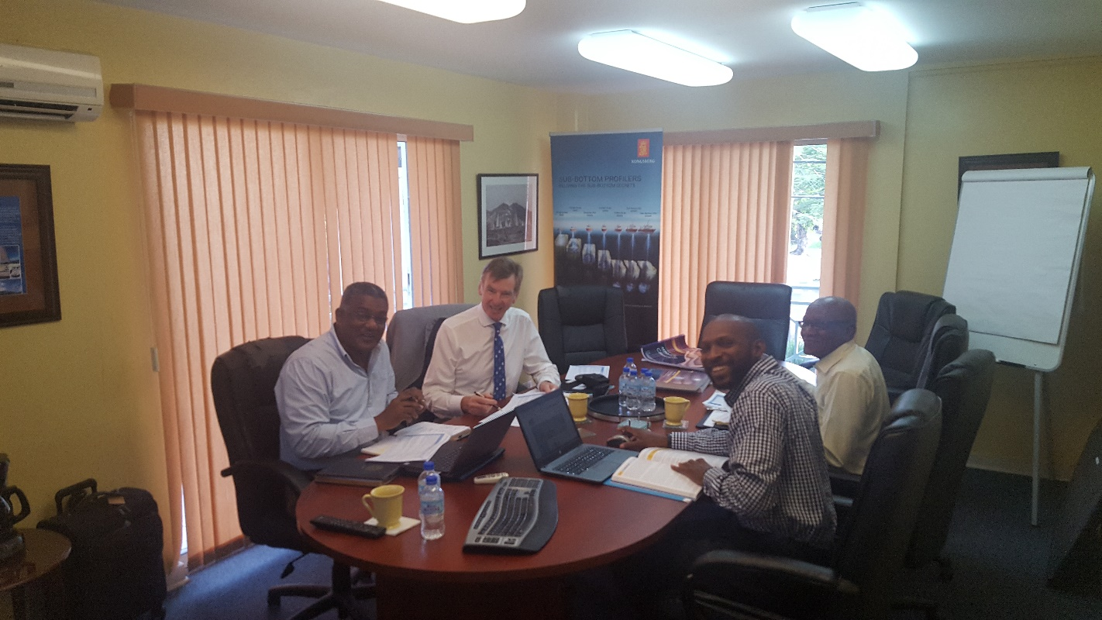
Other Activities
IALA Review - 2016
The IALA World Wide Academy conducted a review of the progress made with respect to the 45 recommendations contained in the report of the technical needs assessment mission completed in December 2015, on the 6th December 2016 in Antigua and Barbuda.
9th December 2016 – Received a letter from the Dean of the IALA World-Wide Academy reporting the decision to remove Antigua and Barbuda from our list of target States
Notes:
Read Slide

Slide 17
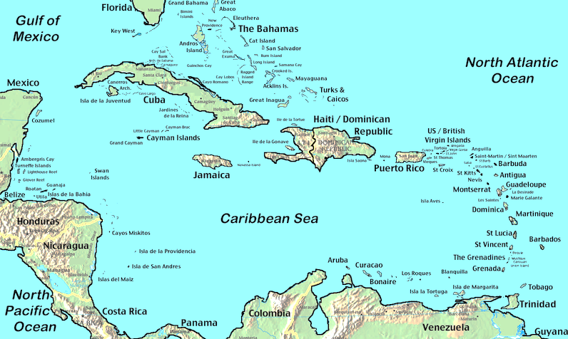
Other Activities
OECS Regional Hydrographic Initiative
Antigua and Barbuda is hopeful that this initiative will gather some momentum in 2017 once the final report is concluded and submitted to the relevant authority to initiate the next phase of this program.
Notes:
Read from slide

Slide 18
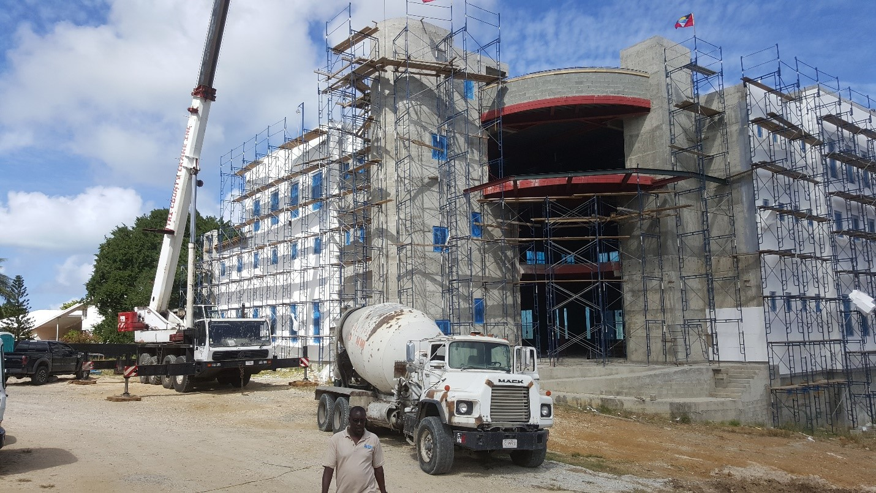
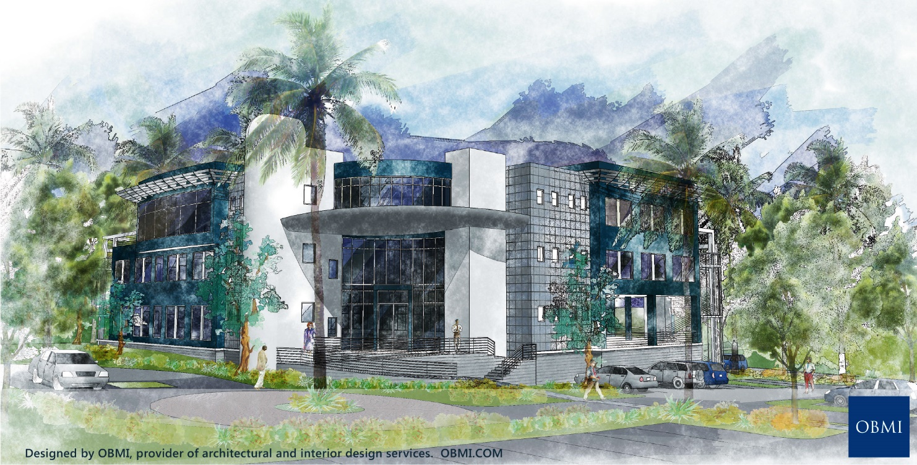
Progress with our HQ Building
Notes:
The Department of Marine Services and Merchant Shipping is committed to establishing a resilient national hydrographic framework to adequately meet Antigua and Barbuda’s international obligations with respect to Hydrography and Aids to Navigation.

Slide 19
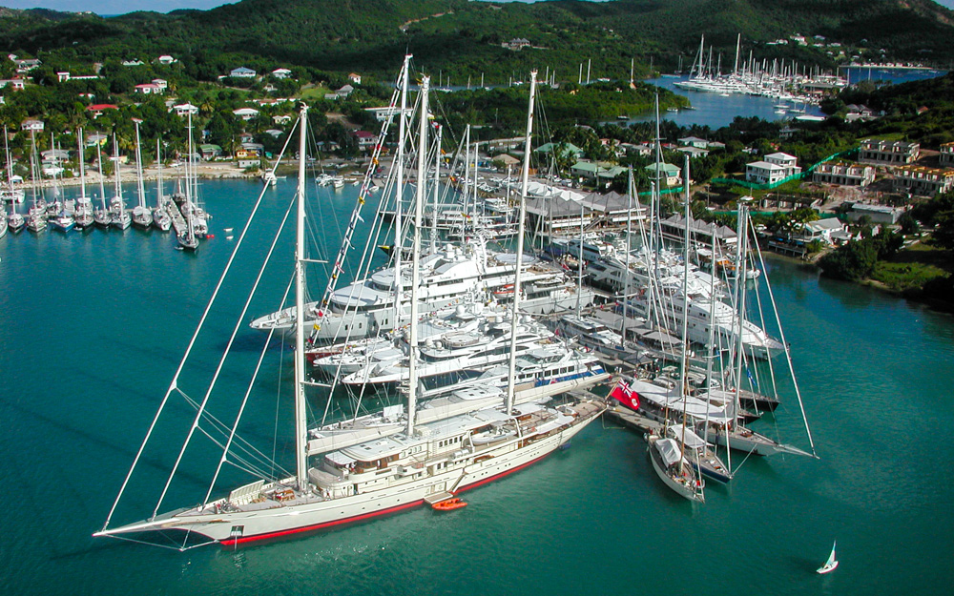
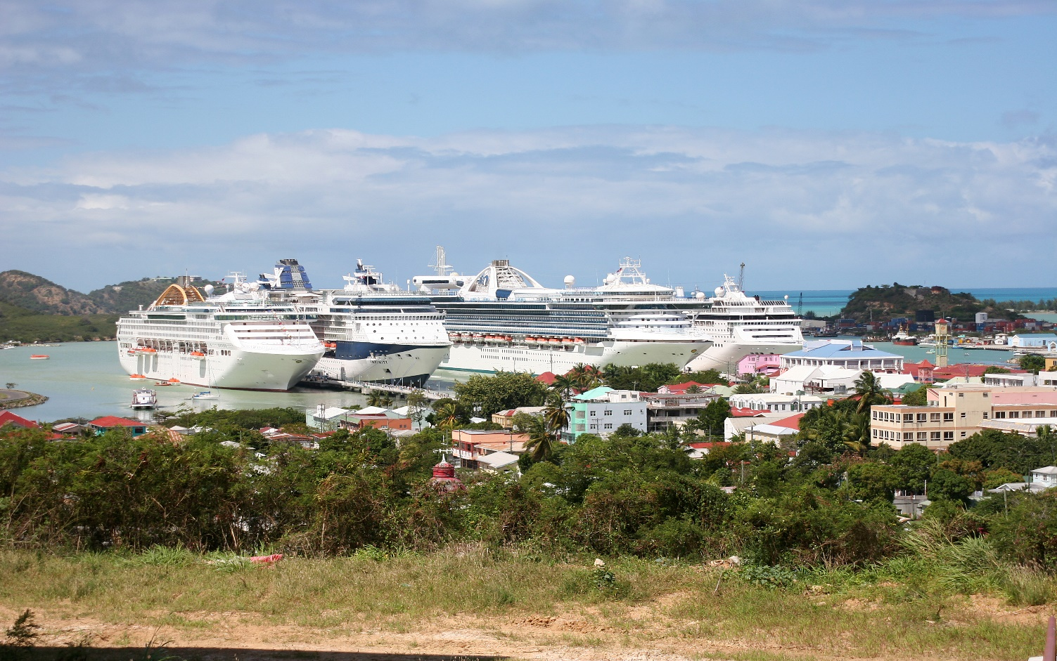
Conclusion
The Antigua and Barbuda appreciates the tremendous support it continues to receive through the MACHC Capacity Building Program and various bilateral-support from its members.
Notes:
Read Slide

Slide 22
Capacity Building Required
1. Hydrography Level 1 and 2
2. MSI
3. Aids to Navigation Maintenance
Notes:
Antigua and Barbuda is still in the process of establishing a robust national framework for applicable hydrographic services and would be most grateful for the following training opportunities.

