Slide 1
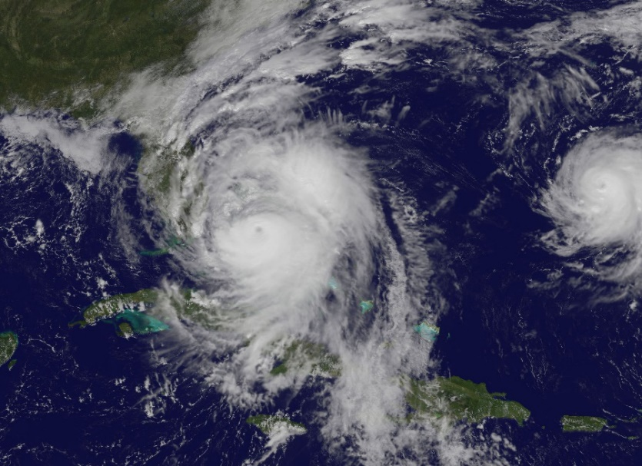
UNCLASSIFIED
NGA Hurricane Matthew Support
Meso American – Caribbean Hydrographic Commission (MACHC)
Jim Rogers
SFHN Technical Executive
NGA Maritime Safety Office
James.E.Rogers@nga.mil
15 DEC 2016
UNCLASSIFIED

Slide 2
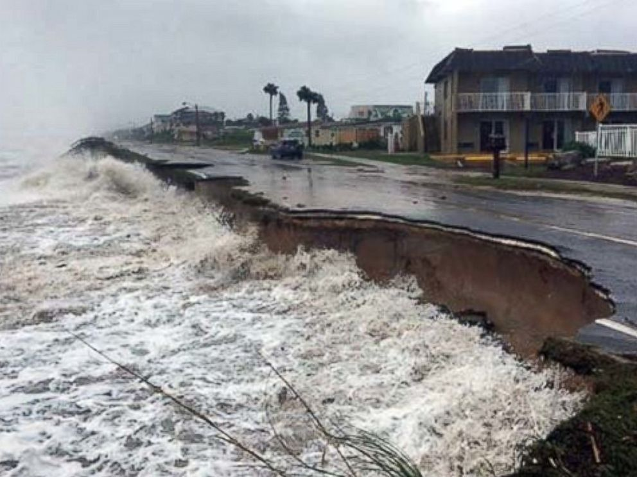
Hurricane Matthew
UNCLASSIFIED
Hurricane Matthew affected the Eastern and Central Caribbean Sea region as well as the Eastern coast of North America.
The region was affected during the period of 28 SEP 2016 – 10 OCT 2016.
Hurricane Matthew brought Hurricane force winds, heavy rains, and flooding throughout the region.
Some of the Countries affected by Hurricane Matthew:
St Vincent and the Grenadines
Dominican Republic
Haiti
Jamaica
Cuba
Turks and Caicos
Bahamas
United States
UNCLASSIFIED

Slide 3
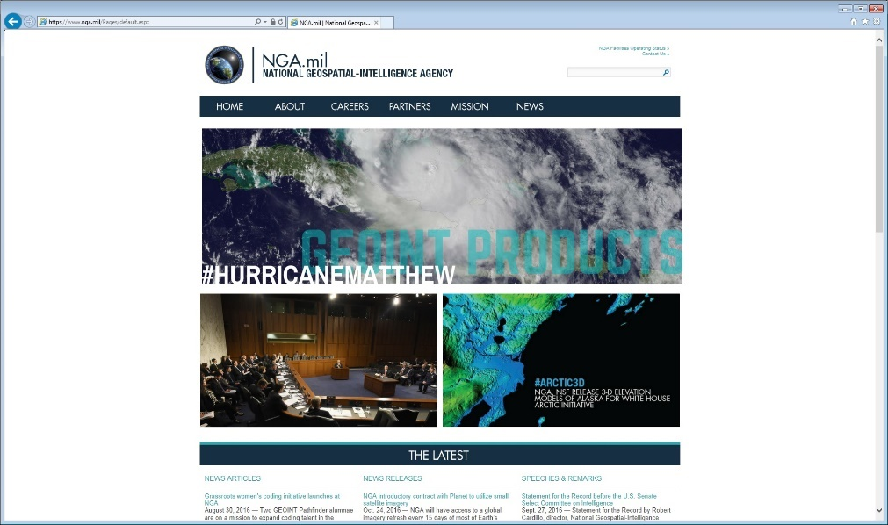
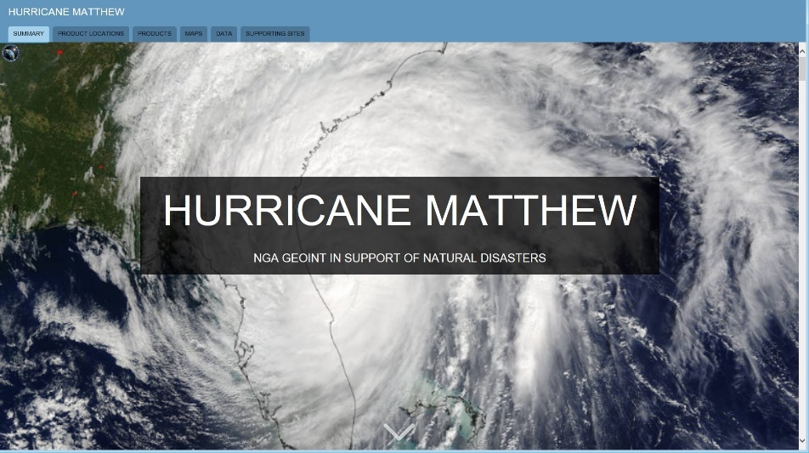
NGA Support to Hurricane Matthew
UNCLASSIFIED
NGA Website created and made available via the WWW
Hurricane_Matthew@nga.mil
UNCLASSIFIED

Slide 4
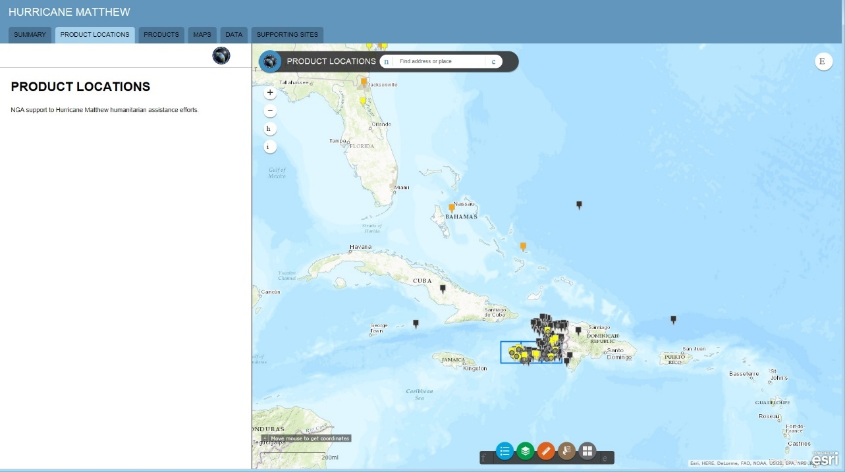
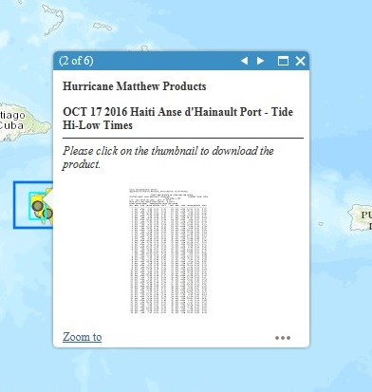
Product Locations
UNCLASSIFIED
Product Location Query
UNCLASSIFIED

Slide 5
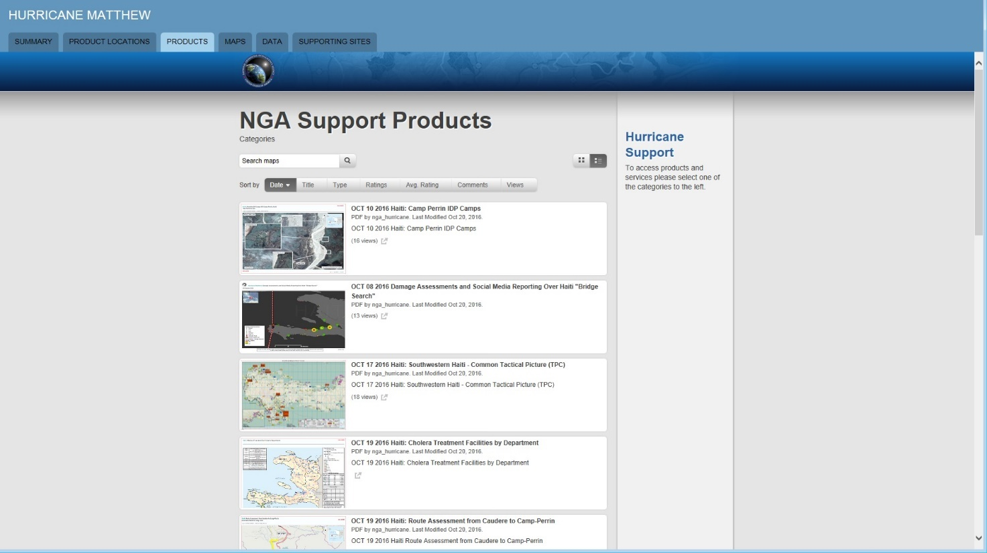
Products
UNCLASSIFIED
Products
UNCLASSIFIED

Slide 6
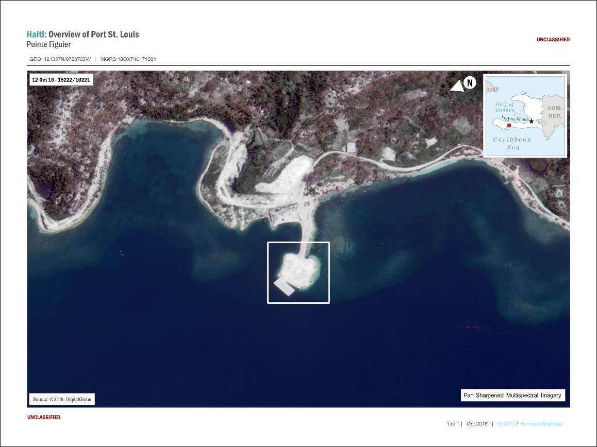
Products
UNCLASSIFIED
Port Assessments
UNCLASSIFIED

Slide 7
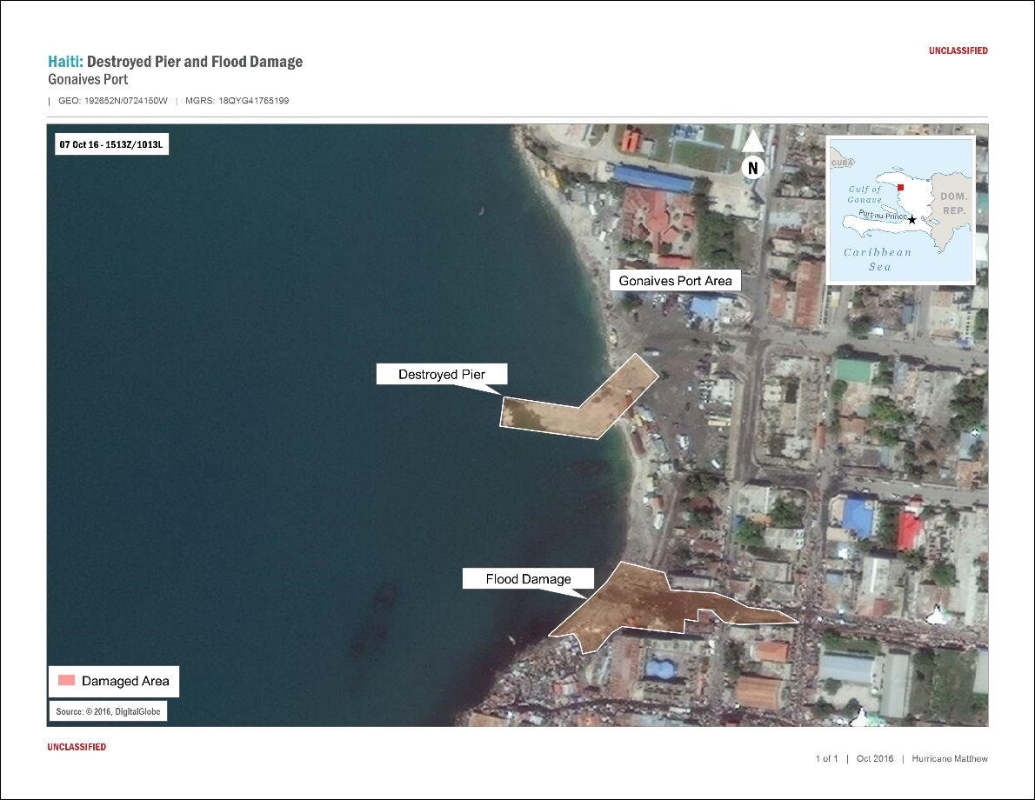
Products
UNCLASSIFIED
Damage Assessments
UNCLASSIFIED

Slide 8
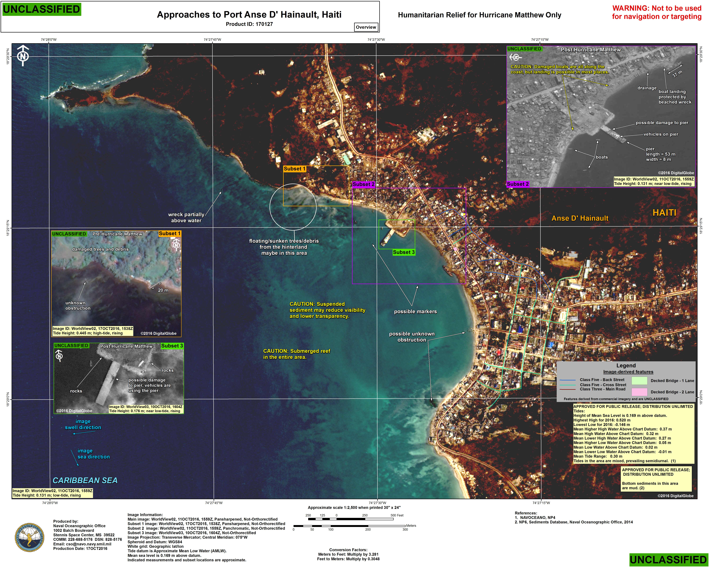
Products
UNCLASSIFIED
Humanitarian Relief
UNCLASSIFIED

Slide 9
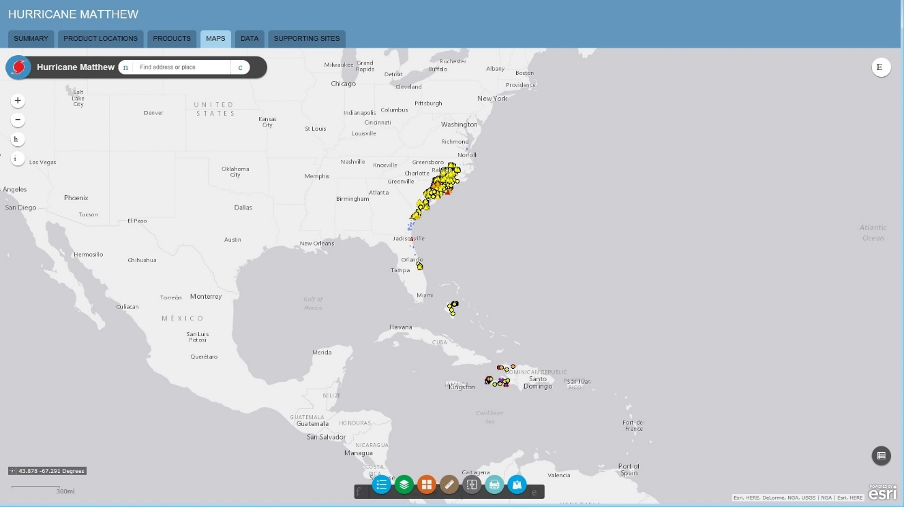
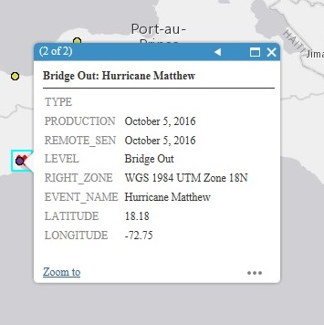
Maps
UNCLASSIFIED
Maps Query – a way to graphically represent reported information
UNCLASSIFIED

Slide 10
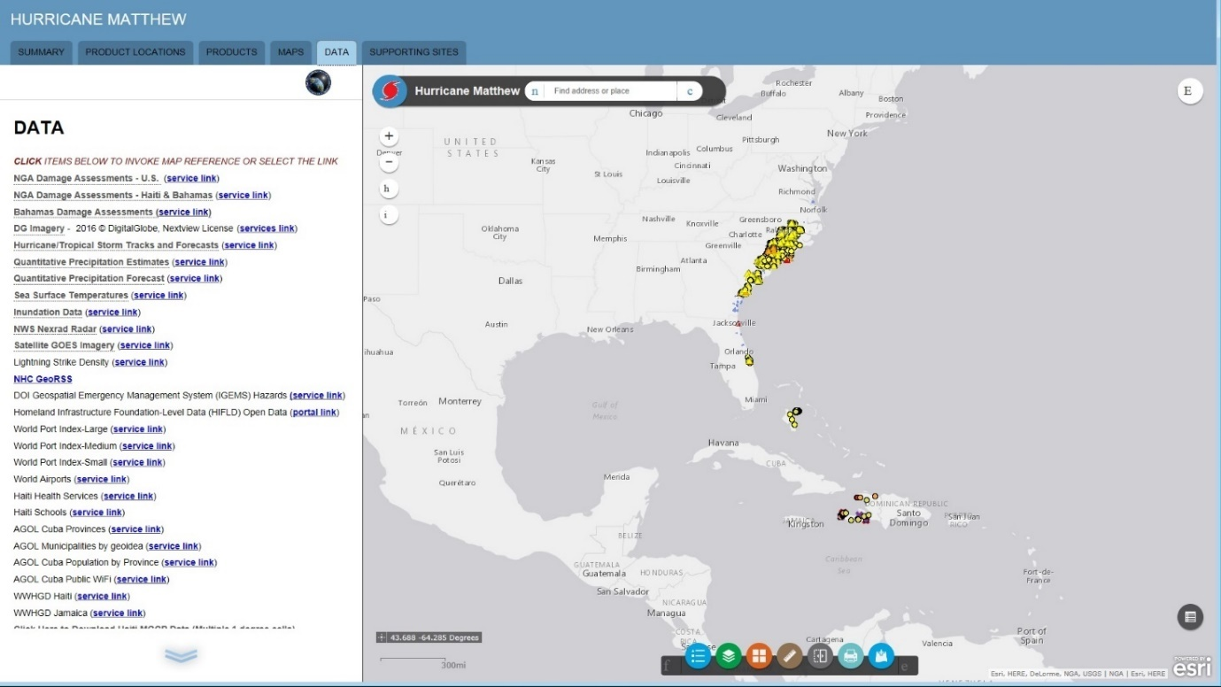
Data
UNCLASSIFIED
Links to data to help support GIS Analysis
UNCLASSIFIED

Slide 11
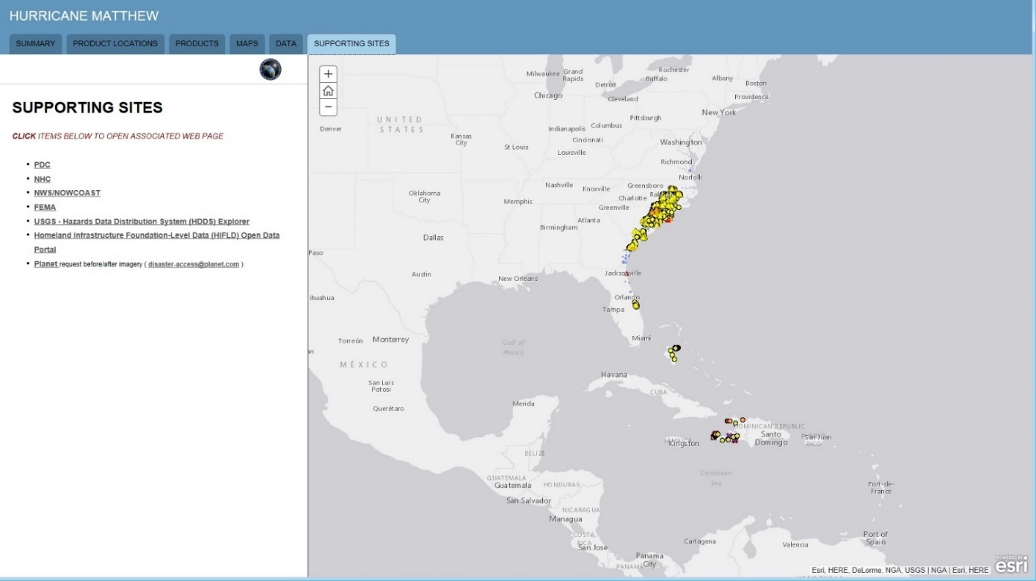
Supporting Sites
UNCLASSIFIED
Links to other partner websites supporting the relief efforts
UNCLASSIFIED

Slide 12
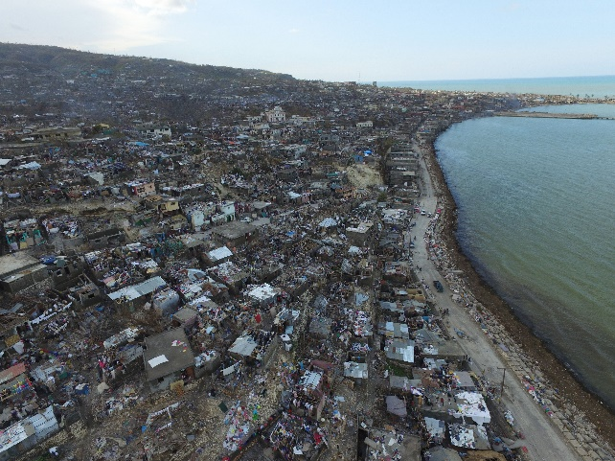
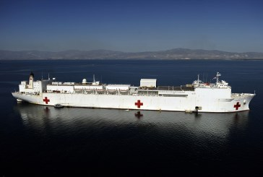
Humanitarian Aid
UNCLASSIFIED
The NGA Hurricane Matthew website supported combined US efforts during the crisis.
The website also supported the efforts of the other international partners with their humanitarian aid as well.
The various products, maps, and data helped responders make more informed decisions and have better situational awareness.
UNCLASSIFIED

Slide 13
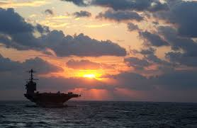
UNCLASSIFIED
UNCLASSIFIED

