Slide 1
IMO/IHO World-Wide Navigational Warning Service
(WWNWS)
Mr. Peter Doherty - Chairman
10 December 2016

Slide 2
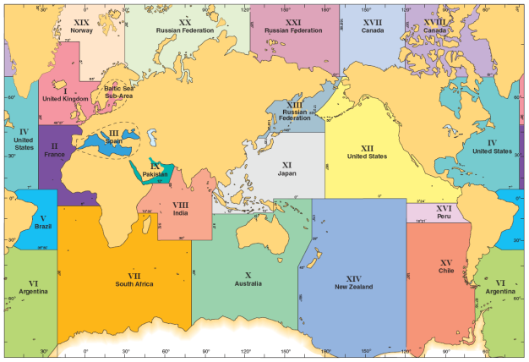
IMO/IHO WWNWS
The World-Wide Navigational Warning Service (WWNWS) is the internationally and nationally coordinated service for the promulgation of hazards to navigation that may effect international shipping.

Slide 3
IMO/IHO WWNWS
Managed in accordance with the requirements of
IMO Resolution A.706(17)
Oversight from the IHO WWNWS-SC
Monitor and guide WWNWS
Study and propose new methods to enhance provision of MSI
Provide guidance to IHO Member State to further the evolution of the WWNWS
Support Capacity Building through training courses aimed at improving Navigational Warning Services

Slide 4
Maritime Safety Information
Navigational and meteorological warnings, meteorological forecasts and other urgent safety related information broadcast to ships
The most essential information for all ships
Wrecks, obstructions, aids to navigation, military exercises
Must be timely and relevant
National Authority support is critical
You are the most important contributor!
You have the knowledge within your national waters
You have the responsibility to forward MSI to NAVAREA Coordinator
IMO Resolution A.705(17)

Slide 5
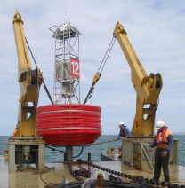
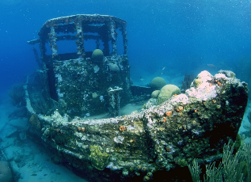
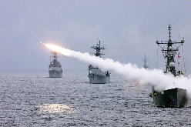
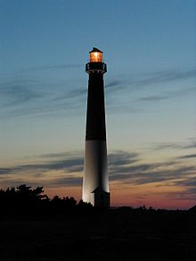
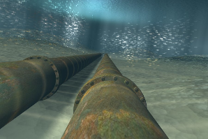
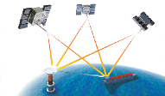
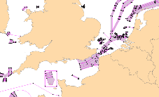
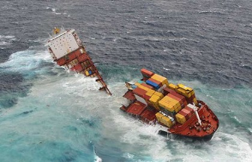
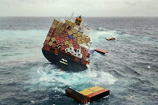
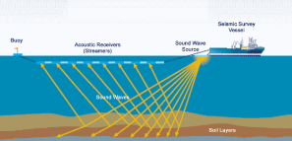
Types of Warnings

Slide 6
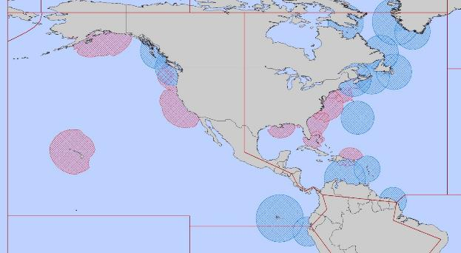
NAVAREA IV/XII Coordinator
Endeavour to be informed of all events that could significantly affect the safety of
navigation within the NAVAREA
IV
XII
IMO Resolution A.706(17) MSC.1/Circ.1288/Rev.1 24 June 2013

Slide 7
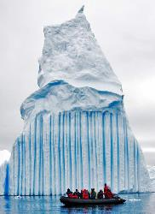
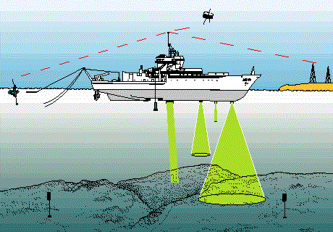
NAVAREA IV/XII Coordinator (cont.)
Assess all information immediately upon receipt in the light of expert knowledge for
relevance to navigation in the NAVAREA;
Select information for broadcast

Slide 8
National Coordinator
Endeavour to be informed of all events that could significantly affect the safety of
navigation within your national waters
IV
XII
IMO Resolution A.706(17) MSC.1/Circ.1288/Rev.1 24 June 2013

Slide 9
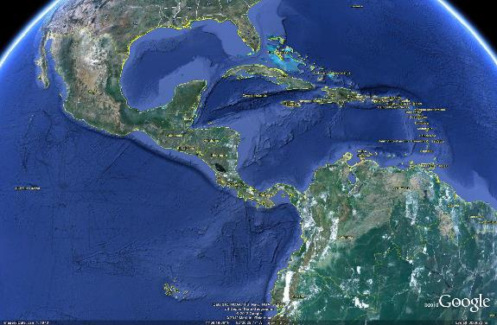
National Coordinator
Forward coastal warnings and relevant associated information directly to
NAVAREA Coordinator
88
navsafety@nga.mil

Slide 10
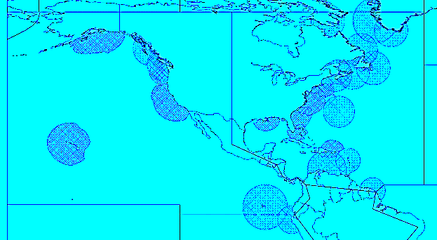
National Coordinators in the MACHC
Cuba | Guyana
Anguilla (UK) | Haiti
Antigua and Barbuda | Honduras
Aruba (Kingdom of the Netherlands) | Jamaica
Bahamas | Martinique (France)
Barbados | Mexico
Belize | Montserrat (UK)
British Virgin Islands (UK) | Nicaragua
Caribbean Netherlands (Kingdom of the Netherlands) | Panama
Cayman Islands (UK) | Puerto Rico (US)
Colombia | Saint Barthélemy (France)
Costa Rica | Saint Kitts and Nevis
Curaçao (Kingdom of the Netherlands) | Saint Lucia
Dominica | Saint Martin (France)
Dominican Republic | Saint Vincent and the Grenadines
Ecuador | Sint Maarten (Kingdom of the Netherlands)
El Salvador | Suriname
French Guiana | Trinidad and Tobago
Grenada | Turks and Caicos Islands (UK)
Guadeloupe (France) | United States Virgin Islands (US)
Guatemala | Venezuela
43
IV
XII

Slide 11
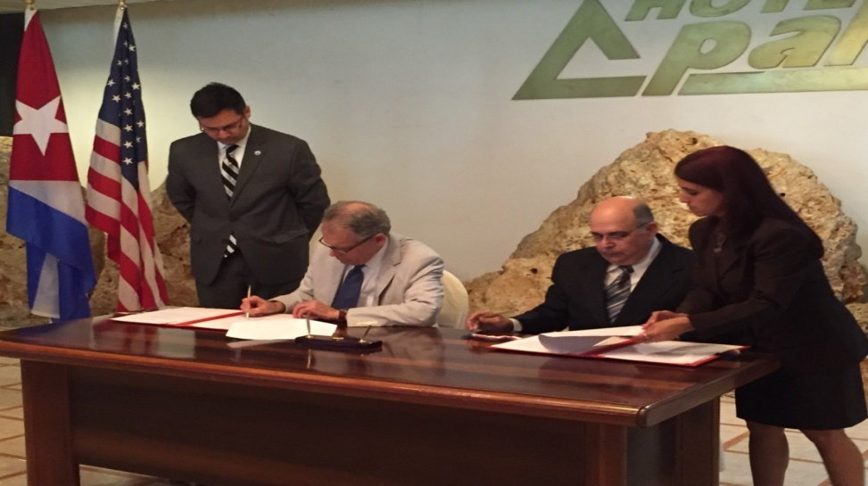
Cuba MSI Exchange Agreement
Preliminary discussions w/Cuba held early Dec 2015
Brief provided on roles and responsibilities
Technical concerns noted with internet/email access
MOU Signed NOAA and ONHG Mar 2016
Follow-on discussion held in Dec 2016
Further discussion on roles responsibilities
ftp site established to enhance MSI exchange
Documents provided in Spanish
Preliminary agreement to
start MSI exchange
in Feb/Mar 17

Slide 12
IHO Capacity Building
The first phase of capacity building is MSI source gathering and dissemination.
Allows for real integration of the country into the World-Wide Navigational Warning Service (WWNWS)
The second phase is the creation of a surveying capability.
The third phase consists of the acquisition of the means to produce charts and publications independently.

Slide 13
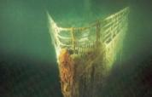
Maritime Safety Information Capacity Building Training Course
3 days of practical training – interactive environment
Objective is to improve navigation within your waters
Inform on all events that could significantly affect the safety of navigation within YOUR coastal region.

Slide 14
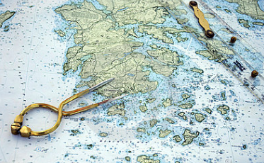
Maritime Safety Information Capacity Building Course Outcomes
Assess information in the light of YOUR expert knowledge for relevance to navigation in YOUR coastal region.
IV
XII

Slide 15
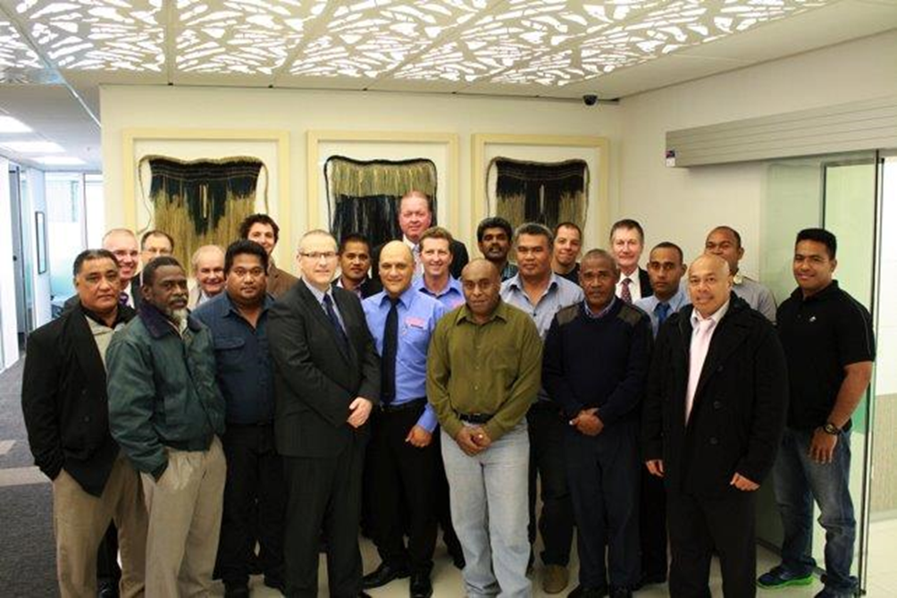
Maritime Safety Information Capacity Building Course Outcomes
Draft navigational warnings in accordance to the
Joint IMO/IHO/WMO Manual on MSI
Pass navigational warnings for promulgation to the NAVAREA Co-ordinator

Slide 16
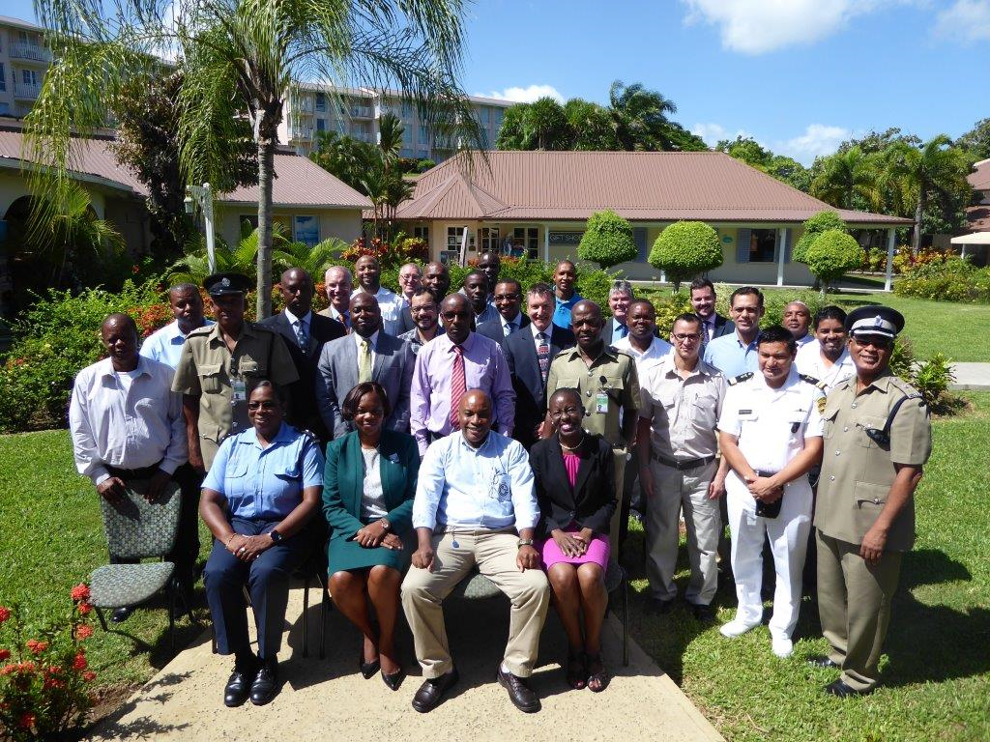
IHO MSI Training Courses (17)
2007 Jamaica (MACHC)
2007 Mozambique (SAIHC)
2008 Spain (MBSHC)
2009 Ghana (EAtHC)
2009 Oman (NIOHC / RSAHC)
2010 Namibia (SAIHC)
2010 Australia (SWPHC)
2011 Brazil (SWAtHC, SEPHC & MACHC)
2013 Trinidad (MACHC)
2013 South Africa (SAIHC)
2014 Oman (NIOHC / RSAHC)
2014 New Zealand (SWPHC)
2014 Ivory Coast (EAtHC)
2015 Japan (EAHC)
2015 Turkey (MBSHC)
2016 Saint Lucia (MACHC)
2016 New Zealand (SWPHC)
2017 tbd (MACHC)

Slide 17
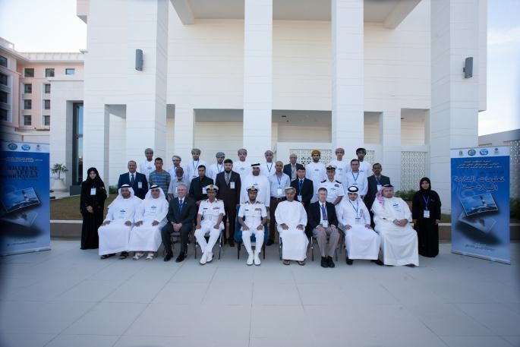
MSI Training Course Data

Slide 18
MACHC MSI Training Course Data
70 students trained from 28 countries
Highly encourage you to attend !!
Imperative that you contribute !!
Anguilla
Antigua and Barbuda
Barbados
Belize
Bermuda
British Virgin Islands
Cayman Islands
Colombia
Costa Rica
Dominica
Dominican Republic
Ecuador
El Salvador
Grenada
Guatemala
Guyana
Haiti
Honduras
Jamaica
Montserrat
Panama
Saint Kitts
Saint Lucia
St. Vincent & Grenadines
Suriname
Trinidad & Tobago
Turks and Caicos

Slide 19
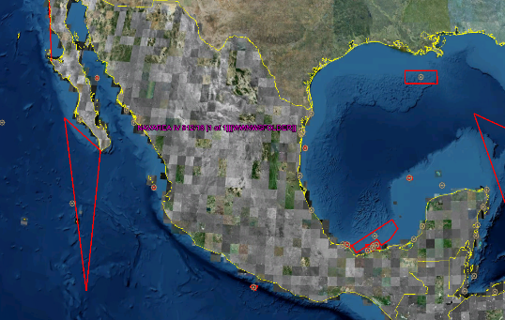
Mexico support 2016
Sent 351 MSI reports to navsafety@nga.mil
Promulgated 131 NAVAREA warnings
29 warnings currently in force

Slide 20
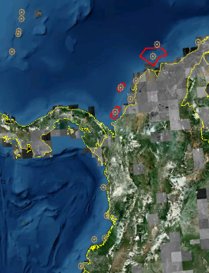
Colombia support 2016
Sent 139 MSI reports to navsafety@nga.mil
Promulgated 57 NAVAREA warnings
17 warnings currently in force

Slide 21
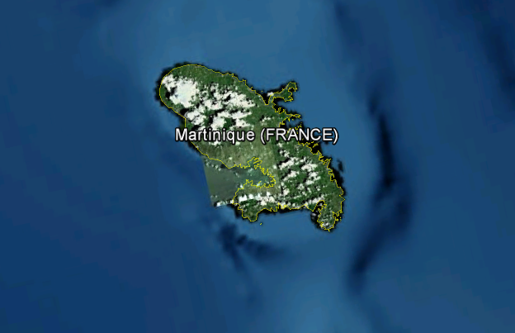
Martinique support 2016
Sent 48 MSI reports to navsafety@nga.mil
Promulgated 34 NAVAREA warnings
No warnings currently in force

Slide 22
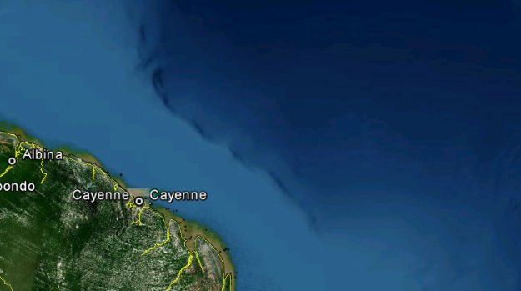
French Guiana support 2016
Sent 38 MSI reports to navsafety@nga.mil
Promulgated 26 NAVAREA warnings
No warnings currently in force

Slide 23
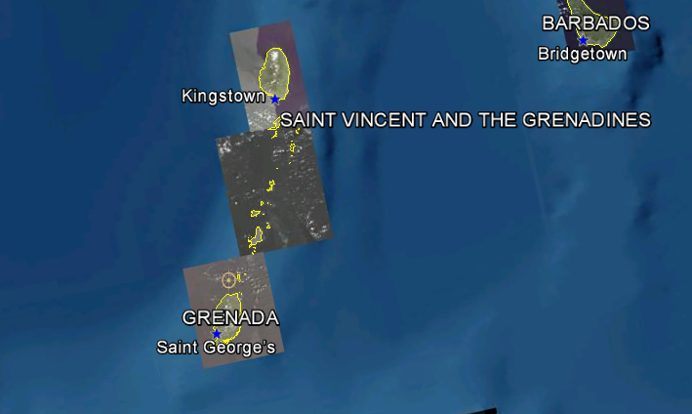
Saint Vincent and the Grenadines support 2016
Sent 3 MSI report to navsafety@nga.mil
Promulgated 3 NAVAREA warning
3 warnings currently in force

Slide 24
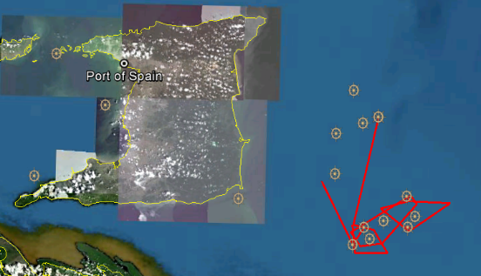
Trinidad support 2016
Sent 43 MSI reports to navsafety@nga.mil
Promulgated 23 NAVAREA warnings
16 warnings currently in force

Slide 25
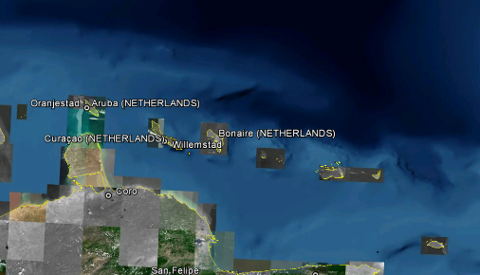
Curaçao support 2016
Sent 12 MSI reports to navsafety@nga.mil
Promulgated 9 NAVAREA warnings
No warnings currently in force

Slide 26
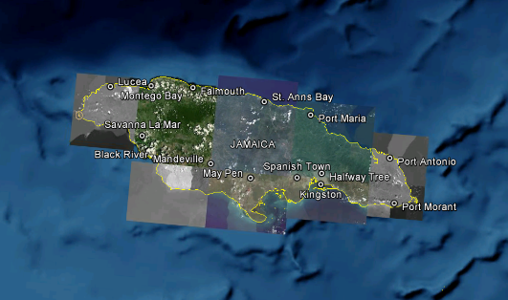
Jamaica support 2016
Sent 6 MSI reports to navsafety@nga.mil
Promulgated 3 NAVAREA warnings
1 warning currently in force

Slide 27
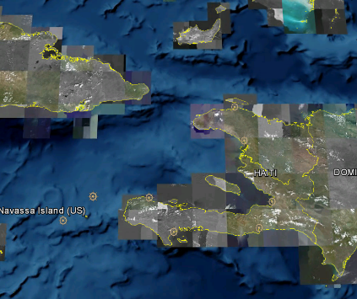
Haiti support 2016
Sent 4 MSI reports to navsafety@nga.mil
Promulgated 4 NAVAREA warnings
1 warning currently in force

Slide 28
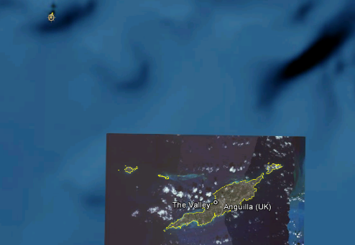
Anguilla support 2016
Sent 1 MSI report to navsafety@nga.mil
Promulgated 1 NAVAREA warning
1 warning currently in force

Slide 29
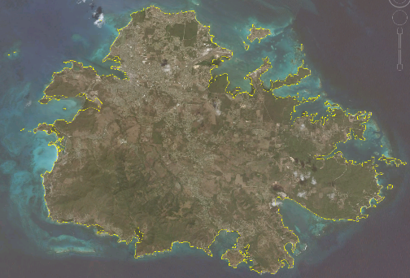
Antigua and Barbuda support 2016
Sent 1 MSI report to navsafety@nga.mil
Promulgated 1 NAVAREA warning
1 warning currently in force

Slide 30
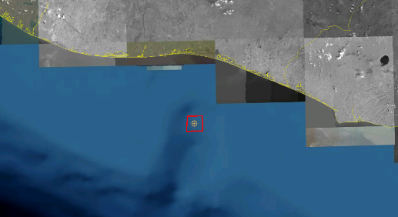
Guatemala support 2016
Sent 1 MSI report to navsafety@nga.mil
Promulgated 1 NAVAREA warning
1 warning currently in force

Slide 31
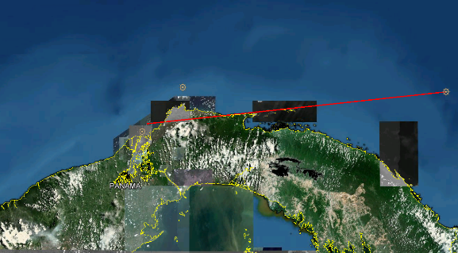
Panama support 2016
Sent 5 MSI report to navsafety@nga.mil
Promulgated 5 NAVAREA warning
3 warnings currently in force

Slide 32
The criticality of MSI !

Slide 33
22 Nov 2016 Panama Maritime Authority Sends MSI to NAVAREA IV
222204Z NOV 16
NAVAREA IV 991/16 – Lifeboat unreported with 3 passengers from M/V JESSIKA in 09-29N 079-50W

Slide 34
231155Z NOV 16 NAVAREA IV 993/16 – DERELICT M/V JESSIKA ADRIFT in 09-29N 079-50W
23 Nov 2016
Panama Maritime Authority Sends Update to NAVAREA IV

Slide 35
23 Nov 2016 Panama Maritime Authority Sends Update to NAVAREA IV
231743Z NOV 16
NAVAREA IV 994/16 – DANGEROUS WRECK established (M/V JESSIKA sank) in 09-25.35N 079-52.02W
Cancel NAVAREA IV 993/16

Slide 36
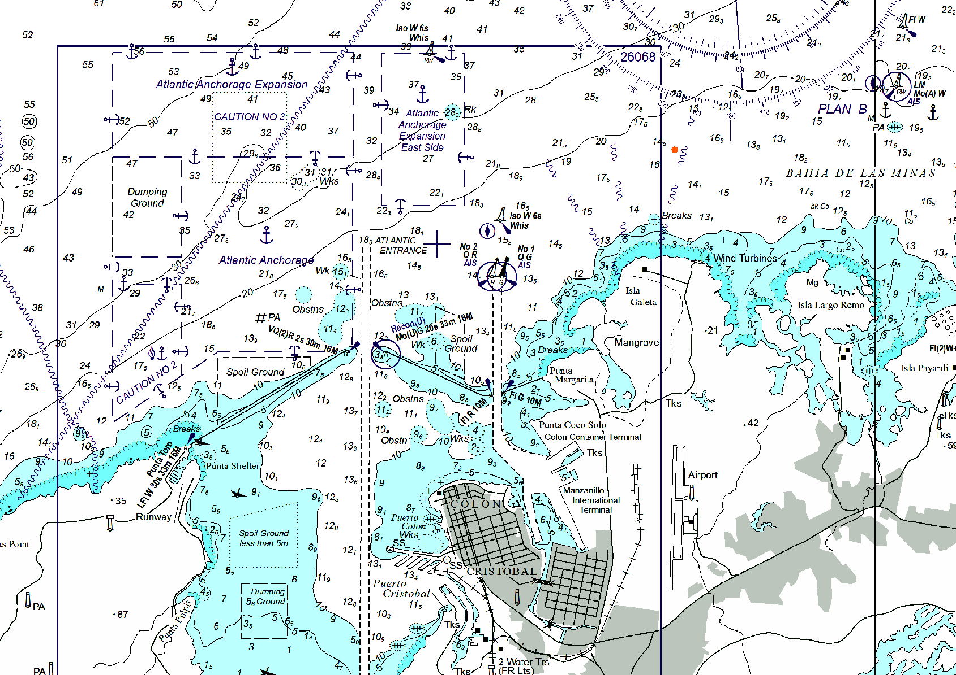
Dangerous Wreck

Slide 37
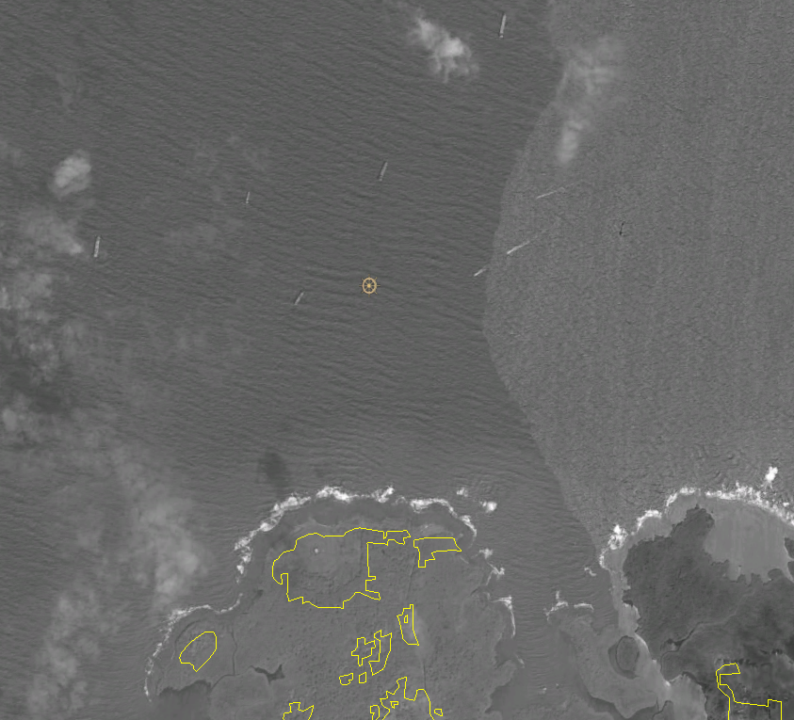
Dangerous Wreck

Slide 38
27 Nov 16 Panama Maritime Authority Sends Update to NAVAREA IV
271521Z NOV 16
NAVAREA IV 1000/16 – Lifeboat recovered, 2 passengers remain missing
Cancel NAVAREA IV 991/16

Slide 39
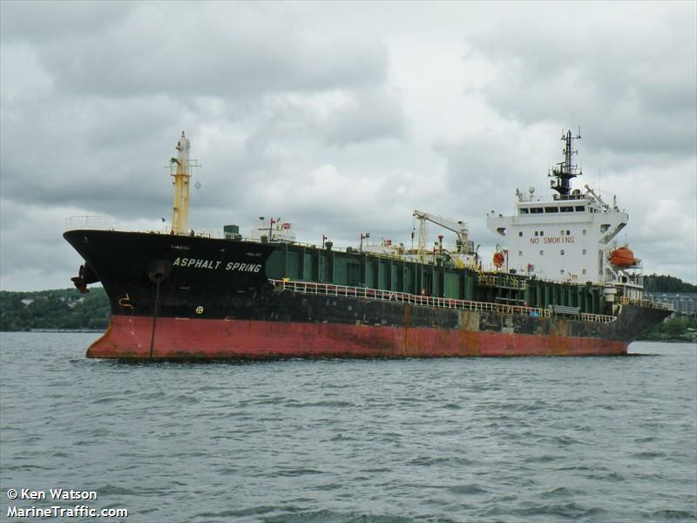
07 Dec 2016 Panama Maritime Authority Sends Update to NAVAREA IV
071230Z DEC 16
NAVAREA IV 1034/16 – M/V ASPHALT SPRING AGROUND in 09-25.35N 079-52.02W

Slide 40
Cristobal, Panama: East entrance to the canal--ship aground on dangerous wreck at 071155Z DEC
NAVAREA IV 994/2016 (26)
WESTERN CARIBBEAN SEA.
PANAMA.
1. DANGEROUS WRECK IN 09-25.35N 079-52.02W.
2. CANCEL NAVAREA IV 993/16.
( 231743Z NOV 2016 )

Slide 41
08 Dec 2016 Panama Maritime Authority Sends Update to NAVAREA IV
080327Z DEC 16
NAVAREA IV 1038/16 – M/V ASPHALT SPRING floated off wreck and towed into port
CX NAVAREA IV 1034/16

Slide 42
NAVAREA IV 991/16
NAVAREA IV 991/16.
WESTERN CARIBBEAN SEA.
PANAMA.
LIFEBOAT, THREE PERSONS ON BOARD, UNREPORTED.
LAST KNOWN POSITION IN VICINITY 09-29N 079-50W.
VESSELS IN VICINITY REQUESTED TO KEEP A SHARP
LOOKOUT, ASSIST IF POSSIBLE. REPORTS TO ANY
COASTAL RADIO STATION.
AUTHORITY/PANAMA MARITIME AUTHORITY 222153Z NOV 16.
Source received at 222153Z NOV
Navigational Warning issued at 222204Z NOV
Time difference: 11 minutes

Slide 43
NAVAREA IV 1000/16
NAVAREA IV 1000/16.
WESTERN CARIBBEAN SEA.
PANAMA.
1. LIFRAFT, ONE PERSON ONBOARD, RECOVERED VICINITY
09-44N 077-28W. TWO PERSONS REMAIN MISSING.
LAST KNOWN POSITION VICINITY 09-29N 079-50W.
VESSELS IN VICINITY REQUESTED TO KEEP A SHARP
LOOKOUT, ASSIST IF POSSIBLE. REPORTS TO ANY
COASTAL RADIO STATION.
2. CANCEL NAVAREA IV 991/16.
AUTHORITY/PANAMA MARITIME AUTHORITY 271431Z NOV 16.
Source received at 271431Z NOV
Navigational Warning issued at 271521Z NOV
Time difference: 35 minutes

Slide 44
NAVAREA IV 993/16
NAVAREA IV 993/16.
WESTERN CARIBBEAN SEA.
PANAMA.
1. DERELICT M/V JESSIKA ADRIFT IN
VICINITY 09-29N 079-50W.
2. CANCEL THIS MSG 261155Z NOV 16.//
AUTHORITY/PANAMA MARITIME AUTHORITY UPDATE 222153Z NOV 16.
Source received at 222153Z NOV
Navigational Warning issued at 231155Z NOV
Time difference: 11 minutes

Slide 45
NAVAREA IV 994/16
NAVAREA IV 994/16.
WESTERN CARIBBEAN SEA.
PANAMA.
1. DANGEROUS WRECK IN 09-25.35N 079-52.02W.
2. CANCEL NAVAREA IV 993/16.
AUTHORITY/PANAMA MARITIME AUTHORITY 231725Z NOV 16.
Source received at 231725Z NOV
Navigational Warning issued at 231743Z NOV
Time difference: 18 minutes
.

Slide 46
NAVAREA IV 1034/16
NAVAREA IV 1034/16.
WESTERN CARIBBEAN SEA.
PANAMA.
CHART 26066.
M/V ASPHALT SPRING AGROUND IN 09-25.35N 079-52.02W.
SALVAGE OPERATIONS IN PROGRESS UNTIL FURTHER NOTICE.
WIDE BERTH REQUESTED.
AUTHORITY/PANAMA MARITIME AUTHORITY 071214Z DEC 16.
Source received at 071214Z DEC
Navigational Warning issued at 071230Z DEC
Time difference: 16 minutes

Slide 47
NAVAREA IV 1038/16
NAVAREA IV 1038/16.
WESTERN CARIBBEAN SEA.
PANAMA.
CANCEL NAVAREA IV 1034/16 AND THIS MSG,
VESSEL IN TOW.
AUTHORITY/PANAMA MARITIME AUTHORITY 080233Z DEC 16.
Source received at 080233Z DEC
Navigational Warning issued at 080327Z DEC
Time difference: 54 minutes

Slide 48
Updates to ENC, Charts and Pubs
NGA updated both the standard nautical chart and ENC for this area with the M/V JESSIKA wreck.
Updated ENC (US409860) will be posted this Friday 16 December
Chart corrections will be published in US Notice to Mariners 52/2016 for charts 26060, 26066, and 26070.
US Notice to Mariners 52/2016 will be posted to NGA website on Friday 16 December.

Slide 49
National Coordinators Send your MSI NAVAREA IV
IT IS VITAL INFORMATION !!
NO COST TO YOU !!
SAVES LIVES!!
Mariners will be able download your warning as a text file or as a Google Earth KMZ from NGA’s Maritime Safety Information website!
http://msi.nga.mil/NGAPortal/MSI.portal
Select the Broadcast Warnings link
navsafety@nga.mil

Slide 51
Panama MSI support
Chronology leading up to the M/V ASPHALT SPRING grounding on December 7, 2016
222204Z NOV 16
NAVAREA IV 991/16 – Lifeboat unreported with 3 passengers from M/V JESSIKA in 09-29N 079-50W
231155Z NOV 16
NAVAREA IV 993/16 – DERELICT M/V JESSIKA ADRIFT in 09-29N 079-50W
231743Z NOV 16
NAVAREA IV 994/16 – DANGEROUS WRECK established (M/V JESSIKA sank) in 09-25.35N 079-52.02W
CX NAVAREA IV 993/16
271521Z NOV 16
NAVAREA IV 1000/16 – Lifeboat recovered, 2 passengers remain missing
CX NAVAREA IV 991/16
071230Z DEC 16
NAVAREA IV 1034/16 – M/V ASPHALT SPRING AGROUND in 09-25.35N 079-52.02W
080327Z DEC 16
NAVAREA IV 1038/16 – M/V ASPHALT SPRING floated off wreck and towed into port
CX NAVAREA IV 1034/16

