Slide 1
8th MEETING OF THE IHO HYDROGRAPHIC SERVICES AND STANDARDS COMMITTEE (HSSC)
IHO Secretariat, Monaco, 15-18 November

Slide 2
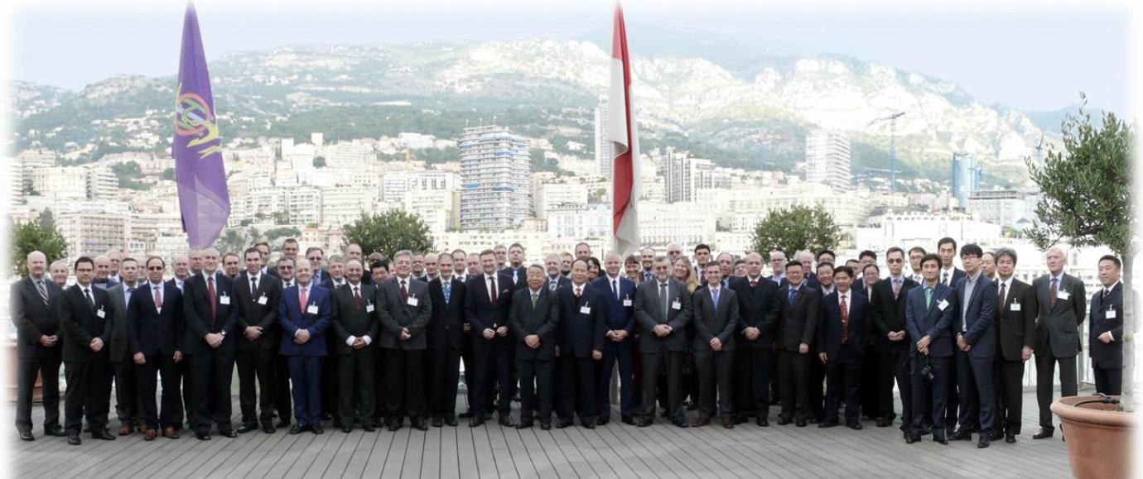
HSSC-8 was attended by 74 representatives from 22 Member States, 9 international organizations accredited as observers and the IHO Secretariat.

Slide 3
The Committee reviewed the activities, proposals, and work plans of its subordinate bodies and the decisions of other organs and organizations affecting its work. Following this review, the Committee agreed on the key messages to be delivered to the 1st session of the IHO Assembly (A-1) in April 2017, in relation to hydrographic standards and services. The Committee endorsed the input from the Chair Group related to the revision of the IHO Strategic Plan and the preparation of the draft 3-year Work Program of the IHO for 2018-2020 that will be submitted.

Slide 4
The main outcomes of the meeting are given as follows:
S-100 development and related activities:
Hyligth – Progress and the upgrade of the web interface of the S-100 Registry.
- First sea-trial of S-10x test data sets, including dynamic data such as S-111 (Surface Currents) and S-112 (Dynamic Water Level Data Transfer), together with static data such as S-101 (ENCs) and S-102 (Bathymetric Surface) data.

Slide 5
The Committee endorsed the draft new Edition 3.0.0 of S-100 - IHO Universal Hydrographic Data Model and welcomed the progress of the work of the Project Teams responsible for developing product specifications: S-101 (ENCs), S-121 (Maritime Limits and Boundaries), S-124 (Navigational Warnings)¹ and S-129 (Under Keel Clearance Management Information.
The Committee invited the Nautical Information Provision Working Group to place priority on the development of two product specifications related to nautical information: S-122 (Marine Protected Areas) and S-123 (Radio Services)
Notes:
5

Slide 6
The Committee decided to disband the Data Protection Scheme Working Group (DPSWG) and to continue the development of the protection scheme (the S-63 equivalent component) of S-100 based-products as well as the monitoring of cyber security requirements through a Project Team under the S-100WG.
The expertise required to support the Secretariat as Scheme Administrator for the existing S-63 - Data Protection Scheme will now be under the responsibility of the ENC Standards Maintenance Working Group (ENCWG).

Slide 7
The Committee endorsed the proposal of the Chair of the Hydrographic Dictionary Working Group (HDWG) to seek contractor support for the development of an experimental multi-lingual wiki-based demonstrator to support a subsequent upgrade of IHO Publication S-32 - Hydrographic Dictionary. The Committee tasked the HDWG to develop a draft policy and road-map taking into account the S-100 framework.

Slide 8
ECDIS matters and Nautical Cartography
The Committee endorsed the principles of the draft revised editions of S-58 - ENC validation checks, S-65 - ENCs: Production, Maintenance and Distribution Guidance and S-66 - Facts about Electronic Charts and Carriage Requirements proposed by the ENCWG and tasked the working group to finalize the drafts and forward them to the Secretariat for subsequent consideration by IHO Member States. The Committee also endorsed the ENCWG proposal to use ECDIS Chart 1 to assist mariners in checking ECDIS operating with Edition 4.0 of the IHO S-52 Presentation Library.

Slide 9
In response to the concerns raised in a submission from the International Association of Independent Tanker Owners (INTERTANKO), the Committee tasked the ENCWG and the Nautical Cartography Working Group (NCWG) to draft a consolidated, authoritative IHO document addressing the issue of “equivalent” Temporary and Preliminary Notices (T&Ps) for ENCs, with the intention of distributing the completed document to Hydrographic Offices, Port State Control (PSC) authorities and mariners.
The Committee requested the Secretariat to invite IHO Member States to liaise with their national maritime administration in order to provide feedback on PSC issues related to the carriage and operation of ECDIS.

Slide 10
The Committee endorsed proposed changes to Edition 4.6.0 of S-4 - Chart Specifications of the IHO and tasked the NCWG to finalize the draft new edition 4.7.0 and forward it to the Secretariat for subsequent consideration by the IHO Member States. The Committee reached a similar decision with regard to the new draft Edition 3.0.0 of S-11 Part A - Guidance for the Preparation and Maintenance of International Chart Schemes, which now includes a separate section on ENC schemes.

Slide 11
Consideration of the need to establish a Hydrographic Surveys Working Group
The Committee considered the report provided by the Chair of the Hydrographic Surveys Scoping Project Team (H2S PT) established in 2015, and decided to establish a Project Team on Standards for Hydrographic Surveys (HS PT), primarily tasked to review S-44 - IHO Standards for Hydrographic Surveys, draft a new edition, if appropriate, and identify additional tasks, if any, that might require the establishment of a standing Hydrographic Surveys Working Group.

Slide 12
Relations with Stakeholders
The Committee invited the IHO Secretariat to monitor the activities of the newly established Marine Domain Working Group of the Open Geospatial Consortium and agreed a set of enabling actions to address the topics provided by the International Cable Protection Committee (ICPC) representative, that might impact current charting specifications, the GEBCO Seabed 2030 project and the on-going development of S-100-based product specifications in relation to the protection of cables.

Slide 13
LIST OF DECISIONS
&
ACTIONS FROM HSSC-8

Slide 14
DATE & LOCATION OF THE NEXT MEETINGS
HSSC-9 (6 to 10 November 2017, Ottawa, Canada); HSSC- 10 (2018, Rostock, Germany);
HSSC- 12 (2020, Taunton, UK ).
HSSC Members were invited to consider the possibility to host HSSC- 11, in May 2019.
More Information
Further information is available on the IHO web site at Home > Committees & WG > HSSC.

