Slide 1
1
BRIEF SUMMARY OF THOSE ITEMS FROM THE 2nd MEETING OF THE IHO COUNCIL
OF INTEREST FOR THE 15TH EASTERN ATLANTIC HYDROGRAPHIC COMMISSION (EAtHC).
15th Conference of EAtHC, Lagos, Nigeria, 17 – 19 October 2018
Notes:
BRIEF SUMMARY OF THOSE ITEMS FROM THE 2nd MEETING OF THE IHO COUNCIL
(IHO C-2, London, 9-11October 2018) OF INTEREST FOR THE 15TH EASTERN ATLANTIC HYDROGRAPHIC COMMISSION (EAtHC).
CONCEPTS EXTRACTED FROM THE DRAFT SUMMARY REPORT
(Version dated 13October 2018)

Slide 2
2
1 Chair: Radm Shepard Smith (US). Need to ensure any conclusions and recommendations are completed for C-3
2 The Council endorsed the proposals made for the use of the IHO Fund for Special Projects. The Council invited HSSC and IRCC Chairs to prepare their 2019 meeting minutes with that view
15th Conference of EAtHC, Lagos, Nigeria, 17 – 19 October 2018
Notes:
1 The Chair of the Council was Radm Shepard Smith (US). He reiterated the need to ensure any conclusions and recommendations are completed for C-3 next year in order to submit the report to A-2.
2 It was established a Decision and Action (C2/16) in which The Council endorsed the proposals made for the use of the IHO Fund for Special Projects, as requested by HSSC (Hydrographic Services and Standards Committee) and invited the HSSC and the IHO Secretariat to implement this decision accordingly, under the 2019 IHO Budget. The Council invited HSSC and IRCC Chairs to prepare their 2019 meeting minutes with the view that they will be used/submitted directly as reports and proposals to be considered at C-3. (deadline: July 2019)

Slide 3
3
3 The Chair of IRCC remarked the need for Capacity-Building. Director Iptes highlighted the need to further develop the good coordination between the RHCs, MSI training is another area to coordinate at a regional level.
4 The concept of Crowdsourced Bathymetry was highlighted. A proposal for the approval of IHO publication B-12 (IHO Guidelines on Crowdsourced Bathymetry) was presented. Some countries expressed their views over this proposal
15th Conference of EAtHC, Lagos, Nigeria, 17 – 19 October 2018
Notes:
3 The Chair of IRCC presented the Committee’s report and proposals, with particular emphasis on the continued need for Capacity-Building; Director Iptes highlighted the need to further develop the good coordination between the Regional Hydrographic Commissions (RHCs), resulting in better value from the available resources. The network of alumni of IHO training courses is constantly expanding. MSI (The Maritime Safety Information) training is another area to coordinate at a regional level. This aspect resulted in a Decision and Action (C2/18) in which The Council endorsed the proposed amendments to the IRCC TORs and ROPs, as revised during C-2, with full alignment with the ROP of HSSC.
4 The concept of Crowdsourced Bathymetry was highlighted. A proposal for the approval of IHO publication B-12 (IHO Guidelines on Crowdsourced Bathymetry) was presented. Some countries expressed their views over this proposal (i.e., the view that crowdsourced bathymetry (CSB) data should be submitted to the IHO Data Centre for Digital Bathymetry (DCDB) only through Trusted Nodes, while another member considered that CSB data should be collected only by vessels flying the flag of the country concerned and submitted to the national authority of that country in the first instance). Other members, while appreciating the restrictions imposed by some Member States’ national legislation, appealed for a global perspective, pointing to the potential contribution of CSB data to the resolution of universal problems such as climate change. Guidance from a respected organization like IHO could help to dispel some of the prevailing scepticism about the value of CSB data. It was generally agreed that the publication must point out that CSB data cannot be obtained legally in some jurisdictions; the proposed list of States permitting CSB data collection, detailing any limitations on the process, was considered a valuable resource, which should potentially be published on the IHO website. CSBWG and endorsed by IRCC in the interim. This aspect resulted in a Decisions and Actions (C2/22, C2/23 and C2/25) were established in which the Council endorsed the proposed Edition 1.0.0 of IHO Publication B-12 - IHO Guidelines on Crowdsourced Bathymetry, the instruction and provision of guidance to the CSBWG to further develop a more detailed paragraph on the data flow in preparation, and the proposal of the IRCC key priorities of the IHO Work Programme for 2009.

Slide 4
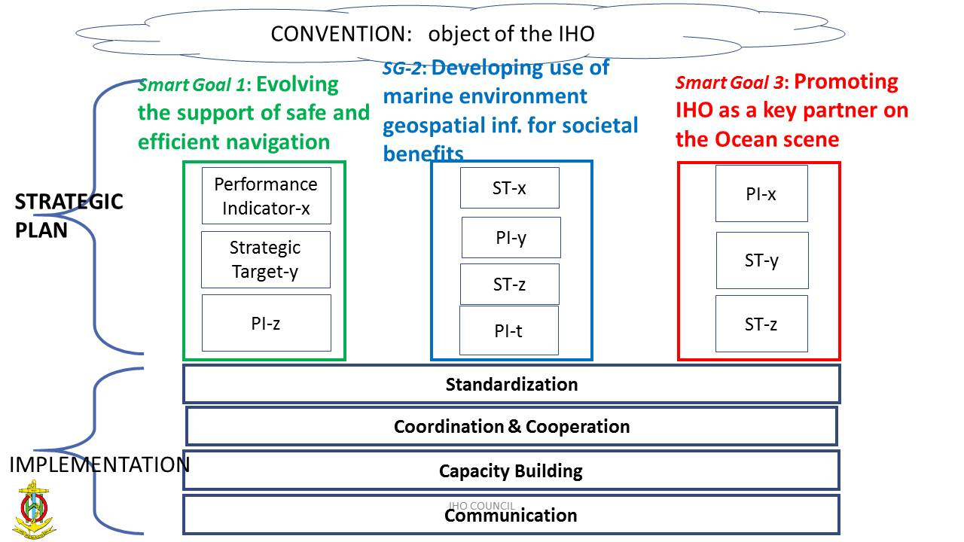
4
5 Comments on IHO Resolution 1/2018 over Elimination of overlapping ENC data in areas of demonstrable risk to the safety of navigation. Overlaps in ENCs.
6 A revised structure of the IHO strategic plan were addressed.
15th Conference of EAtHC, Lagos, Nigeria, 17 – 19 October 2018
Notes:
5 Some comments on an IHO Resolution 1/2018 over Elimination of overlapping ENC data in areas of demonstrable risk to the safety of navigation were expressed. Attention was drew to the overlaps in ENCs which caused ECDIS to behave unpredictably, with a resulting risk to safety of navigation. Some Members noted that overlaps in ENCs often have political origins which are challenging to solve quickly and suggested that technical improvements to ECDIS could solve issues when loading overlapping ENCs. IRCC could produce technical guidance for regional hydrographic commissions, which are often responsible for assessing overlap status and risks to navigation. This aspect resulted in a Decision and Action (C2/27) in which IRCC should instruct the WENDWG to include in its next meeting agenda, an initial assessment of the lessons learned from the implementation process of the new IHO Resolution 1/2018 since its entry into force. (deadline February 2019).
6 A revised structure of the IHO strategic plan were addressed based on a strategic plan and its implementation.

Slide 5
5
7 Nippon Foundation: GEBCO Seabed 2030 Project (Dr Graham Allen)
8 Recent Activities Related to Satellite –derived Bathymetry and Hydrographic Remote Sensing. Utility of air-and space-borne remote sensing to hydrography
9 Next meeting: to hold Council meetings immediately before and after a conference or Assembly at the IHO headquarters in Monaco. C-3 15 to 17 Oct 2019
15th Conference of EAtHC, Lagos, Nigeria, 17 – 19 October 2018
Notes:
7 Concerning the Establishment and future governance of the Nippon Foundation, in the aspect of the General Bathymetric Chart of the Oceans (GEBCO), the Seabed 2030 Project was introduced by Dr Graham Allen, Acting Director, Seabed 2030. Seabed 2030 is managed from a global centre based at the National Oceanography Centre in the United Kingdom; the global centre compiles the GEBCO Grid, most recently updated in 2014. The Atlantic and Indian Oceans (Columbia University, USA) are under the responsibility of a regional centre (Columbia University, USA). This aspect resulted in a Decision and Action (C2/49) in which the Council commended Dr Graham Allen for the presentation given on the Seabed 2030 Project and noted his “call to action” to the IHO.The Council tasked the SPRWG (Strategic Plan Review Working Group) to consider the Seabed 2030 Project during the revision process of the Strategic Plan.
8 Recent Activities Related to Satellite –derived Bathymetry and Hydrographic Remote Sensing were presented, addressing the utility of air-and-space borne remote sensing to Hydrography. Canada presented a report on behalf of Canada, France, Germany and USA highlighting recent events relating to hydrographic remote sensing (HRS) and satellite-derived bathymetry (SDB). The utility of air-and space-borne remote sensing to hydrography continued to grow with developments in technologies and methodologies.
9 Concerning the next meeting, the Secretary-General said that it had been the custom to hold Council meetings immediately before and after a conference or Assembly at the IHO headquarters in Monaco, in order to receive the support of all Secretariat staff. That resulted in a decision (C2/51) in which the Council agreed to hold C-3 in Monaco, at the IHO Secretariat, from 15 to 17 Oct. 2019.

Slide 6
6
10 Any Other Bussiness. IRCC to engage with RHCs Chairs in order to prepare the arrangements for reporting to A-2. IHO Secretariat, Member States, HSSC and IRCC to pursue the preparation the 3-year IHO Programme of Work and Budget.
11 Finally a review of actions and decisions of the meeting was presented by the Council Assistant Secretary.
15th Conference of EAtHC, Lagos, Nigeria, 17 – 19 October 2018
Notes:
10 Into the “Any Other Bussiness” paragraph, a decision (C2/53) was taken for the IRCC to engage with RHCs Chairs in order to prepare the arrangements for reporting to A-2 [to avoid duplication with the Council Chair’s Report which is planned to include the IRCC Report]. (deadline: November 2018). Also, an action (C2/54) was defined for the IHO Secretariat, Member States, HSSC and IRCC to pursue the preparation the 3-year IHO Programme of Work and Budget, to be submitted to A-2. (deadline: From April 2019 to C-3 in preparation of A-2).
11 Finally a review of actions and decisions of the meeting was presented by the Council Assistant Secretary.

Slide 7
7
THANK YOU
15th Conference of EAtHC, Lagos, Nigeria, 17 – 19 October 2018
Notes:
Thank you . Now we are moving to the National Reports.

