Slide 1
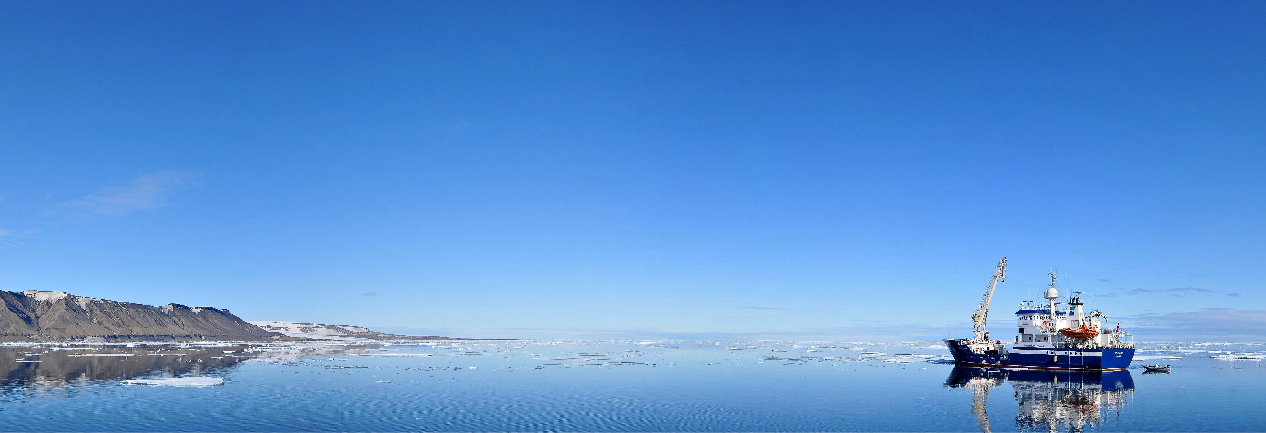
Status AICCWG
ARHC8:Longyearbyen, Svalbard
Edward Hands
Norwegian Mapping Authority

Slide 2
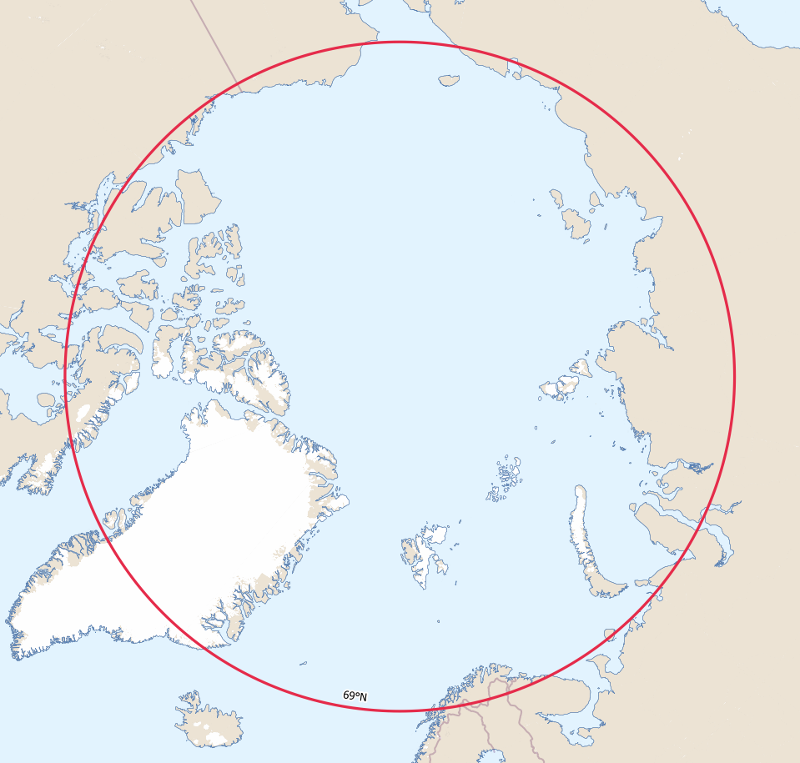
AICCWG
AICCWG is fully manned.
Norway continues chair.
No formal meetings – work done by correspondence.
Good level of engagement and progress is being made.
ToR’s updated Feb 2018.
Available here: ToR_AICCWG
INT Region N

Slide 3
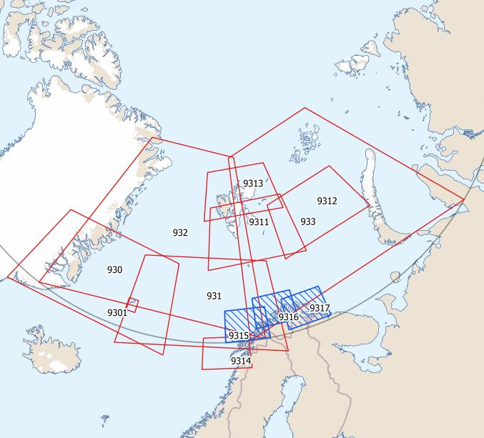
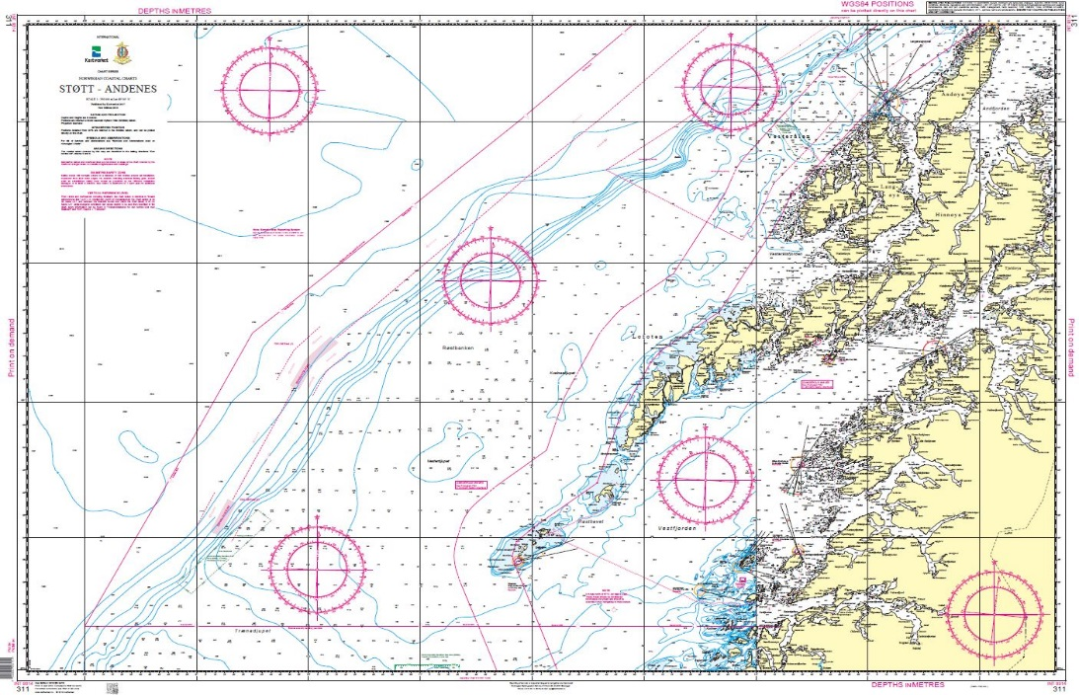
INT Charts Status
The INT chart portfolio for Region N now consists of 9 charts with a further 3 coastal charts planned.
All Charts are Norwegian.
1 New INT Chart published in 2018:
INT 9314 (NO 311)
Produced
Planned
Is extending the INT chart coverage in the region a desirable goal?

Slide 4
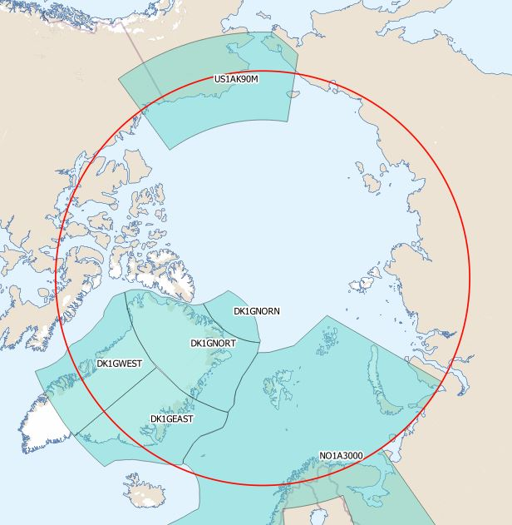
Status of The ENC Scheme UB1 in Region N
6 ENCs
No new ENCs planned.

Slide 5
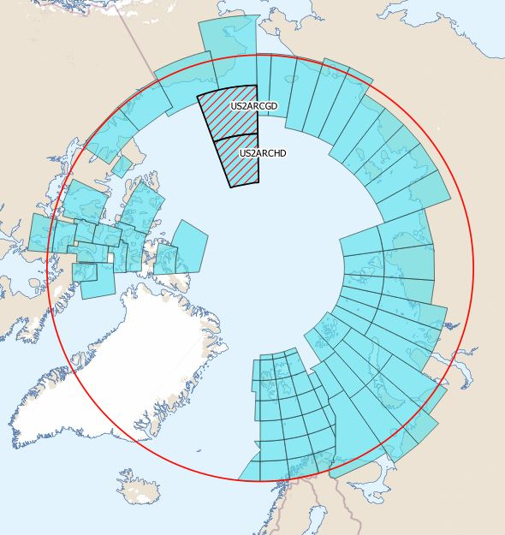
Status of The ENC Scheme UB2 in Region N
83 ENCs
2 new ENCs published by United States:
US2ARCDG
US2ARCHD

Slide 6
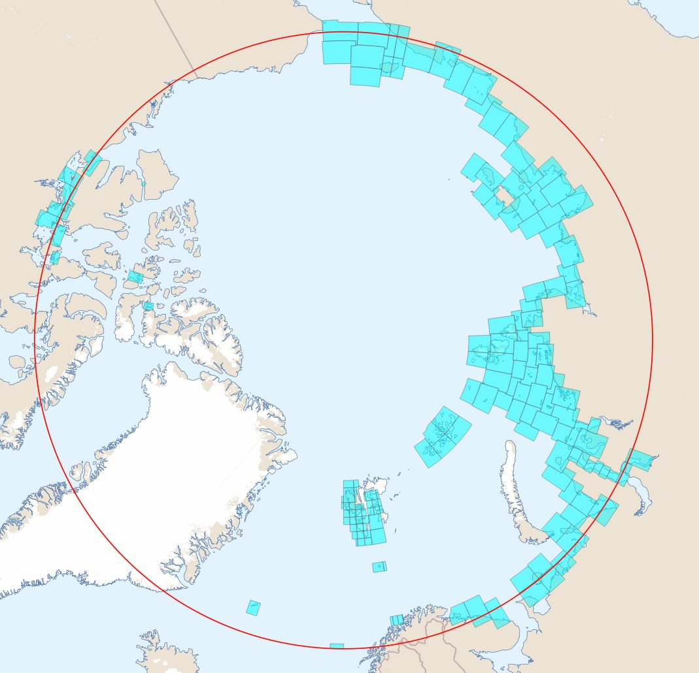
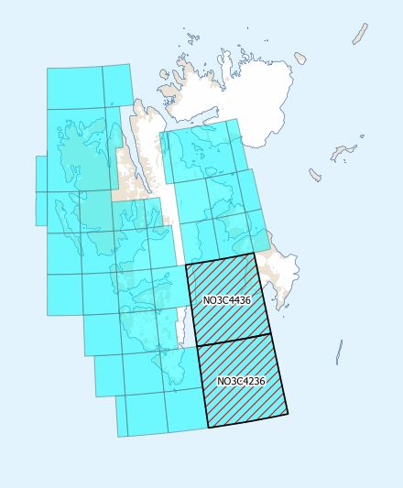
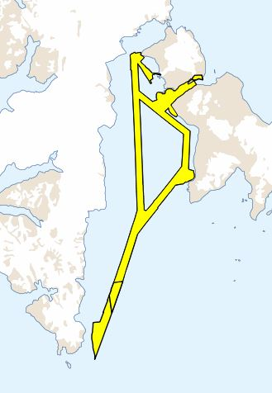
Status of The ENC Scheme UB3 in Region N
159 ENCs
2 new ENCs from Norway
NO3C4436
NO3C4236
Coverage extended for
NO3D4636
Covering corridor through Storfjorden, Svalbard

Slide 7
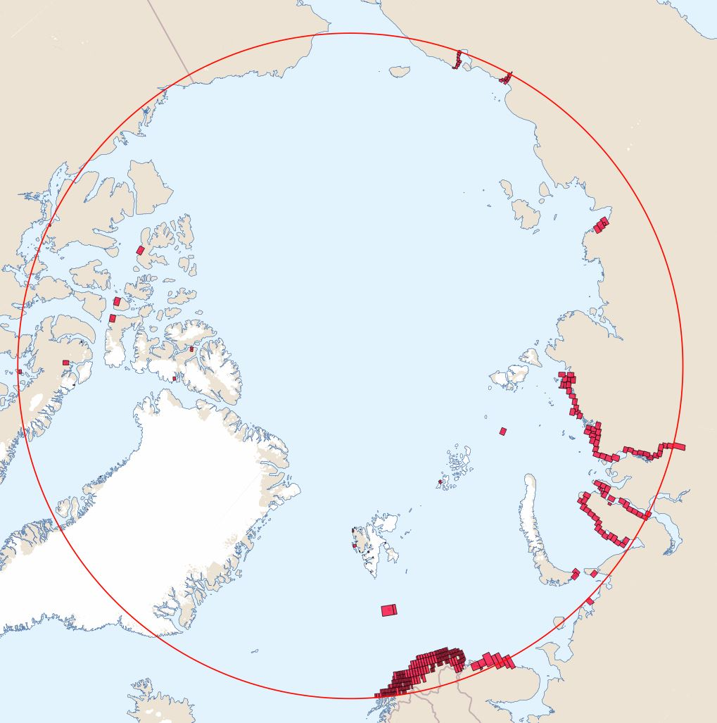
Status of The ENC Scheme UB4 in Region N
345 ENCs
The following changes have been made by The Russian Federation.
6 New ENCs :
RU4P7PA0
RU4P6PA0
RU4P6P90
RU4P5P70
RU4P1P90
RU4OQP90
Coverage amended on 2 ENCs:
RU4P1P70
RU4POQP70
1 Enc deleted:
RU4P5P90

Slide 8
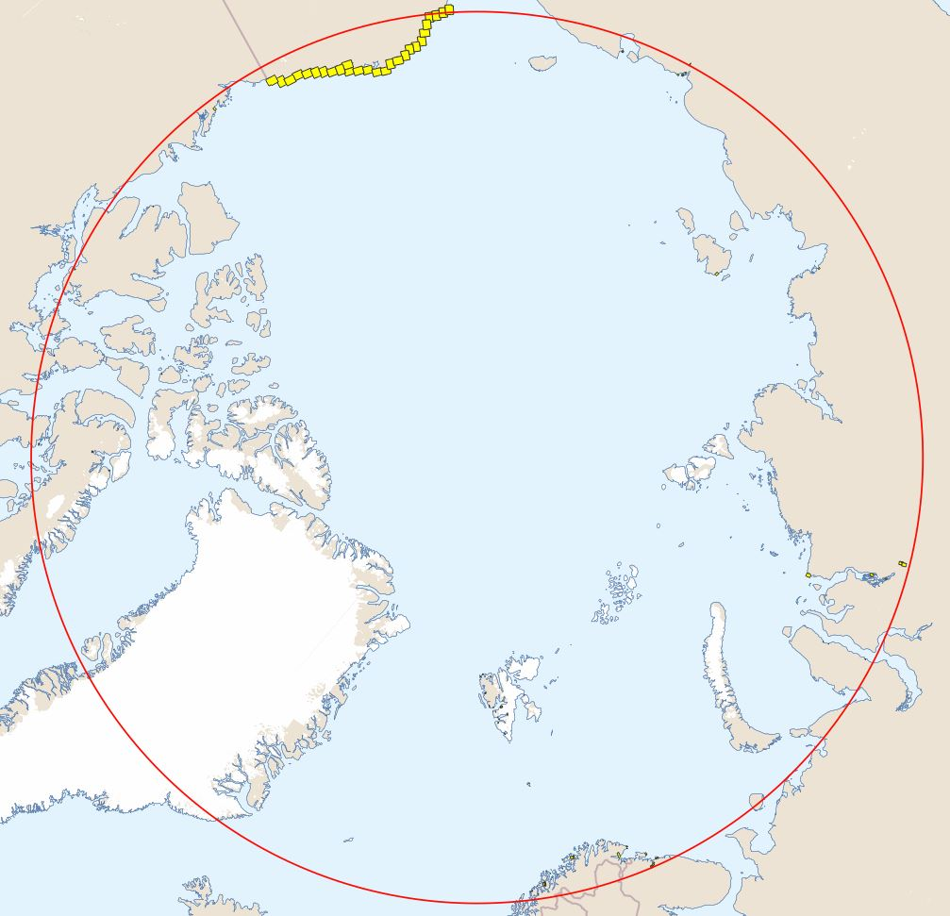
Status of The ENC Scheme UB5/6 in Region N
Usage Band 5
135 ENCs
3 New
Norway:
NO5H2939
NO5G2940
Russian Federation
RU5OSL80
Usage Band 6
23 ENCs

Slide 9
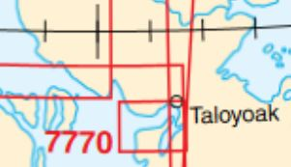
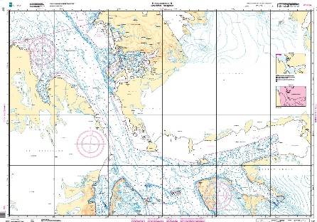
ENC Proposals
Canada – A new UB3 ENC is under production for chart 7770: Spence Bay and Approaches – Due for publication October 2018.
Norway – A new UB3 ENC is planned for chart 537.
United States – NOAA is planning to rescheme its entire ENC suite. Still in planning stages with no set schedule confirmed.

Slide 10
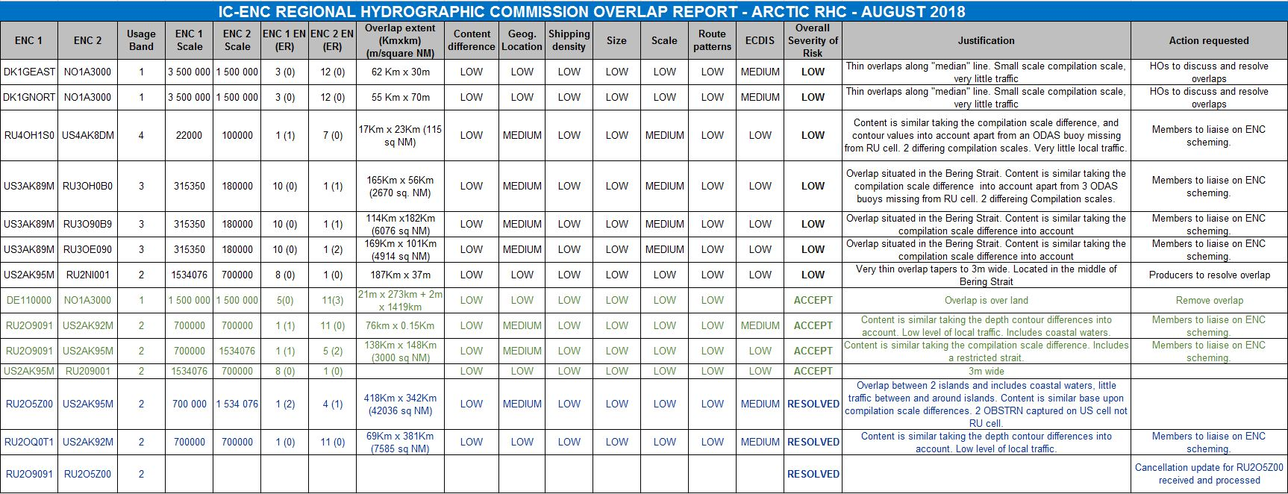
ENC Coverage Issues
IC-ENC Overlap report – relatively small number of overlaps all assessed as ‘low’risk.
Significant progress has been made in eliminating overlaps most notably the collabarative efforts of
The United States and The Russian Federation – See additional report from NOAA.
Norway is currently working in collaboration with Denmark and Germany to eliminate overlaps with the NO1A3000 cell.
Work in progress/ complete on all but two overlapping issues.

Slide 11
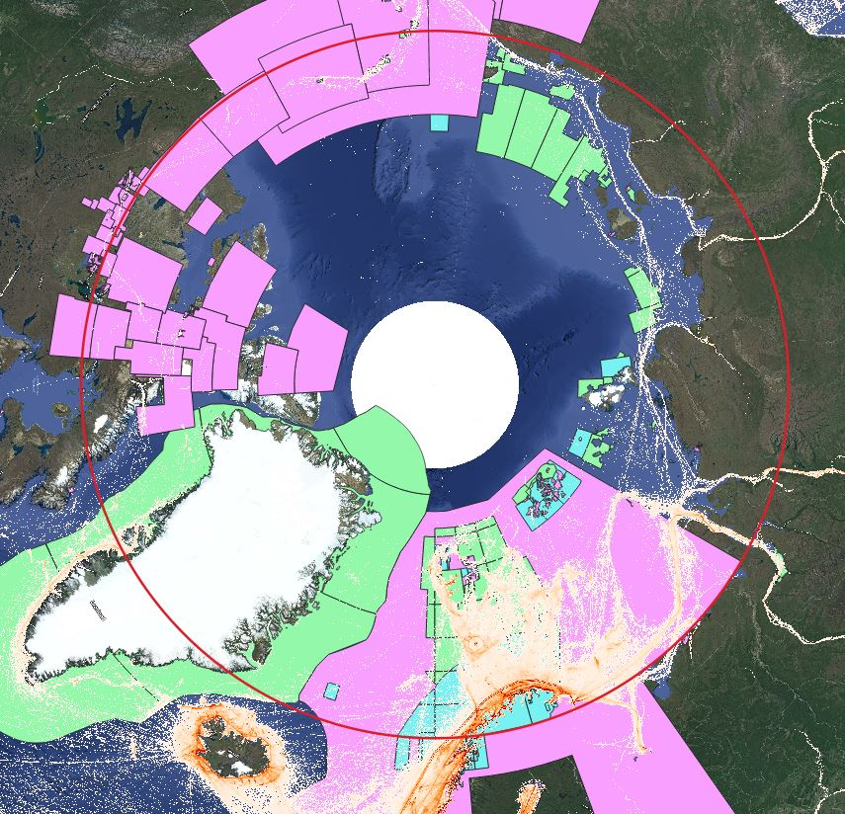
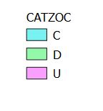
AIS and CATZOC
Utilising Ship traffic data based on AIS and survey data quality to highlight gaps in ENC coverage.
Process in infancy – potential to be of great use in ENC scheming.

Slide 12
The Way Forward
Continue to monitor ENC coverage in Arctic.
Finalise work to eliminate gaps and overlaps in ENC coverage.
Further explore possibilities of using AIS and CATZOC data for ENC Scheming.
Test INToGIS development phase II tools and report back.
Provision of backup requirements for paper chart in accordance with action item ARHC7-21.

Slide 13
Thank you for your attention.

