Slide 1
Overhaul of all IHO communication means and digital revamp of the International Hydrographic Review
Agenda Item 7.2
Reference Document C2-7.2

Slide 2
Conclusions of the Secretariat´s workshop
All IHO existing communication means need a
- New functional design
New creative design
New corporate design
IHO cannot ignore social media any longer.

Slide 3
Basic assumptions on the overhaul of IHO communication means
Social media shall be set up soon;
All communication means shall be centered by design and functionality to the IHO Website;
All other design elements such as for printed media and decoration shall be coherent with the digital design;

Slide 4
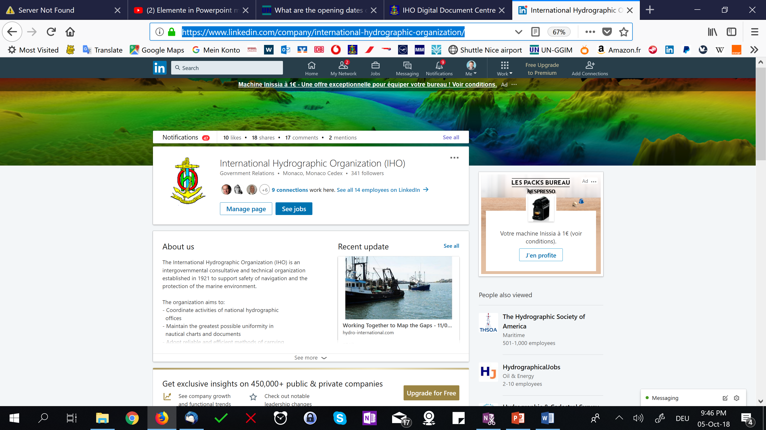
Social media: IHO on LinkedIn
https://www.linkedin.com/company/international-hydrographic-organization/

Slide 5
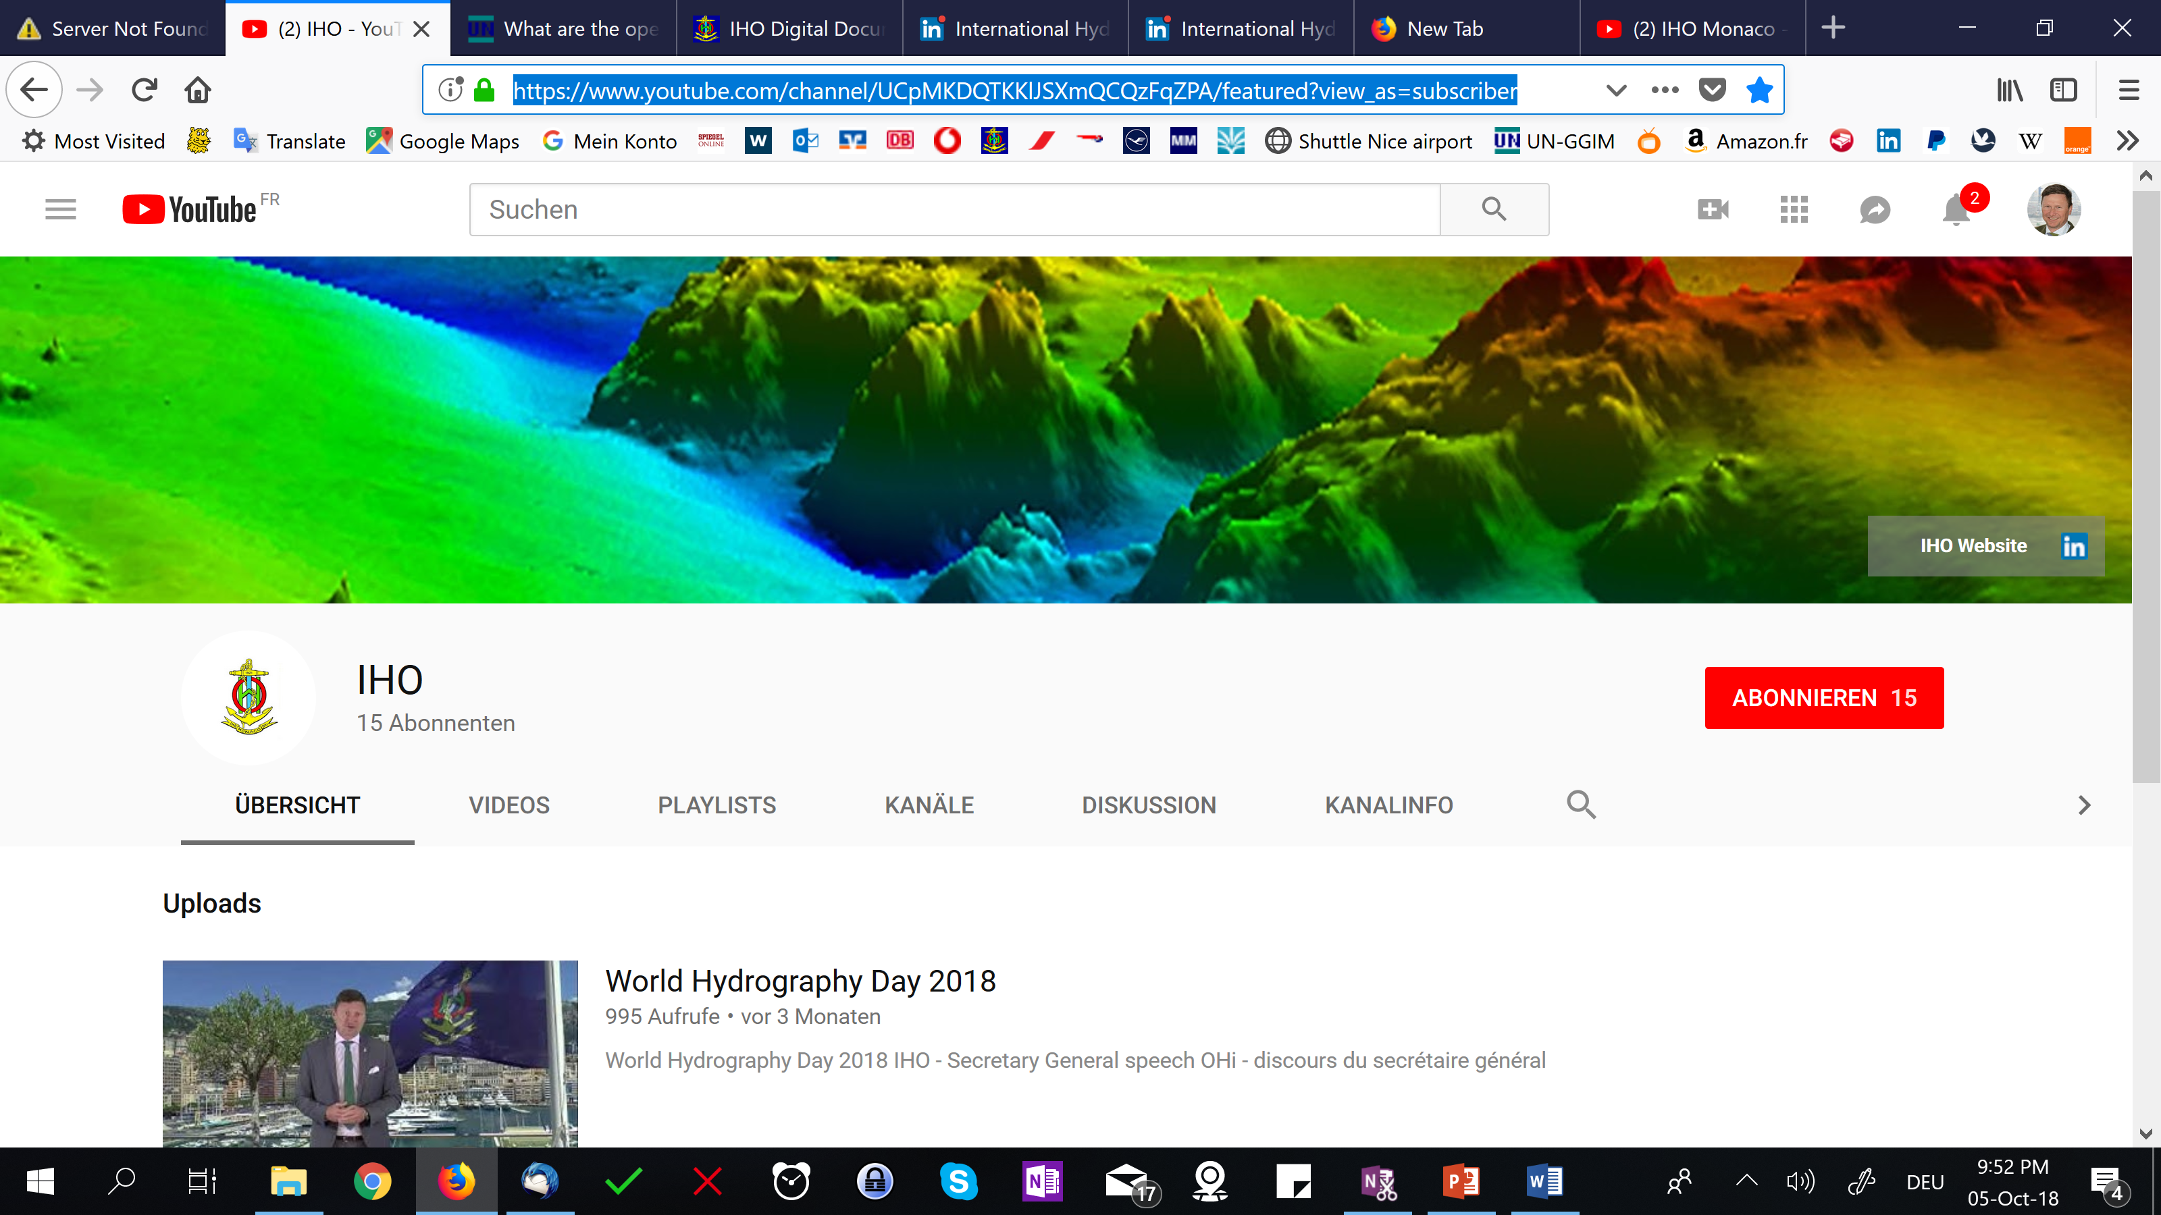
Social media: IHO on youtube
https://www.youtube.com/channel/UCpMKDQTKKlJSXmQCQzFqZPA/featured?view_as=subscriber

Slide 6
Basic functional assumptions IHO website
The IHO website shall feed the following principal user needs:
General information about the IHO such as scope, history, constitution etc;
Organizational structure, work programmes and membership of committees and subordinate working bodies;
IHO Event Calendar and attendance management;
Provision of a wealth of working documents;
Advanced search function;
Embedded GIS services;

Slide 7
IHO website: Technical requirements
the Website shall be technically up to date for modern browser technology;
Responsive HTML-design is required to
maintain all sorts of screen sizes including mobile devices,
To get listed as top results by search engines.
The easy content management by IHO Secretariat’s staff;
Website shall harmonize with social media;
Logging functions to find out who visits and which topics are of main interest.

Slide 8
IHO website: Conclusion for design and functionality
Functional split between operational information and the repository for all sorts of documents;
Access to the documents repository through account (taking example from IMO);
Separate websites for both working languages;
New functional design and new creative design paying respect to tradition but fit for modern technology;
Contractor: Geomares B.V. The Netherlands

Slide 9
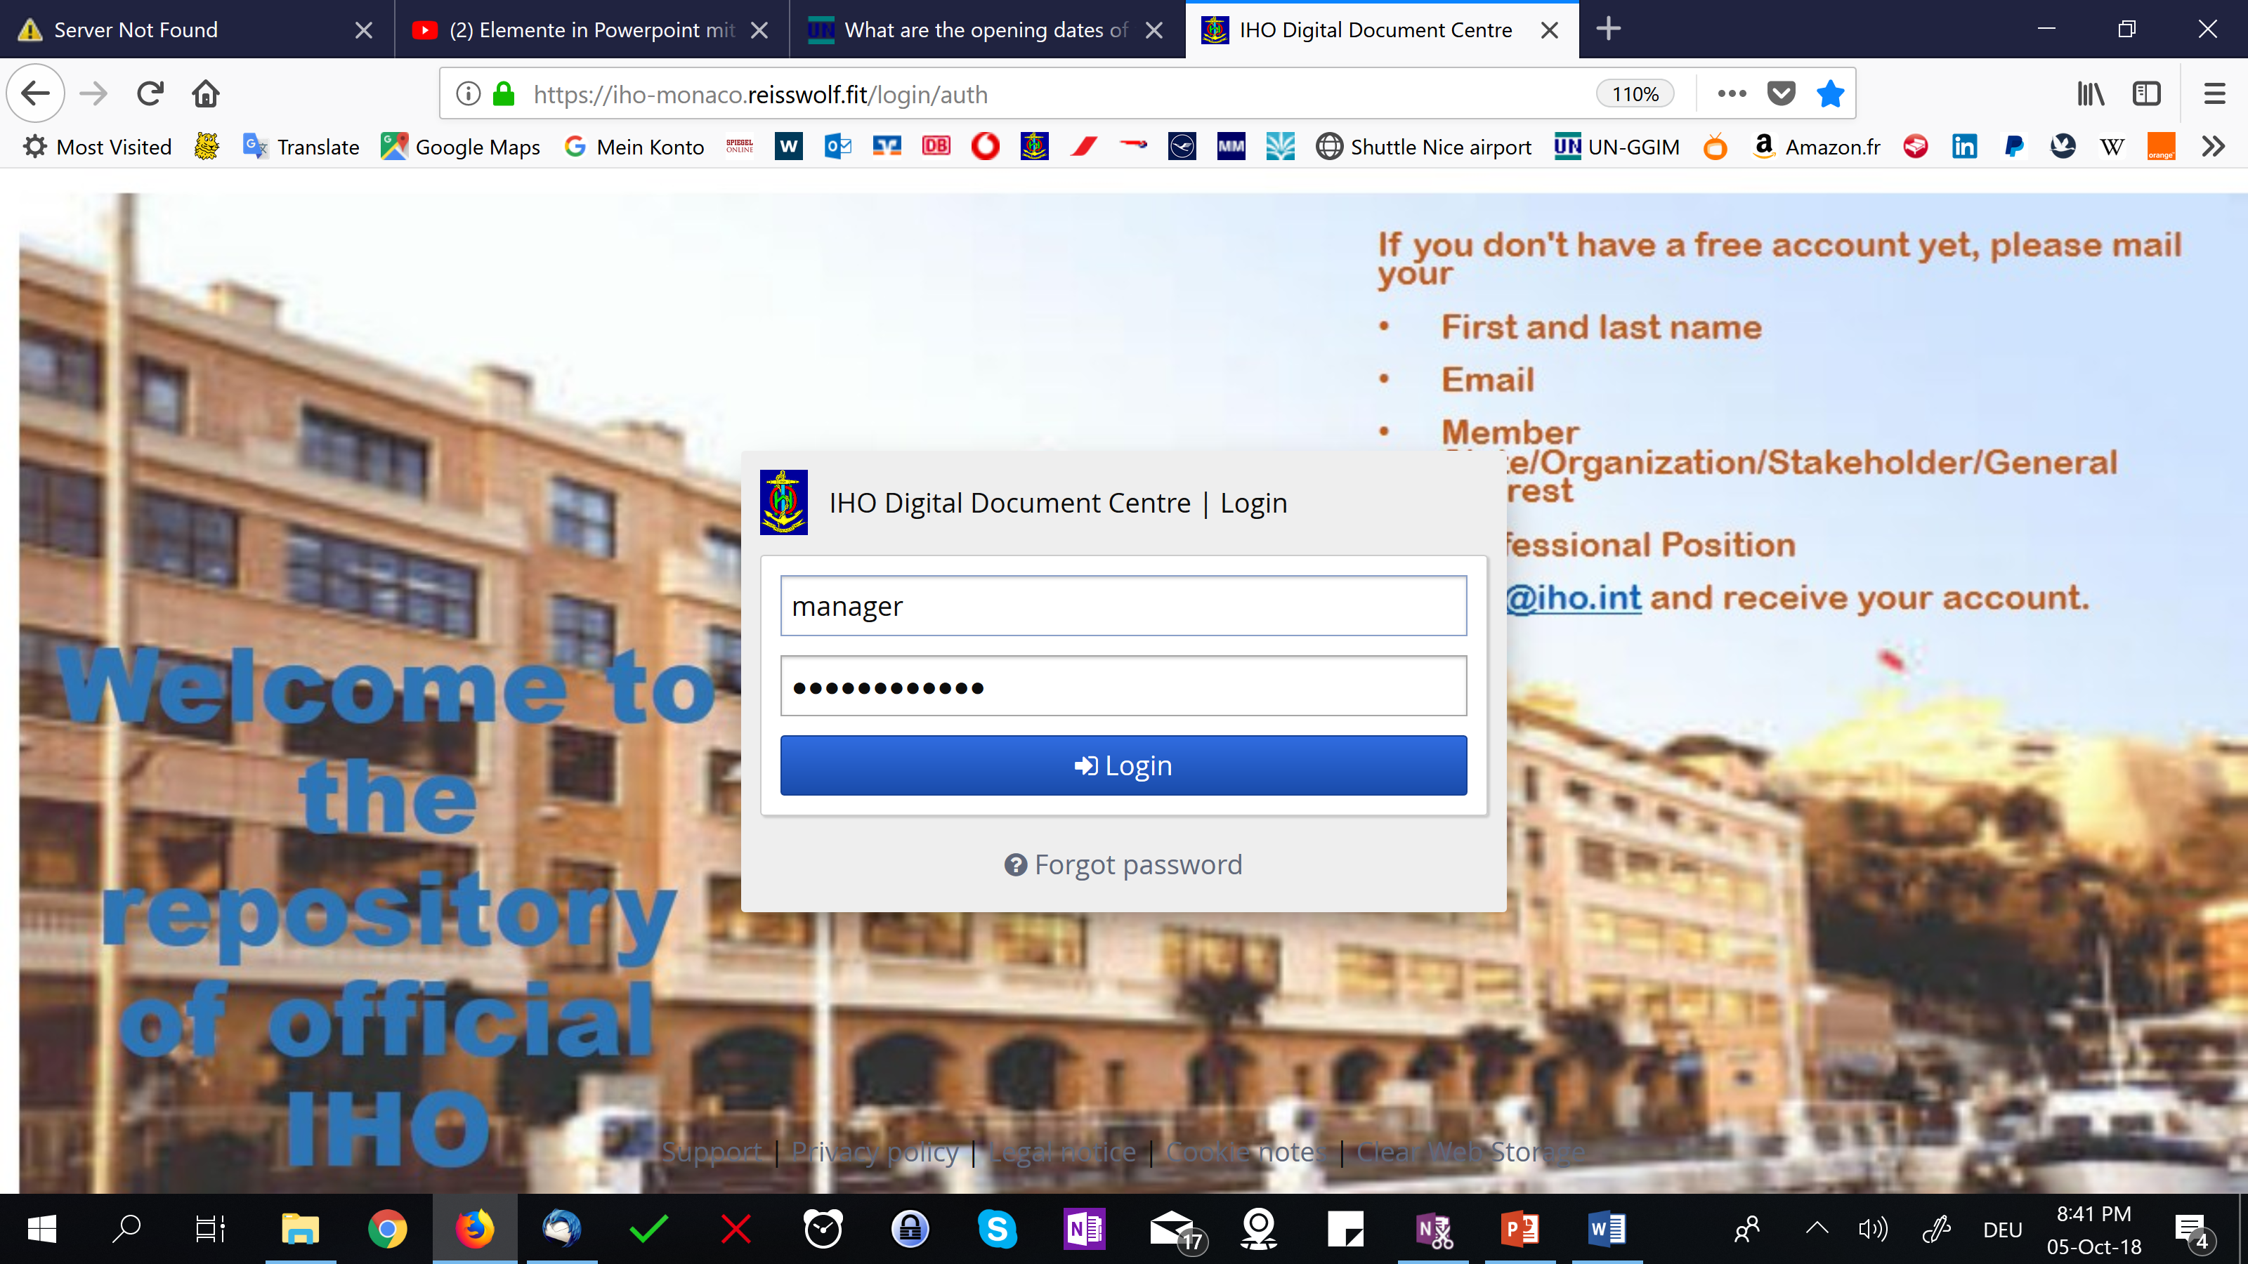
Repository for IHO working documents

Slide 10
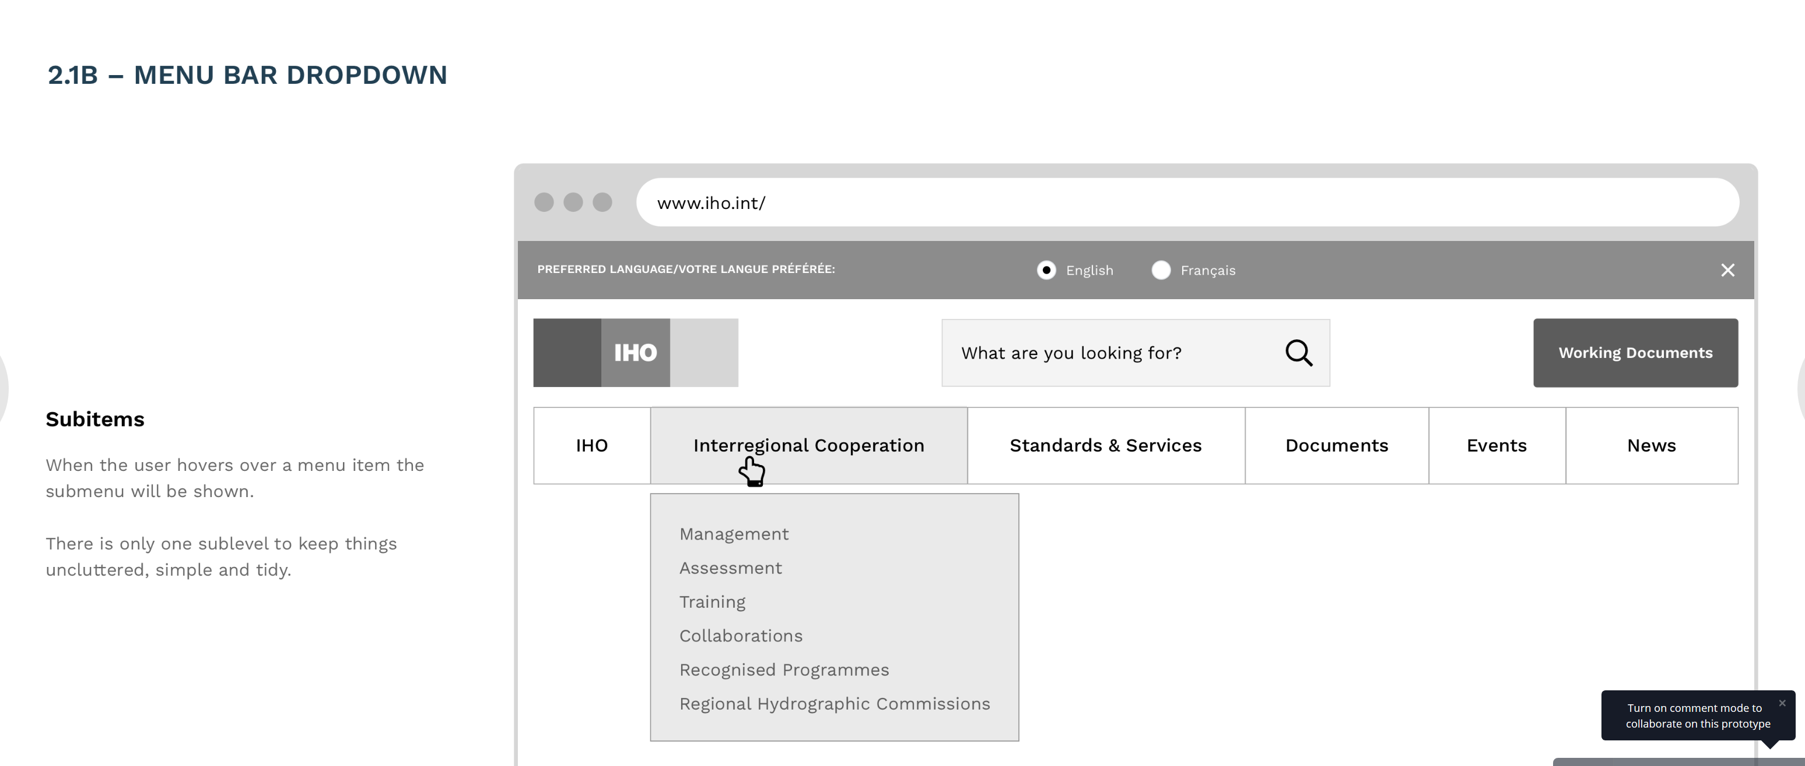
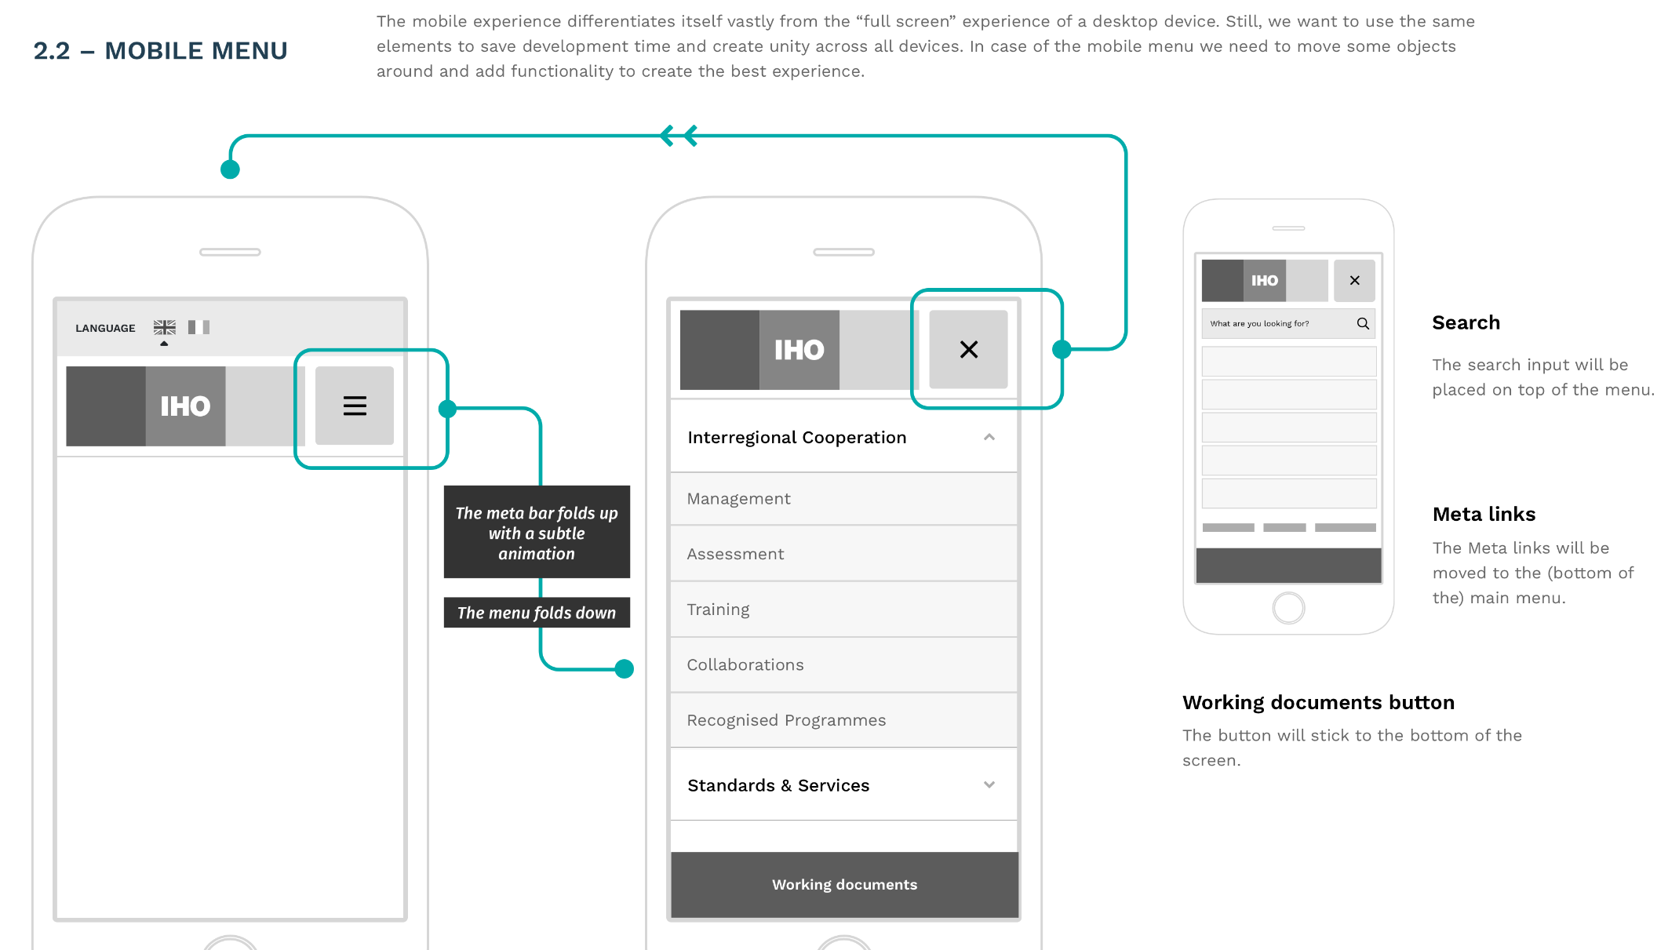
IHO website: new functional design

Slide 11
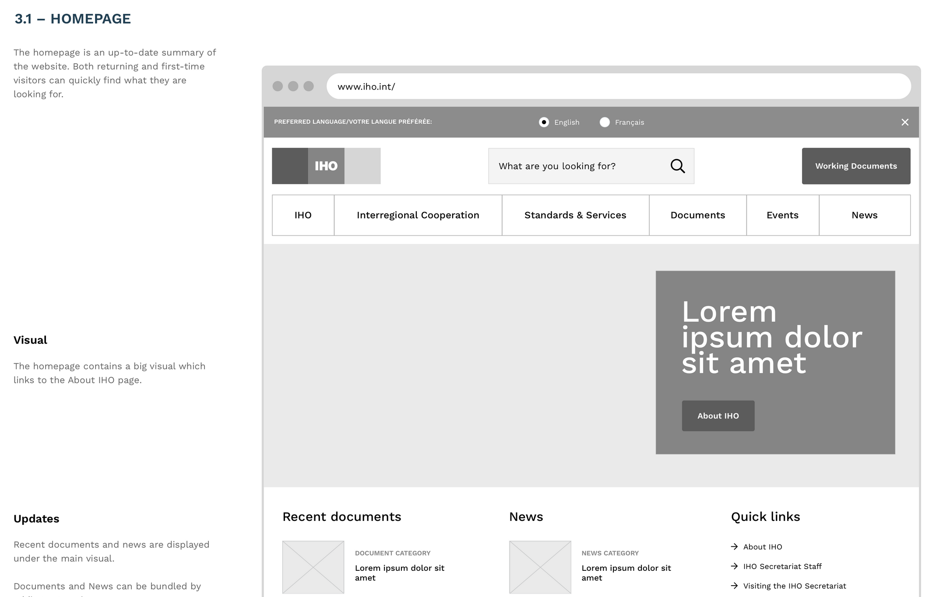
IHO website: new functional design homepage

Slide 12
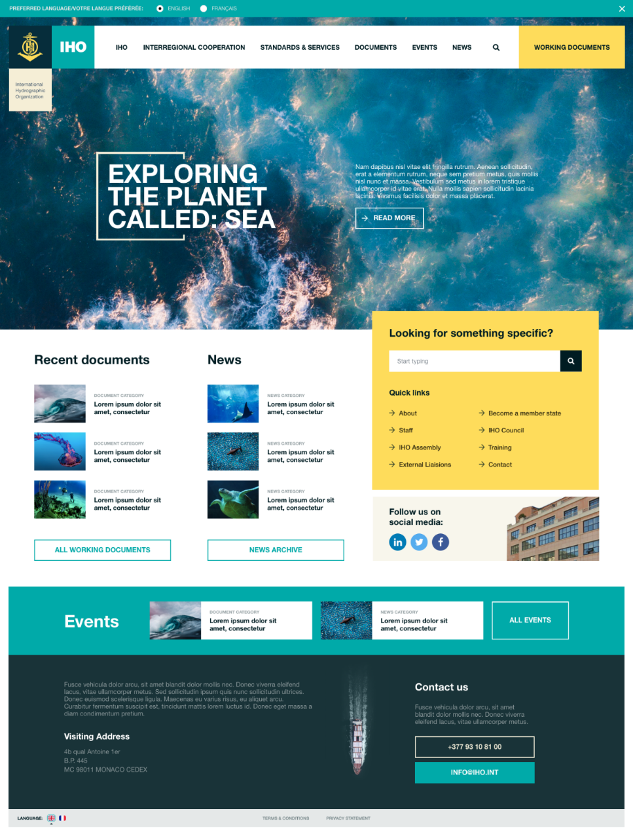
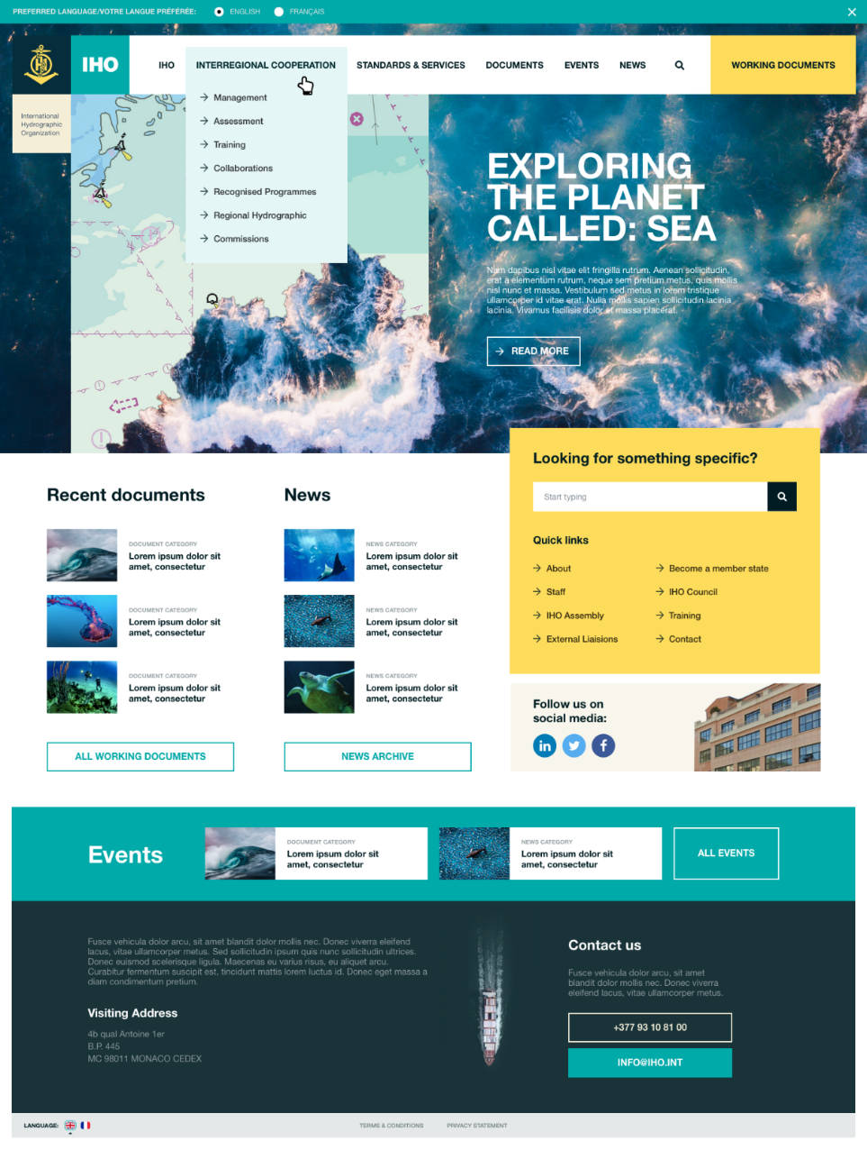
IHO website: new creative design homepage

Slide 13
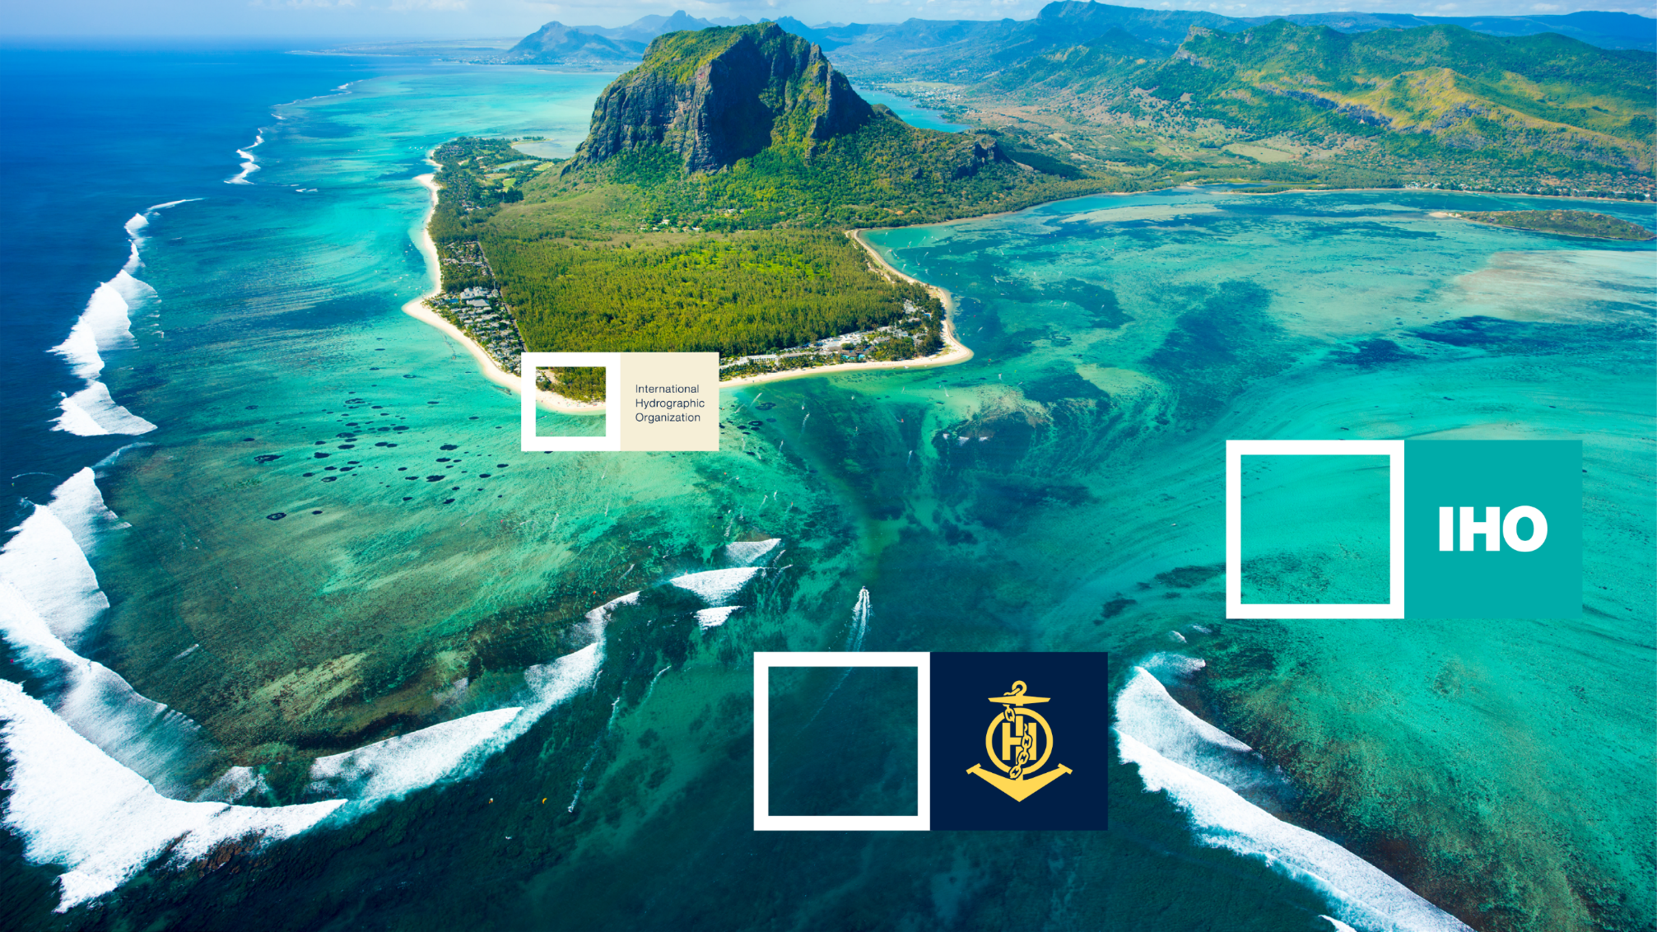
New corporate design: inspirations

Slide 14
New corporate design: new emblem

Slide 15
New corporate design: emblem variations (1)

Slide 16
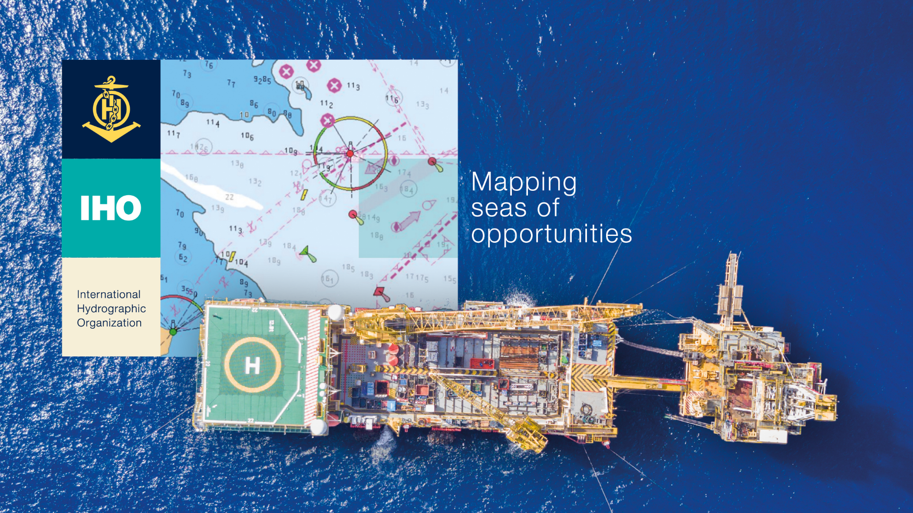
New corporate design: emblem variations (2)

Slide 17
New corporate design: Publications

Slide 18
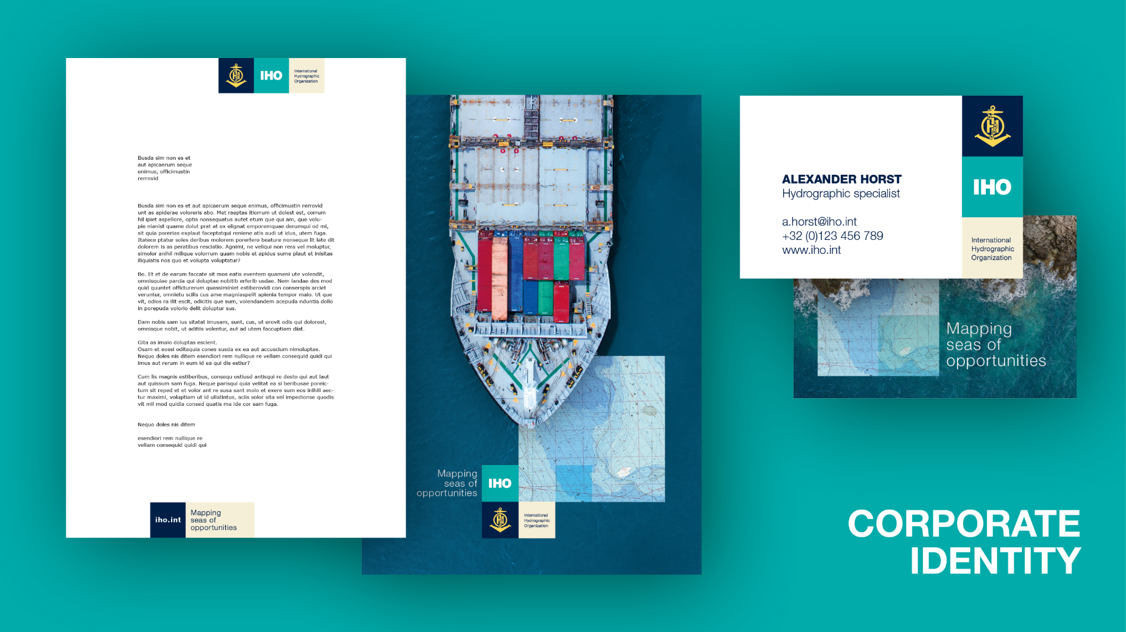
New corporate design: Letters etc.

Slide 19
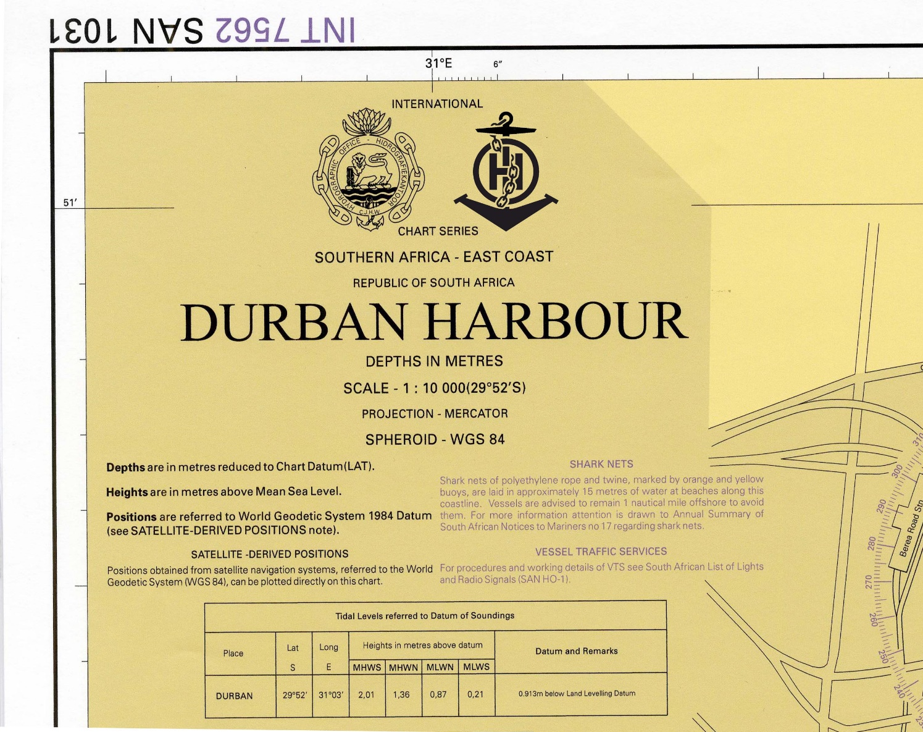
New corporate design: INT Charts

Slide 20
New corporate design: others

Slide 21
IHR: new functional, creative and corporate design
Design the International Hydrographic Review as online publication and printable version (PoD).
Facilitate technical options to create customized topical compilations out from the digital repository of IHR articles for pdf-download and print.

Slide 22
The Council is invited to
take note of the USA´s in-kind contribution through temporary nomination of a seconded social media expert;
endorse the Secretariat´s ongoing activities for the overhaul of all IHO communication means;
discuss and agree about the proposal for a digital revamp of the International Hydrographic Review;
endorse the allocation of additional budget to the Special Projects Fund in 2019 to cover the costs for the digital IHR revamp; and
take any other actions that may be appropriate.

