Slide 1
Report of the representative of the RSAHC on the implementation of ENC Schemes
Saeid Parizi I.R.of IRAN
WORLDWIDE ENC DATABASE WORKING GROUP (WENDWG)

Slide 2
Background
ROPME Sea Area Hydrographic Commission (RSAHC) established in October 2000.
Core Members: Bahrain, IR of Iran, Kuwait, Oman, Pakistan, Qatar, Saudi Arabia, United Arab Emirates.
Associate Members: France, Iraq, United Kingdom, United States of America.
Observers: Regional Organization for the Protection of the Marine Environment (ROPME), Middle East Navigation Service (MENAS). International Association of Marine Aids to Navigation and Lighthouse Authorities (IALA), Arabian Maritime and Navigation Aids Services LLC (AMNAS)
INT Charting Region ‘I’ created on October 2000 in Tehran, I.R. of IRAN.
RSAHC INT Chart Coordination Working Group (RSAICCWG) established in March 2011.
RSAICCWG fully manned – IR of IRAN acting as regional charting coordinator.

Slide 3
Background
RSAHC approved that the development and maintenance of ENC schemes in the region should be coordinated by the RSAICCWG, in place of the RSAHC.

Slide 4
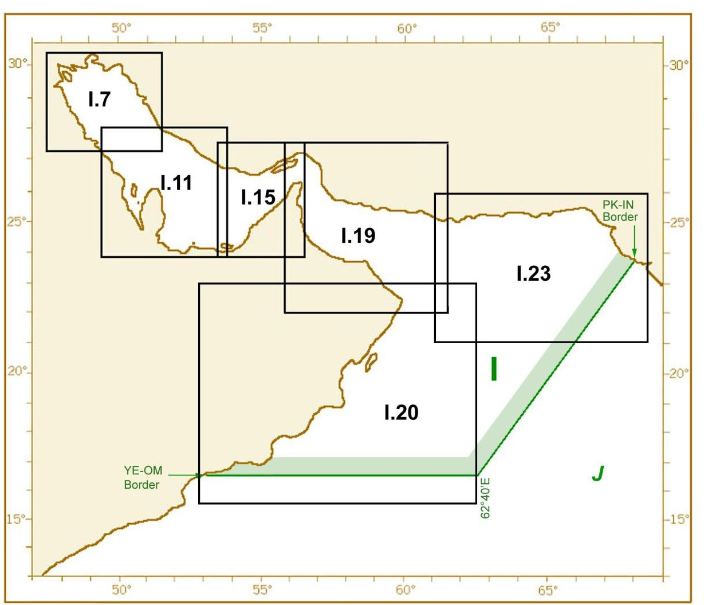
Overview of Region I(Persian Gulf, Oman Sea and Arabian Sea) INT Region IHO COUNCIL

Slide 5
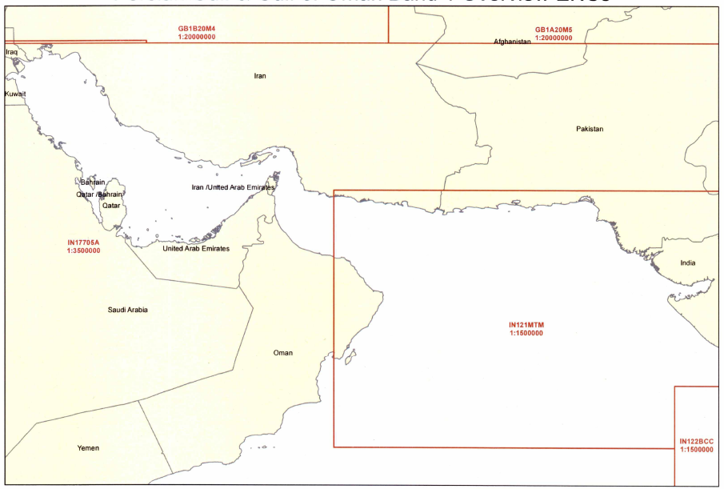
Status of the ENC Scheme UB1 in Region I
Number of ENC |  |  | Usage Band | Scale
To be produced |  | published
2nd stage | 1st stage
- | - | 5 | UB 1 | Overview≤ 1:1,500,000

Slide 6
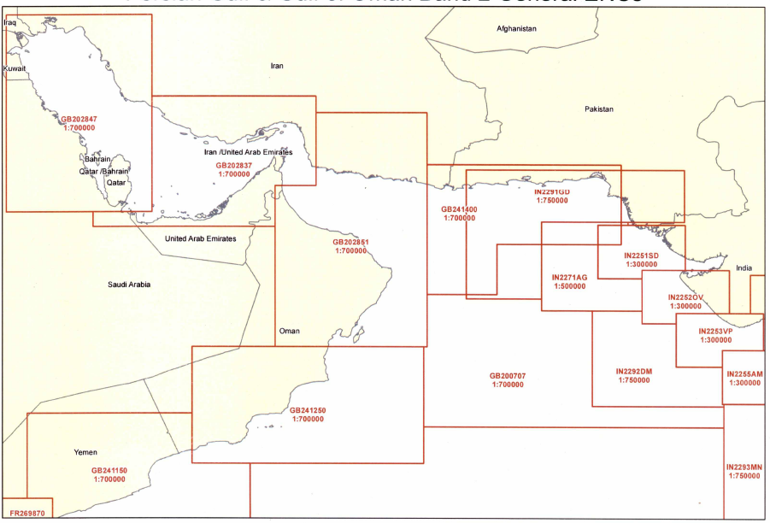
Status of the ENC Scheme UB2 in Region I
Number of ENC |  |  | Usage Band | Scale
To be produced |  | published
2nd stage | 1st stage
- | - | 7+6=13 | UB 2 | 1:1,500,000 < General ≤ 1:350,000

Slide 7
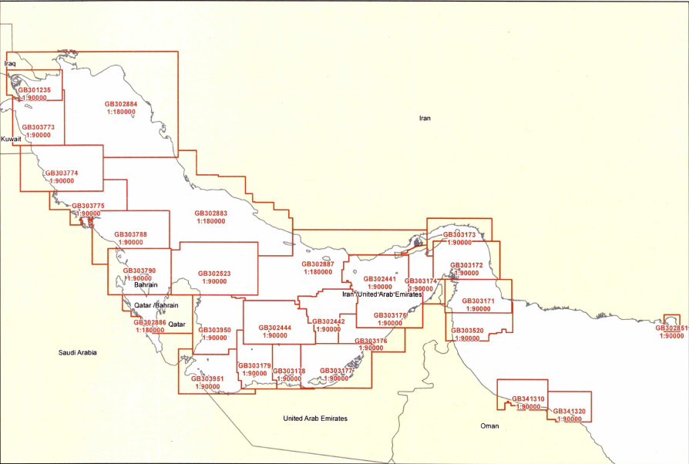
Status of the ENC Scheme UB3 in Region I
Number of ENC |  |  | Usage Band | Scale
To be produced |  | published
2nd stage | 1st stage
- | 20 | 11+35= 46 | UB 3 | 1:350,000 < Coastal ≤ 1:90,000

Slide 8
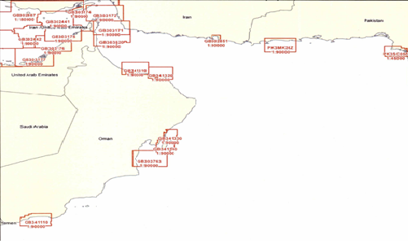
Status of the ENC Scheme UB3 in Region I

Slide 9
Status of the ENC Scheme UB3 in Region I ( I.R. of Iran)

Slide 10
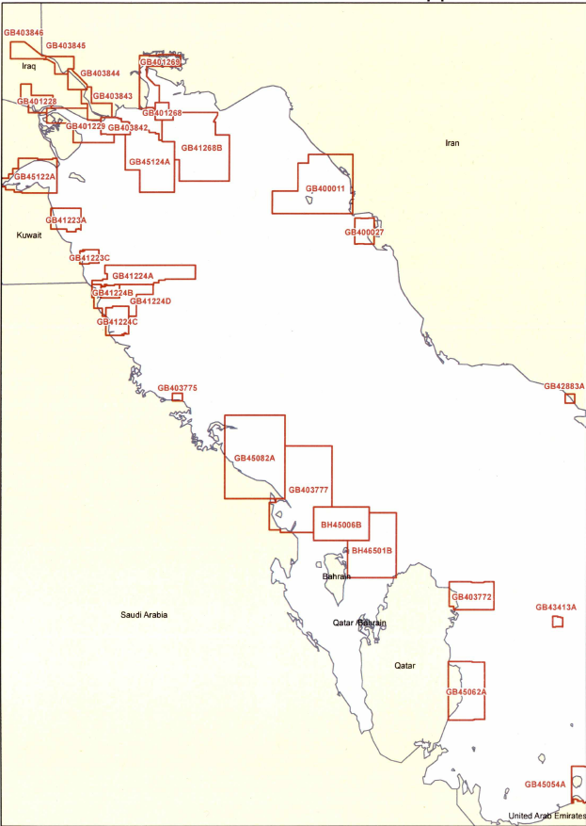
Status of the ENC Scheme UB4 in Region I
Number of ENC |  |  | Usage Band | Scale
To be produced |  | published
2nd stage | 1st stage
24 | 20 | 29+57= 86 | UB 4 | 1:90,000 <Approach ≤ 1:22,000

Slide 11
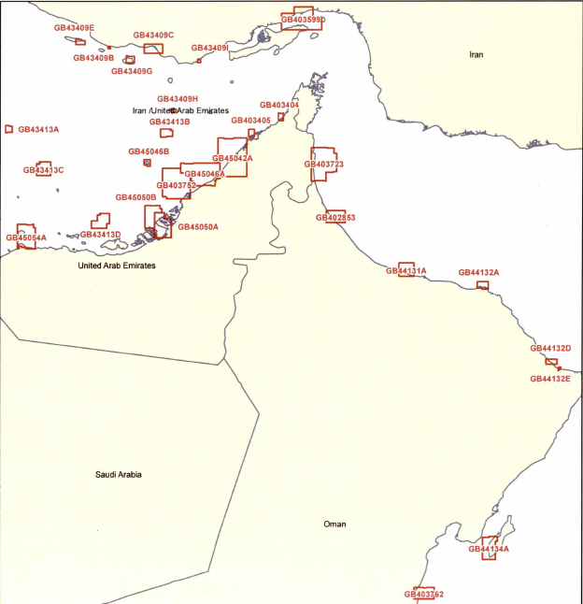
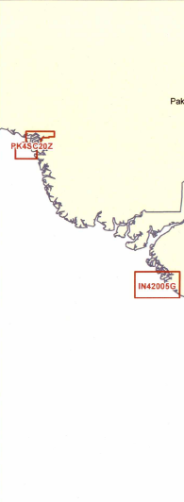
Status of the ENC Scheme UB4 in Region I

Slide 12
Status of the ENC Scheme UB4 in Region I ( I.R. of Iran)

Slide 13
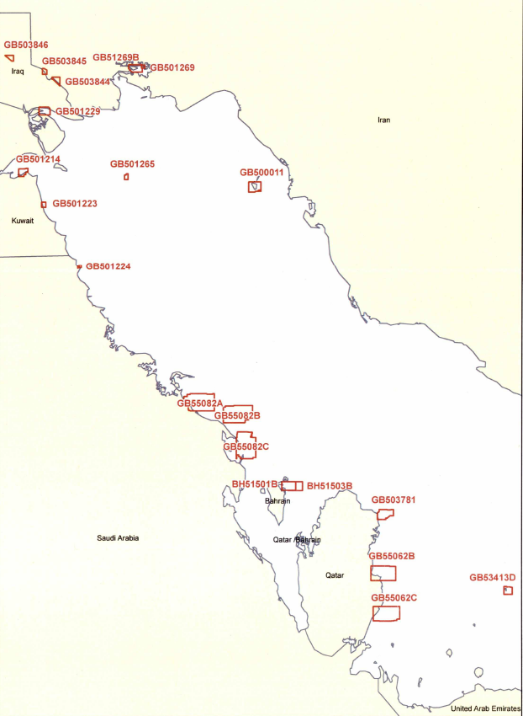
Status of the ENC Scheme UB5 in Region I
Number of ENC |  |  | Usage Band | Scale
To be produced |  | published
2nd stage | 1st stage
8 | 14 | 1 +43= 44 | UB 5 | 1:22,000 <Harbour ≤ 1:4,000

Slide 14
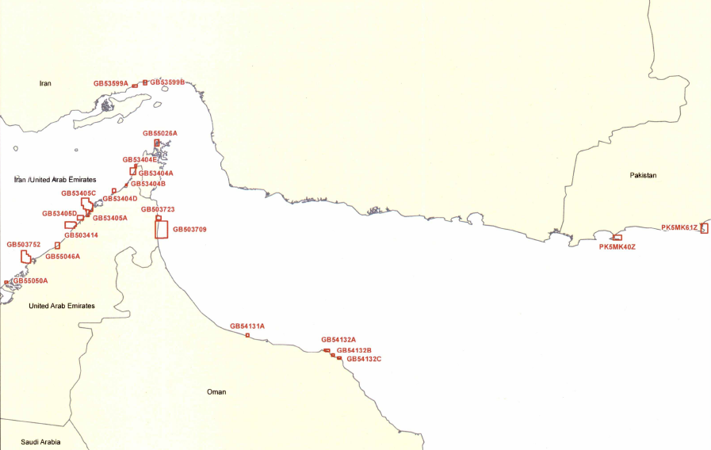
Status of the ENC Scheme UB5 in Region I

Slide 15
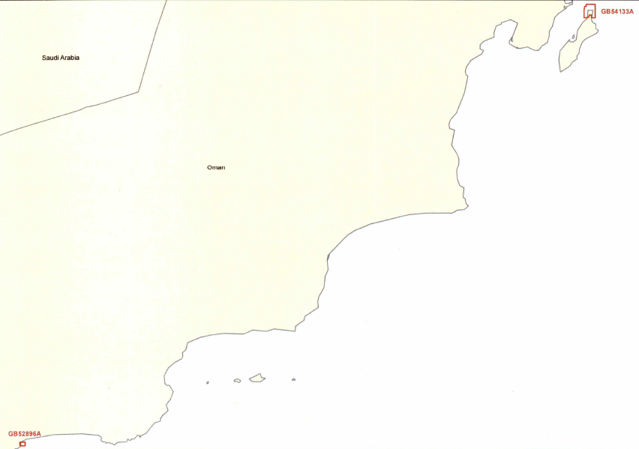
Status of the ENC Scheme UB5 in Region I
Number of ENC |  |  | Usage Band | Scale
To be produced |  | published
2nd stage | 1st stage
- | - | 5 | UB 1 | Overview≤ 1:1,500,000
- | - | 7+6=13 | UB 2 | 1:1,500,000 < General ≤ 1:350,000
- | 20 | 11+35 | UB 3 | 1:350,000 < Coastal ≤ 1:90,000
24 | 20 | 29+57 | UB 4 | 1:90,000 <Approach ≤ 1:22,000
8 | 14 | 1 +43 | UB 5 | 1:22,000 <Harbour ≤ 1:4,000
7 | - | - | UB 6 | 1:4,000 <Berthing

Slide 16
Status of the ENC Scheme UB5 in Region I ( I.R. of Iran)

Slide 17
Coverage issues, gaps and risk assessment analysis
Bellow information are based on the latest data which we had from the member States of RSAHC:
The main navigational passage of Bahrain is adequately covered by ENCs.
Pakistan has an issue of ENC covered INT751 with India national ENC at the same band.
UAE is intending to join a RENC in near future but so far they have not produced ENC.
Oman joined to IC-ENC and so far they have produced 14 ENC cells, but not released yet.
Pakistan has produced 8 ENC cells.
KSA does not have any ENC produced for Region I.
IR of Iran has produced 41 ENC cells for the coastal waters in north of the Persian Gulf and is releasing 12 more ENC cells covering coastal waters of I. R. of Iran in Oman Sea and Strait of Hurmuz.

Slide 18
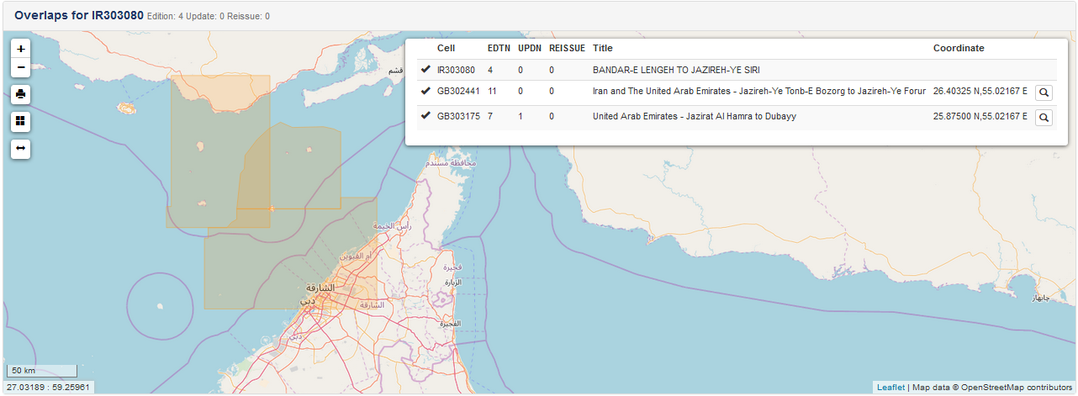
Overlaps in RSAHC Region
….

Slide 19
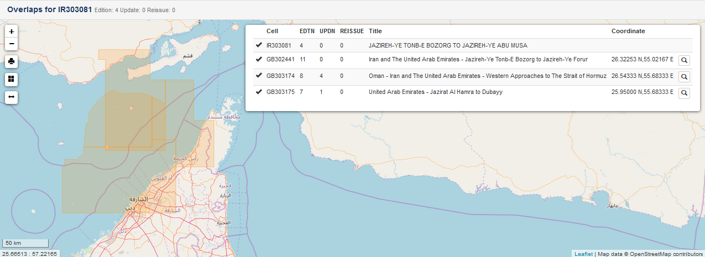
Overlaps in RSAHC Region
….

Slide 20
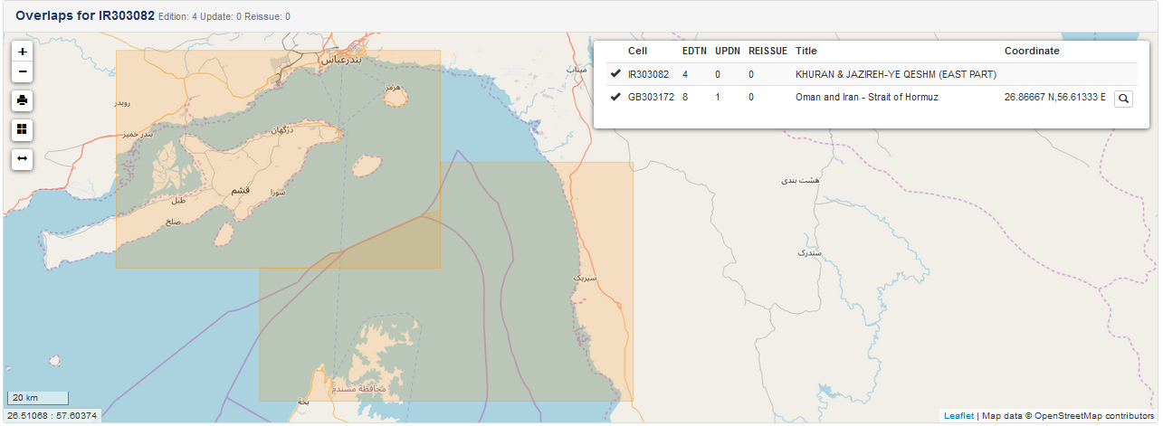
Overlaps in RSAHC Region
….

Slide 21
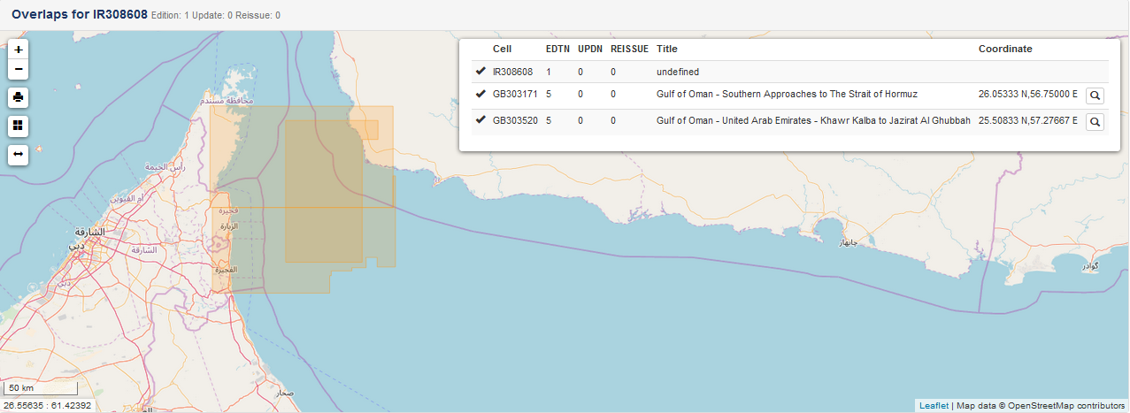
Overlaps in RSAHC Region
….

Slide 22
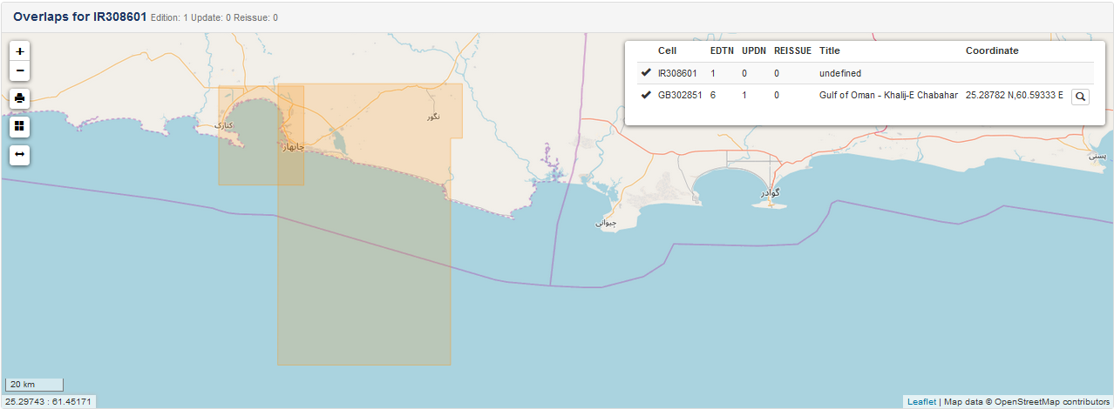
Overlaps in RSAHC Region
….

Slide 23
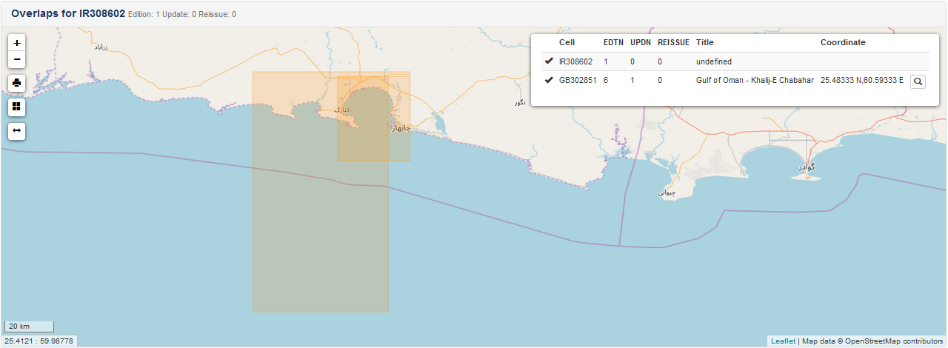
Overlaps in RSAHC Region
….

Slide 24
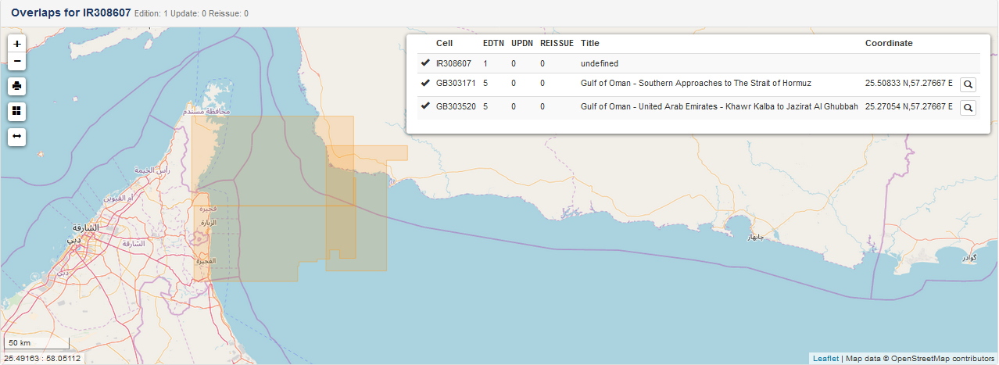
Overlaps in RSAHC Region
….

Slide 25
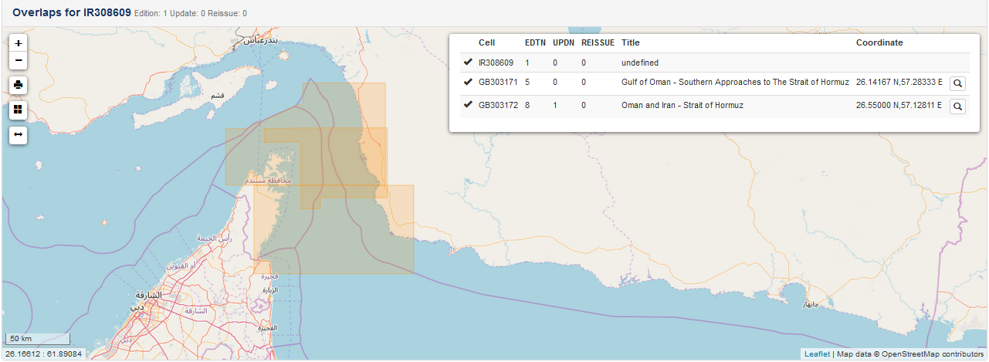
Overlaps in RSAHC Region
….

Slide 26
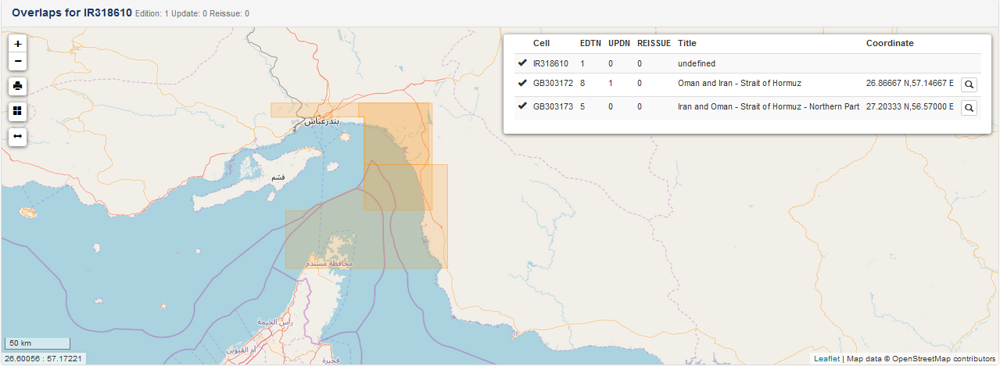
Overlaps in RSAHC Region
….

Slide 27
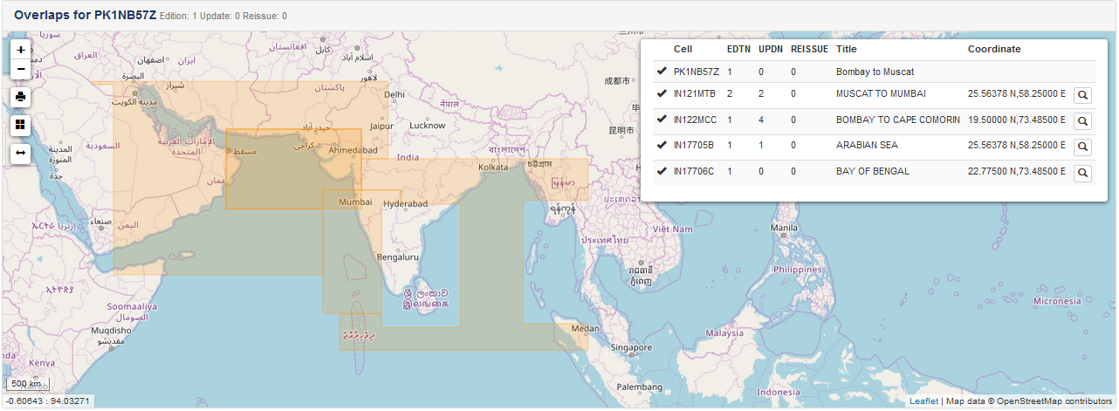
Overlaps in RSAHC Region
….

Slide 28
Actions requested of WENDWG/IRCC
WENDWG is invited to note the report from RSAHC

