Slide 1
INToGIS PROJECT II Presented by KHOA (Yong BAEK)
IHO-ROK Technical Cooperation Project

Slide 2
Background (1/2)
Purpose of the INToGIS Project
Support International Chart Scheme of S-11
Provide systematic management procedures and functionality
Share the digital data among the IHO MSs and other parties with common data format such as EXL, SHP and GML (S-128)
Main outcomes of Project 1(2014~2015)
S-11 Part B INT chart DB modelling
S-11 Part B GIS Database
Tool for Management rules according to S-11
INT chart Web-service for the catalogue and manager system

Slide 3
Background (2/2)
Requirements
Base map for Polar regions (Artic & Antarctic)
ENC scheme management procedures (S-11)
Additional layers for 500 world ports and AIS traffic density information
Connection between IHO ENC catalogue and INToGIS systems
Improve the chart display functions
User Feedbacks from HOs, regional coordinator
And other improvements

Slide 4
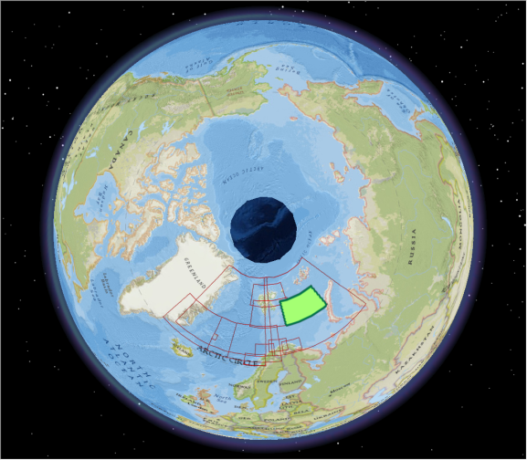
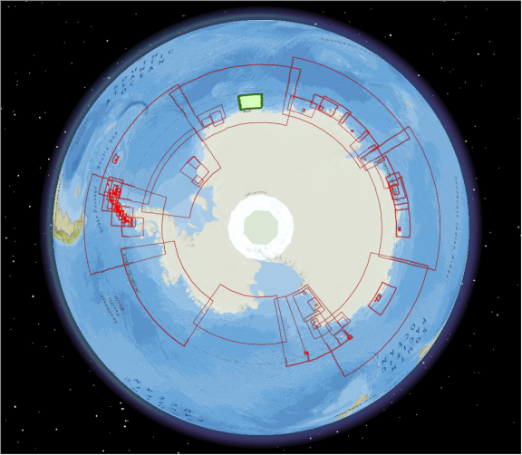
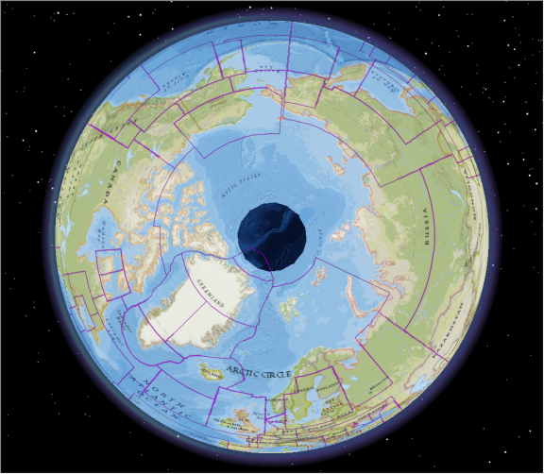
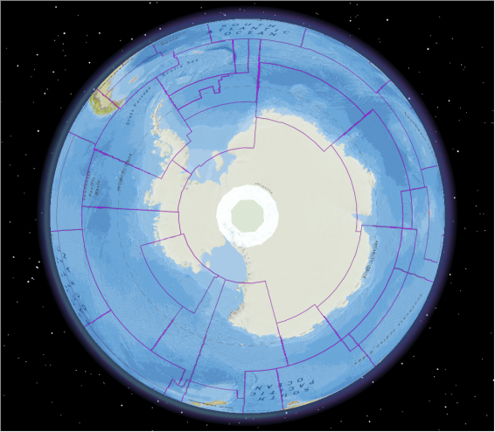
Improvement (1/8)
1. Base map of Polar region
Both INT Chart and ENC Scheme
Apply to the management procedures
INT Chart Arctic
INT Chart Antarctic
ENC Scheme Arctic
ENC Scheme Antarctic

Slide 5
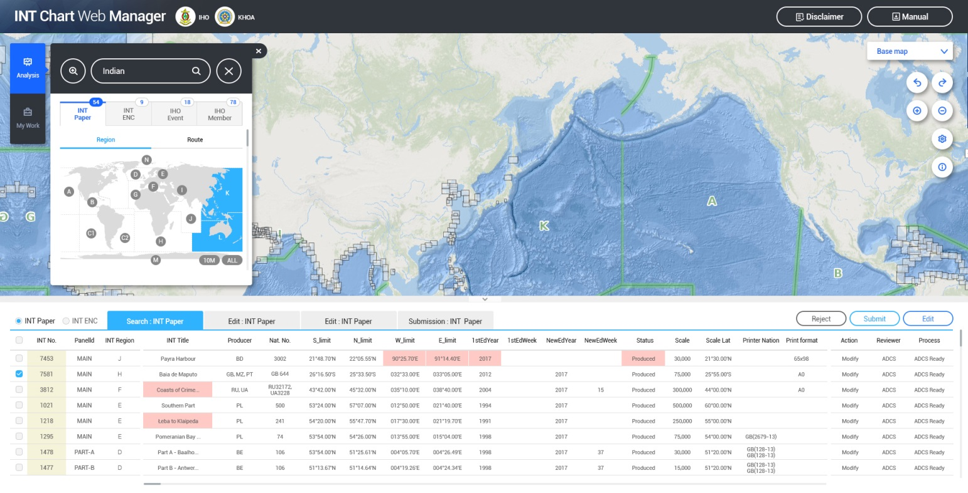
Improvement (2/8)
2. ENC scheme Management procedure
Management workflow
(HO→ICCWG→IHO Sec.→DB)
Search options / Various Base Maps / Database for ENCs

Slide 6
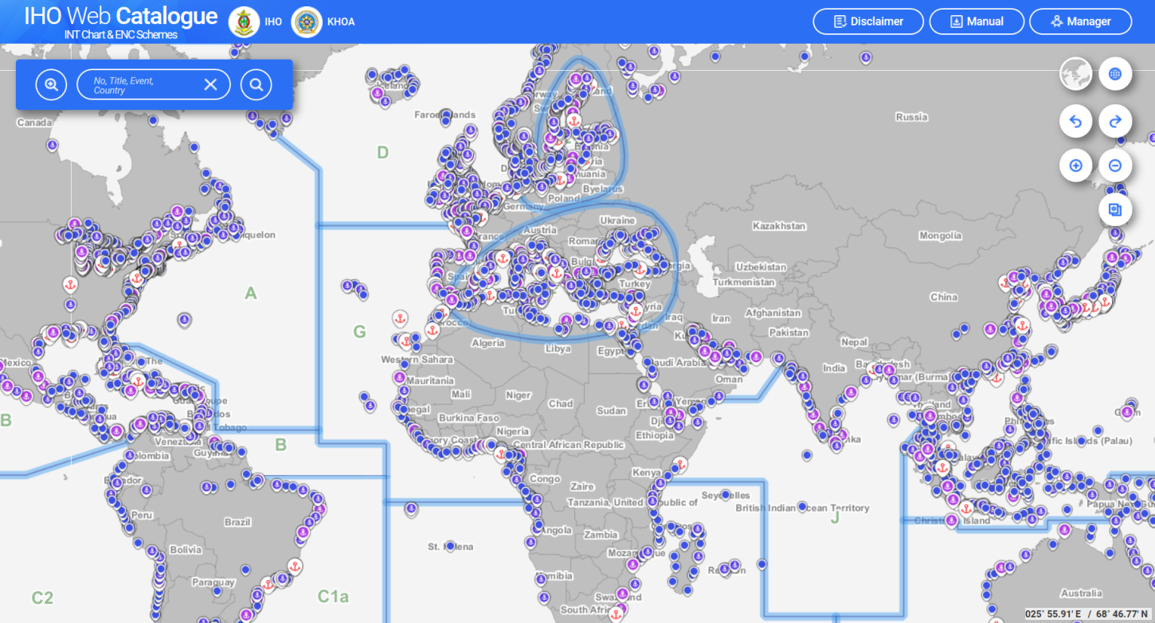
Improvement (3/8)
World Port
3. World Port layer
Size Code | Count | Harbor Size
L | 159 | Large
M | 362 | Medium
S | 992 | Small
V | 2166 | Very Small
Source from NGA

Slide 7
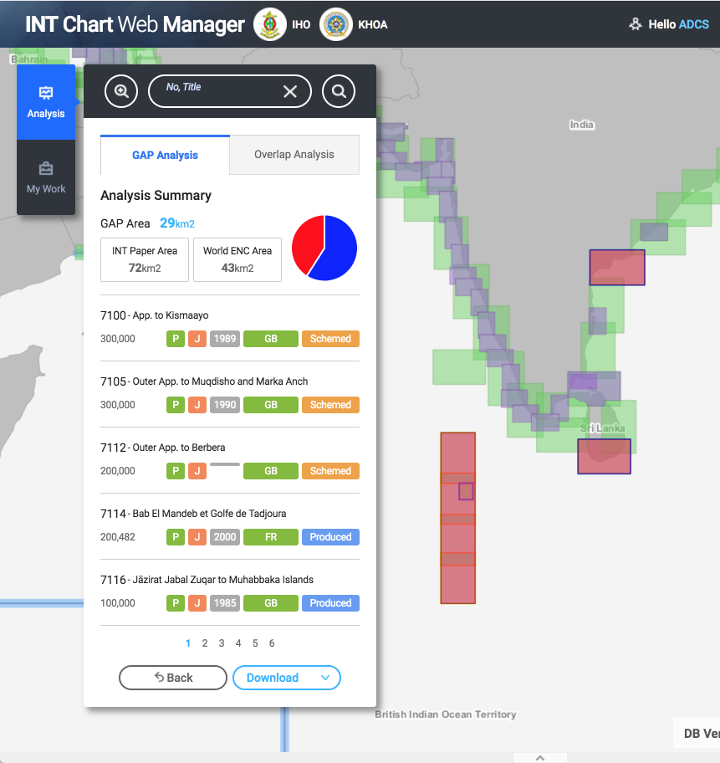
Improvement (4/8)
1
* Select a country
4. ENC scheme : Gap finder
2
3
Comparison between INT Chart and ENC
4
Analysis button: Show analysis window
Gap Analysis Menu: Show detailed conditions for gap analysis
Step 1: Select an INT chart and ENC to be analyzed
Step 2: Select INT Region or country
Step 3: Select a scale
Step 4: Set tolerance (+ / - )
5
6

Slide 8
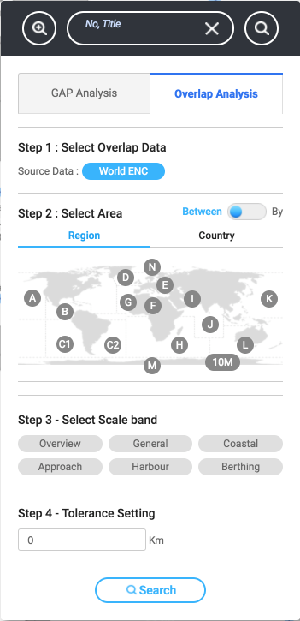
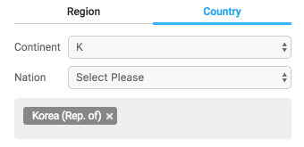
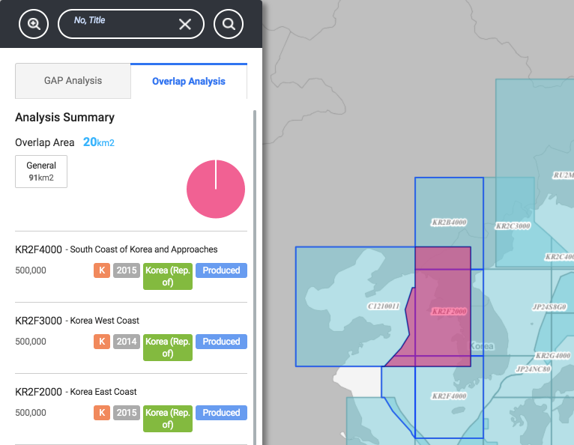
Improvement (5/8)
* Select two regions/countries
5. ENC scheme :
Overlapping checker
1
2
3
* Select one region/country
4
5
6

Slide 9
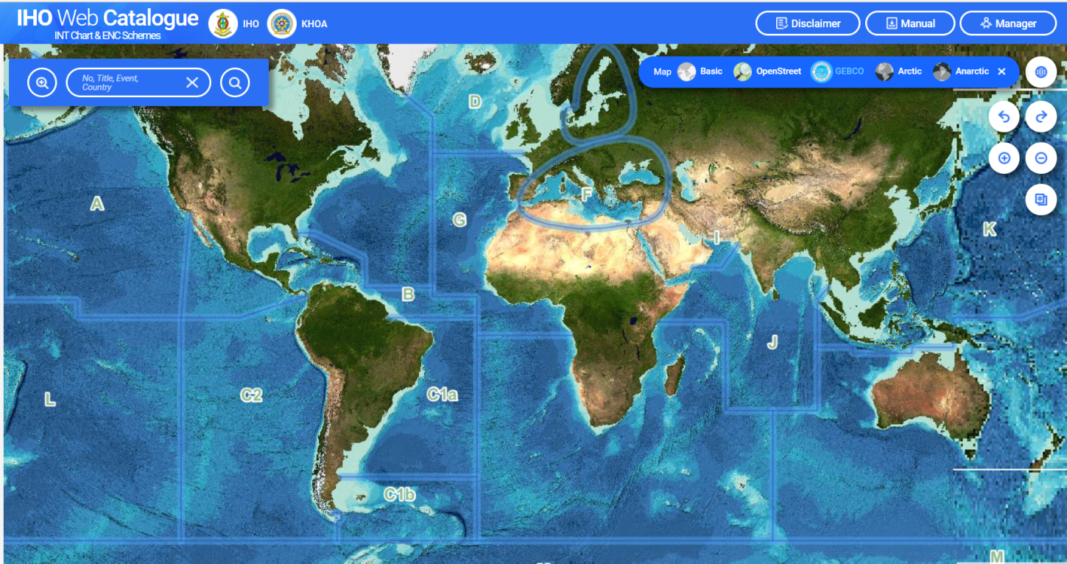
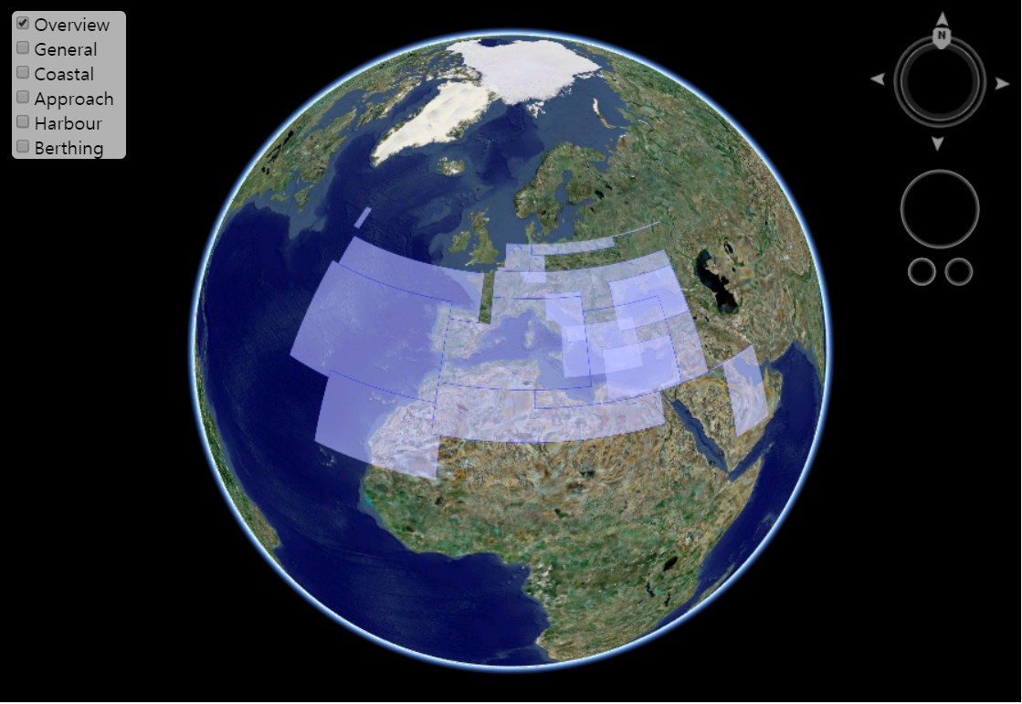
Improvement (6/8)
6. Other improvements
1) GEBCO Base Map
2) 3D Globe

Slide 10
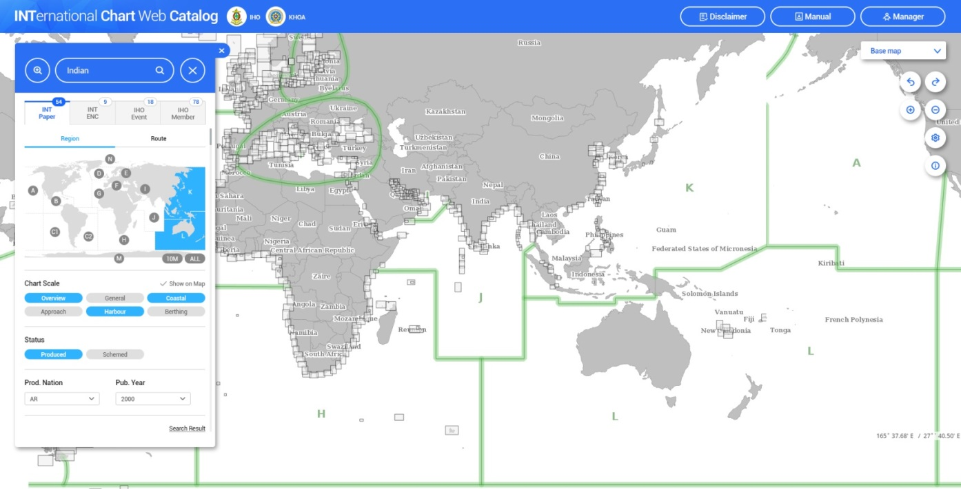
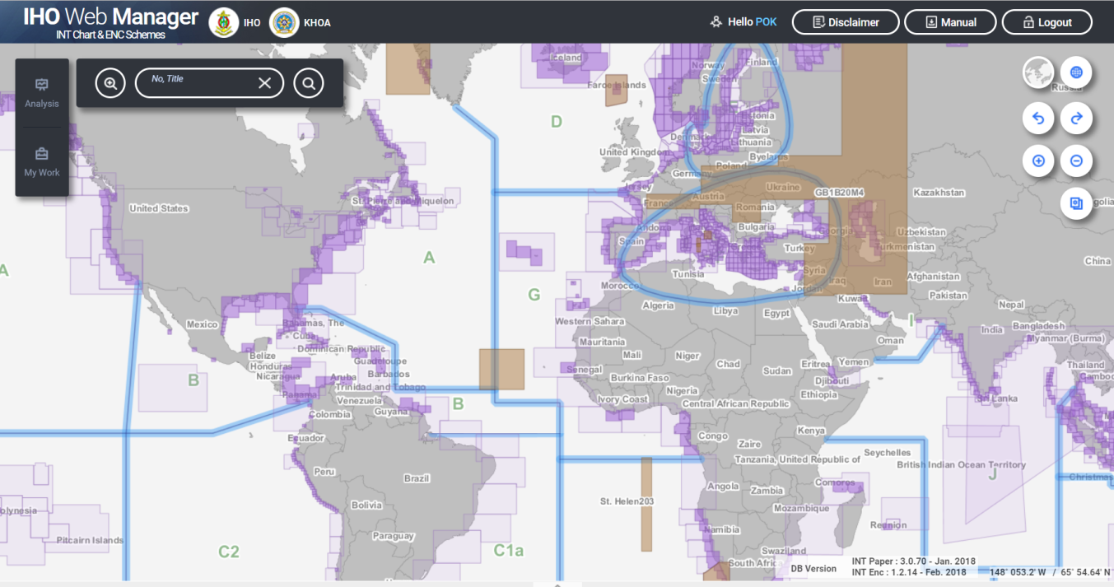
Improvement (7/8)
6. Other improvements
3) Renewal of INTOGIS interface
Web Catalogue
Web Manager

Slide 11
Improvement (8/8)
6. Other improvements
4) Additional layers
AIS traffic density layer
IHO meeting & event layer
IHO member states layer
CATZOC layer
d. Functions
Email notification
Update contents …

Slide 12
Development Status
Design and develop DB (Oct. 2017)
Develop the new interface and functions (Nov. 2017)
Create additional layers (Nov. 2017)
Test operation (Nov. 2017 ~ early 2018)
Run the New INToGIS system (TBD)

Slide 13
Thank you

