Slide 1
8th WENDWG meeting
20 – 22 March 2018
Buenos Aires
Unveiling of ENC depth information
Friedhelm Moggert-Kägeler, SevenCs

Slide 2
Introduction of SevenCs

Slide 3
Introduction SevenCs
Located in Hamburg, founded in 1992
7Cs belongs to ChartWorld International group of companies (Digital Chart Agent, ECDIS Manufacturer, VAR, ENC and SENC distribution services)
Products and Services related to ENC / ECDIS
Long term member of IHO Working Groups
TSMAD and Colours & Symbols
S-100 Working Group, ENC Working Group
Contributor to S-100/S-101 Testbed

Slide 4
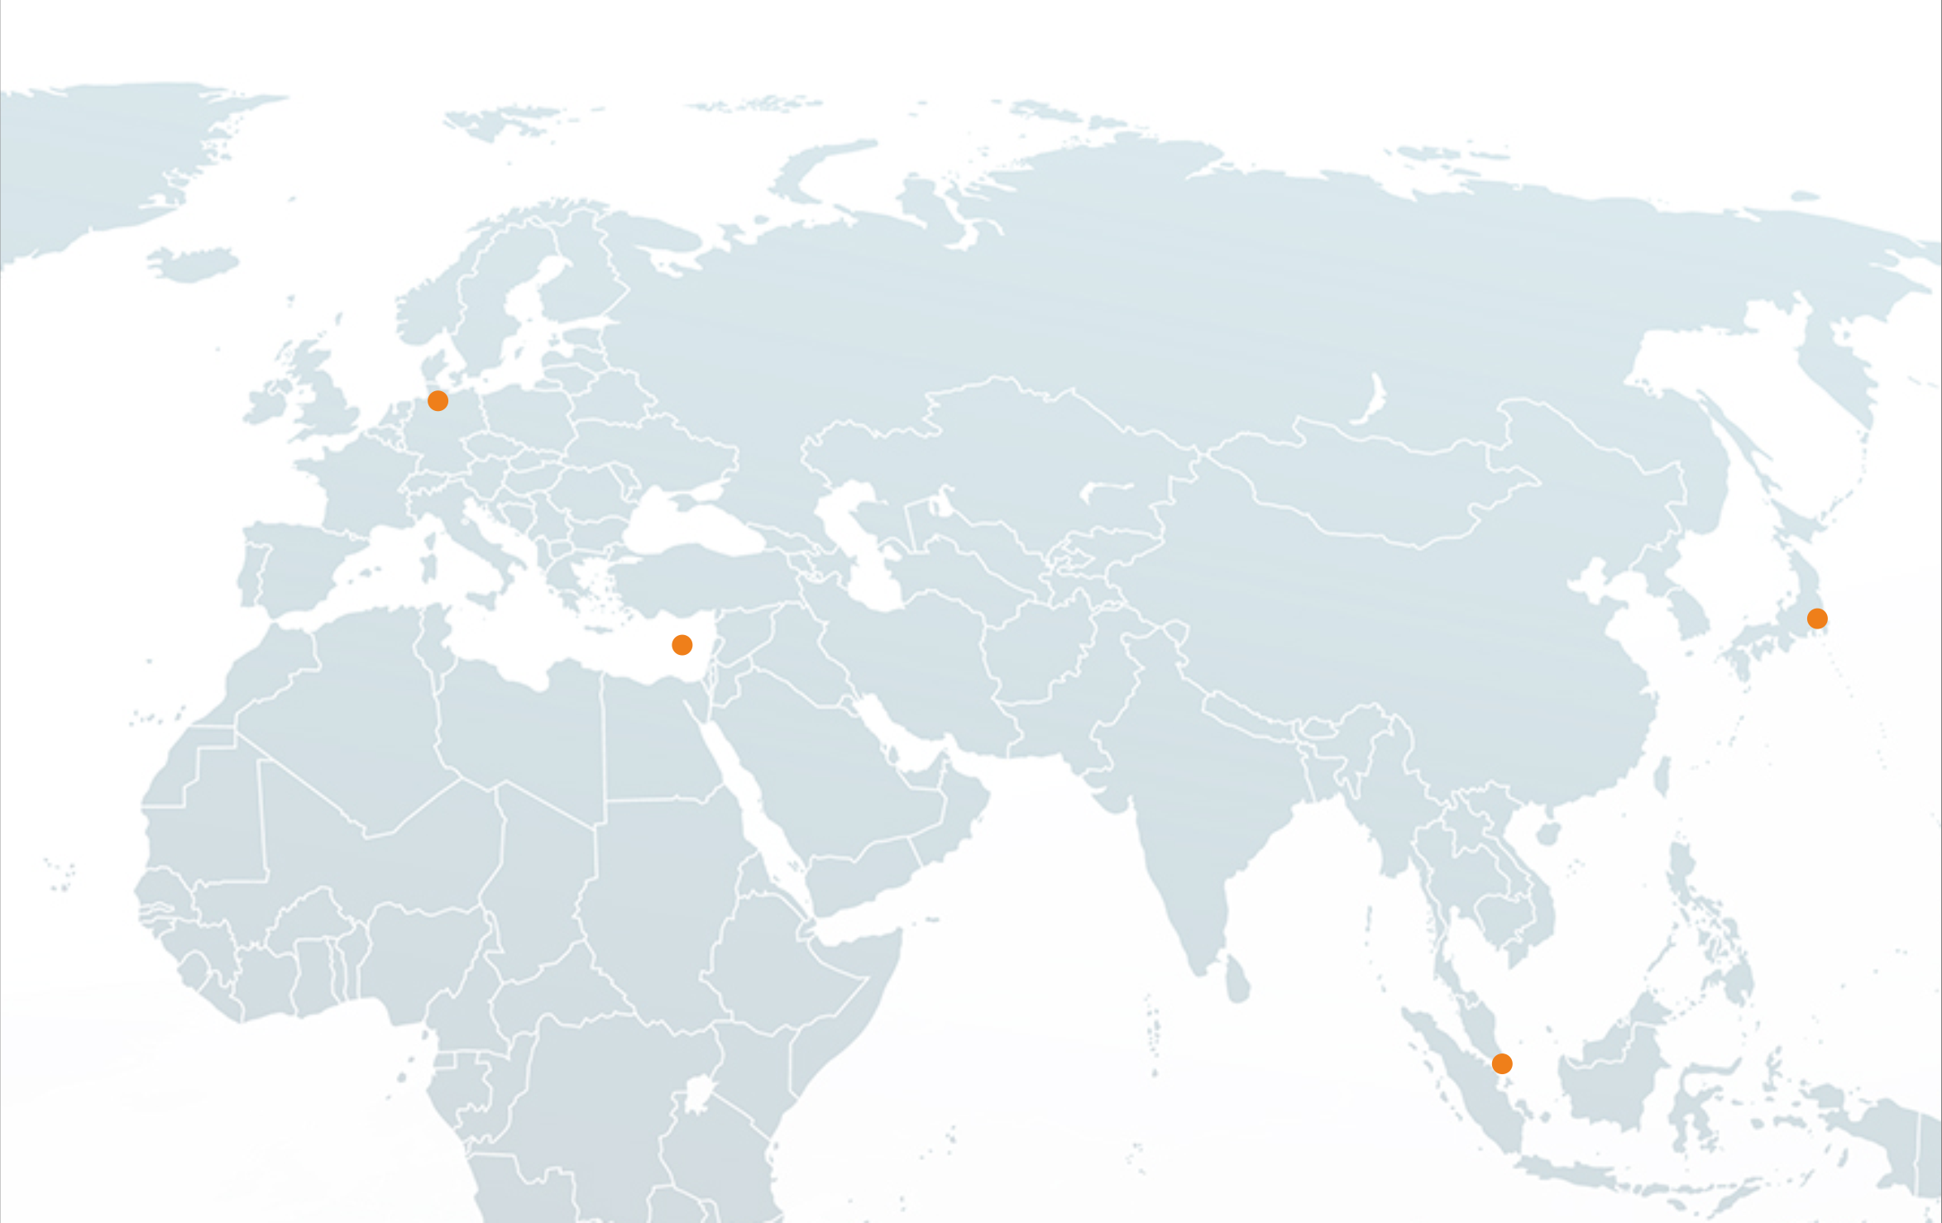
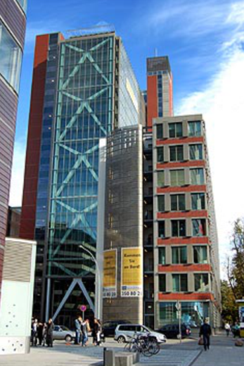
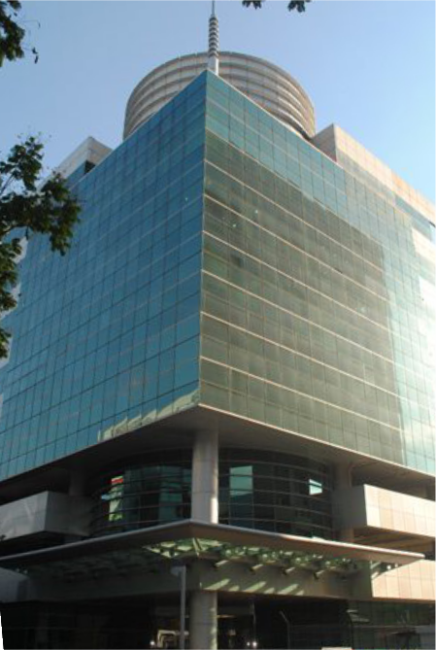
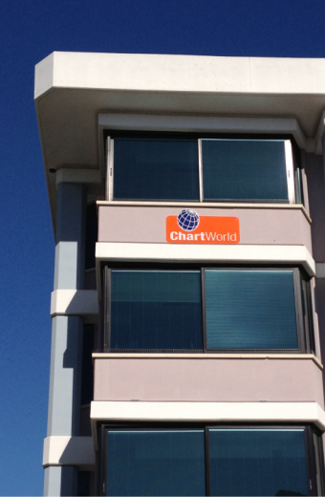
Founded in 1992
80+ Employees
4 Office locations
Hamburg
Limassol
Tokyo
Singapore

Slide 5
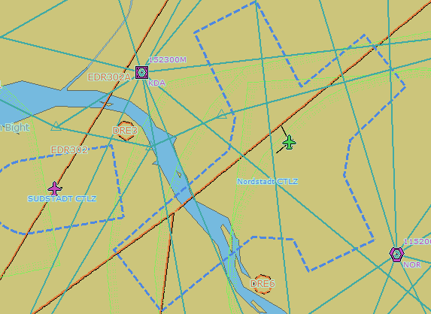
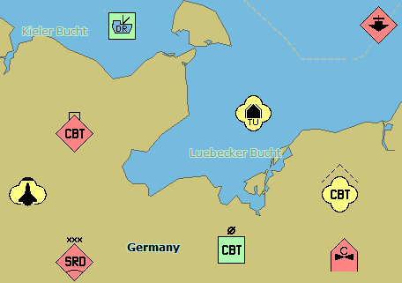
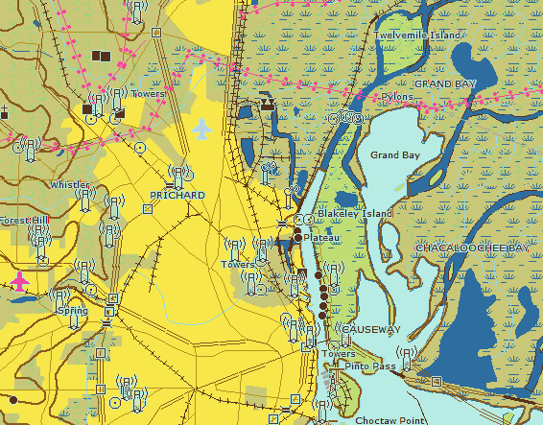
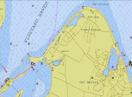
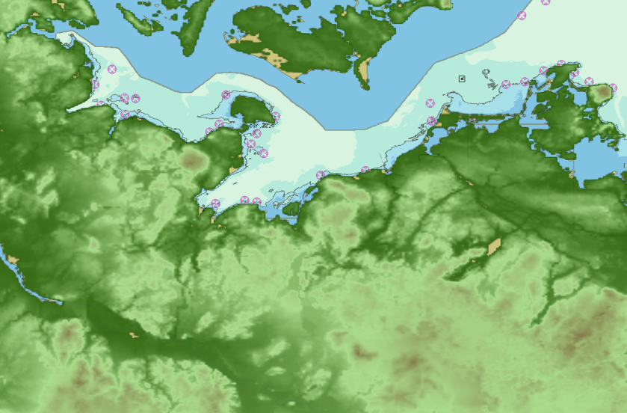
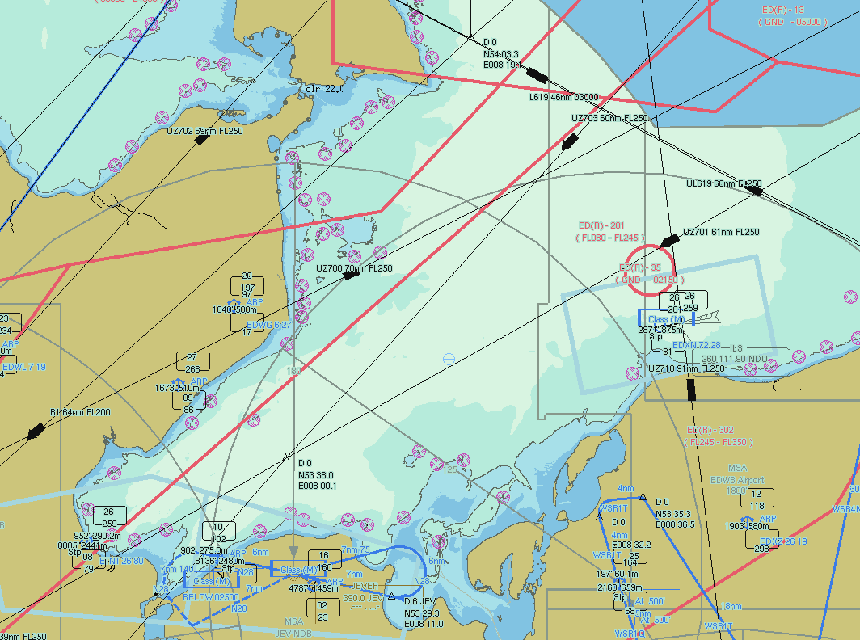
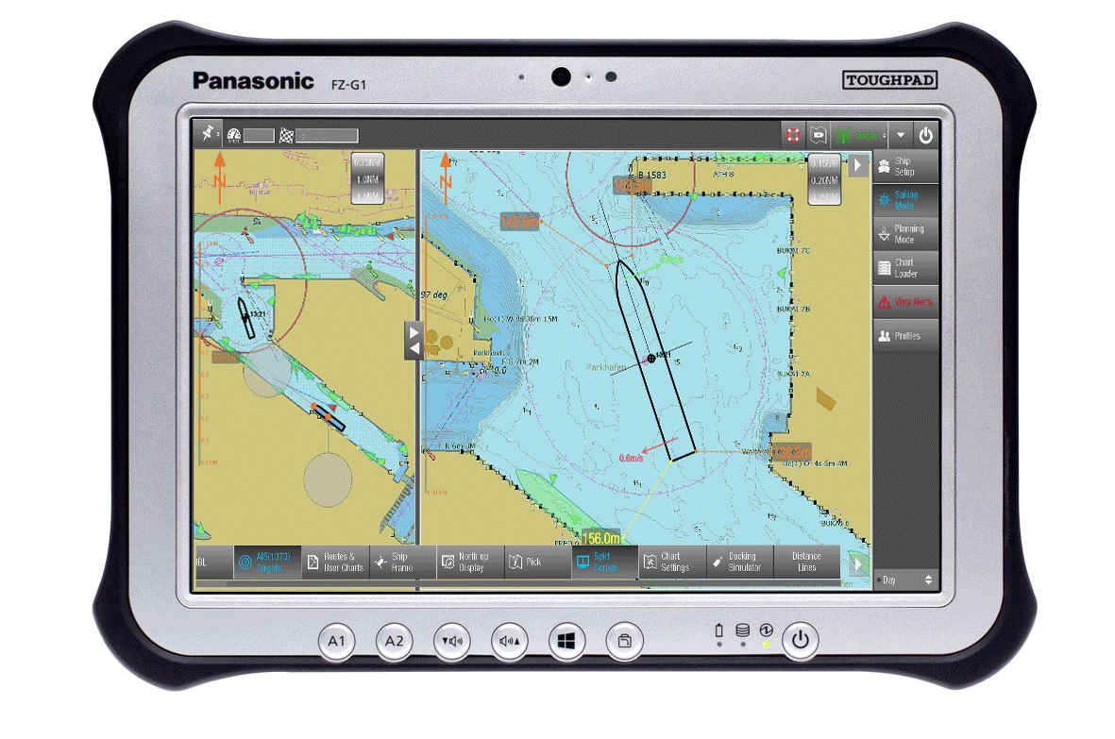
SevenCs - Products and Services
ECDIS Kernel software
Web based solutions for electronic charts
Chart Production/Validation Software
Navigation Software (ECS, PPU)
Software Development (e.g. ECDIS for ChartWorld )
Training and Consulting

Slide 6
S-100/S-101 activities

Slide 7
Current S-100/S-101 activities
Member of IHO S-100 working group and of S-100 technical expert team
SevenCs S-100 ECDIS Kernel Nautilus
basis for large variety of S-100 applications (S-101,S-102, ...)
S-101 Validation Software
provided to S-100/S-101 IHO expert groups to assist in development and testing of S-101 validation checks
S-101 Reader Plugin for FME
include S-101 data in geo-data processing procedures

Slide 8
Unveiling of ENC depth information

Slide 9
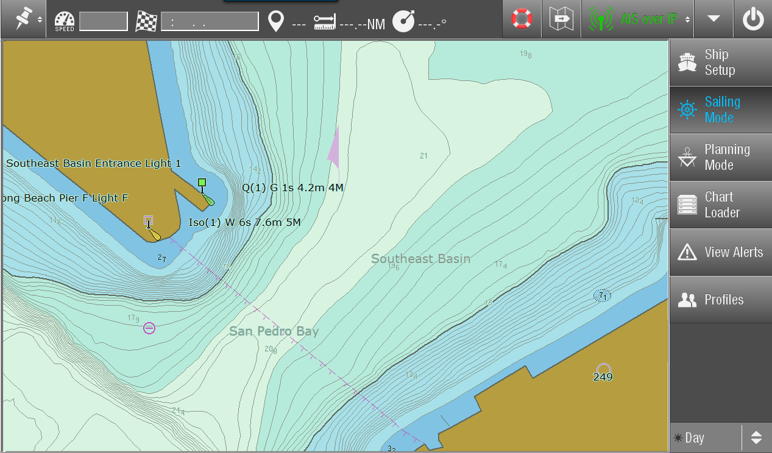
Depth information in ENCs and ECDIS

Slide 10
Depth Contours in ENCs
ENCs use same contour levels as paper charts
-2m, -1m, 0m, 2m, 5m,10m, 20m, 30m, 50m, …
ECDIS safety contour display is bound to the same schema
Hence ECDIS safety contour setting cannot always be reflected in ECDIS chart display
This results in unused potentially navigable areas
=> ENCs should have much denser contours

Slide 11
Examples
Safety Depth in ECDIS

Slide 12
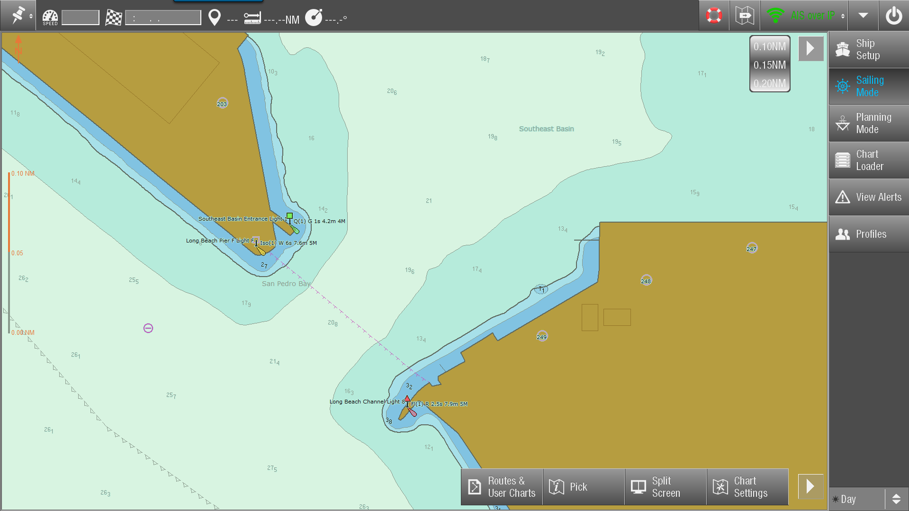
Safety Contour 10m
10m Contour

Slide 13
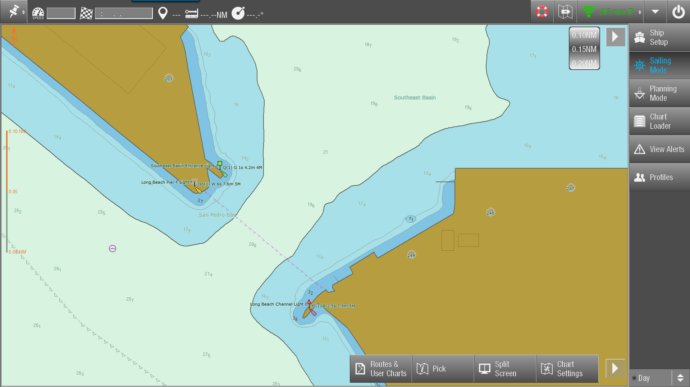
Safety Contour 20m
20m Contour

Slide 14
Safety Contour 11m
20m Contour

Slide 15
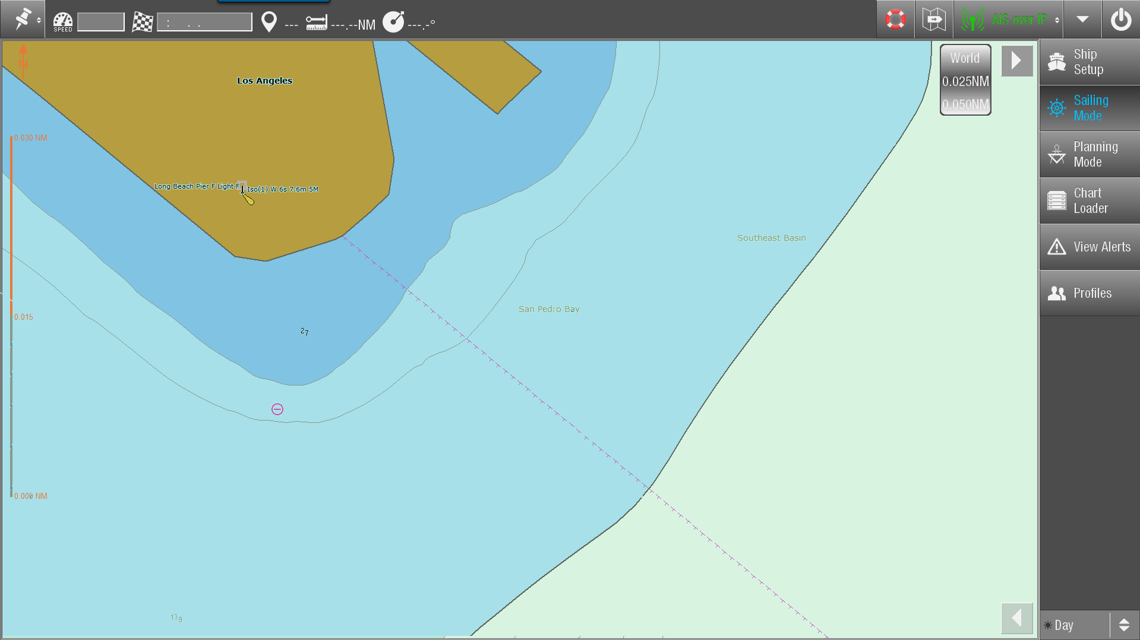
Safety Contour 11m
20m Contour
10m Contour

Slide 16
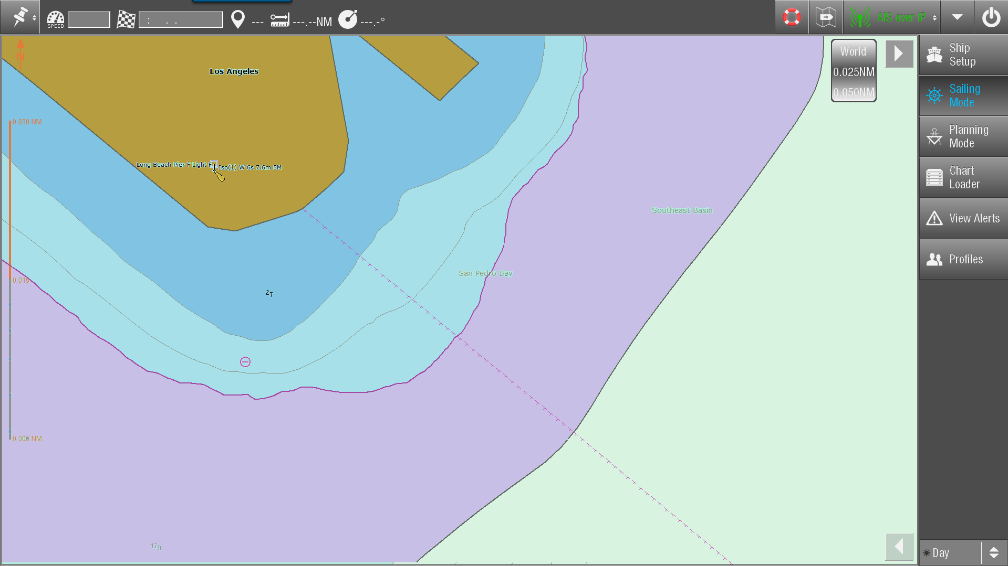
SC 11m „Lost“ Navigable Area
20m Contour
10m Contour

Slide 17
ENC with High Density Contours

Slide 18
Why do we not create ENCs
with denser contours?

Slide 19
Problems with denser contours in ENCs (?)
What data producers say:
Still a lot manual work involved in contour generation
Contour creation at small intervals can result in topological issues (line overlaps, degenerated edges)
Potential issue with 5MB cell size limit
What SevenCs thinks:
If issues can be solved navigation with ECDIS will become significantly more effective than today

Slide 20
Thank you very much
for your attention
www.sevencs.com
mo@sevencs.com

