Slide 1
Elevation Data Modelling
Variable Resolution Surfaces

Slide 2
Variable Resolution Surface
Digital elevation model where the resolution varies over different areas of the model
R₁
R₂
R₃
Notes:
A digital elevation model where the resolution varies over different areas of the model, to better reflect the properties of that area.
Why would we need that?

Slide 3
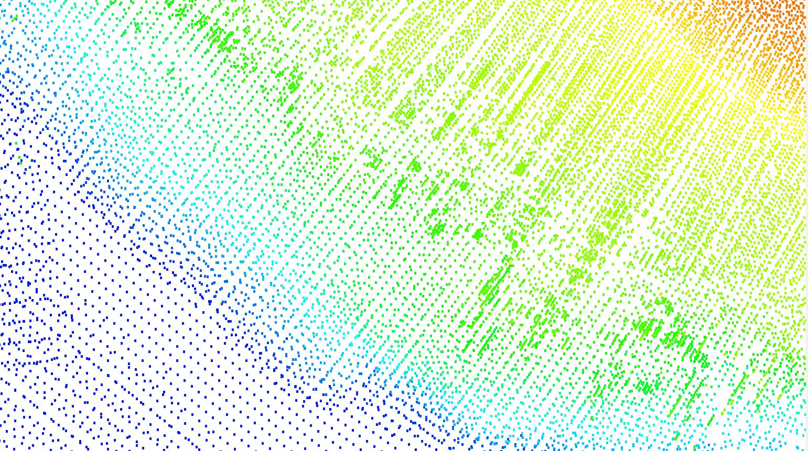
Motivation – The challenge
Sensor data is not regularly spaced - difficult to model
Notes:
Remotely sensed data is irregular, varies by scanning technique, range etc
Data is modelled to make computations easier
Modelling is difficult over large areas: density changes, usually have to pick one resolution

Slide 4
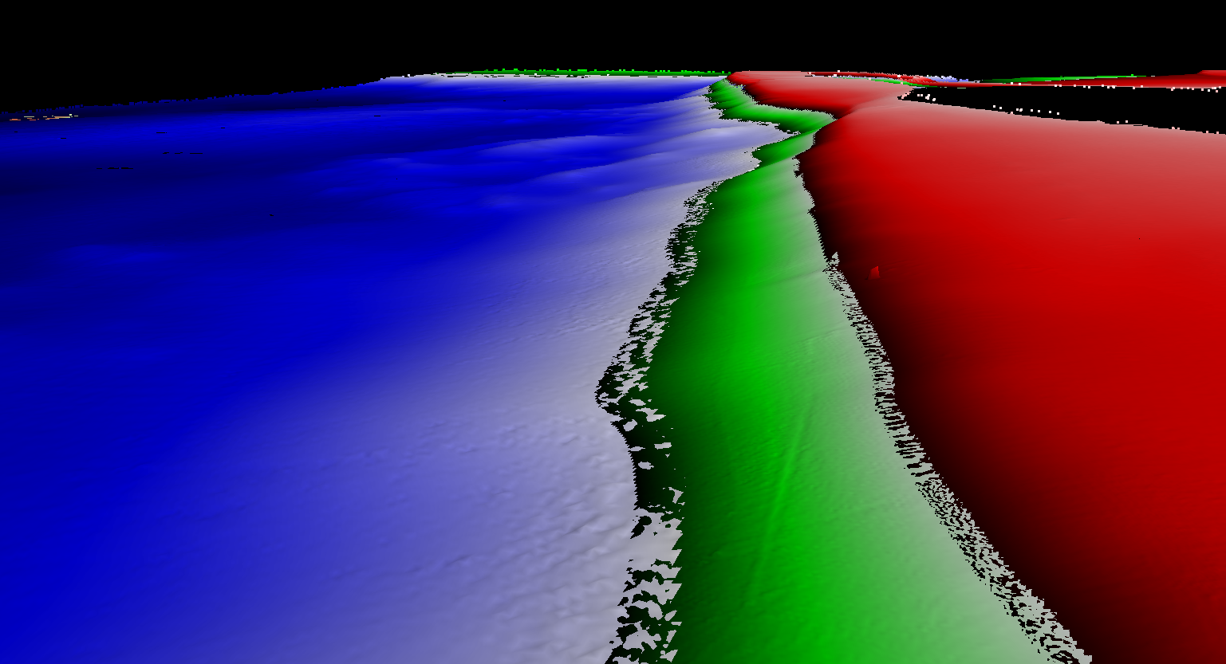
Motivation – Current solution
Divide model into depth range and resolution
Have to manage multiple models
Discontinuity near boundaries
Use a TIN
Limited by size
Holidays
Edge removal
Notes:
One technique: divide into depth ranges, one resolution per range
Above example: 3 BAG files (red/green/blue) of different depth ranges and resolutions. Overlap areas and file management are a problem
TIN is more flexible, but limited in size. Holidays end up filled in, and long edges must be removed (Delauney triangulation)

Slide 5
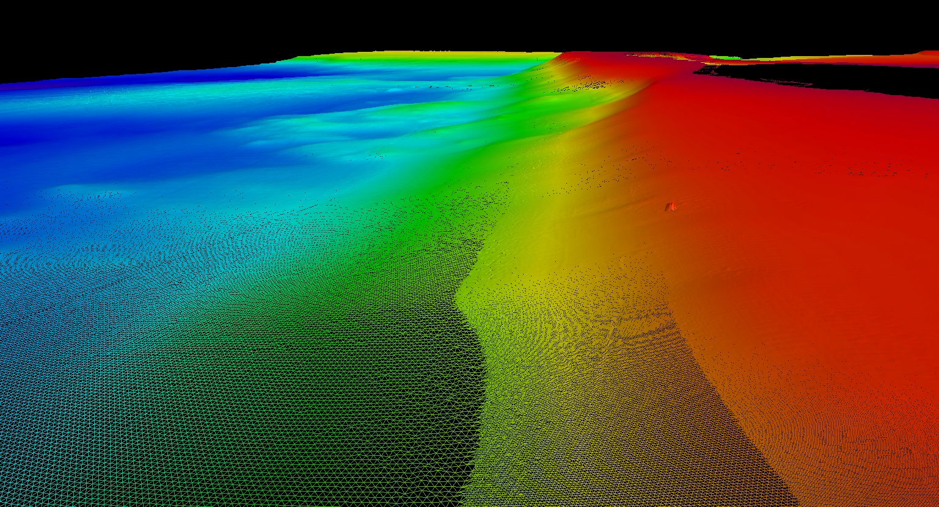
Motivation – The solution
Variable Resolution Surface
Better and continuous model of different data densities
Workflow efficiencies and easier data management
Notes:
Variable resolution: continuous model over a large region with varying resolution to match density.
Single product for easier workflow and data management

Slide 6
What is a Variable Resolution Surface?
Defines every value within a continuous area
Surface values are explicitly defined at nodes
Variable Resolution surface has regularly spaced nodes within a tile with resolution defining spacing between nodes for that tile
A mesh defines values everywhere else
Notes:
Variable Resolution is similar to surface:
Defines every value in a continuous area
Values defined explicitly at nodes
Spacing is regular within a tile, defined by resolution for each tile
Mesh defines values for interpolation between nodes (i.e. Linear interpolation)

Slide 7
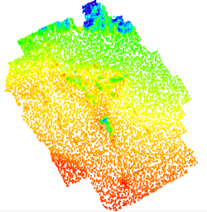
VR Surface Creation
Step 1: Compute All Tiles
Based on Point Cloud
Result: Resolution Map
Tiles have roughly an equal number of points
Step 2: Compute Individual Tile Resolution
By point density or depth range
Analyze Point Cloud
Resolution Map
Notes:
Start with a point cloud and analyze the points.
Create a resolution map (using a quad-tree structure). For efficiency, each tile has roughly the same number of points
Assign a resolution to each tile based on depth or density algorithm

Slide 8
Variable Resolution - Tiles
1 TILE
Notes:
Tiles are blue outline
Calculated resolution grids in red... Resolutions are not constrained (e.g. powers of 2), can be any value
Grids populated as normal

Slide 9
VR Resolution from Depth Range
Depth Res.
+20m 0.25m
-5m 0.5m
-10m 1.0m
-20m 2.0m
-40m 4.0m
-80m 8.0m
-1600m 16.0m
Notes:
Resolution by Depth Range is analogous to current depth/resolution breakdown (good)
Compute statistics for each tile (min/max/median/average), user picks a value
Value is used to pick resolution from lookup table, also provided by the user
E.g. Min tile depth is 14.58m, use 1.0m resolution for that tile
Bad: user makes assumptions about data density. Might lead to under- or over-sampling.

Slide 10
VR Resolution from Density - CARIS
Notes:
User defines the target average number of points per node (e.g. 5)
Points in each tile are analysed and a resolution determined to meet an average of 5 per node

Slide 11
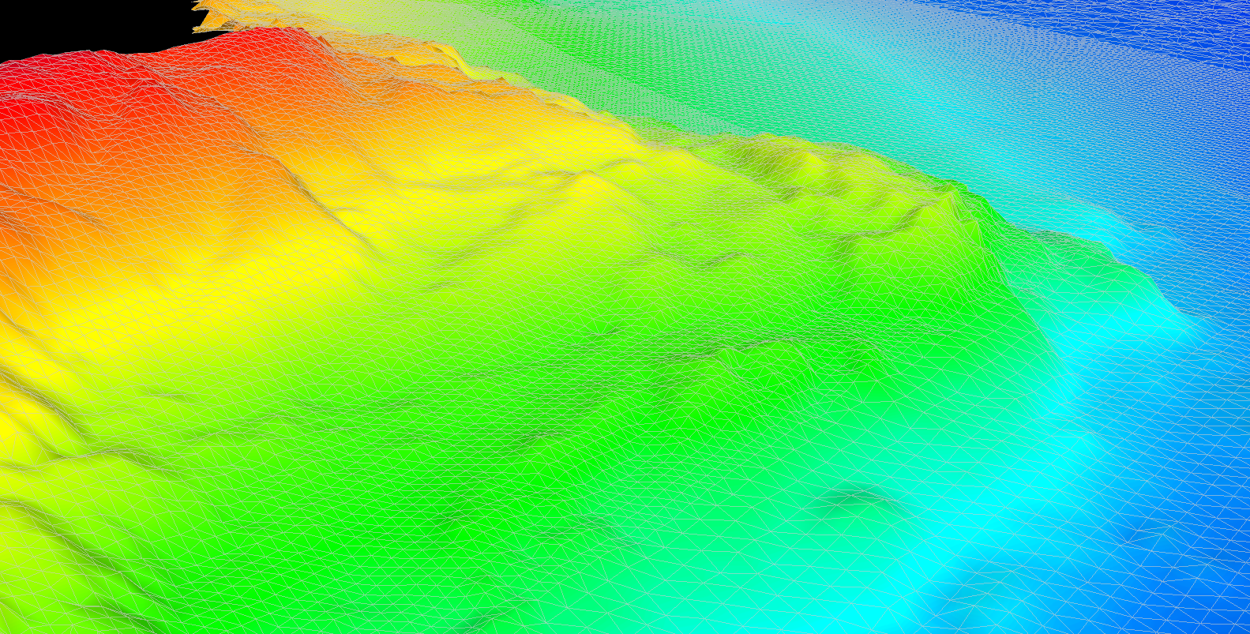
VR Resolution from Density – Calder-Rice
Notes:
User defines the target average number of points
Ensonified area of all soundings in the tile is calculated using beam angle or similar
Ensonified area / target density = Resolution
Developed by Dr. Brian Calder at the University of New Hampshire, as part of CHRT (Cube with Hierarchical Resolution Technique). We have implemented his resolution estimation in CARIS VR, available in the first release. CHRT itself will be available in a later release pending testing and approval from UNH.
The results of both density methods are very similar, but CARIS is offering both so that users can see what is most suitable.

Slide 12
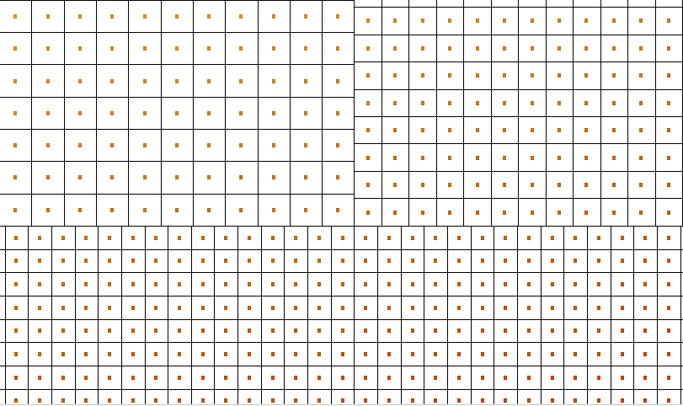
VR Surface Nodes
Notes:
Yellow highlight is boundary between tiles of different resolutions

Slide 13
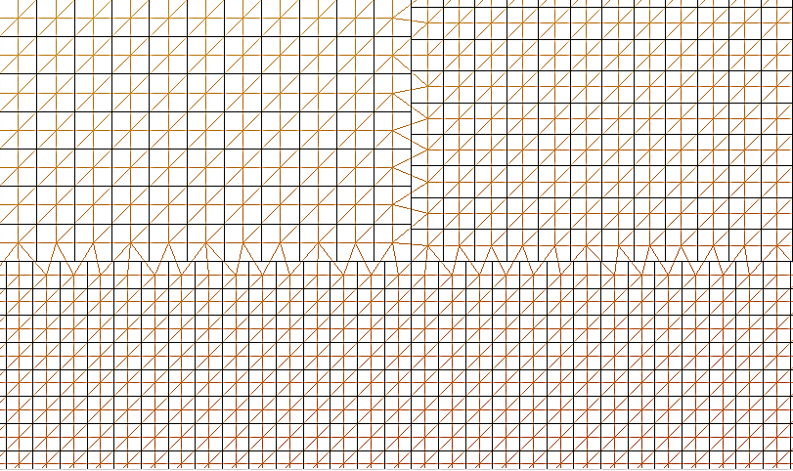
VR Surface Mesh
Notes:
Mesh is generated dynamically for display and computation across each resolution tile
This was the hardest problem to solve.
Scales to huge volumes of data, just like CSAR. Best-of-both hybrid of TINs and surfaces

Slide 14
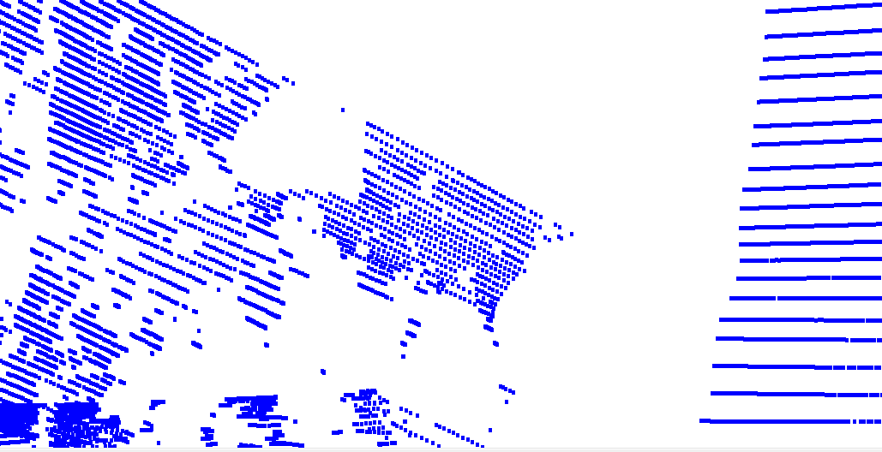
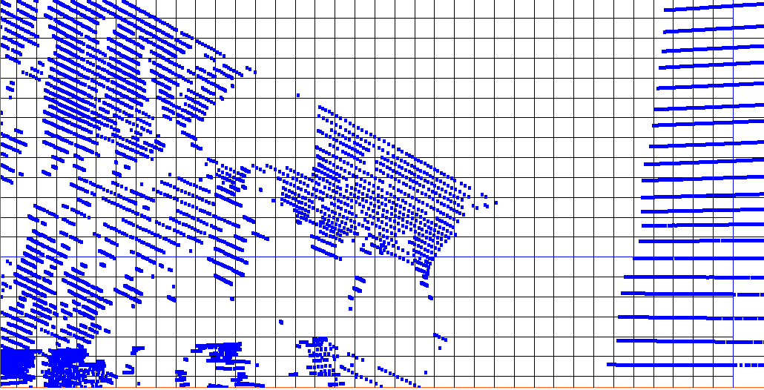
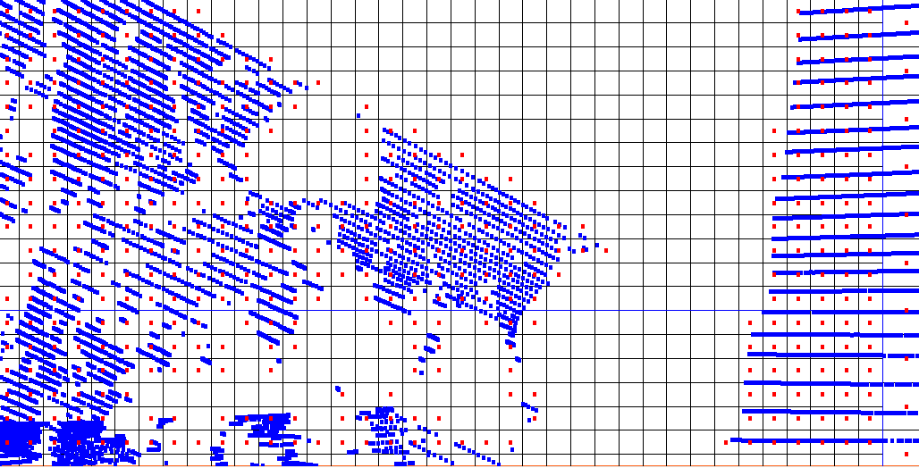
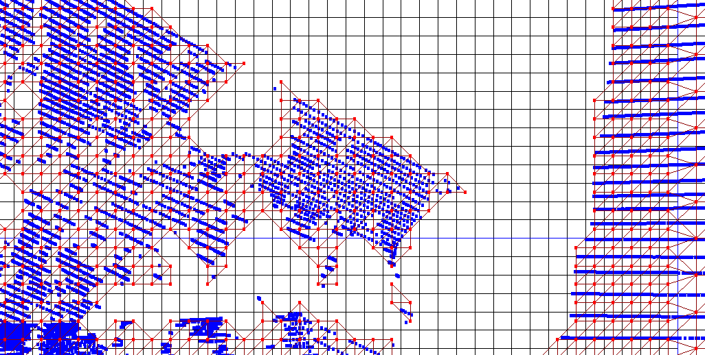
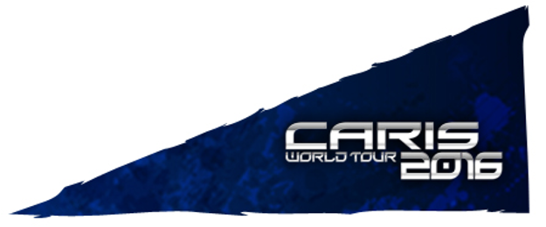
How to Compute a VR
VR Surface Mesh
Meshing constrained by resolution
Notes:
Previously mentioned holes and long edges being problems with TINs...
The mesh is constrained by the resolution, TIN edge can only cross to an adjacent node
Pictured: raw points in blue, nodes as red points, mesh as red lines

Slide 15
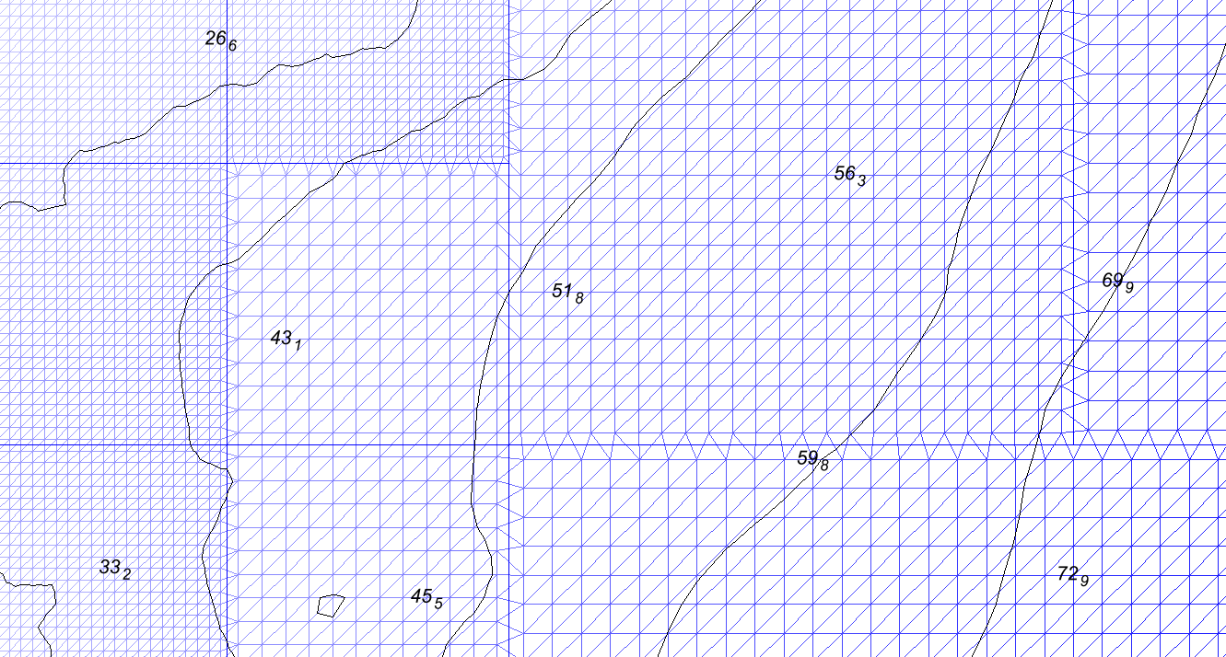
VR Contouring and Sounding Selection
Notes:
Example contours and sounding selection from a VR surface (blue), crosses multiple resolution areas

Slide 16
VR First release
First release in CARIS HIPS and SIPS 10
Released October 2016
Includes:
Depth/density creation tools
Standard node computation (gridding) techniques
Contouring/sounding selection
Several raster tools (difference, shift, compute layer, etc.)
CARIS Bathy DataBASE
4.3 release in February 2017
Notes:
First release in HIPS, September 2016
Depth and Density resolution estimation methods
CUBE, inverse distance weighting and others for gridding
Vector creation will work, plus several raster tools
BDB 4.3 will follow with VR in early 2017
Interchange will be a big deal. There is no “open source” format for VR surfaces, other than ASCII. BAG will be releasing one, but other vendors must add support. Computation is easy, visualization/computation is hard.
We will therefore be including a down-sampling tool to resample Variable Resolution to single-resolution rasters.
Included with updates. Available for users paying subscription. So no extra payment for this functionality.

Slide 17
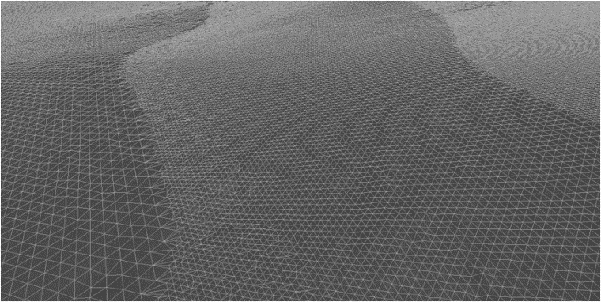
VR Future Considerations
VR built on a flexible framework, ready for the future
Ideas:
Alternative methods to define resolution
Alternative tile schemes
Alternative node placement methods
VR is a new technique developed based on a need in the hydrographic community
Offers time/cost savings in data modelling and product creation
Further development also depends on user input
Notes:
Future ideas for Variable Resolution
Other resolution techniques (not just by depth/density)
Other tile schemes (other than quad-tree or fixed size). Hexagonal, octagonal? Rectangles? Arbitrary regions? CSAR can support any type.
Other node placement schemes. Irregular grids? CSAR can support this as well.
Based on a need in the hydrographic market, we have developed the technique to create surfaces with a variable resolution and there is quite a number of CARIS users that are eagerly awaiting the release.
This is a new technique in the market and we have built this solution for the future, on a flexible framework, so that users can start playing with it and see how it fits best in their organization, to solve important issues and improve workflow efficiencies.
We’re seeking feedback on where we need to go to further develop the VR surfaces and expand the possibilities.

