Slide 1
Report of the Tides, Water Level and Current Working Group Gwenaële Jan¹, Peter Stone ² , David Wyatt³ (1) Chair, Shom, (2) Vice Chair elected at TWCWG3, NOAA (3) Secretary, International Hydrographic Bureau TWCWG activities for HSSC-10
Hydrographic Services and Standards Committee

Slide 2
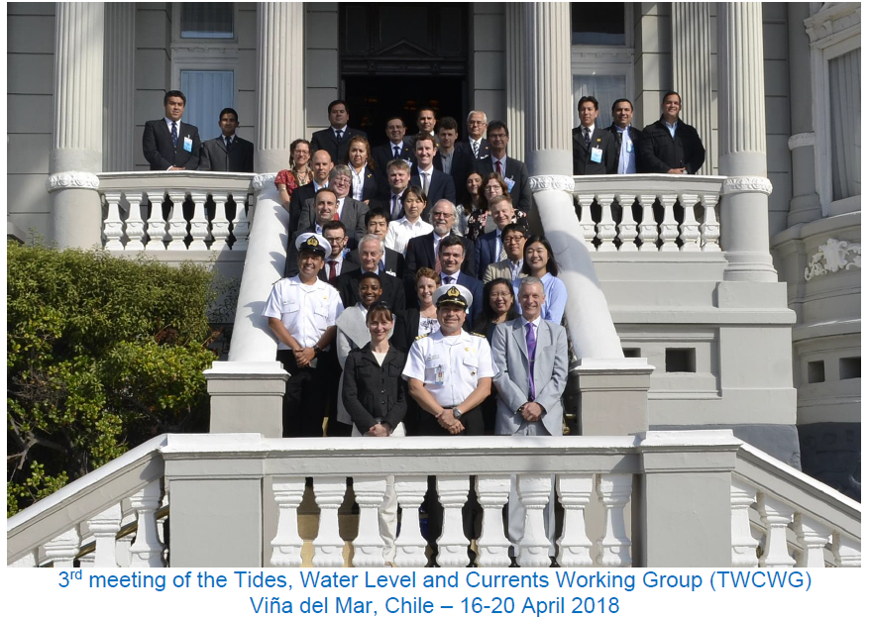
TWCWG objectives
To monitor developments related to tidal, water level and current observation, analysis, prediction, vertical and horizontal datums;
To develop and maintain the relevant IHO standards, specifications and publications for which it is responsible in liaison with the relevant IHO bodies and non-IHO entities;
To develop standards for the delivery and presentation of navigationally relevant surface current/water level information;
To provide technical advice and coordination on matters related to tides, water levels, currents and vertical datums.

Slide 3
Principal activities and achievements
Capacity Building
Course with the basics for a first learning on hydrography and tides has been provided (Milestone Sept. 2017): Done.
Other level of courses will be delivered in English by P. Contact of the activity (Milestone S.A.N, 2017,-2018) : Done.
Translation of workshop material into Spanish and into French. Input for this task : The different levels of courses deliveries. Milestone : 2018. First module of courses materials available in Spanish. All modules are available in French (delivered in April, 2018).
Ongoing actions :
Provide feedback on the existing documents available on IHB web site (TWCWG) https://www.iho.int/mtg_docs/com_wg/IHOTC/IHOTC_Misc/Tides_and_Water_Level_Workshop_Course_Material
Translation in Spanish+ Portuguese to complete the action before submission to the review committee TWCWG and IHB (Milestone 2019).
Ongoing actions (3) Through their appropriate representatives, highlight to meetings the course availability and the intended target audiences

Slide 4
Principal activities and achievements
Products specification (PS)
S-104 – Water Level Information for Surface Navigation
S-111 – Surface Currents
Products specification (PS) S-104 – Water Level Information for Surface Navigation
Milestone 2017 : Product specification draft writing draft version delivered in 2017, May.
https://www.iho.int/mtg_docs/com_wg/IHOTC/S-100_PS/S-104_Tidal_Information_for_Surface_Navigation_Product_Specification_Documents/S-104_Tidal_Information_for_Surface_Navigation_Product_Specification_Documents.htm
Milestone 2018: dataset for tests ; Prototype S-104 data sets for the end of this year. Action started 2018/02.
Progression in the wake of S-111 aligned with the PSs, S-100WG.
Milestone 2019 - 2020 : S-104 PS final document, and Portrayal setup item.
Objective, concern, in IHO framework : Compatibility. Consistency with the S-100WG guidance, and HSSC WGs outputs.

Slide 5
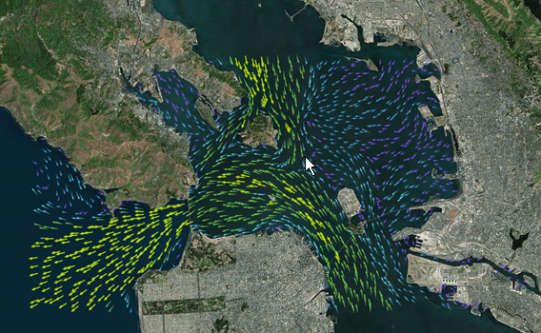
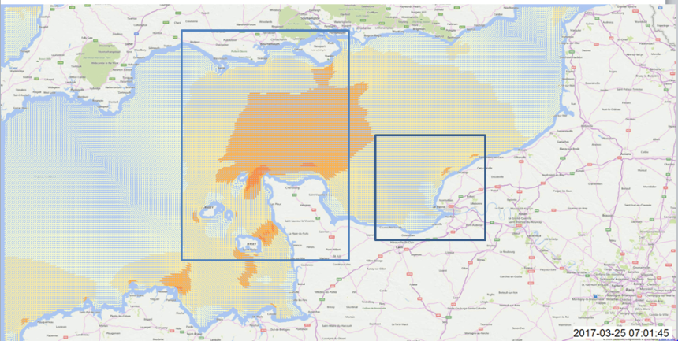
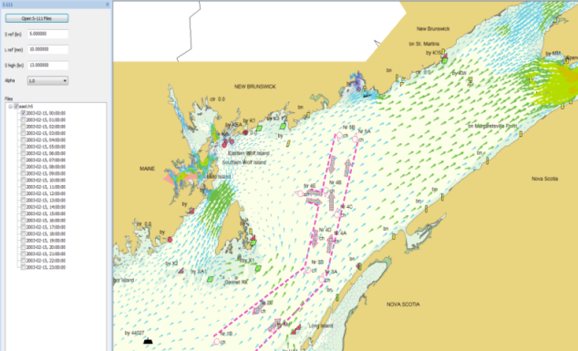
Principal activities and achievements
S-111 : Current product specification
Milestone 2017: A set of data have been uploaded. S-111 TWCWG web page.
First tool available from Canada (2018)+ S-100 viewer (South Korea) able to read S-111 test datasets.
Sample S-111 compliant HDF5 surface current data files have been posted on the TWCWG website for (L.Maltais , K. Hess et al., Sewoong OH)
HSSC8, HSSC9 (Src: CA)
2018, New data test : Current from FR . Netcdf written in HDF5 following S-111 documentation (CA et al.; Louis Maltais, Mike Sheward, Maxime Carre)
Draft, 1st preliminary test
S-111 & S-104 program info Codes: Java, python script

Slide 6
Principal activities and achievements
S-111 : Current product specification : The latest version of the S-111 PS contains the recent (2018-05-09) revisions to Part 10c. With the latest refinement of the HDF5 harmonization version 4.0.0 (S-100WG).
HSSC MS approval Res.2/2007 process
1st edition.
S-111 mature
S-111: PS Documentation developed with the S-100WG guidance.
The PS is in compliance with the HDF5 file formatting as proposed at S-100WG3.
The PS is in a mature form. It is now in its 13th version at TWCWG level, and has been reviewed by TWCWG.
Compliance to IHO resolution 2/2007,as proposed at HSSC-10, explains the adoption and change processes for published IHO Technical Standards and Specifications.

Slide 7
Principal activities and achievements
Vertical Reference Frame
From TWCWG 2017 : Increase information on IHB TWCWG web page. 2nd term of 2017.
=> Started action.
April, 2018 at TWCWG3 with an entire session dedicated to vertical reference frame : Geoid, mean sea level, national projects
Increase interactions with NSHC and intersessionnal activities
Participation at NSHC meeting 2017-10-25 : TWCWG members 1 TWCWG member participated to IOC/GLOSS 2017-07, USA : Peter Stone, TWCWG, USA.
+ GLOSS 2018 : Engage with IOC Secretariat and GLOSS Programme lead to advance proposal for collocated meeting (GLOSS, TWCWG)

Slide 8
Principal activities and achievements
Data archeology
2019 task TWCWG : “Investigate what historical data is held and to consider preserving it as digital data for future use (All MS TWCWG)“ (TWCWG3 report, 2018).
Possible GLOSS session on data archeology with TWCWG participation.
There is a strong recommendation (from more and more Services, ex: EU) to pay attention to this exercice. Interest for climate science, data rescue.

Slide 9
Problems or outstanding issues
Product specification : Current (S-111), water level (S-104)
Generate more S-111 and S-104 compatible datasets; (CA, USA, agreed to generate compatible datasets from existing data using CARIS software). KHOA will continue testing of datasets against S-104 and S-111 PSs as they are developed. Other TWCWG members were encouraged to contribute and build up their national and organizational knowledge base.
Principal contact (AUS) agreed to finalize the next draft version of S-104 and circulate for comment; no expertise available to commence encoding in HDF5 format. But tools available and ready to be shared by TWCWG members (S-100 web page to share tools, data sets, viewers, etc.) + a webinar session initiated the process provides elements to start.
Continue testing datasets provided by the TWCWG (CA, USA)
Milestone 2018: Data test sets is increasing and ready for uploading to the website (a S-100 based Product Specification). Stakeholders are volunteers to share and test files for encoding following IHO guidance.
Next step : Test endbedment evaluation ; Portrayal work along.

Slide 10
Action requested of HSSC
The HSSC is invited to:
Note the TWCWG report,
review the current version of S-111 and approve it for publication as Edition 1.0.0 in accordance with the proposed review cycle for WG/PT, as proposed at HSSC-10, aligned with the requirements of IHO resolution 2/2007. The TWCWG formally presents S-111 to HSSC for approval and subsequent publication,
reappoint the TWCWG to continue its work under its current Terms of Reference, (Annex C),
endorse the draft Work Plan at Annex B of the report to HSSC-10.

Slide 11
Future work programme
2020
2019
2018
A | Maintain the list of standard tidal constituents (IHO Task 2.8.4)
B | Compare the tidal predictions generated as a result of analysis of a common data set using different analysis software
C | Develop, maintain and extend a Product Specification for digital tide and tidal current tables (IHO Task 2.3.4)
D | Develop, maintain and extend a Product Specification for dynamic surface currents in ECDIS (S-111) (IHO Task 2.3.4)
E | Develop, maintain and extend a Product specification for dynamic water level in ECDIS (S-104) (IHO Task 2.3.4)
F | Liaise with S-100WG on water level and current matters relevant to ECDIS applications (IHO Task 2.3.5)
G | Liaise with industry experts on the development of product specifications for water level and currents
H | Prepare and maintain an inventory of water level gauges and current meters used by Member States and publish it on the IHO/TWCWG web site (IHO Task 2.8.5)
I | Review and maintain the Actual Tides and Currents On-Line links as published on the IHO TWCWG website
J | Maintain and extend the relevant IHO standards, specifications and publications as required (IHO Tasks 2.8.4 and 2.1.8)
K | Conduct the at least annual meetings of TWCWG and its sub-group(s) and project team(s) (IHO Tasks 2.1.2.7)
L | Develop and maintain material for course on Tides, Water Levels and Currents
Vice-Chair election : Mr Peter Stone (NOAA-OCS-USA) was elected for the period 2018-2020 as vice-Chair

