Slide 1
OGC Marine DWG Connecting Land and Sea 2023 and the Future
Rafael Ponce, Marine DWG Co-chair, ESRI
Trevor Taylor, OGC
March 7, 2024

Slide 2
Agenda – OGC Land and Sea 2023 Pilot
Welcome, Introduction and Context Setting (Rafael Ponce, Marine DWG Co-chair)
Digital Twin of Land Sea Interface – Singapore - Background, Process, and Challenges ( SOON, Kean Huat SLA, CHEW , Lawrence , MPA)
Overview ( Trevor Taylor, OGC)
Digital Arctic Connecting Land & Sea – Canadian Arctic
Integrating Land & Sea for Various Use Cases – Caribbean
2024/2025 potential Scenarios/Use Cases (Trevor Taylor, OGC)
Discussion ( Rafael Poncem OGC Marine DWG Co-chair)
Close

Slide 5
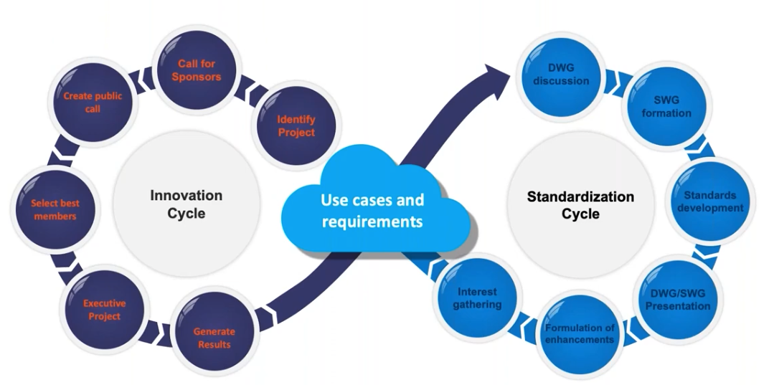
How does OGC Work?
I
Collaborative Solutions and
Innovation Program (COSI)
Standards Program
Testbeds , Pilots
Sprints and more
Domain Working Groups (DWGs)
Standards Working Groups (SWGs)

Slide 6
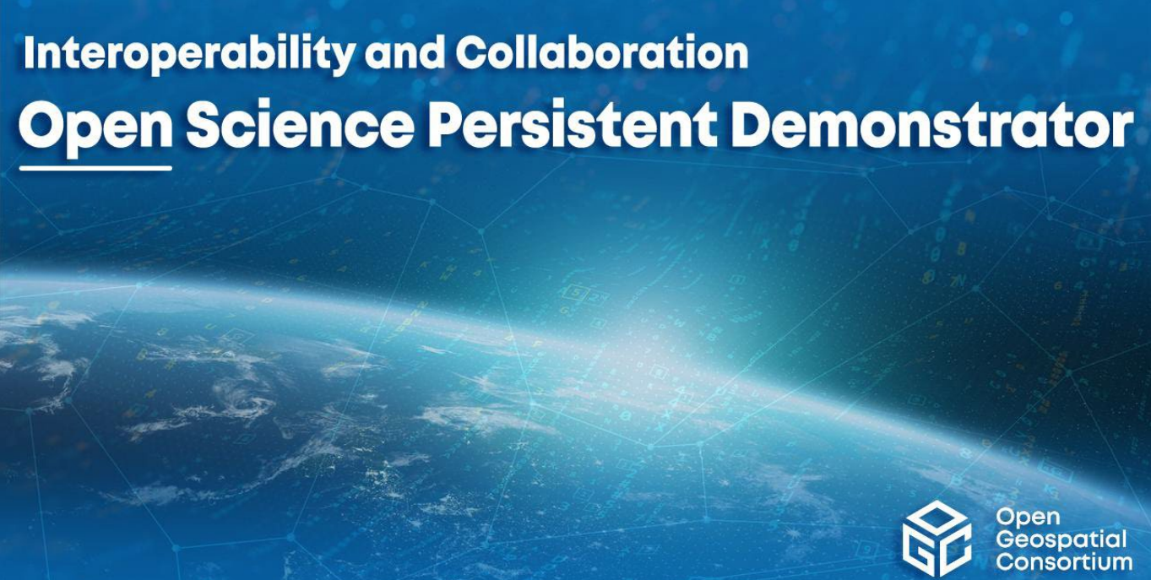
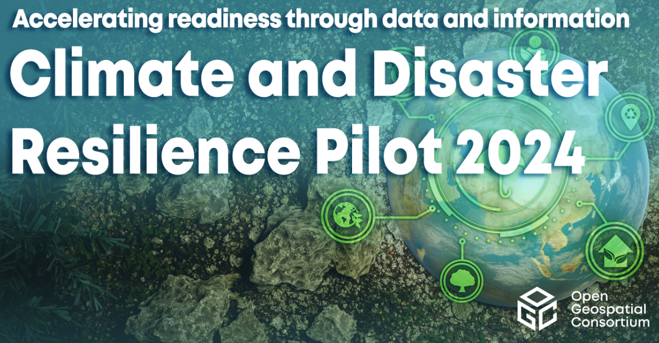
Selected Active Initiatives ( Total 24)
Learn more COSI initiatives: https://www.ogc.org/projects/initiatives/active

Slide 7
Why?

Slide 8
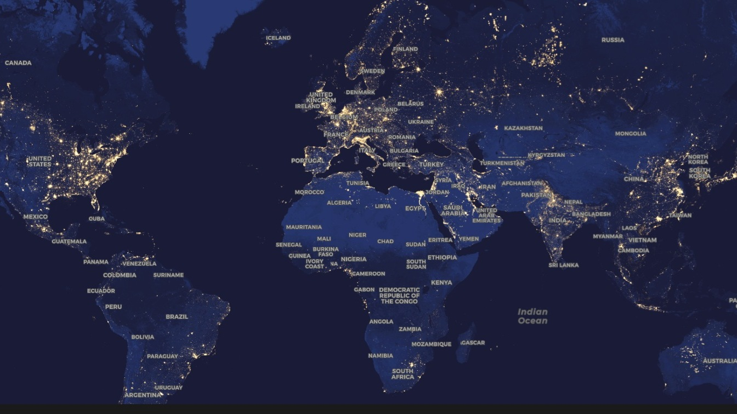
Around 40% of the World's population lives in a Coastal zone (up to 100KM inland)

Slide 9
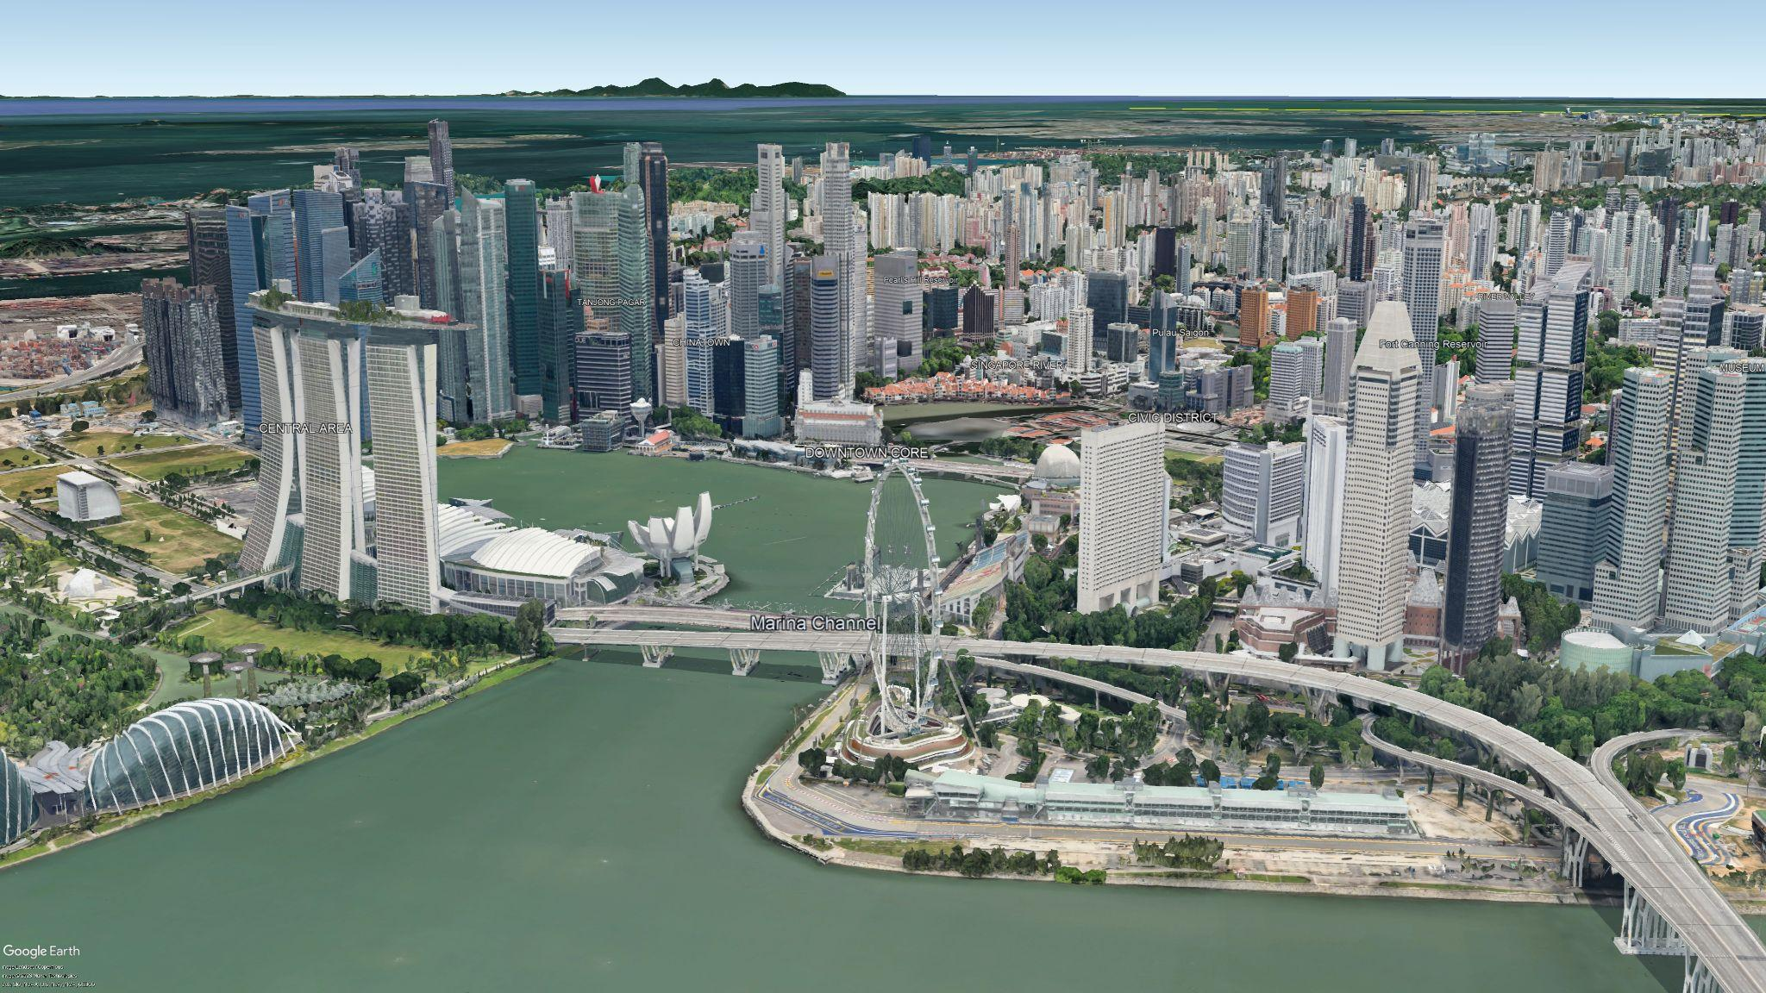
75% of Megacities are in coastal zones

Slide 10
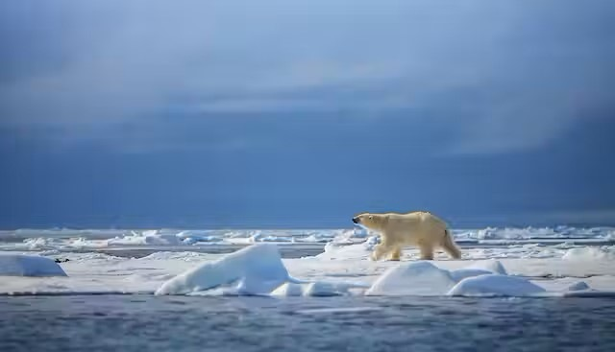
Climate Change
With Climate change comes a massive increased risk to billions of people
Disasters, reduced food security, environmental degradation and more.
We need to get better at connecting data and information!

Slide 11
The global Geospatial/Hydrospatial community recognized fundamental need to:
Improve how well we connect land and sea data (a big challenge!)
Improve regional connectivity between various MSDIs at different maturity levels
Unlock the value of non-navigational data
Make everything more FAIR!

Slide 12
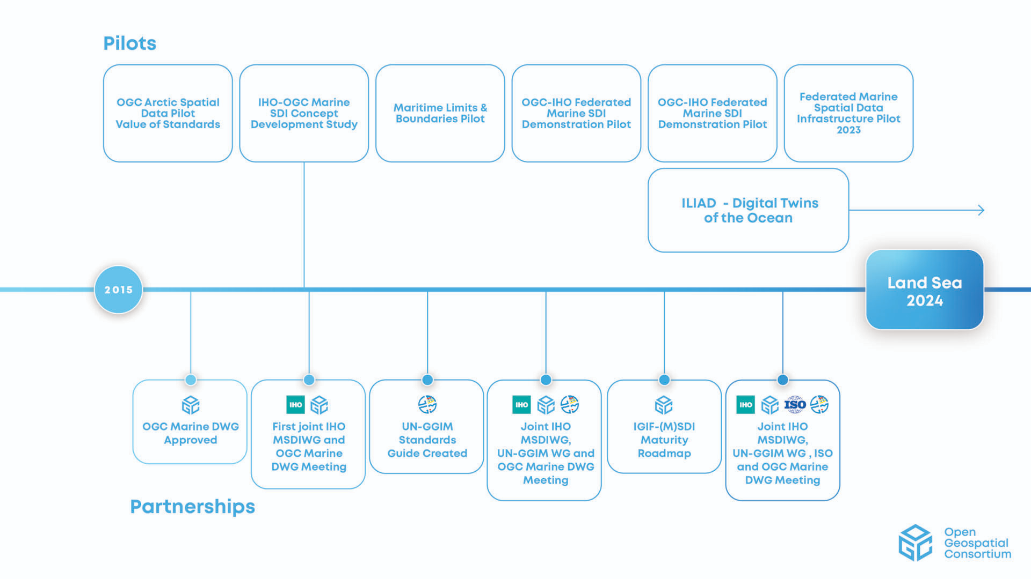
A Committed and Strong Community

Slide 13
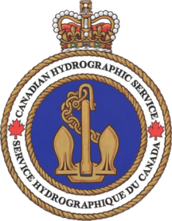
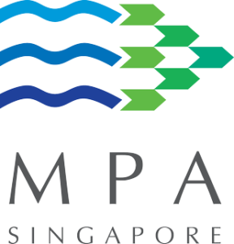
Thank you to our Sponsors

Slide 14
Partnerships
Practical Demonstrations on potential “how to implement standards-based technologies” based on use cases

Slide 15
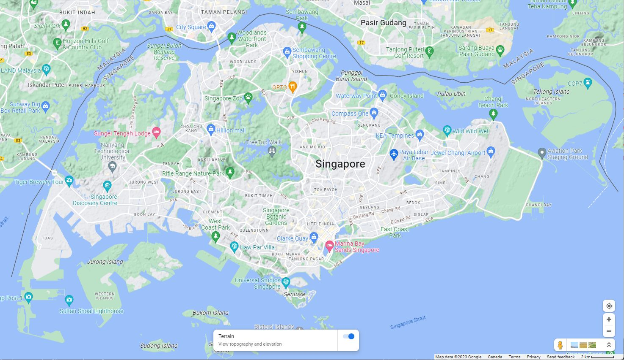
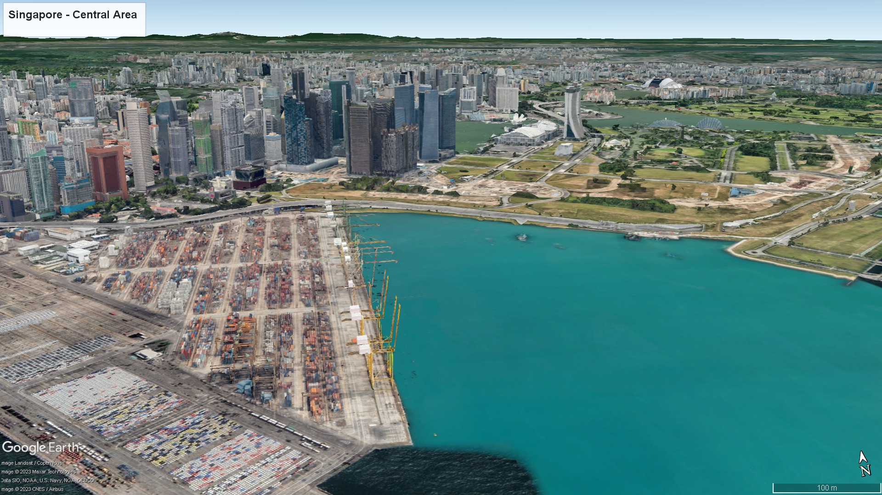
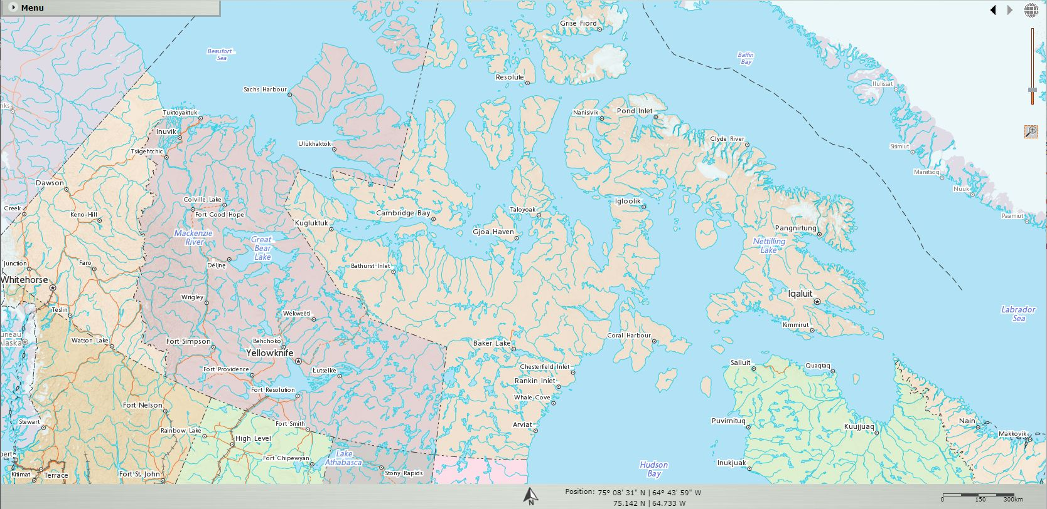
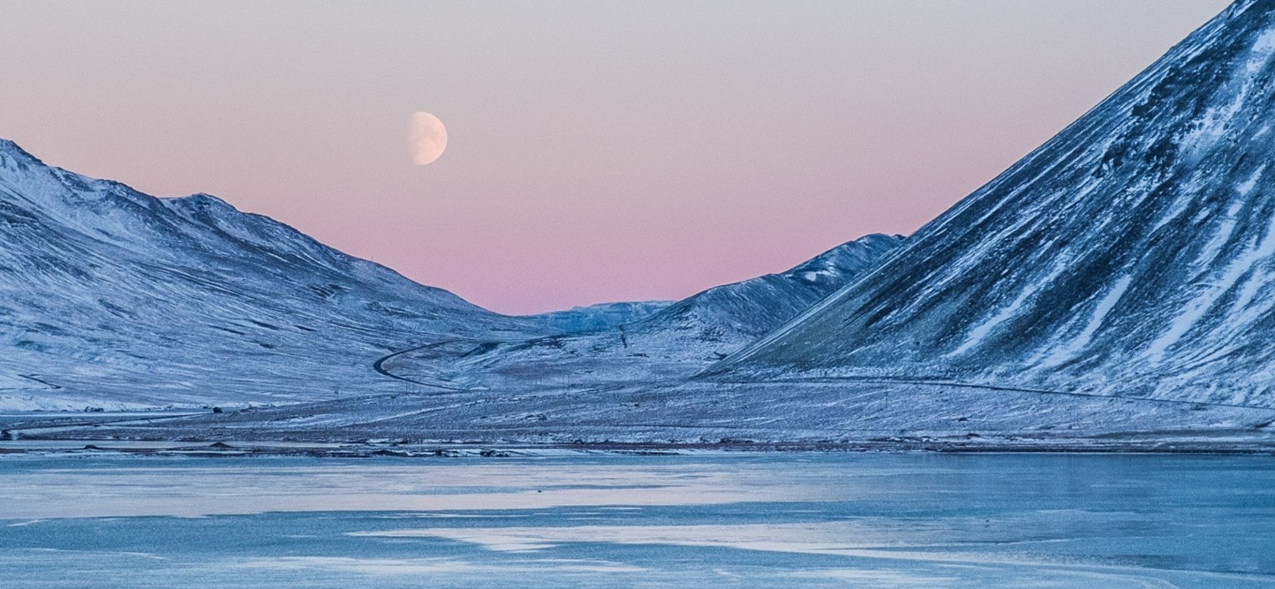
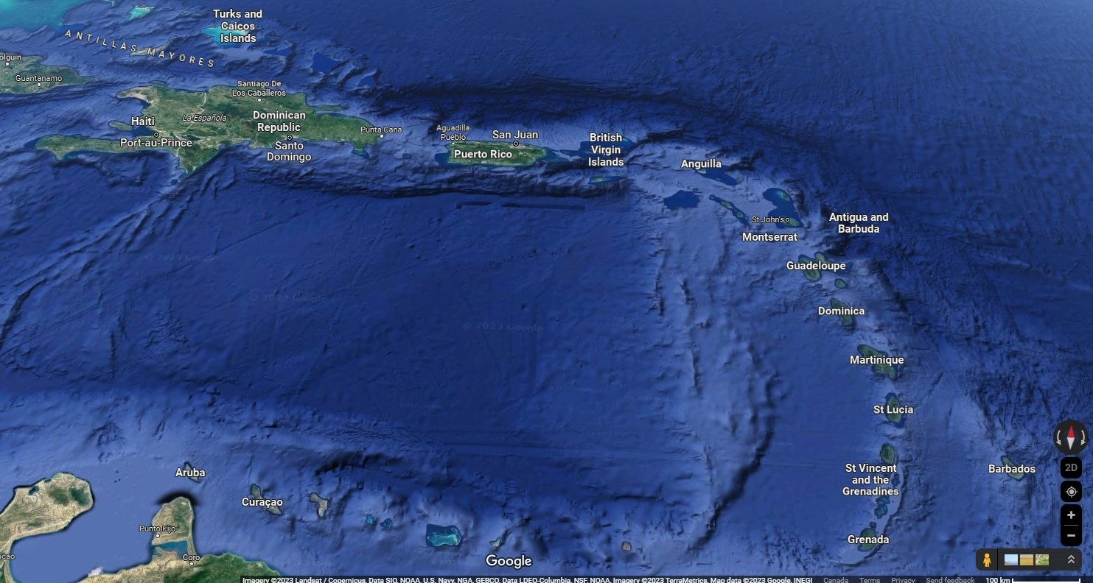
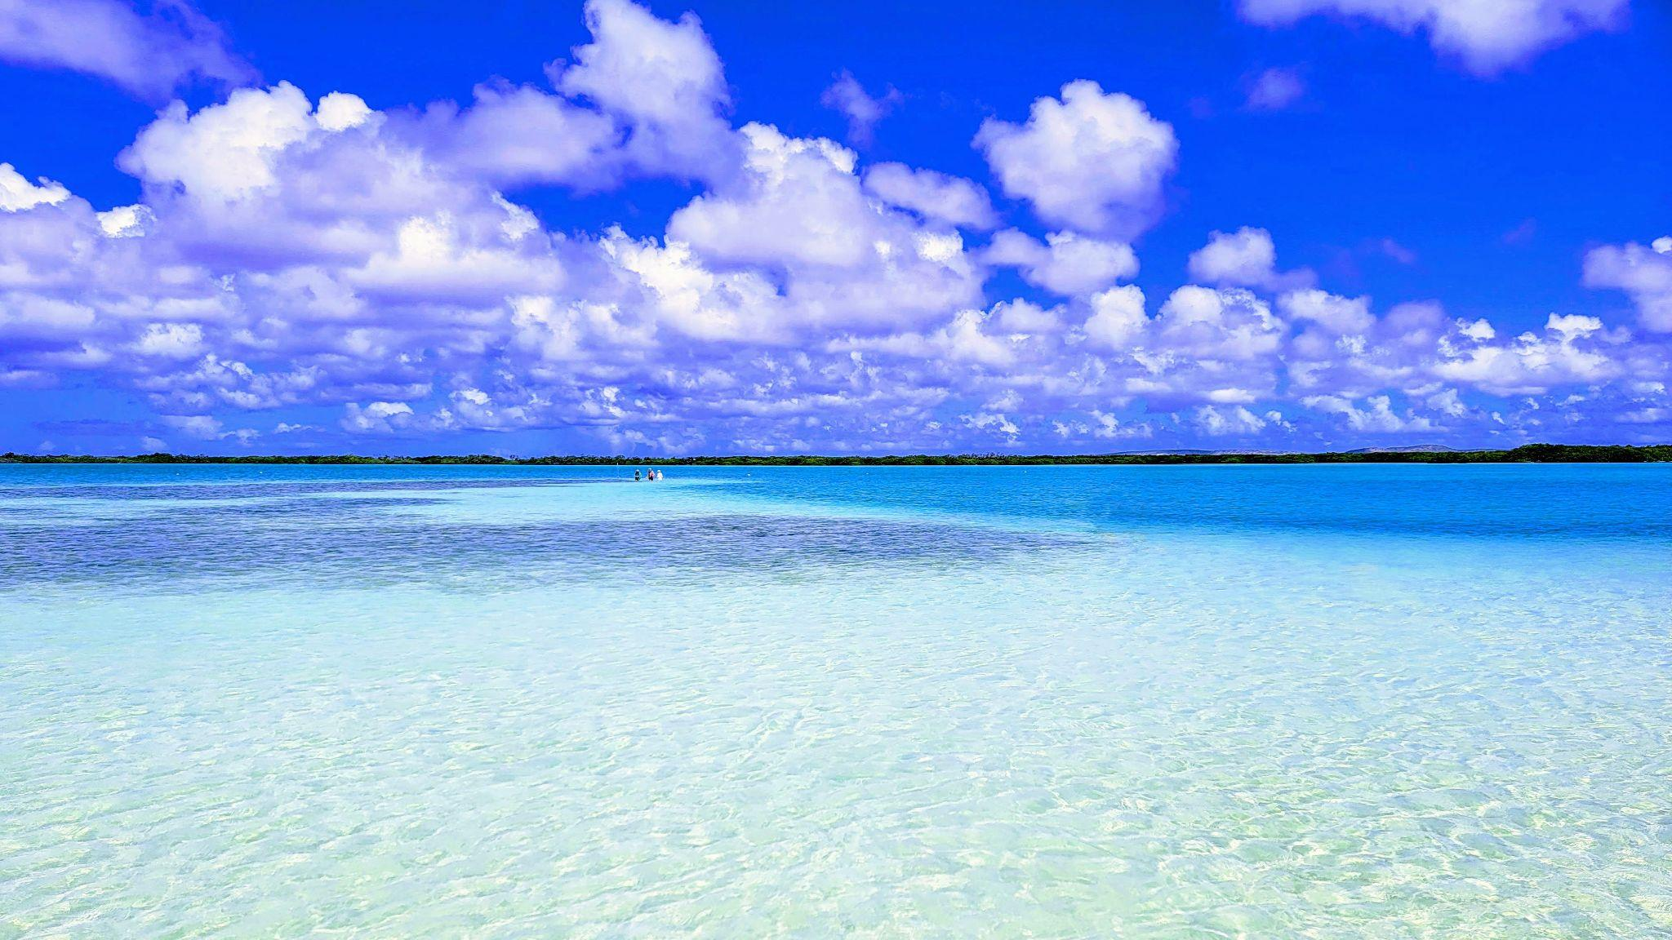
FMSDI 2023: A Taste
Digital Twin of Land Sea Interface – Singapore
Digital Arctic Connecting Land & Sea – Canadian Arctic
Integrating Land & Sea for Various Use Cases – Caribbean

Slide 16
SINGAPORE
Digital Twin of Land Sea Interface

Slide 17
Digital ARCTIC

Slide 18
Arctic : Overview
The Challenge
How to efficiently discover and present diverse data, from many sources, for a variety of scenarios in the Arctic
Scenarios
Impact of Arctic ice melt rates on Bow whale and Killer whale populations and behavior
How spatial data can be used to analyze and visualize the impacts of climate change on the Arctic environment, infrastructure and inhabitants.
Identify Arctic communities at higher risk of adverse health outcomes due to microplastic bioaccumulation toxicity.

Slide 19
Land and Sea CARIBBEAN

Slide 20
Caribbean : Overview
Five Scenarios
Concentration and distribution of micro-plastics before and after climate events
Tropical storms and hurricanes: Improving decision making using improved data availability through standards
Develop a Offshore Wind Farm Decision Support System framework to aid site selection.
Hurricane Health Risk Index identifies a priori the underlying health and medical needs of a hurricane-impacted population
Leveraging navigational data for non-navigational purposes by understanding how useable this type of data is for building a geospatial information management foundation
Methodology
Use OGC / IHO and other standards to improve FAIR within a collection of diverse scenarios.
Determine how well data from disparate sources “fits” together.
Determine non-navigational data use within the “Blue Economy” - sustainable use of ocean resources for economic growth, improved livelihoods, and jobs while preserving the health of ocean ecosystem

Slide 21
Deep Dive – Report
Now Public - pending small edits and publication on the OGC Website. OGC members can download it. For the moment. It will be added to the IHO Body of Knowledge once fully published

Slide 22
2024/25 Pilot – Potential Scenarios/Use cases
Connecting Land and Sea. Use cases designed to make progress on solving the hard problem of connecting data and overcoming gaps between land and sea,- eg datums, challenges related to local datums. Examples may include scenarios involving ports, slow-onset disasters crossing national boundaries (Cyclones), continued work in Arctic Coastal areas, storm surge and potential additional small island states.
Connecting to the Oceans Community. Use cases designed to connect better to global Ocean science data. Examples may include biodiversity, ecosystems, and sea surface temperature predictive models and may be connected to the current OGC Open Science Persistent Demonstrator.
Digital Twins for Land and Sea. Use cases designed to further experiment with OGC and other standards related to connecting Digital Twins of the Land and sea.( Built Environment)
Water Column Use cases designed to explore underwater data gathering/water column for scenarios such as near coastal environmental monitoring and seabed and sub-seabed resource management
Coastal Data Integration Use Cases integrating Marine, Met, environmental, and built infrastructure for a “coast” – huge challenge!
Advance the implementation of MPAs (S-122) – lots till to be done!
portal.ogc.org/files/?artifact_id=106819&version=1
portal.ogc.org/files/?artifact_id=106819&version=1

Slide 23
Moderated Discussion
What is important for your organization/region?
(How to !)

Slide 24
Thank You
Community

