Slide 1
ARMSDIWG Report
Current status and planned actions of the ARMSDIWG in its fifth full year of operation.
MSDIWG13

Slide 2
ARMSDIWG5
Meetings
ARMSDIWG 5.1, 09 NOV 2020
ARMSDIWG 5.2, 12 NOV 2020
ARMSDIWG 5.3, 10 MAY 2021
ARMSDIWG 5.4, 20 MAY 2021
ARMSDIWG 5.5, 30 JUN 2021
ARMSDIWG 5.6, 30 SEP 2021
Highlights
An assessment of Arctic Voyage Planning Guide (AVPG) feasibility with limited resources
An information session on automatic identification system (AIS): Global Maritime Traffic Density Service
Planning for participating in the Federated MSDI-Pilot activity organized by Open Geospatial Consortium (OGC)
Potential collaboration to Arctic Council Arctic Data Policy with Arctic SDI
Reporting national MSDI progress towards ARHC activities
5-year reassessment of the working group

Slide 3
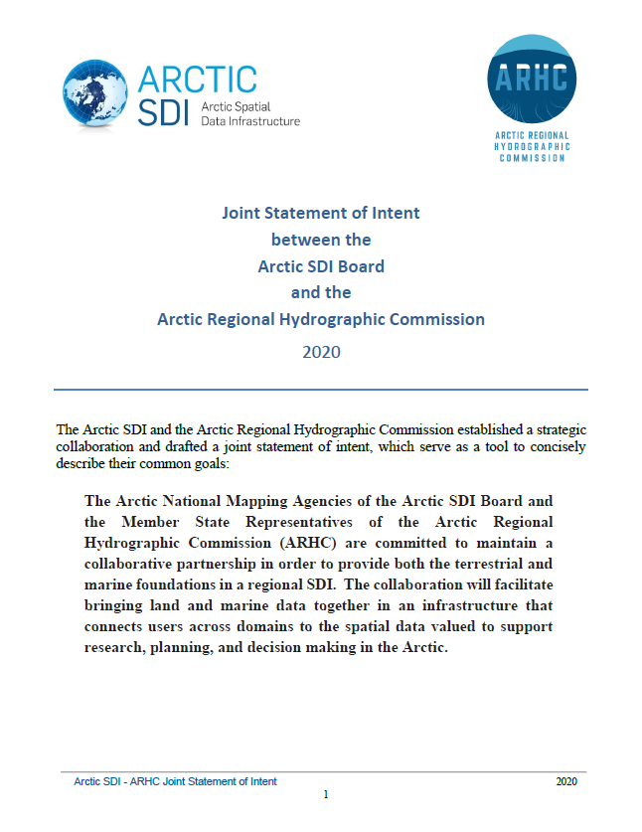
Cooperation with Arctic SDI
The approved Joint Statement of Intent between the Arctic SDI Board and the Arctic Regional Hydrographic Commission (2020) has been provided in PDF format for posting to the ARHC web page.
ARMSDIWG confirmed that the Copernicus Marine Service sea ice web services are available, and the US representation from ARMSDIWG began a dialog with the U.S. National Ice Center (USNIC) and the National Snow and Ice Data Center (NSIDC) about potential for future high-quality sea ice web services sourced from NSIDC for reuse.
ARMSDIWG to participate in Arctic SDI project helping to refine the harvesting of relevant marine data services for the region.

Slide 4
Federated Marine SDI-Pilot (FMSDI-Pilot)
Organized by OGC, the FMSDI-Pilot is excellent opportunity for collaboration of stakeholders across the marine domain.
Builds upon the foundation of the OGC-IHO MSDI Concept Development Study (CDS) from 2018-2019 that included the participation of several ARMSDIWG member organizations.
Multiple members of ARMSDIWG are currently, or in the process of, supporting the Federated MSDI-Pilot.
Potential exists to explore use cases of voyage planning with a land/sea interface component in the Arctic, as well as other use cases in other regions.

Slide 5
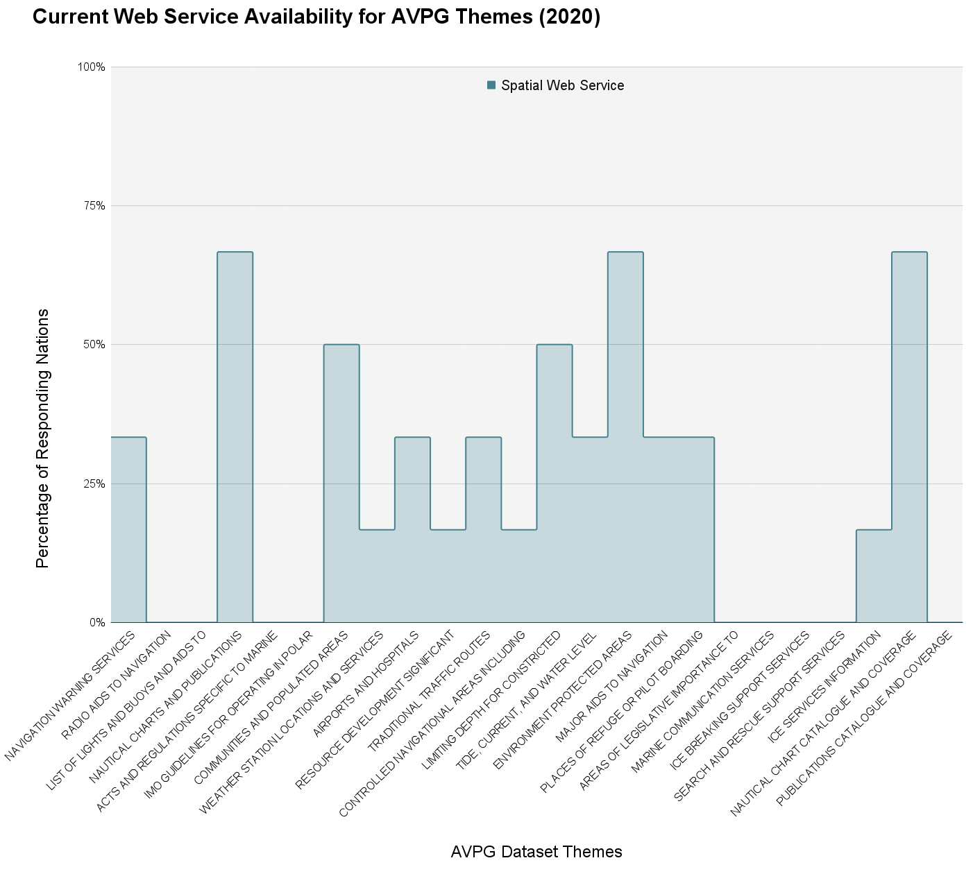
AVPG Status (Web Services)
Only 21% of AVPG Datasets are collectively available as a geospatial web service.
No single theme is fully covered by ARHC HOs.

Slide 6
5-year Reassessment of ARMSDIWG
List of milestones achieved in report.
ARMSDIWG with their current resources and their organizational breadth/structure are very limited in capacity and cannot equally mirror that of Arctic SDI to contribute in an equal way or support operational tasks that may be desired by ARHC, such as the AVPG.
ARMSDIWG’s previous Terms of Reference (ToR) was not initiated with an operational component, so the last few years of ARMSDIWG interpreting AVPG criteria/requested data, inventorying available datasets, etc. has been a lengthy process without achieving a prototype stage at the very least.

Slide 7
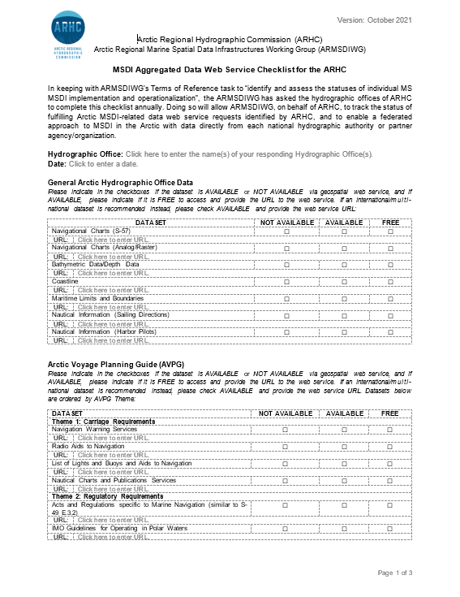
5-year Reassessment of ARMSDIWG
The truth today is that an Arctic user still does not currently have a central or common way to find authoritative Arctic marine spatial data from ARHC’s HOs, nor do they have a total set (i.e. gaps in coverage) of usable web services available to them for the majority of themes they’ve asked for in various studies and surveys.
ARMSDIWG cannot require an individual HO to create data and make that data Findable, Accessible, Interoperable, and Reusable (FAIR Data Principles)
Those requirements come from the HO’s government and its office polices to produce data or make it available.
ARMSDIWG can help organize and make recommendations as to what types of data HOs could produce to fulfill the feedback received from users in the Arctic (ref. checklist).
It is ultimately up to each HO to make available the data that they can share.

Slide 8
5-year Reassessment of ARMSDIWG
After 5 years of ARMSDIWG’s existence and meeting the threshold of their current capacity, ARHC may want to reassess what they would like to achieve with regards to MSDI in the region.
ARMSDIWG has provided an updated ToR and aligned Work Plan given their current capacity and resources for ARHC consideration.

