Slide 1
Marine Spatial Data Infrastructure Working Group
United States of America (USA)
National Report

Slide 2
POLICY AND GOVERNANCE
United States of America, MSDI

Slide 3
US - International MSDI Participation
IHO MSDIWG
IHO Arctic Regional Hydrographic Commission (ARHC)
Arctic Regional MSDIWG (ARMSDIWG)
IHO Meso American & Caribbean Sea Hydrographic Commission (MACHC)
MACHC MSDIWG (MMSDIWG)
IHO South-West Pacific Hydrographic Commission (SWPHC)
SWPHC MSDIWG
UN-GGIM Working Group on Marine Geospatial Information (WG-MGI)
OGC Marine Domain Working Group (Marine DWG)
IHO-OGC Marine Spatial Data Infrastructure Concept Development Study (MSDI-CDS)
Federated MSDI Pilot – Connecting Land and Sea Across Nations

Slide 4
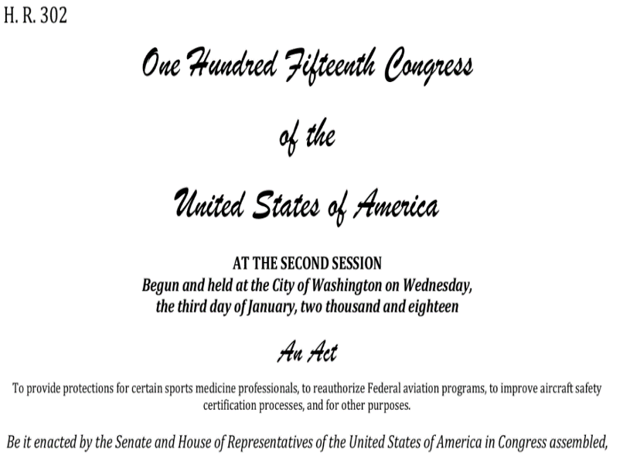
National Policies and Legislation
Presidential Executive Order 13840 – Ocean Policy to Advance the Economic, Security, and Environmental Interests of the United States.
Foundations for Evidence-Based Policymaking Act of 2017
Title II – Open Government Data Act
Geospatial Data Act of 2018 (GDA)
National Spatial Data Infrastructure Strategic Plan 2021-2024
Federal Geographic Data Committee

Slide 5
Information Systems
United States of America, MSDI

Slide 6
Information Systems
Charting Information / Production Databases
Nautical Information System (NIS)
National Bathymetric Source (NBS)
Server Infrastructure
GIS Servers (Internal & External)
Database Servers (Internal & External)
Physical vs. Virtual….
Software
Esri
Caris
SevenCs
Etc.

Slide 7
Technical standards
United States of America, MSDI

Slide 8
Technical Standards
IHO S-100 Standard
Open Geospatial Consortium (OGC) Standards
Federal Geographic Data Committee (FGDC) Metadata Standards
Image courtesy of opensource.com

Slide 9
Geographic content
United States of America, MSDI

Slide 10
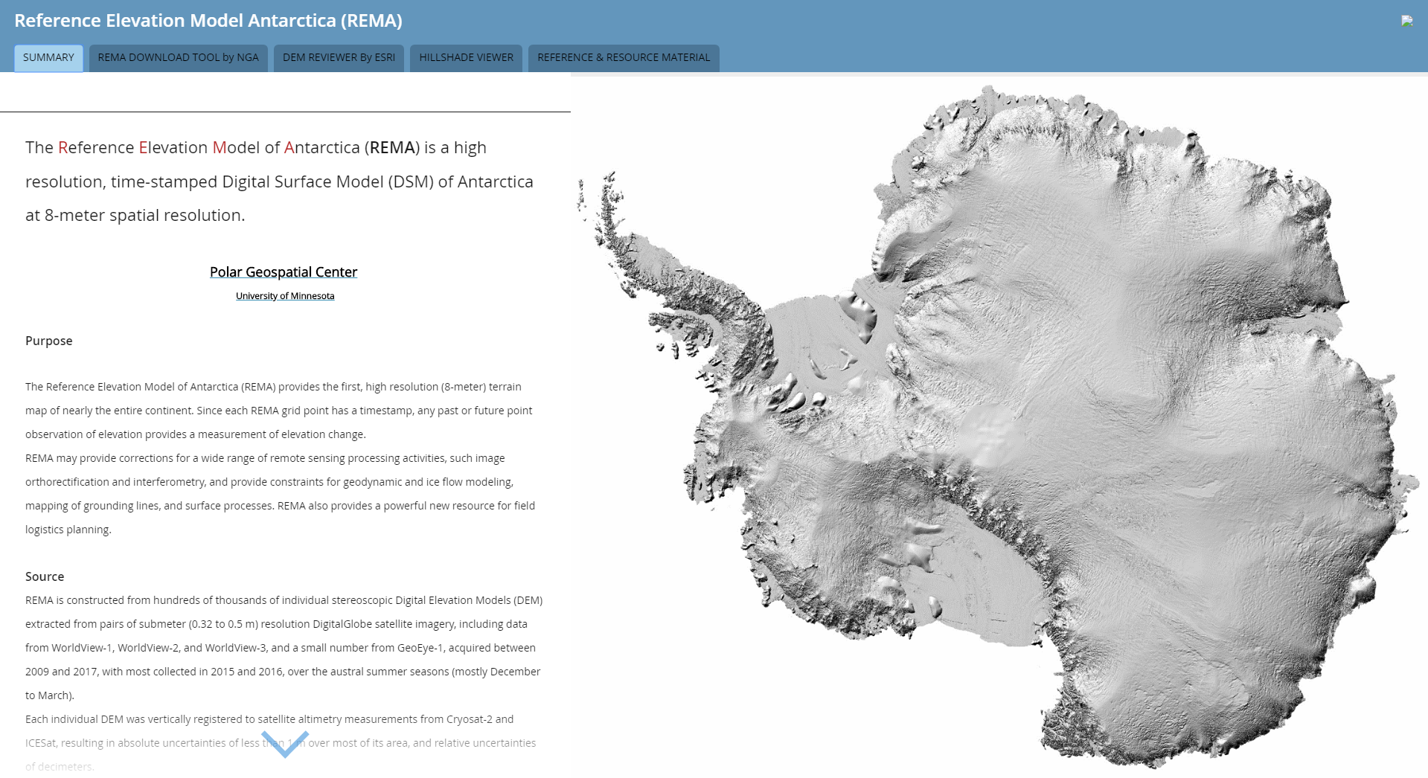
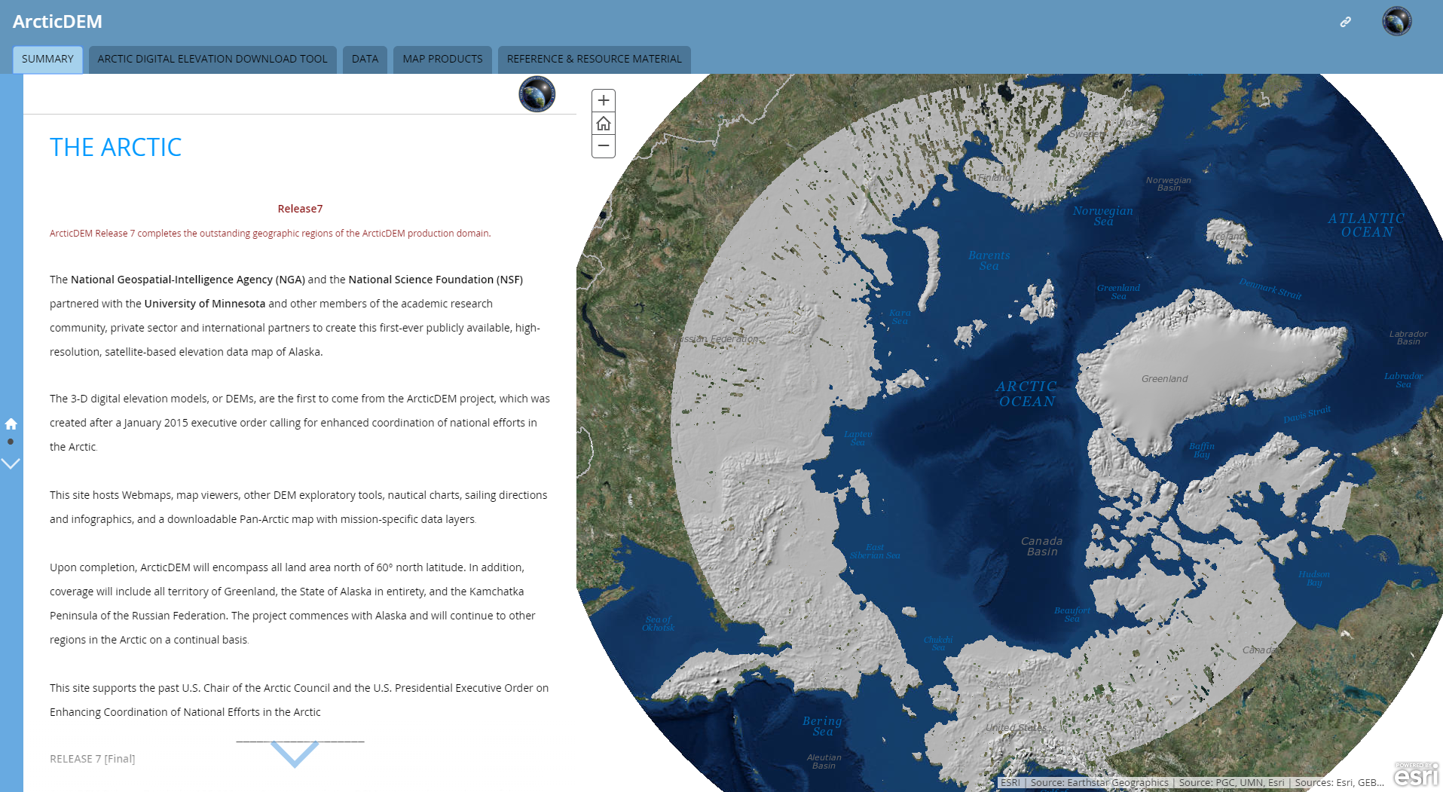
NGA GEOINT Services - Digital Elevation Models (DEMs)

Slide 11
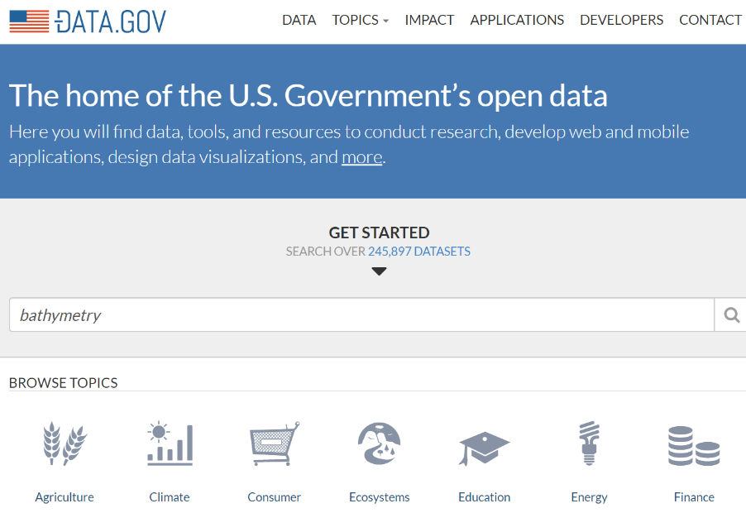
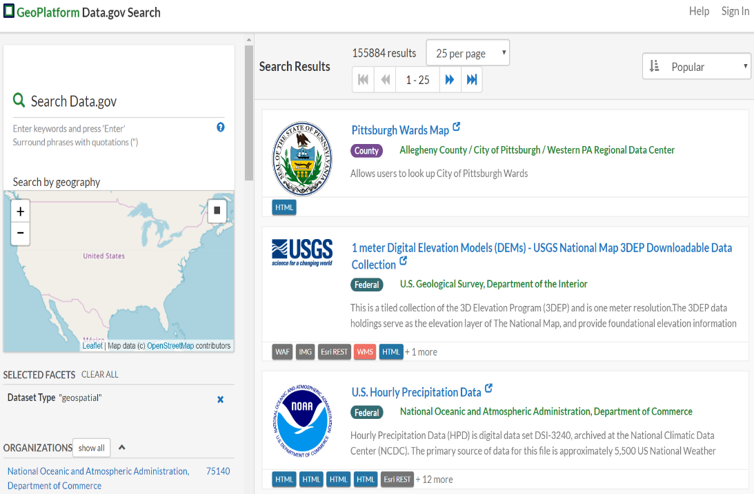
National SDI

Slide 12
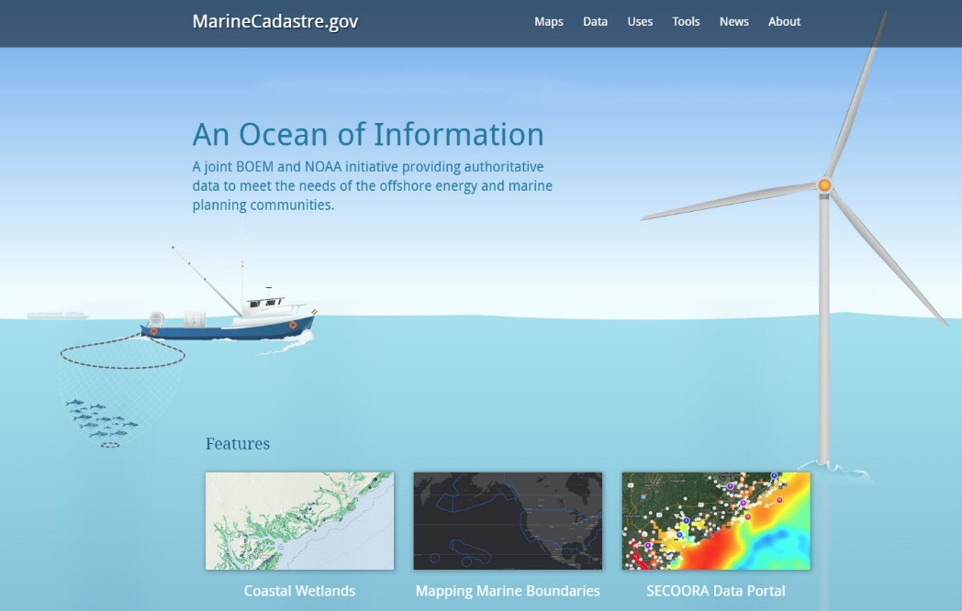
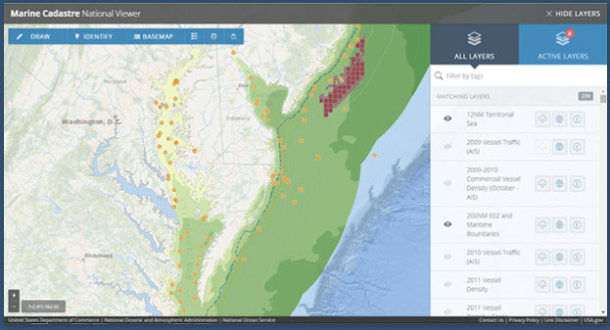
Marine Cadastre
MarineCadastre.gov provides direct access to authoritative and trusted datasets.
Provides data , tools, and technical support for US Ocean Planning
27+ data providers contributing over 280 data layers
Downloadable and Service Enabled
National Data Viewer

Slide 13
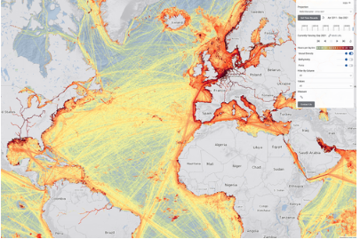
Global Maritime Traffic Density Service (GMTDS)

Slide 14
Thank You

