Slide 1
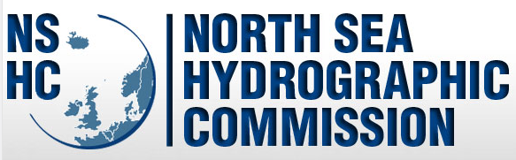
Report of the Baltic Sea and North Sea Marine Spatial Data Infrastructures Working Group
(BS-NSMSDIWG)
Online IHO MSDIWG meeting
17-18 March 2021

Slide 2
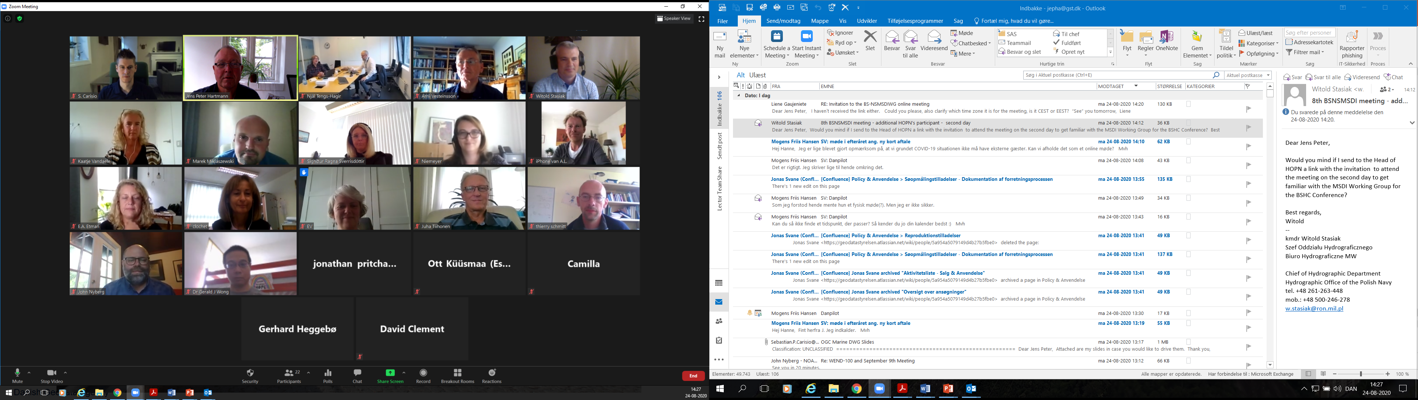
The Baltic Sea and North Sea Marine Spatial Data Infrastructure Working Group (BS-NSMSDIWG) online meeting No. 8 took place August 24 - 25 2020.
MS from the North Sea Hydrographic Commission and the Baltic Sea Hydrographic Commission participated in the meeting

Slide 3
Focus arears at the The Baltic Sea and North Sea Marine Spatial Data Infrastructure Working Group (BS-NSMSDIWG) online meeting No. 8.
Day 1:
The national SDI cooperation
INSPIRE
EMODnet
The framework for maritime spatial planning
in Europe (MSP-directive)
UN-GGIM Working Group on Marine
Geospatial Information
OGC Marine Domain Working Group
S-121 for maritime limits and boundaries
EMODnet Bathymetry
Day 2:
Overview of the BSR MSP Data ESG works.
Introduction to the Baltic MSP data services.
(BASEMAPS, HELCOM Map and Data Service, EU MSP Technical Expert Group on Data for MSP.
The EMODNET-MSP perspective and the new EU data strategy.
Pan North and Baltic MSP project
DigiTwin Northsea – MSP Challenges.

Slide 4
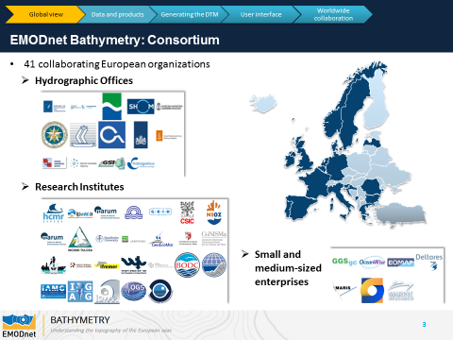
A new call for EMODnet bathymetry

Slide 5
S-121. Maritime limits and boundaries
It was agreed that the BS-NSMSDIWG should investigate how the BSHC and NSHC could work with S-121 1220and if it was possible and desirable to establish at pilot project with the North Sea and Baltic Sea as an S-121 122 testbed.

Slide 6
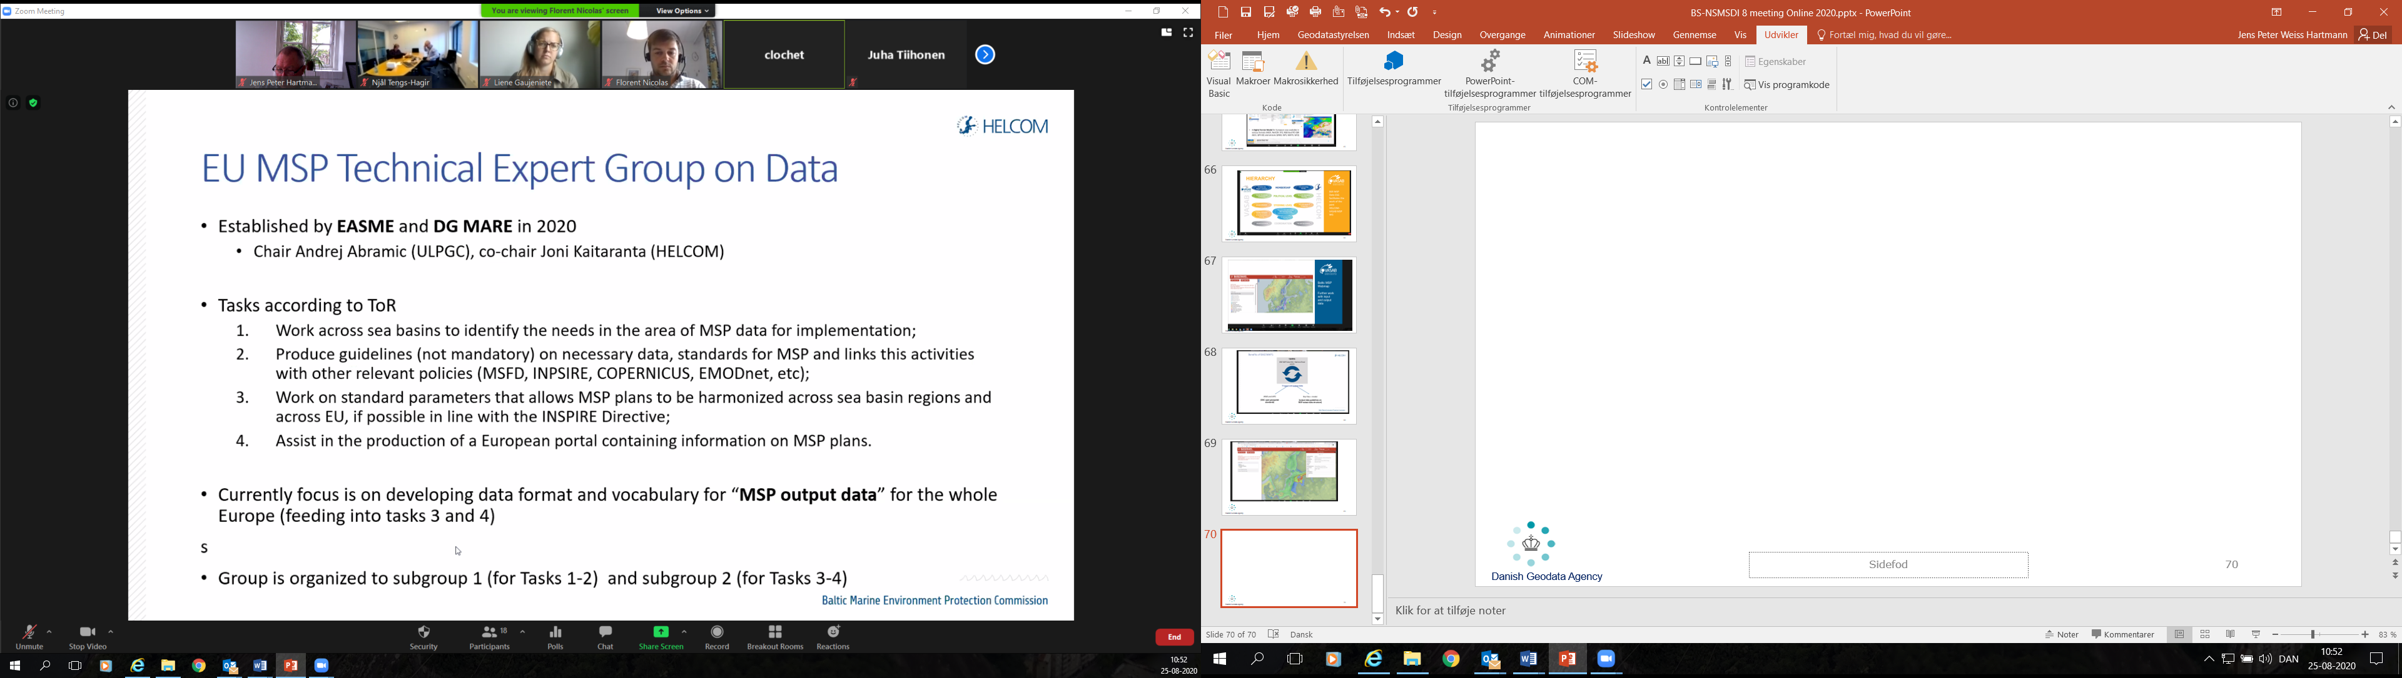
HELCOM presentation
To investigate the possibilities to establish a joint online meeting between the EU MSP Technical Expert group on data and the BS-NSMSDIWG in order to share information and to identify areas of cooperation

Slide 7
Pan North and Baltic MSP project
The BS-NSMSDIWG should follow the EU project eMSP in order to investigate possibilities for cooperation

Slide 8
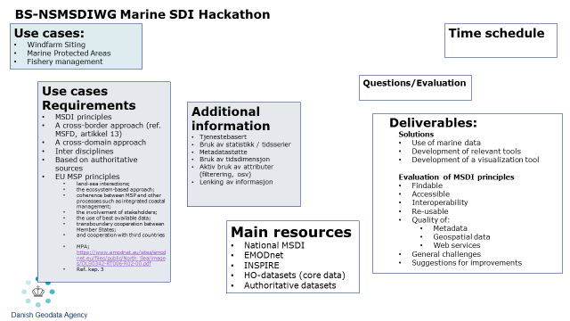
BS-NSMSDI hackathon
It was decided to continue the planning of a MSDI Hackathon but due to lack of resources it should be a small scale MSDI Hackathon with HO data and the possibility to cooperate with relevant university and/or stakeholders should be investigated as the possibility to have an online MSDI Hackathon.

