Slide 1
MSDI-WG
UN-GGIM-WGMGI Update
Busan, Korea
John Nyberg

Slide 2
WG Objectives
Play a leading role at the policy level by raising political awareness and highlighting the importance of reliable, timely and fit-for-purpose marine geospatial information to support the administration, management and governance of the inland waters, marine and ocean environments;
Encourage the use of internationally agreed-upon geospatial information frameworks, schemas, systems and established standards to improve the growing inter-dependent relationships between people and the marine environments; and
Support the Committee of Experts in the development of norms, principles, guides and standards to increase significantly the availability of high-quality, timely and reliable geospatial information including any regional capacity development initiatives.

Slide 3
Membership – Current Composition
18 Member States
The International Hydrographic Organization
Division for Ocean Affairs and the Law of the Sea, Office of Legal Affairs, United Nations
2 from UN-GGIM Private Sector Network (Esri and Ocean Wise)
* Intergovernmental Oceanographic Commission of UNESCO (wishes to be kept informed)
co-Chairs – Burkina Faso and United States of America

Slide 4
Sustainable Development Goals

Slide 5
Examples
Marine data needed for response to disasters and the benefit of having data readily available
Data needed for determining where to best harvest wind energy and the associated economic impacts
Nautical charting data for use in mobile technology to assist small island reef fisherman
Arctic Spatial Data Infrastructure
Seabed 2030

Slide 6
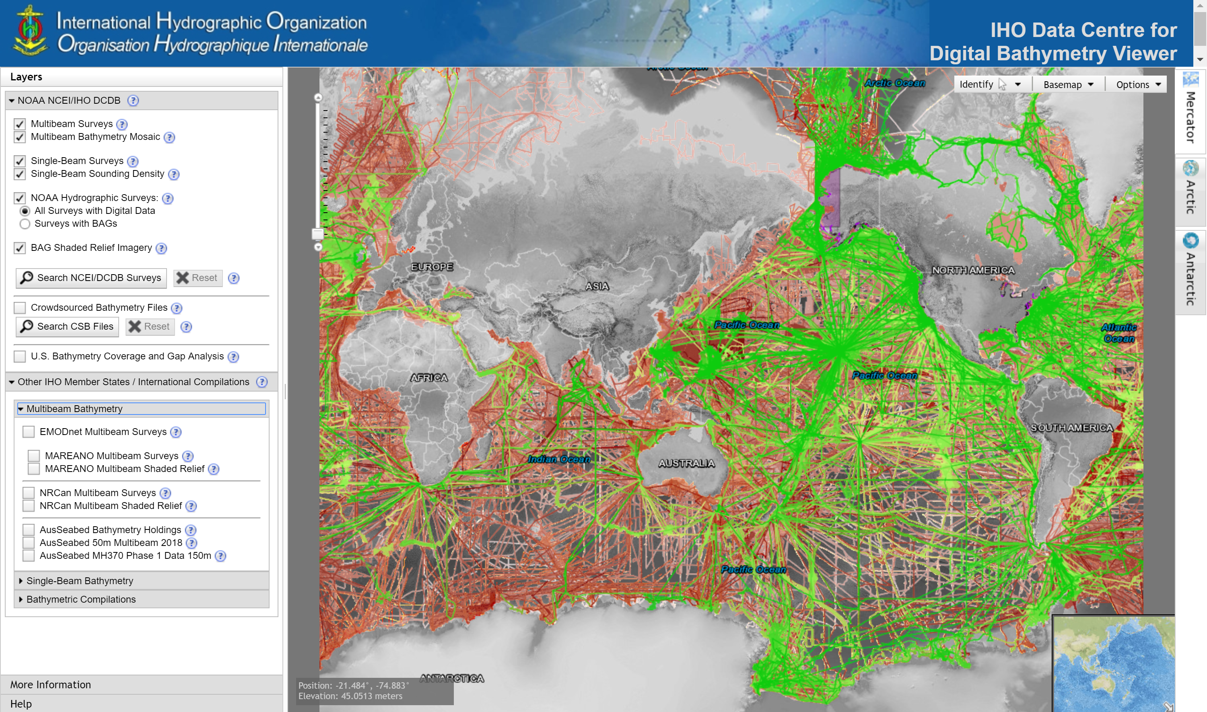

Slide 7
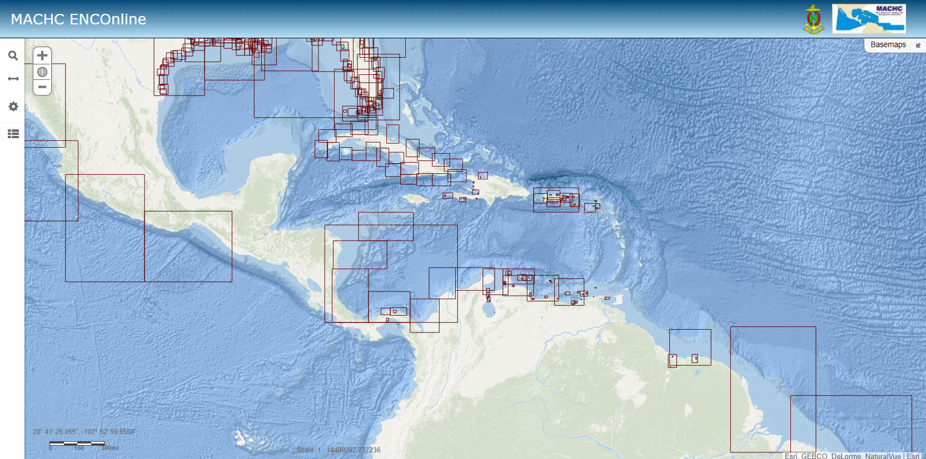

Slide 8
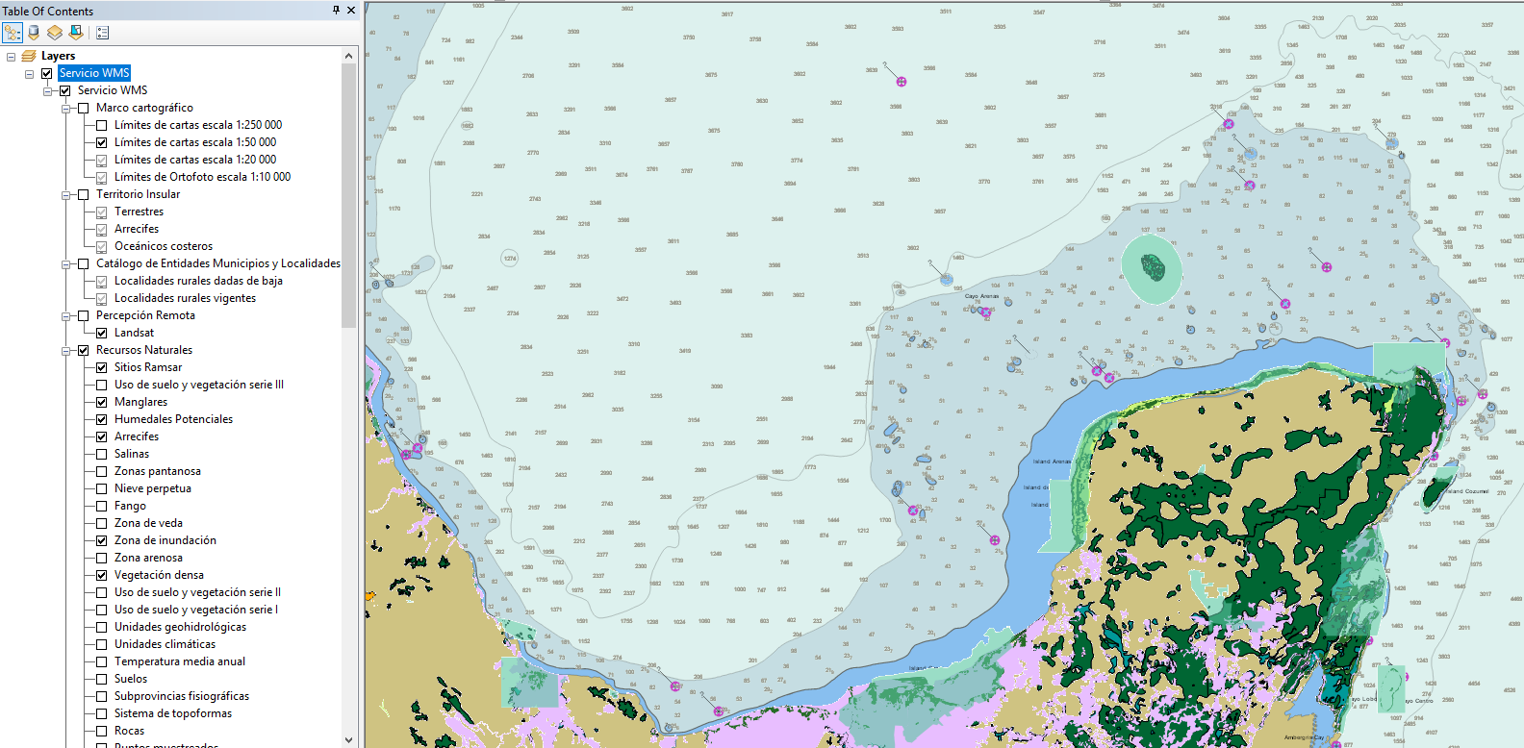
Notes:
MACHC ENC Online merged with Mexico’s INEGI dataset in ArcGIS. It would be great to have something like this – merging the land and sea together for the entire world, but ….

Slide 9
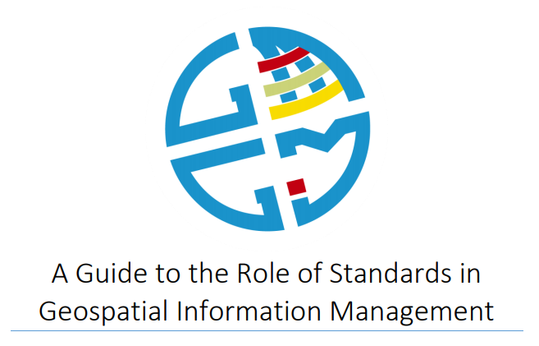
International Standards
S-101 ENC
S-102 Bathymetric Surface
S-103 Sub-surface Navigation
S-104 Water Level Information for Surface Navigation
S-111 Surface Currents
S-121 Maritime Limits and Boundaries
S-122 Marine Protected Areas
S-123 Radio
S-124 Navigational Warnings
S-125 Navigational Services
S-126 Physical Environment
S-127 Traffic Management
S-128 Catalogues of Nautical
S-129 Under Keel Clearance Management (UKCM)
S-201 Aids to Navigation Information
S-210 Inter-VTS Exchange
S-230 Application Specific Messages
S-240 DGNSS Station Almanac
S-245 eLoran ASF Data
S-246 eLoran Station Almanac
S-247 Differential eLoran Reference Station Almanac
S-401 Inland ENC
S-402 Bathymetric Inland ENC
S-411 Ice Information
S-412 Weather Overlay

Slide 10
Work Plan Progress Update
Recognize Capacity Development Initiatives which may Benefit from WG Activities – Excellent start on identifying opportunities
Liaise with Relevant Organizations including IHO and GGIM Regional Entities – Members have attended regional entities, IOC, and UNCLOS, excellent IHO participation
Recognize and endorse established standards for geospatial information in marine and inland waters

Slide 11
Work Plan Progress Update
Communications Plan – Published in 2018
Use Case Report – Outline produced, more this week

Slide 12
Focus for next 12 months
Complete first draft of Use Case Report
Further refine capacity building opportunities and initiatives for advancing WG-MGI objectives
Identify WG members to participate in regional groups
Expand membership, reach out to landlocked member states

Slide 13
MSDIWG / WGMGI Partnership
Make data available!
Open SDG Data Hub
Seabed 2030
Promote and use established (agreed upon) standards
Standards Guide for Anyone
Side Event during GGIM
Be an ambassador for the GGIM-WG-MGI
Participate in a regional GGIM meeting
Talk to your GGIM HOD about being a member

Slide 14
Thank You

