Slide 1
Agenda 4
CBWP 2022 closure and CBWP 2023 update
- Contributes from the EAHC’s Coordinators
VTC, 13 March 2023
Peter (Hak-yoel) YOU
EAHC coordinator

Slide 2
Items
Meetings
CB activities in 2022
CB plan
Raised issue
Action required
2/7

Slide 3
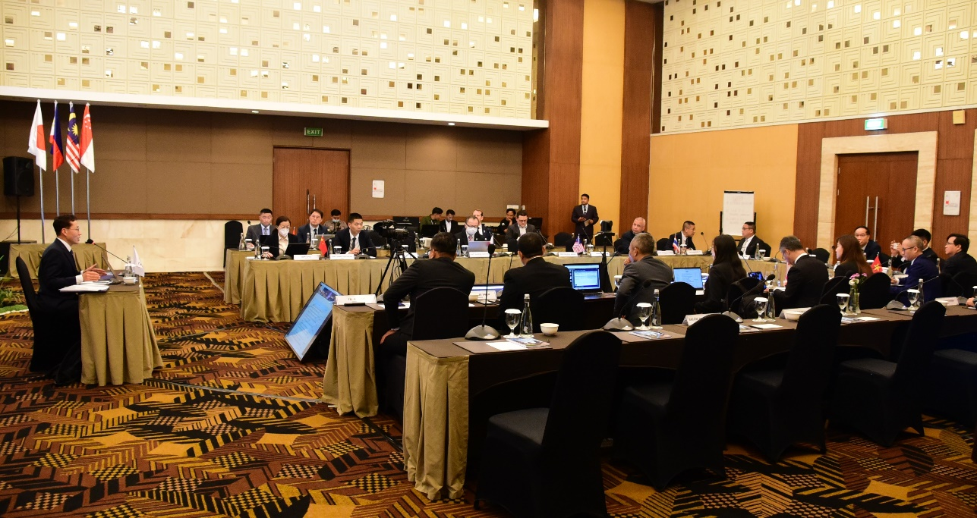
1. Meetings
TRDC-BOD 12
15 February 2023 / Yogyakarta, Indonesia
3/7

Slide 4
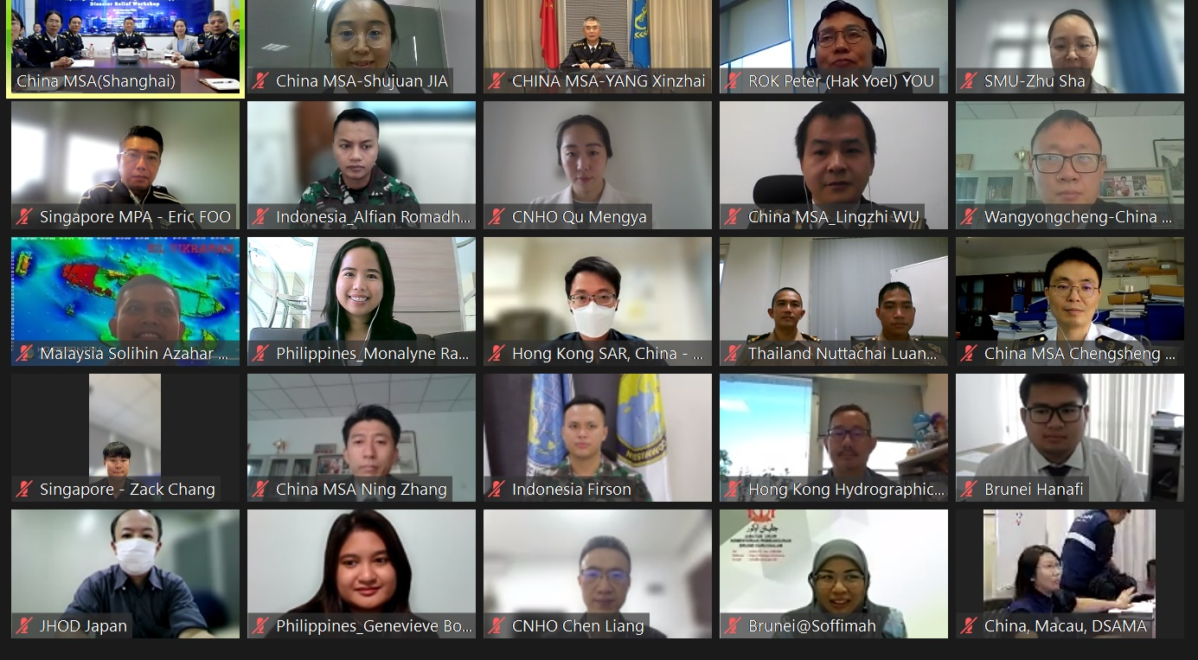
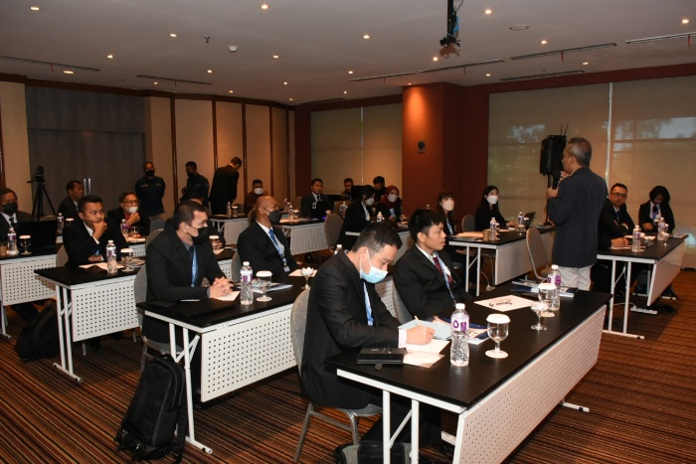
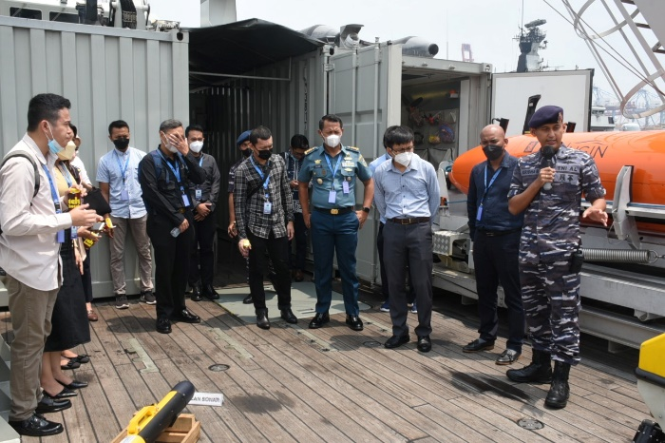
2. Activities in 2022
Programmes | Date / MSs | Part/ MSs
P-37 Developing and Implementing a Regional framework for Disaster Mitigation and Management (Hybrid-mod) | 6 - 8 Sep. 22 / Jakarta, Indonesia | 15 / 9
Hydrographic Data Managements to Support Disaster Relief (Hybrid-mod) | 25 -28 Oct. 22 / Shanghai, China | 31 / 8
4/7

Slide 5
3. CB plans
Allocated by CBSC
Year | Programmes | Date / Budget / Venue | Status
2023 | Hydrography for Disaster Mitigation and Humanitarian Support (P-11) | TBD / 22,360 €/ China | Planned (from 2021 P-11)
2024 | Technical Visit to Cambodia (A-15) | TBD / €5,720 / Cambodia | Planned (from 2021 A-08)
5/7

Slide 6
4. Raised issue
1. CB activities are necessary in order to reduce the hydrographic technology gap among our regions and to develop together.
2. TRDC BOD to deliver S-100 training for the member states to implement S-100 regarding the IHO S-100 roadmap
3. ROK, Singapore and Malaysia modify and uploads TFT materials to EAHC Website
4. The new Chair of EAHC TRDC-BOD was selected Captain Renny Lilik Asmoro form Indonesia on 2023
- Vice Chair and EAHC CB coordinator will be selected 2024
6/7

Slide 7
5. Action required
Take note of this report.
Take any other actions considered appropriate.
7/7

