Slide 1
South West Pacific
Regional Hydrographic Commission
Capacity Building Report to CBSC21 Intercessional
Matt Borbash

Slide 2
2022 CB Activity
SWPHC Hydrographic Leaders Programme (Feb – Dec)
SWPHC Seabed 2030 Webinars 1-4 (May – Jul)
SWPHC S-100 Workshop #2 (Oct)
U.S. Navy IHMEP CAT B; Indonesia graduate (Aug)
IIC S-5 CAT B (May)

Slide 3
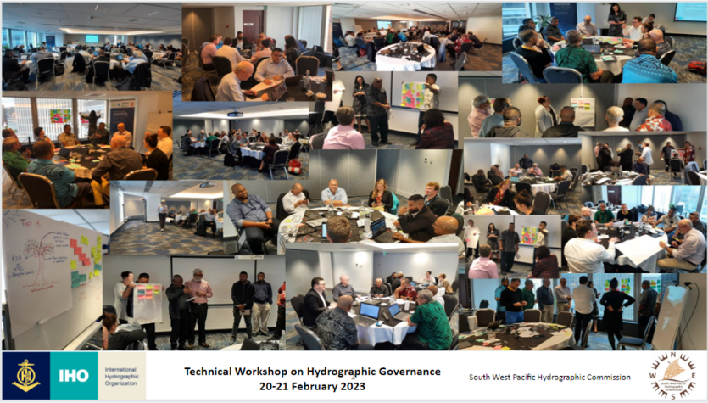
2023 Activity
Technical Workshop on Hydrographic Governance (Wellington ICW SWPHC20; 20 -21 Feb)
To build institutional knowledge and capability to develop and implement enduring Hydrographic Governance
To provide the knowledge and roadmap to deliver an effective institutional framework for Hydrographic Governance
To work with PICTs to develop a Hydrographic Governance structure that is fit for purpose and meets each PICTs requirements
To share experience and knowledge between SWPHC members
To build enduring relationships with representatives from SWPHC

Slide 4
2023 Activity
MSI Regional Workshop (Fiji 25-27 July)
To build institutional knowledge, commitment and capability to deliver MSI for the region that will improve maritime safety and increase maritime domain awareness
To provide MSI training to representatives from SWPHC
To increase the knowledge and experience to provide compliant MSI
To build enduring relationships with representatives from SWPHC

Slide 5
2024 Activity
Workshop on Disaster Response (ICW SWPHC21)
To assess effectiveness of the SWPHC DRF and to establish necessary corrective actions to further refine and improve the DRF
To generate a scenario driven (table –top) disaster event and exercise the Disaster Response Plan
To identify lessons learned, successes and shortfall of the Plan
To share experience and knowledge between SWPHC members and other RHCs
To build relationships with representatives from SWPHC

