Slide 1
8.3
IHO Empowering Women in Hydrography (EWH) Project
Denpasar, Indonesia
VTC, 1 – 3 June 2022
CBSC20-0X.XX

Slide 2
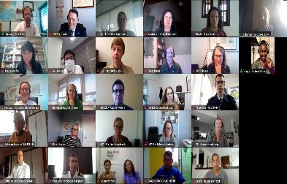
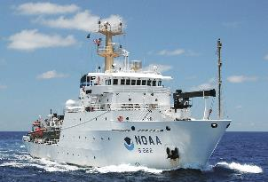
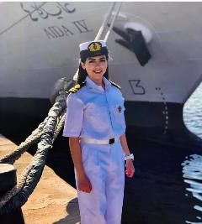
First year achievements
Kick-off meeting (33 participants from 16 countries)
1 internships on the outreach of the EWH project, in the IHO office
3 internships related with the review process of submitted programmes to the IBSC, with in-person participation on the IBSC45 Meeting.
3 at-sea experiences made available by NOAA.
Submission to the ‘Call for Decade Actions No. 02/2021’ as part of the United Nations Decade of Ocean Science for Sustainable Development
Webinar on Gender-balance and empowering leaders
Women role-models - interviews among volunteer women from all position in the hydrographic community

Slide 3
Second year - plans
Promotion of the gender-diversity program to Member States during IHO activities
Continuation of the Outreach project including planned activities.
Support internships at the IHO Secretariat, at other hydrographic offices, or at-sea activities for operational experience for women.
Prepare for and host an EWH symposium to be held in conjunction with the IHO Council meeting, which the participants will also attend.
Integration with other IHO activities (e.g. education).

Slide 4
Second year - plans
Teaming up with other events in the ocean science or maritime domain with gender-equity themes.
Based on the initial symposium, discuss intended activities and present it to the Inter-Regional Coordination Committee (IRCC) for review.
Develop a mentoring programme
Actions required:
Take note of this report
Take any other actions considered appropriate.

Slide 5
Actions required
Please note this report
Take any other actions considered appropriate.
Thank you

