Slide 1
8.4
Performance Indicators and Statistics
Denpasar, Indonesia
VTC, 1 – 3 June 2022
CBSC20-0X.XX

Slide 2
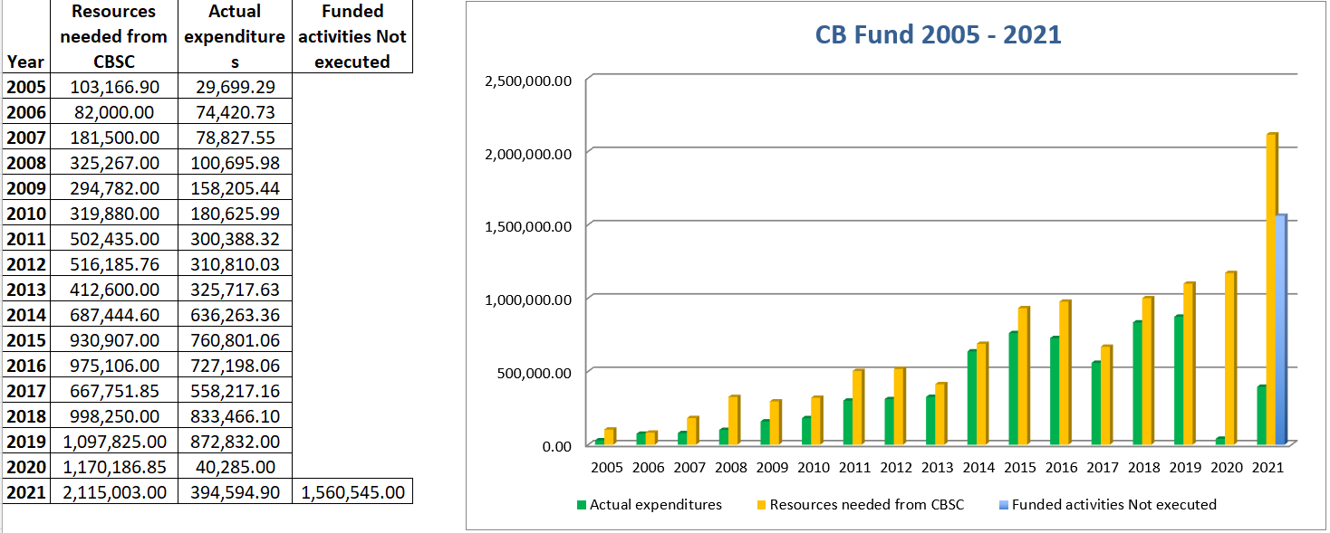
8.4. Statistics

Slide 3
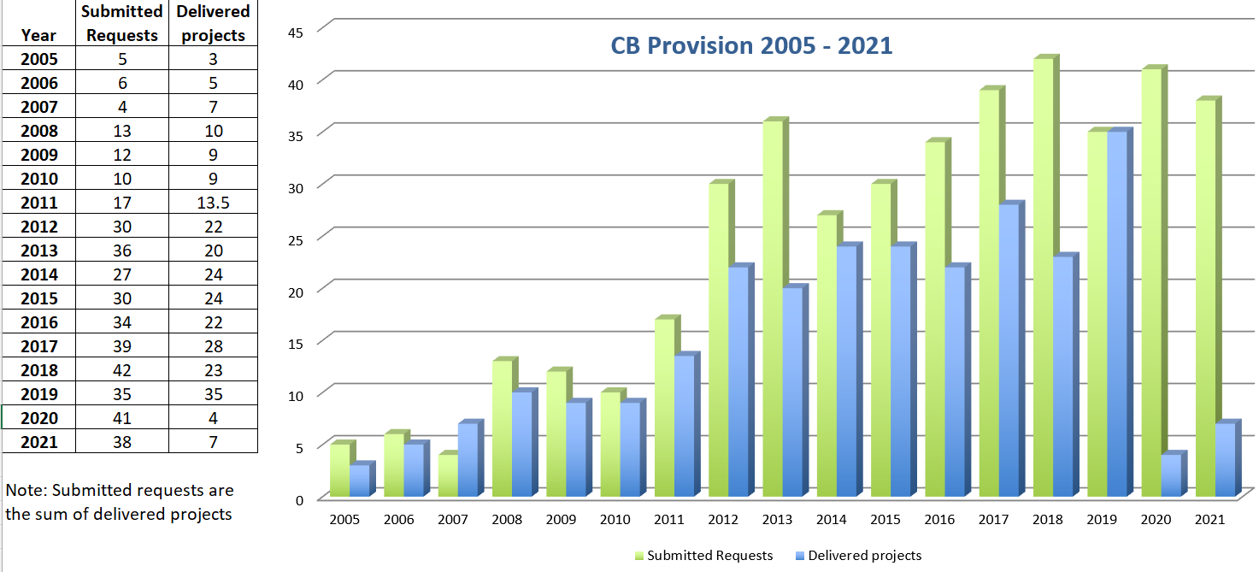
8.4. Statistics

Slide 4
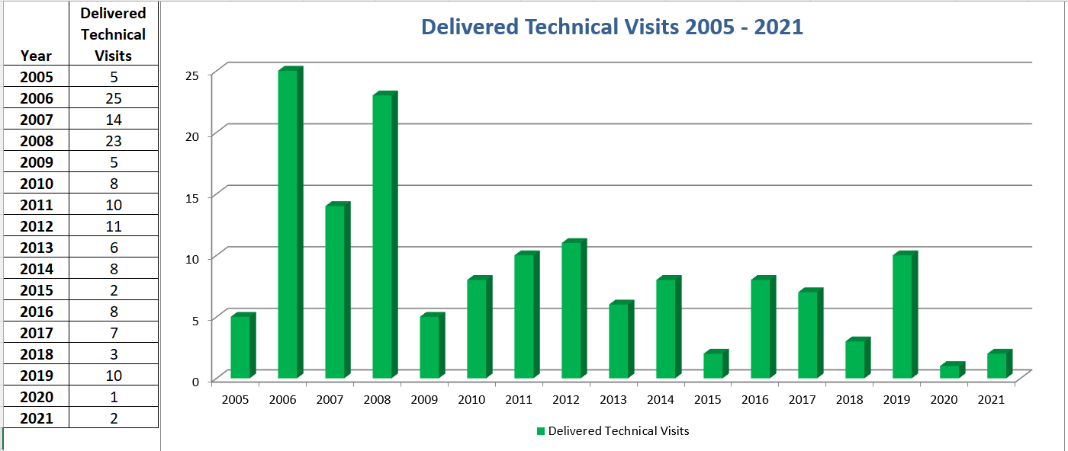
8.4. Statistics

Slide 5
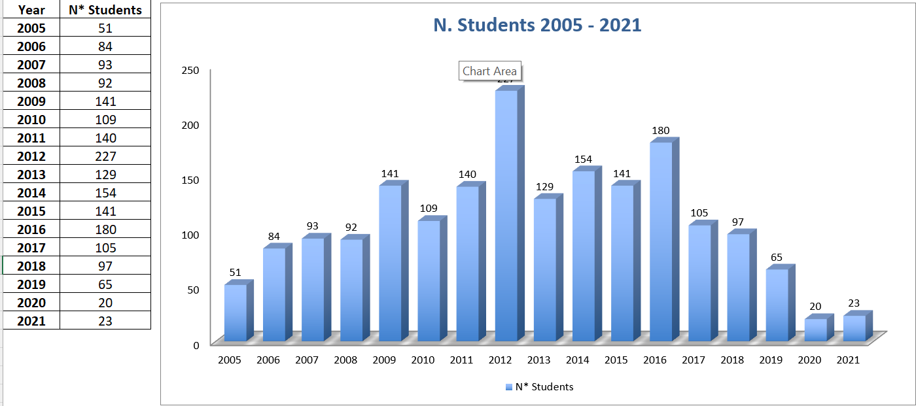
8.4. Statistics

Slide 6
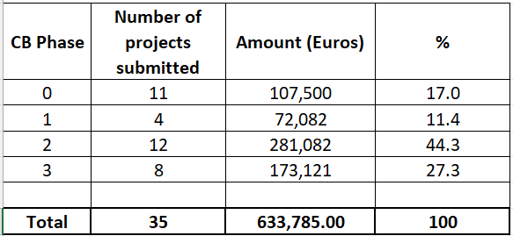
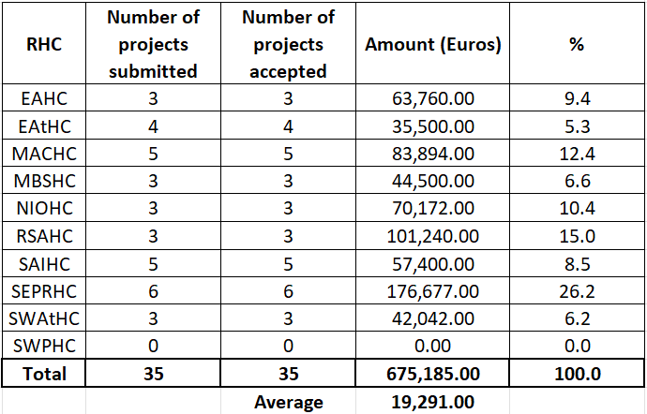
8.4. Statistics

Slide 7
8.4. Performance Indicators and Statistics
Actions Requested of CBSC
Note this report
Take any actions as considered appropriate
Thank you!

