Slide 1
JICA Training Course
on hydrographic survey
Report
VTC, 1 – 3 June 2022
By Hydrographic and Oceanographic
Department, Japan Coast Guard
CBSC20
VTC, 1 – 3 June 2022
CBSC20-06.XX

Slide 2
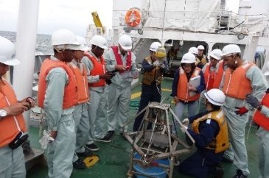
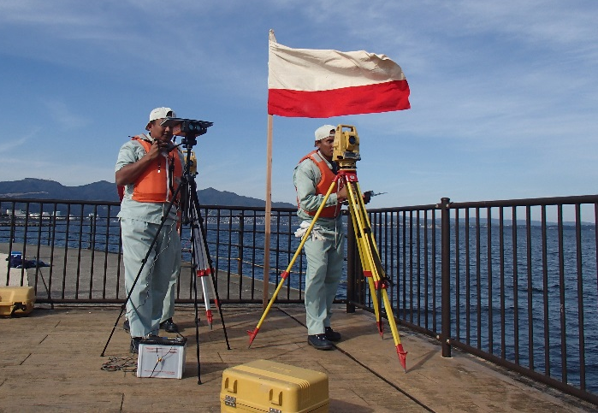
JICA Knowledge Co-creation Program (Group and Region Focus)
Hydrography for Charting and Disaster Management
(Internationally Accredited Category B)
Six-month training course conducted by Japan International Cooperation Agency (JICA) since 1971 in cooperation with Hydrographic and Oceanographic Department, Japan Coast Guard (JHOD).
Lectures and field exercises are provided to acquire theory and skills on hydrographic survey.
Due to the COVID-19, short-term online training were held in 2020 and 2021. (But not meet Cat B requirement.)
Ocean survey (above); Field training (below)
CBSC20
VTC, 1 – 3 June 2022

Slide 3
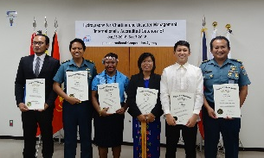
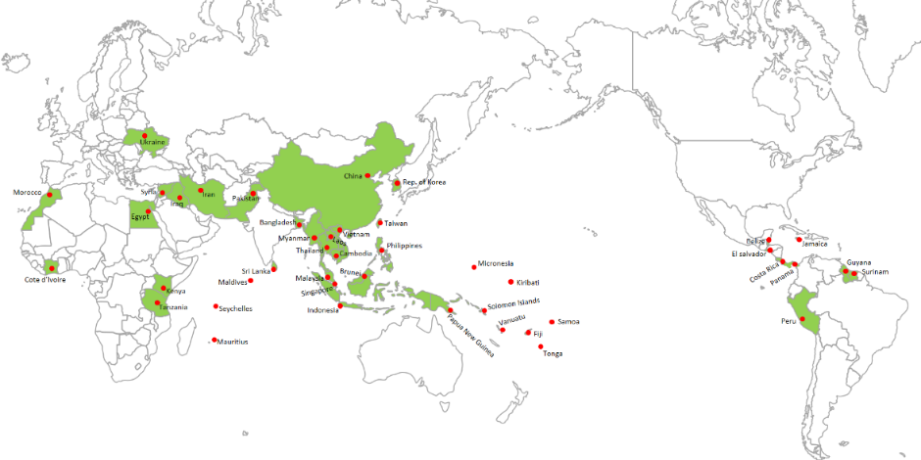
JICA Knowledge Co-creation Program (Group and Region Focus)
Hydrography for Charting and Disaster Management
(Internationally Accredited Category B)
After the COVID-19, the training course will resume in Japan as usual.
If you wish to attend the training course, your country needs to respond “Needs Survey” to be conducted by JICA through diplomatic channels around June 2022.
For more details, please contact a JICA office^{(*1)} in your country or JHOD^{(*2)} by asking how to apply.
closing ceremony
(*1): https://www.jica.go.jp/english/about/organization/overseas/index.html
(*2): ico@jodc.go.jp
Number of participants from 1971 to 2019:
442 trainees from 44 countries
CBSC20
VTC, 1 – 3 June 2022

