Slide 1
Agenda 5.1E
EAHC REPORT
1 June 2022
Peter YOU
EAHC Coordinator

Slide 2
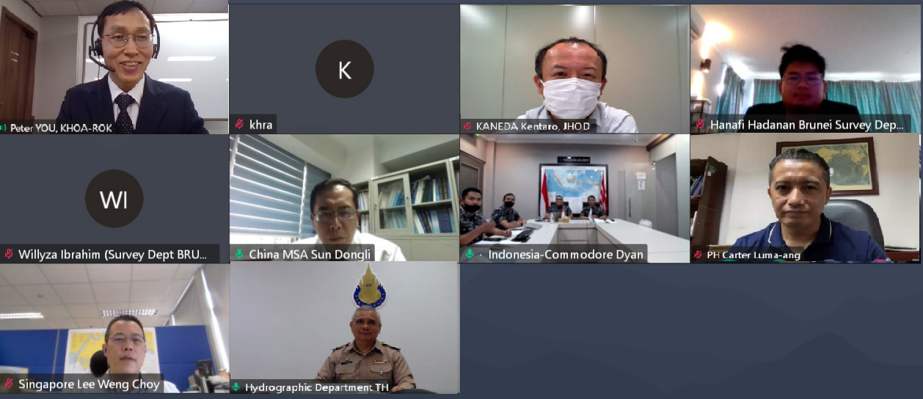
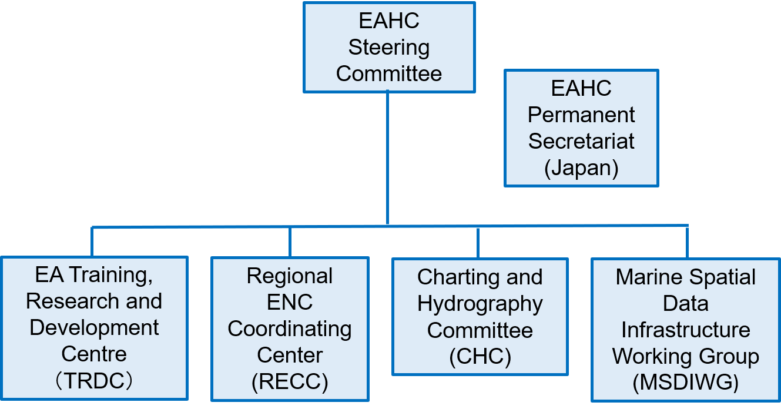
1. Activities after CBSC19
Meeting
Title : TRDC-BOD12 Interim meeting (VTC)
Date : 22 April 2022
Participants: 8 MSs, 12 persons
Limited discussions
Need to Face to Face meeting
2/7

Slide 3
Assessment of Capacity Building Phase
Country / Territory | NHC or NHCC | CB Phase 1 | CB Phase 2 | CB Phase 3 | Last TV
Brunei Darussalam | 0 | 1 | 1 | 1 | 2014
China | 1 | 4 | 4 | 4 | N/R
Democratic People's Republic of Korea | -1 | -1 | -1 | -1 | N/R
Indonesia | -1 | 4 | 4 | 4 | N/R
Japan | 2 | 4 | 4 | 4 | N/R
Malaysia | 2 | 4 | 4 | 4 | N/R
Philippines | 1 | 4 | 4 | 3 | N/R
Republic of Korea | 2 | 4 | 4 | 4 | N/R
Singapore | -1 | 4 | 4 | 4 | N/R
Thailand | -1 | 4 | 4 | 2 | N/R
Cambodia* | 0 | 0 | 0 | 0 | 2019
Timor-Leste* | 0 | 0 | 0 | 0 | 2016
Vietnam** | -1 | 2 | 2 | 2 | 2014
√
√
√
√
√
√
√
√
√
√
√
* impending IHO MSs, ** IHO MS but impending EAHC MS
3/7

Slide 4
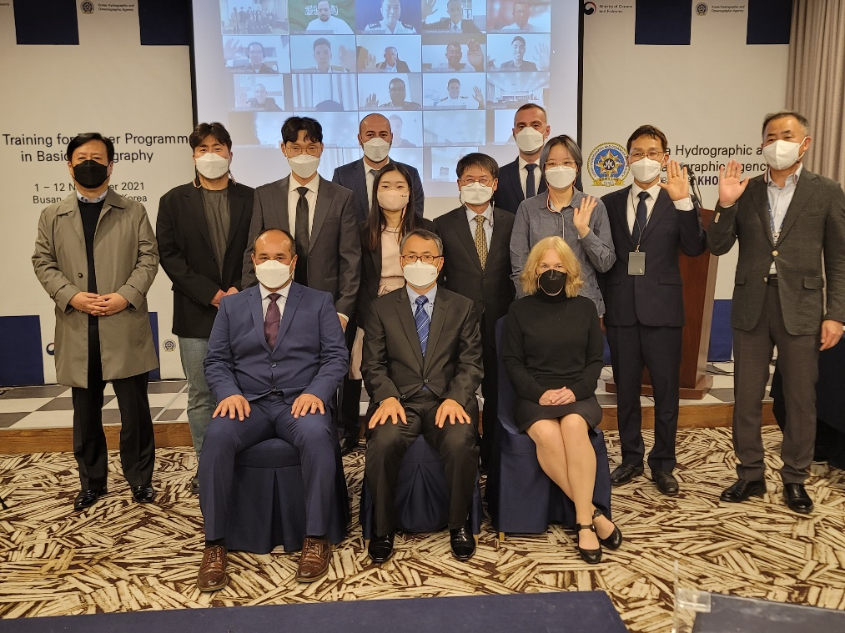
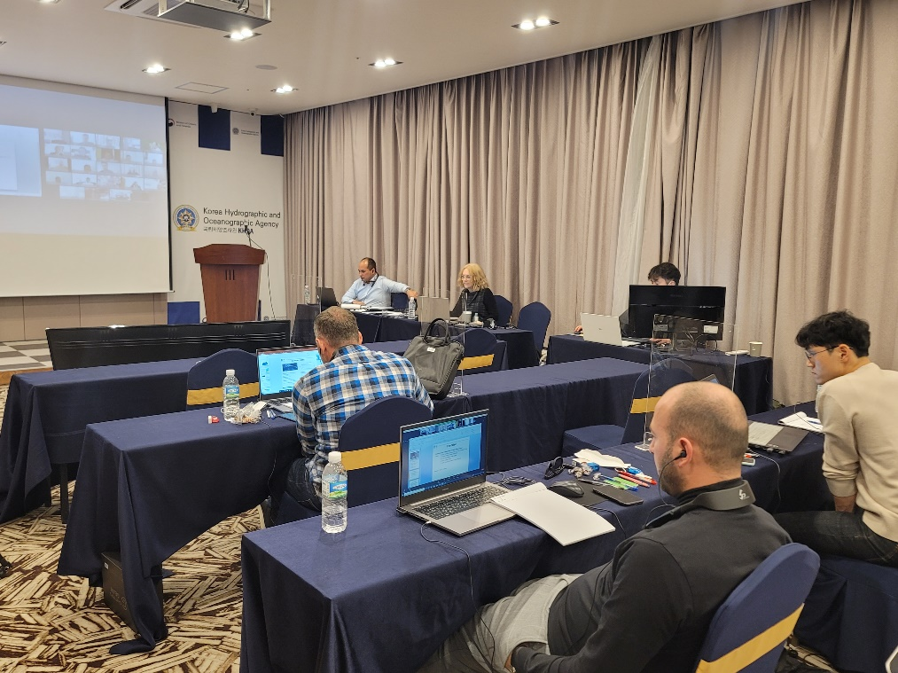
CB activities
Training for Trainers (TFT) in Basic Hydrography
Period / Location: 1. Nov. ~ 12. Nov. (2 weeks) / Busan (Hybrid)
Trainees: 20 MSs, 23 persons
Limited CB activity,
But Hybrid has a beneficial
4/7

Slide 5
2. EAHC’s CBWP 2022-2023
Need to Hybrid mod
Project No. | Title | Venue | Date | Status
P-15 | Developing and implementing a regional framework for disaster mitigation and management | Indonesia (hybrid) | 22 - 24 Aug. 2022 | Planned
P-19 | Hydrographic data management to support disaster relief | China ( hybrid ) | July 2022 | Planned
P-11 | Hydrography for Disaster Mitigation and Humanitarian Support | TBD | 2023 | Postpone
A-08 | Technical Visit to Cambodia | Cambodia (Face to Face) | TBD (depend on COVID-19) | Planned
5/7

Slide 6
3. EAHC’s new CB proposal
Limited chances
Need to make a digital contents
Priority | Project Name | Countries involved | Benefits
1 | Seminar on MSI Interpretation and Enhancements | Within NAVAREA XI region, EAHC MSs. | To improve knowledge and awareness of HO’s role in MSI infrastructure and to establish network amongst EAHC
2 | Seminar on S-57 to S-101 Transition | EAHC (including pending EAHC MS Vietnam) | Promote the IHO Strategic Plan and the S-100 Implementation Plan
3 | Workshop on the Measuring SDB according to S-44 Standard in Developing the Future Nautical Chart | EAHC (including pending EAHC MSs, e.g. Vietnam) | Efficiency of budget and reducing the personnel risk on updating nautical charts
6/7

Slide 7
Action required
Take note of this report
e-Learning Center should be able to provide a variety of contents needed by RHCs and consider developing RHC lectures into e-Learning contents process at the level of CBSC.
take any other actions considered appropriate.
7/7

