Slide 1
Agenda-3
CBWP2021 Update
- EAHC
Peter YOU
Chair of TRDC-BOD,
EAHC Capacity Building Coordinator

Slide 2
Contents
Meetings
EAHC’s CBP on 2021
Follow-up Activities

Slide 3
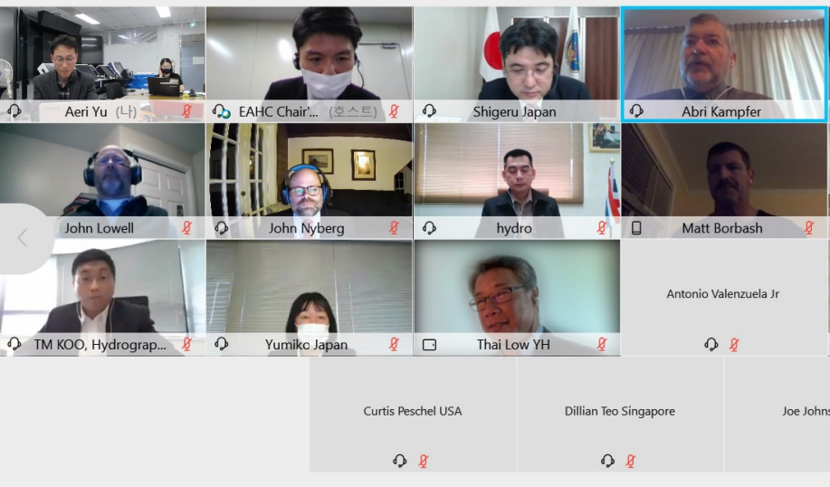
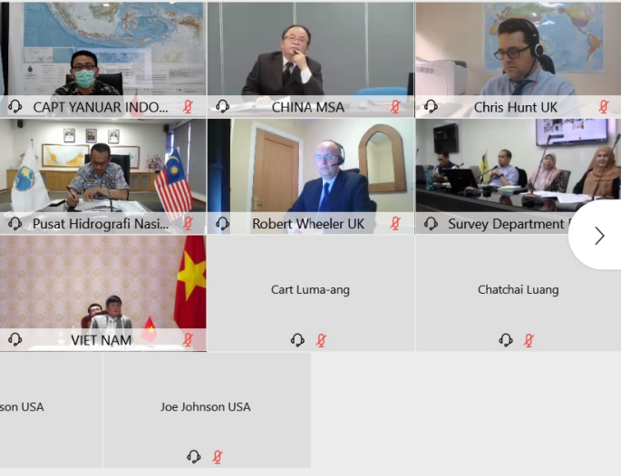
Meeting
• Date: 20 January 2021
• Venue: Online meeting
• Participants: 37 (13 MSs) :
EAHC, Vietnam, UK, USA , IHO
• Main issues:
IHO activities, Capacity Building, 50th Anniversary etc.
EAHC AD HOC Video Conference

Slide 4
EAHC’s CBP on 2021
EAHC’s CBP: 2 accepted, 1 earmarked for TRDC
No. | Events | Budget | remark
P-04 | Training for Trainers – Basic Cartography | 80,943€ | Led by KHOA, Nov. 2021 On/offline course
P-15 | Developing and Implementing a Regional Framework for Disaster Mitigation and Management | 22,260 € | Led by China or Indonesia
P-19 | Hydrographic Data Managements to Support Disaster Relief | 22,260 €

Slide 5
Follow-up Activities
Arising issue
EAHC recognizes the difficulty of running CB activities this year
Hosting MS consider voluntary on/offline CB activities (online facility, lecturer etc.)

Slide 6
Thank you

