Slide 1
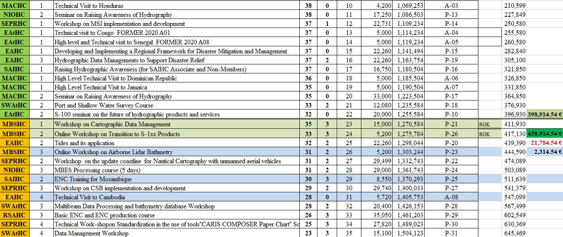
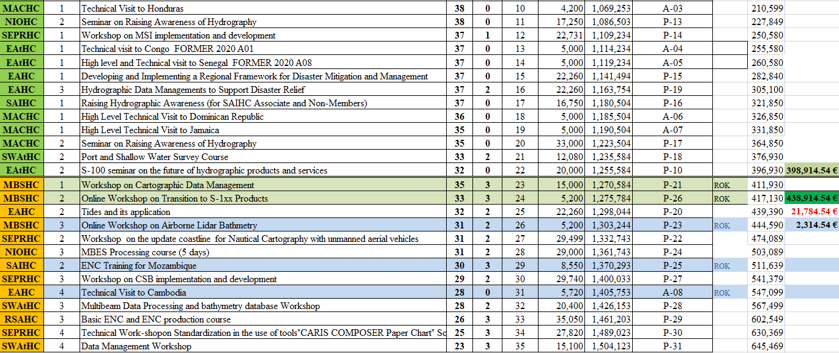
Proposal to Update the CBWP2021 with the 40,000 Euros provided by ROK

