Slide 1
CBSC19-05.1B
EAtHC Report
Report to CBSC19
VTC, 9 – 10 June 2021
By Julien Smeeckaert (Shom - France)
EAtHC CB Coordinator
CBSC19-05.1B

Slide 2

Activities completed since CBSC18
Impact of pandemic Covid-19 !
Cancellation of Plenary EAtHC16 and the MSI/MSDI Seminar planned beforehand and of several TVs.
[CBWP2020 – A-09] : Technical Visit to Togo
31 October – 5 November 2020
Led by Shom

Slide 3

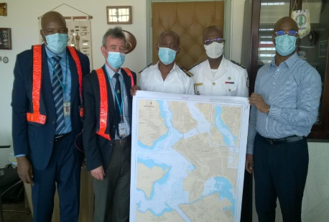
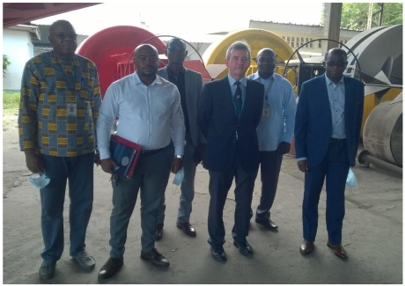
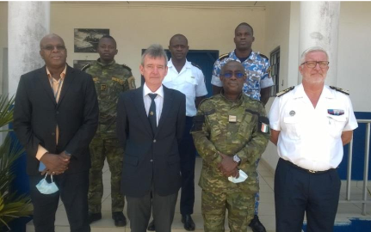
Activities planned for 2021
[CBWP2021 – A-01] : Technical Visit and Training Centre Visit to Côte d’Ivoire
31 May – 4 June 2021
Led by Shom
CBWP2021 – A-04 | Technical Visit to Congo | Led by Shom
CBWP2021 – P-32 | MSI & MSDI Seminar | September 2021, led by Shom

Slide 4
Challenges
26 EAtHC Member States but only 7 IHO Members
CB mainly focused on Central and Western African coastal States
Phase 1 (MSI) : Non Western African coastal States fulfill independently its national obligations in a sustainable way. Importance of TVs. But ongoing progress
Phase 2 (Survey capacity) : Only Morocco and Nigeria with developed capacities (offshore). Quite limited survey capacities (mainly harbour and non-national) incompliant with the development of important ports.
Phase 3 (Charting capacity) : Morocco and Nigeria have developed their own capacities and started the transition for chart production. Increase of geomatics capacities (but not MSDI)
Strong needs in lagunas and rivers surveying and charting (Currently no foreign assistance)
To strengthen the involvement of other MS : currently mainly FR, PT, UK. In a longer term : MA, NG as local support for neighbouring countries.

Slide 5
Lesson-learned from Covid-19
use of virtual meetings and e-learning
Face-to-face meeting : limited number of places, travel and cost constraints
Virtual meeting : no more constraints, participation is increased (entire national committees for hydrography can attend a MSI course whereas only 2 of them could attend the same face-to-face seminary)
> E-learning or webinar can have more impact among attenders with a global reduced cost. But face-to-face meetings remain necessary.
Opportunity to develop regional seminars in French and English languages with support of IHO MS for organization (for ex : CI provides offers for training)

Slide 6
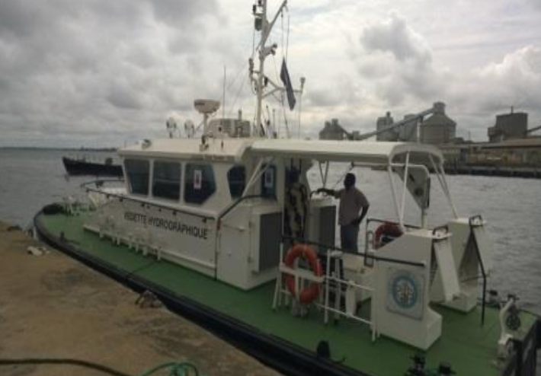
Actions required of CBSC19
Please note this report
Take any action considered appropriate
THANK YOU

