Slide 1
IHO e-Learning Center
CB e-Learning Project Team
Report to CBSC19
By
Helber Carvalho (DHN – Brazil) – Chair
Mina Foroutan (CHS – Canada) – Vice-Chair
Peter You (KHOA)
CBSC19-08.2

Slide 2
e-Learning Project Team
Introduction / Background
The Assembly endorsed the installment of an IHO e-Learning Center based on A-2 Pro 3.3 and related recommendations of the IRCC/CBSC
Key outcomes include the recognition of :
The importance and potential of e-Learning for the improvement and extension of Capacity Building activities in hydrography;
The acceleration of e-Learning during and post-pandemic world; and,
The initiative from Republic of Korea to establish and support an IHO e-Learning Center, to provide the infrastructure and to cooperate with IBSC, its Member States and industry.

Slide 3
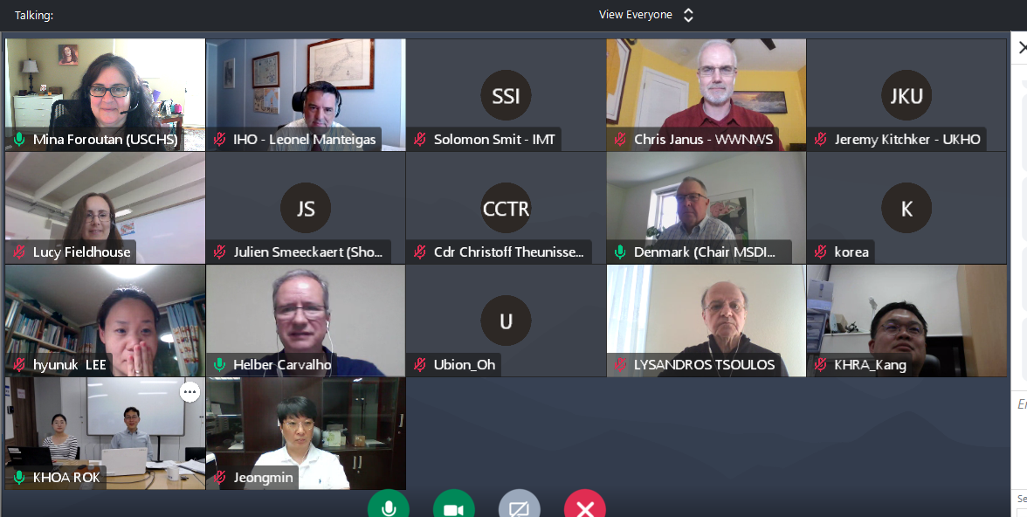
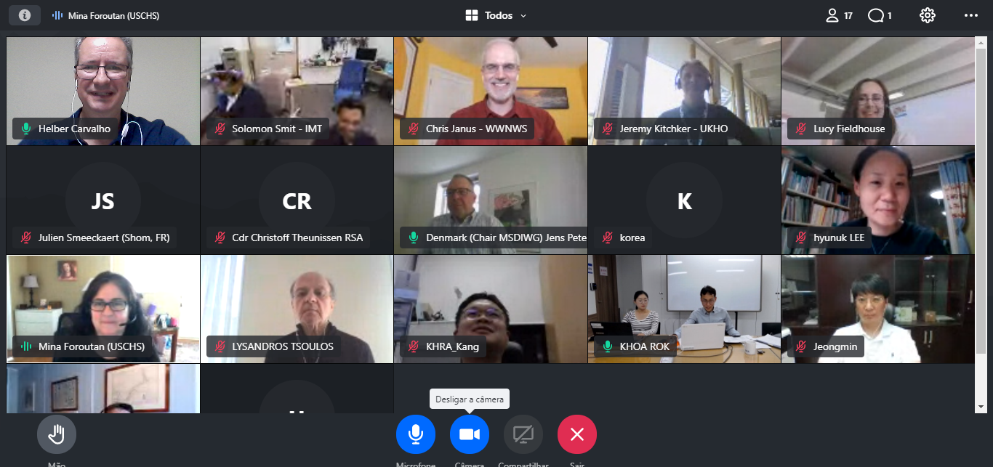
Establishment of PT (Representatives)
The Project Team of IHO e-Learning Center started Its work after CBSC-18 with ten (10) representatives. In March 2021, during the 2nd Meeting, the PT grew by receiving 5 new members and replacing two (2). After 3rd Meeting, 1st June 2021, increasing the efforts two (2) new members joined to PT, replacing one.
Nowadays, the PT has fourteen (14) participants.
3 meetings to date (September 2020, March & June 2021)
Images of 3rd Meeting, 1st, June

Slide 4
Successes to date
Terms of Reference
Rules of Procedure
Finalization of the Implementation Plan
Sharing Member States’ experiences and contends:
MSDIWG
IC-ENC
SANHO
KHOA
SHOM
UNESCO - Global Citizen Education

Slide 5
Planned Activities for 2021
Continuation with sharing of Member States’ experiences
Drafting of the IHO e-Learning Center Guidelines
Small Task Force setup to finalize
Projected completion September 2021
Creation of Center e-Learning Website
Uploading 4 e-Learning curriculums
Projected completion November 2021
Report to CBSC19

Slide 6
Planned Activities for 2022
Continuation with sharing of Member States’ experiences
Set up the Center Steering Committee
Finalize the framework of the Center
Run the Center Secretariat
Testing of operational site with IHO Member States
Report to CBSC20

Slide 7
e-Learning System & Website - System architecture (updated)
CDN
Internet
Targeting
10,000 users
1,000 client concurrent connection
Reliable & convenient service
Firewall
Users
(PC, Mobile)
Switch HA
L4/7 Switch #1
L4/7 Switch #2
Monitoring
system
Dual WEB
VOD system
System admin.
Source management,
DB monitoring
WEB#1
WEB#2
Stream Server
DB Server
Storage Server
Etc. Server
WEB_NAS
VOD_NAS
DB
Active
Etc. Data
Contents, Dev. Server

Slide 8
Type of IHO e-Learning Courses
OPEN
course
REGULAR
course
CERTIFICATE
course
SPECIAL
course
Log-in not required
No course registration
Containing short video clips
Available to all
Log-in required
Require the approval of Steering Committee
For fundamental knowledge
Run on a monthly basis
Log-in required
Require the approval of IBSC
For certification
Run regularly
For special subjects
Taught by subject experts in real-time
Not regular course

Slide 9
Conclusions
IHO e-Learning Center is proceeding with the cooperation of IHO, Project Team, Republic of Korea, IBSC, and Member States;
A great deal of gratitude is owed to the KHOA who actively supported the budget required for building an e-Learning system and a website in 2021;
The CBSC e-Learning Project Team is committed to developing and implementing the IHO e-Learning Center; and
Despite of the ongoing pandemic, it is expected that the Center will be operational test from 2022.

Slide 10
Action Required of CBSC19
The CBSC is invited to:
Note this report.
Take any action considered appropriate.
Obrigado! / Thank you!
Helber Carvalho (DHN – Brazil) – Chair
Mina Foroutan (CHS – Canada) – Vice-Chair
Peter You (KHOA)

