Slide 1
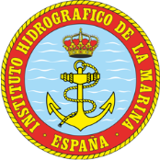
Instituto Hidrográfico de la Marina (IHM)
Spanish Navy Hydrographic Office has a Hydrographic School “Alejandro Malaspina”
Equipment and vessels. Knowledge and capacity.
IHM is the NAVAREA III coordinator
Capacity building in Spanish: 136 international students since 1969
1

Slide 2
Courses at IHM (Cádiz)
1. Hydrography specialization course of Category “A” (10 months)
2. Hydrography specialization course of Category “B” (10 months)
Hydrographic surveys basic course (8 weeks)
Hydrography and Cartography middle course (15 weeks)
Hydrographic equipment management basic course (8 weeks)
Processing multibeam data and acquisition advanced course (15 weeks)
2

Slide 3
Hydrography specialization courses of Category “A” & “B”, by means of the Plan of International Cooperation for Military Teaching
In Spanish
8 students per course (4 international students)
From September to June.
Military students with a set of requirements.
Cat “A”: graduate students
Cat “B”: technical studies
International students are accepted by means of the Plan of international cooperation.
Some international students are granted scholarships to study.
Applications are through the Spanish Defence Attaché Offices
3

Slide 4
Other courses
The hydrographic surveys basic course admits until 2 international students.
- From January to March approximately (the next courses will be in 2022, 2023 and 2024).
The hydrographic equipment management basic course admits till 2 international students. This course is to update periodically the knowledge of our hydrographers and to deal with lessons learned during surveys.
- From April 15th to June 15th approximately (next course in 2023, every two years).
The hydrography and Cartography middle course admits till 2 international students.
- From September 1st to December 11th approximately (the next courses will be in 2022, 2023 and 2024).
Processing multibeam data and acquisition advanced course admits until 2 international students.
- From April normally (in 2022 and 2024, every two years).
4

Slide 5
Instituto Hidrográfico de la Marina (IHM)
IHM is opened to collaborate in seminars, courses and workshops, for Spanish-spoken language, with highly-qualified educators, such as:
Multibeam data processing course (5 days)
Hydrographic surveys basic course (10 days)
Maritime security information (MSI) course (3 days)
Hydrographic surveys in shallow and deep waters course (5 days)
Seafloor characterization workshop (5 days)
Tides and sea level workshop (5 days)
5

Slide 6
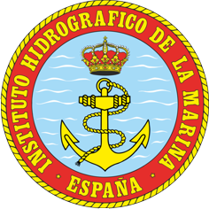
Instituto Hidrográfico de la Marina
Thank you very much for your attention
Capacity building Coordinator in Spain Commander Gustavo Gómez-Pimpollo Crespo
ihmesp@fn.mde.es ihmrelin@mde.es
https://www.iho-machc.org/training/Spain_es.html
6

