Slide 1
CBMS User Manual
Version: 1.5(28th May, 2020)
1.0 (6th March. 2020)
Made by : Dr. Hoyun Kang (Korea Hydrography and Research Association)
Peter YOU (Korea Hydrographic and Oceanographic Agency)

Slide 2
If you….
If it has any problem to use CBMS system, please check this manual first and send it to me by screen capture if it is not solved, which help us understand and take action.
Please notice to Peter You (peterhak@korea.kr), and
Hoyun Kang (hykang@khra.kr)

Slide 3
Category | Contents | Page
Common | Sign Up Login | - 4 - 6
CBSC Coordinator | 3. Project registration (Local user) 4. Assessing the Projects (Local Users) 5. Summary View (Local Users) 6. Submit the Project (Local User) 7. Select the project host country (Local users) | - 9 -14 -18 -19 -21
CBA, CBSC secretariat, Chair | 8. Project Assessment (CBA, SEC, CHAIR) 9. Pending the Project (CBA) 10. Reject the Project (CBA) 11. Submit project to SEC after approval (CBA) 12. Approved the project and submitted to CHAIR (SEC) 13. Project Final Approval (CHAIR) | -24 -28 -33 -34 -36 -38
Contents

Slide 4
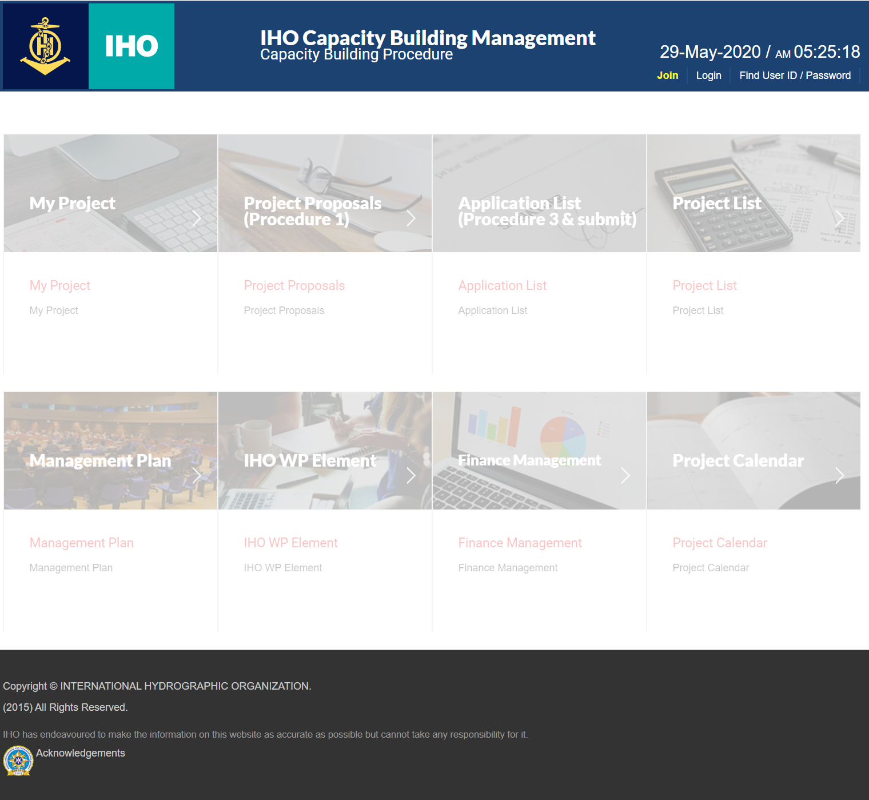
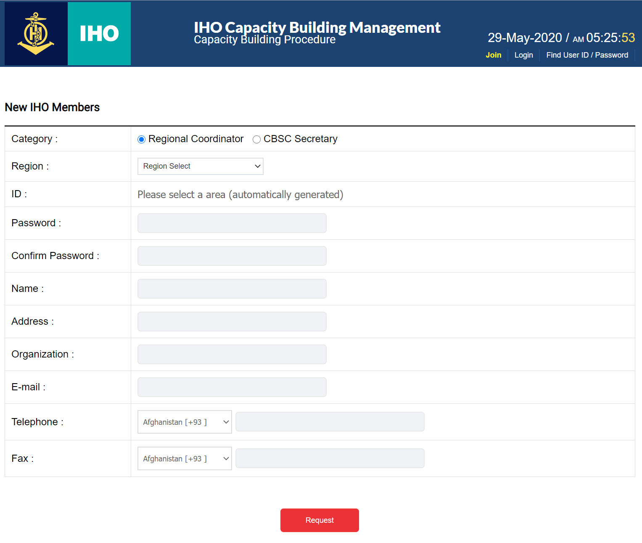
Sign Up (1)
① Click Join button
② Move page
1
2
http://cbms.iho-khoa.kr

Slide 5
Sign Up (2)
1
2
① Select a user category.
② set the area.
③ Remember your assigned account.
④ Enter password and additional information.
⑤ Complete membership.
3
4
5

Slide 6
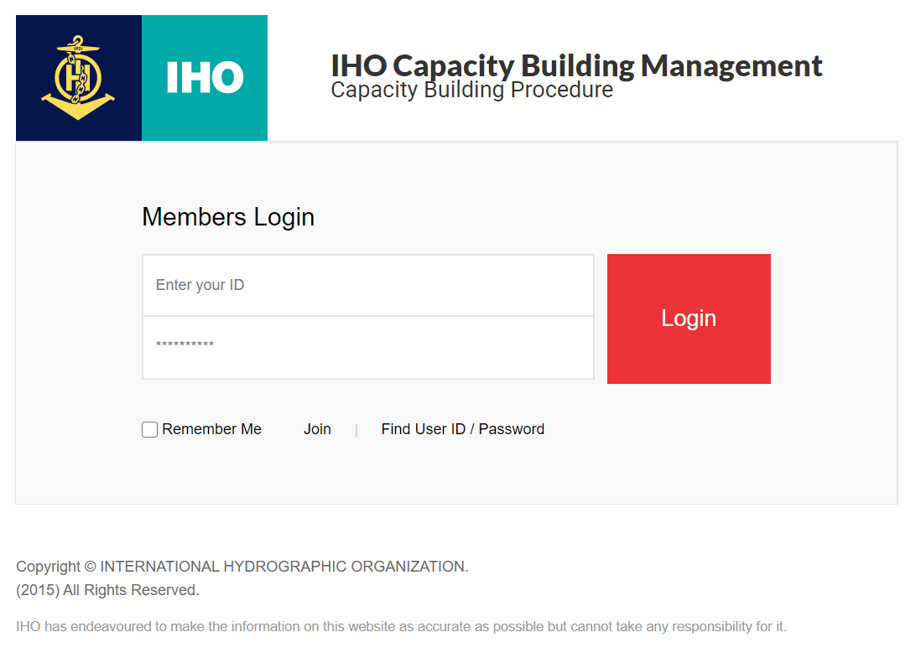
Login (1)
① Click Login button
② Move page
1
2
Login in ID
Category | ID (default) | e.g.
CB Coordinator | RHC_Coordi | EAHC_Coordi
CBSC Secretary | CBSC_Sec | 2 ID
 | CBSC_Sec1
CBSC Chairman | CBSC_Chair | CBSC_Chair
Password (initial default) : 123456
→ user can change the PW

Slide 7
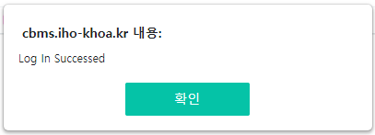
Login (2)
① Enter account
② Password input
③ Click the login button
④ Confirm login
3
1
2
4

Slide 8
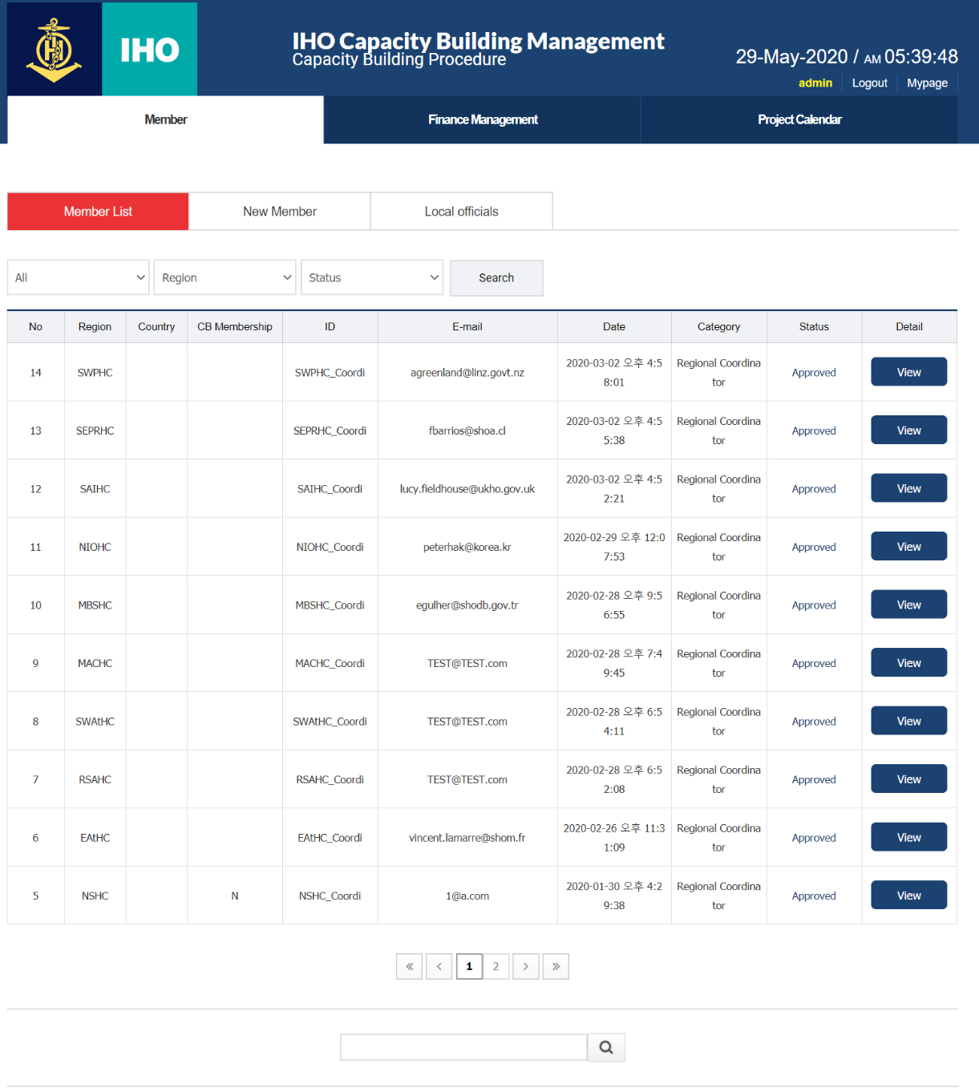
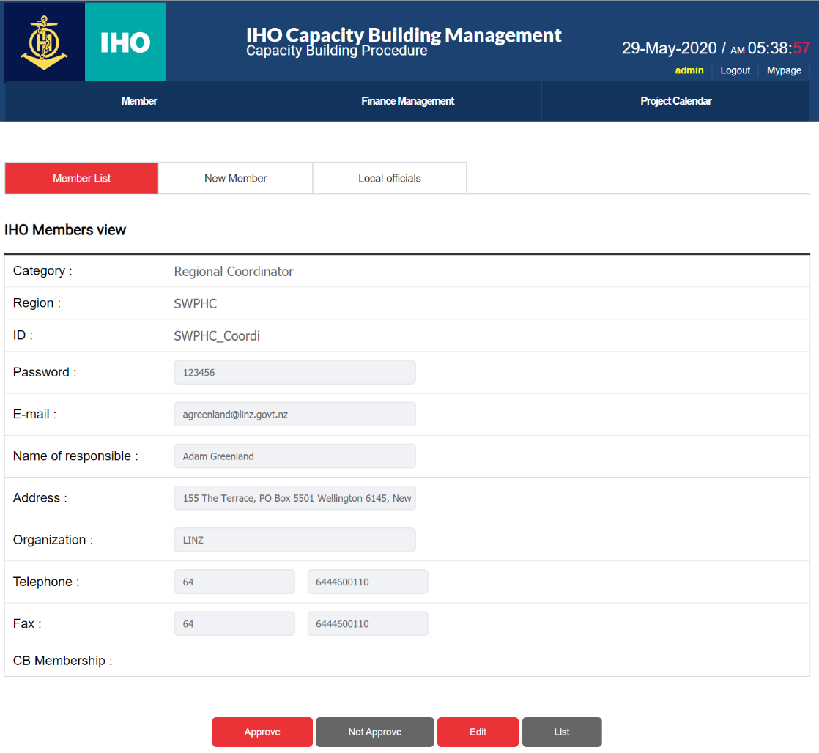
Administrator login
admin
admin
1
Not Approved
Approval for membership in ADMIN account
2

Slide 9
Local user

Slide 10
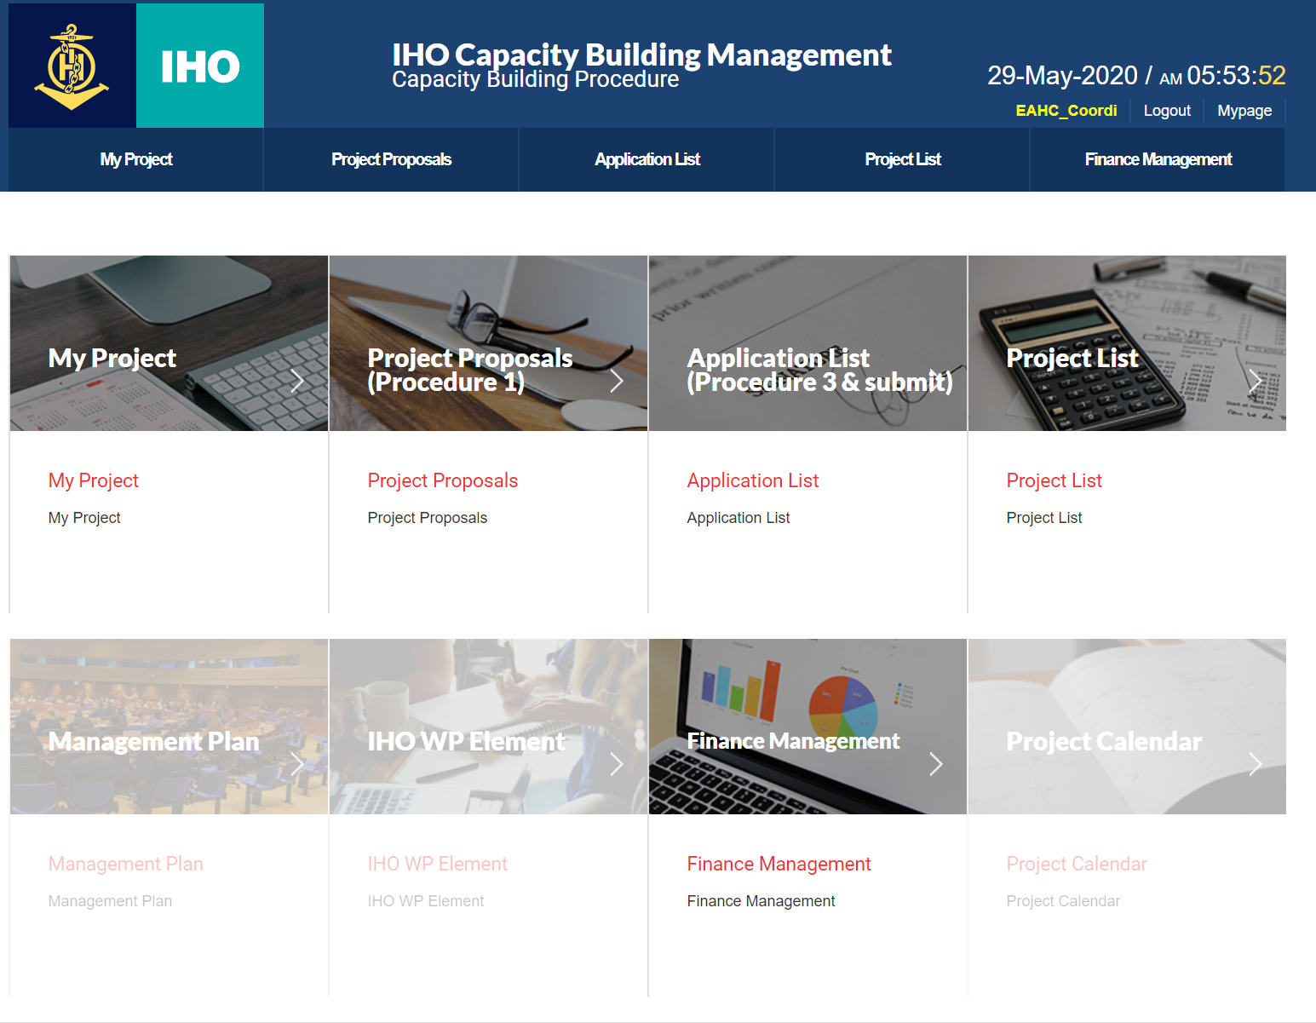
Project registration (1)
①② Project Proposals
Click the button
③ Move page
3
1
2

Slide 11
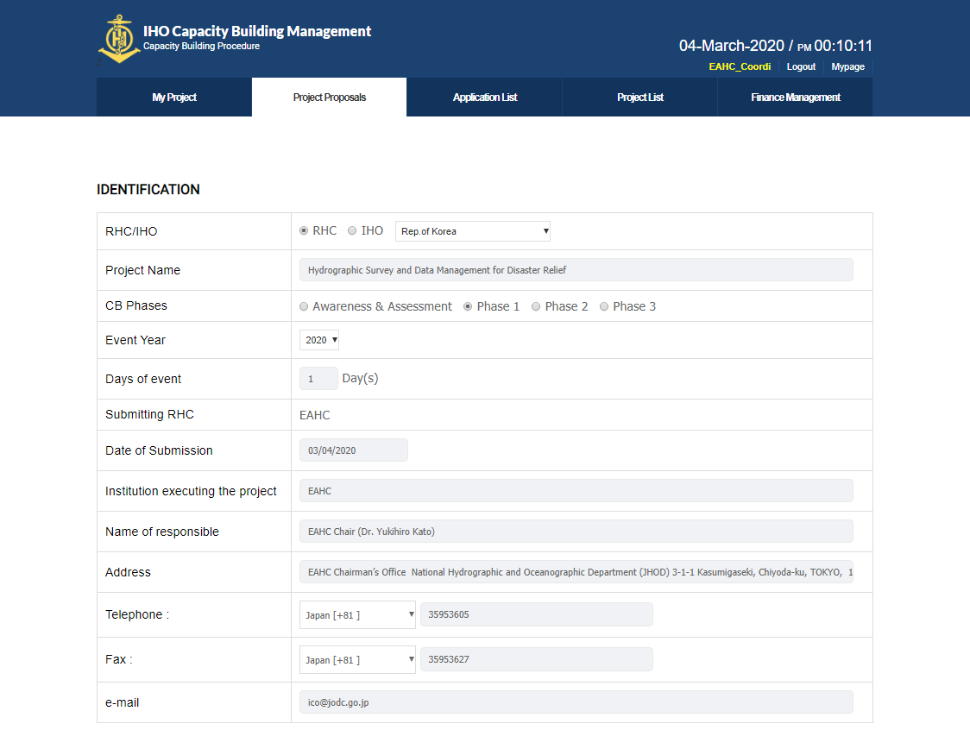
Project registration (2)
① Select Project Type
② Enter Project Name
③ CB Phases Input
④ Select Event Year
⑤ Days of event input
⑥ Date of Submission
⑦ Enter Institution executing the project
⑧ Input personal information
1
2
3
4
5
6
7
8

Slide 12
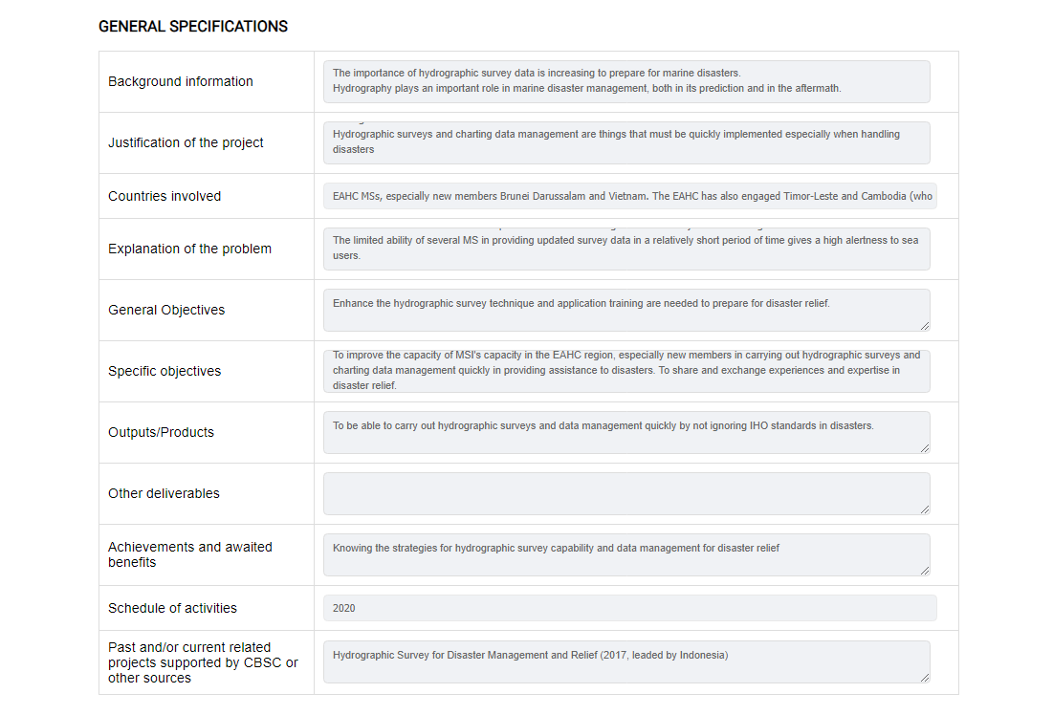
Project registration (3)
① Enter project details
1

Slide 13
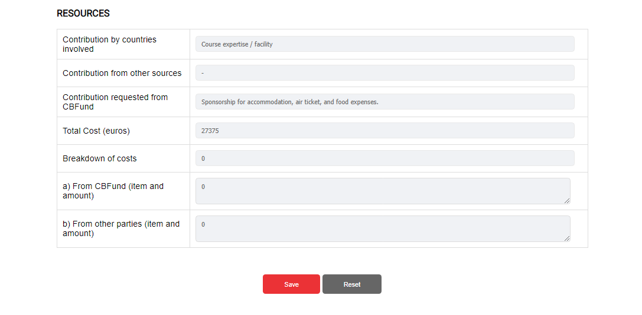
Project registration (4)
① Enter project additional information
② Project registration completed
1
2

Slide 14
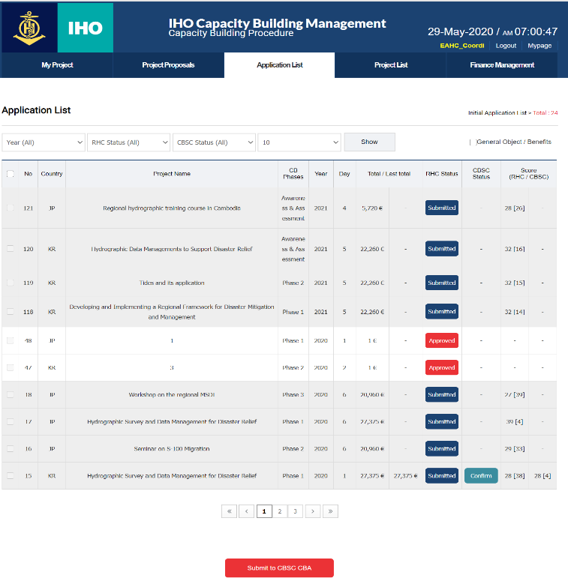
Assessing the Projects (Local Users) (1)
①② Click on Application List button
③ Move page
1
2
3

Slide 15
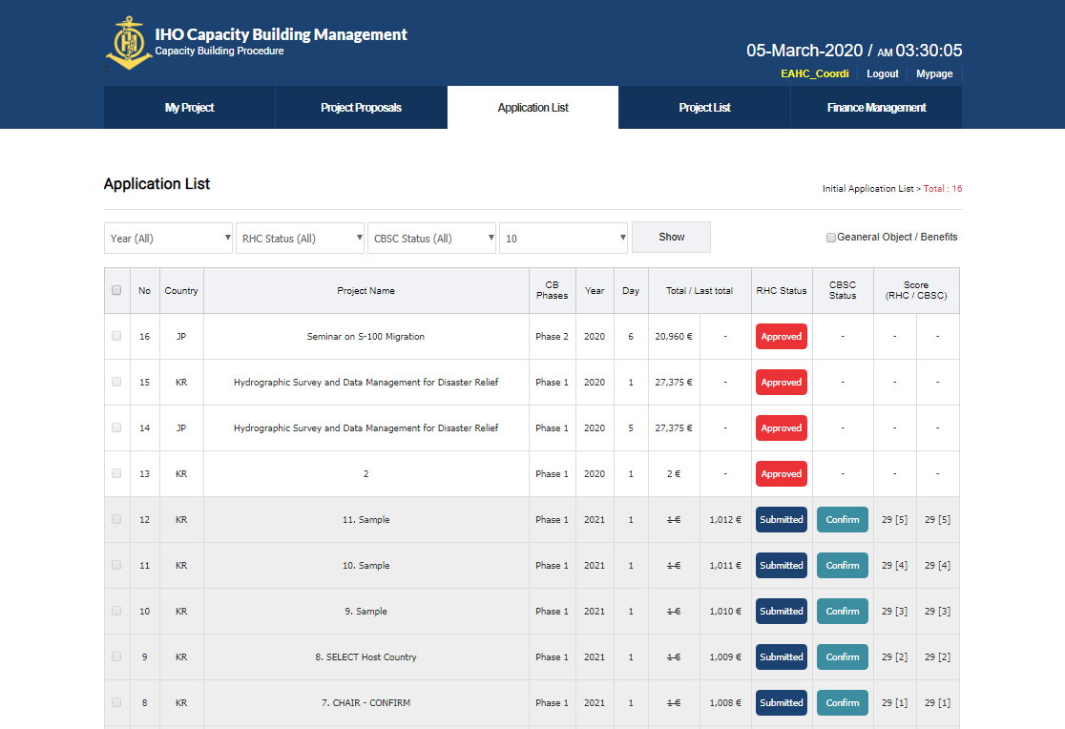
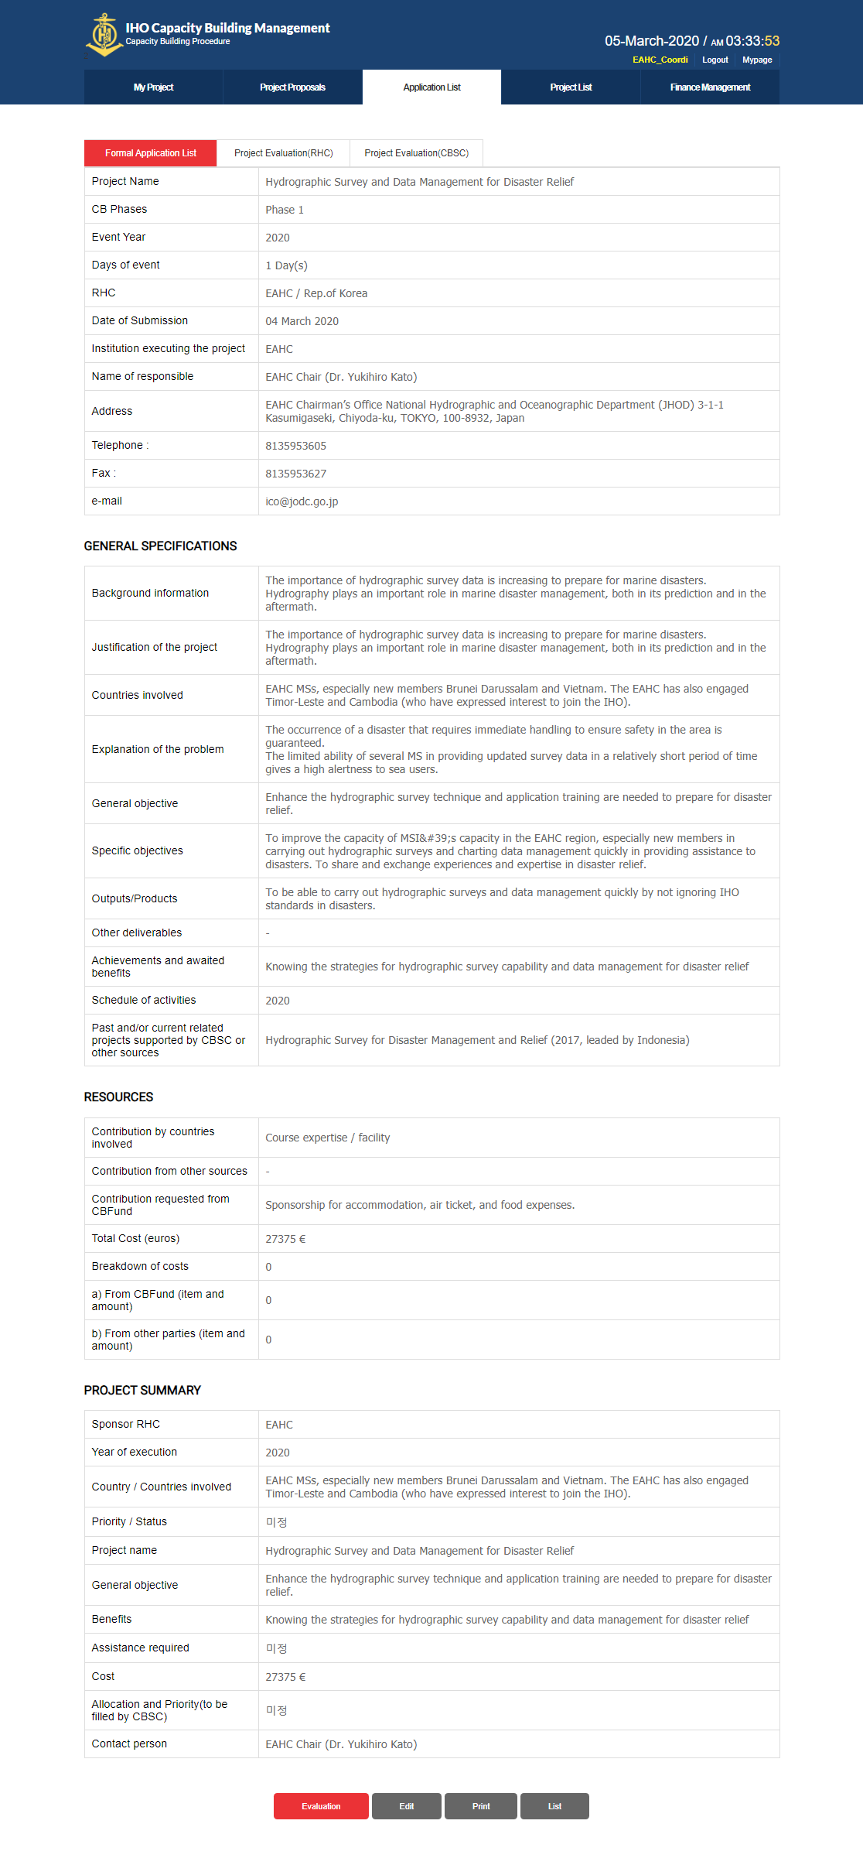
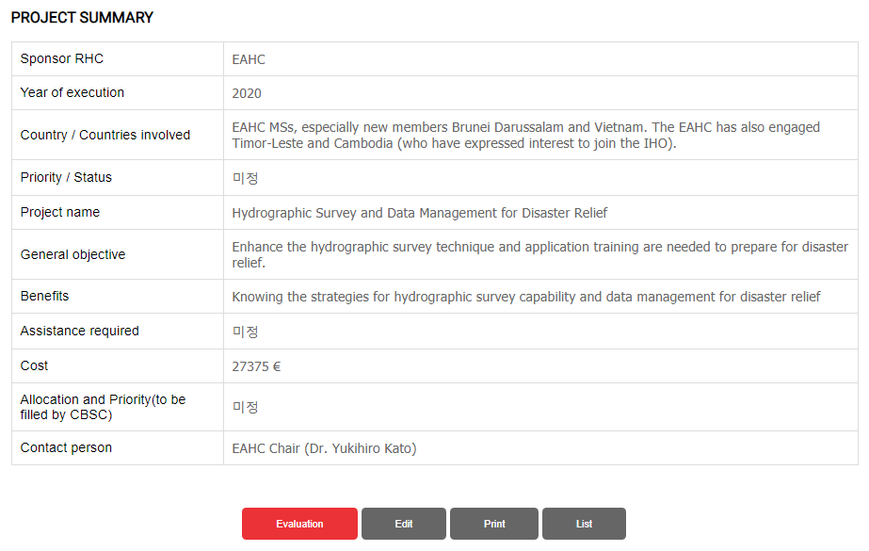
Assessing the Projects (Local Users) (2)
2
① Click on the evaluation item name
② Move page
③ Move to the bottom of the page
1
3

Slide 16
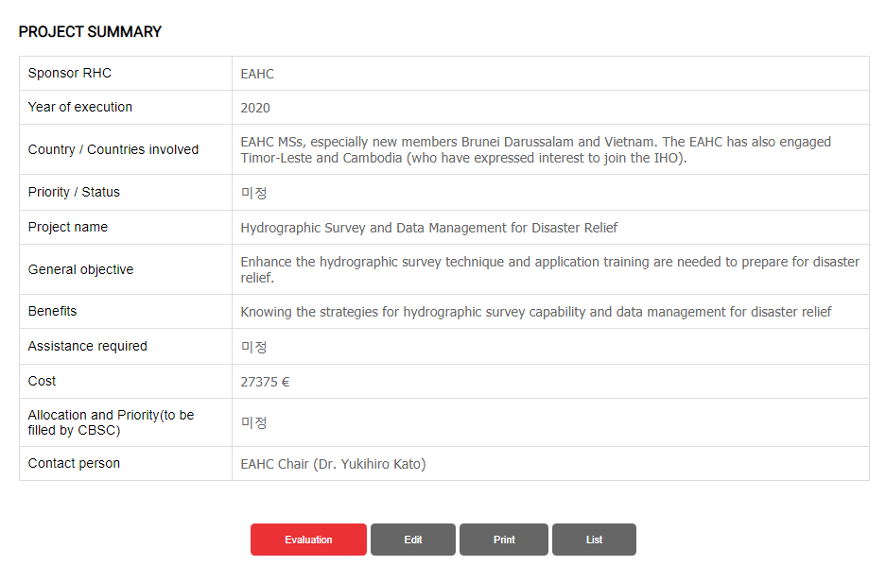
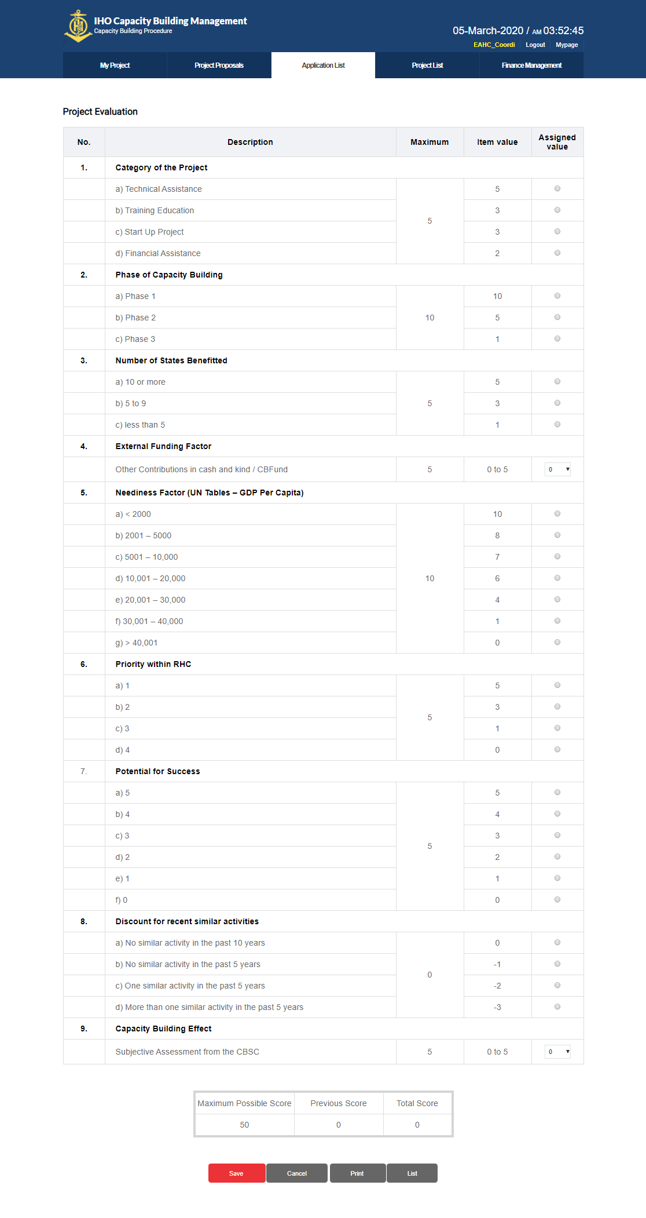
Assessing the Projects (Local Users) (3)
① Click the evaluation button at the bottom of the page
② Go to the evaluation page
1

Slide 17
Assessing the Projects (Local Users) (4)
① Evaluate all items
② Save Assessment
1
2

Slide 18
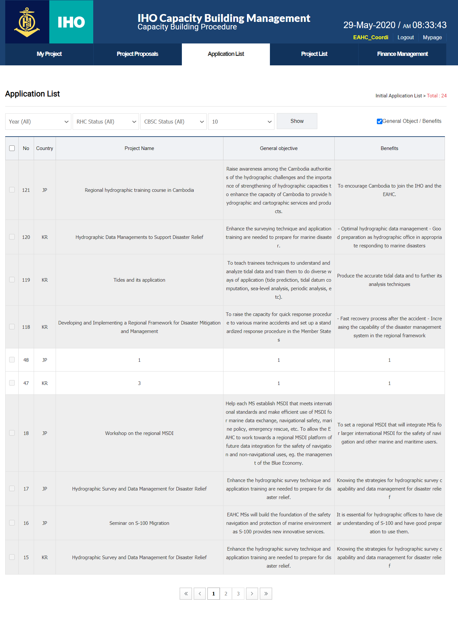
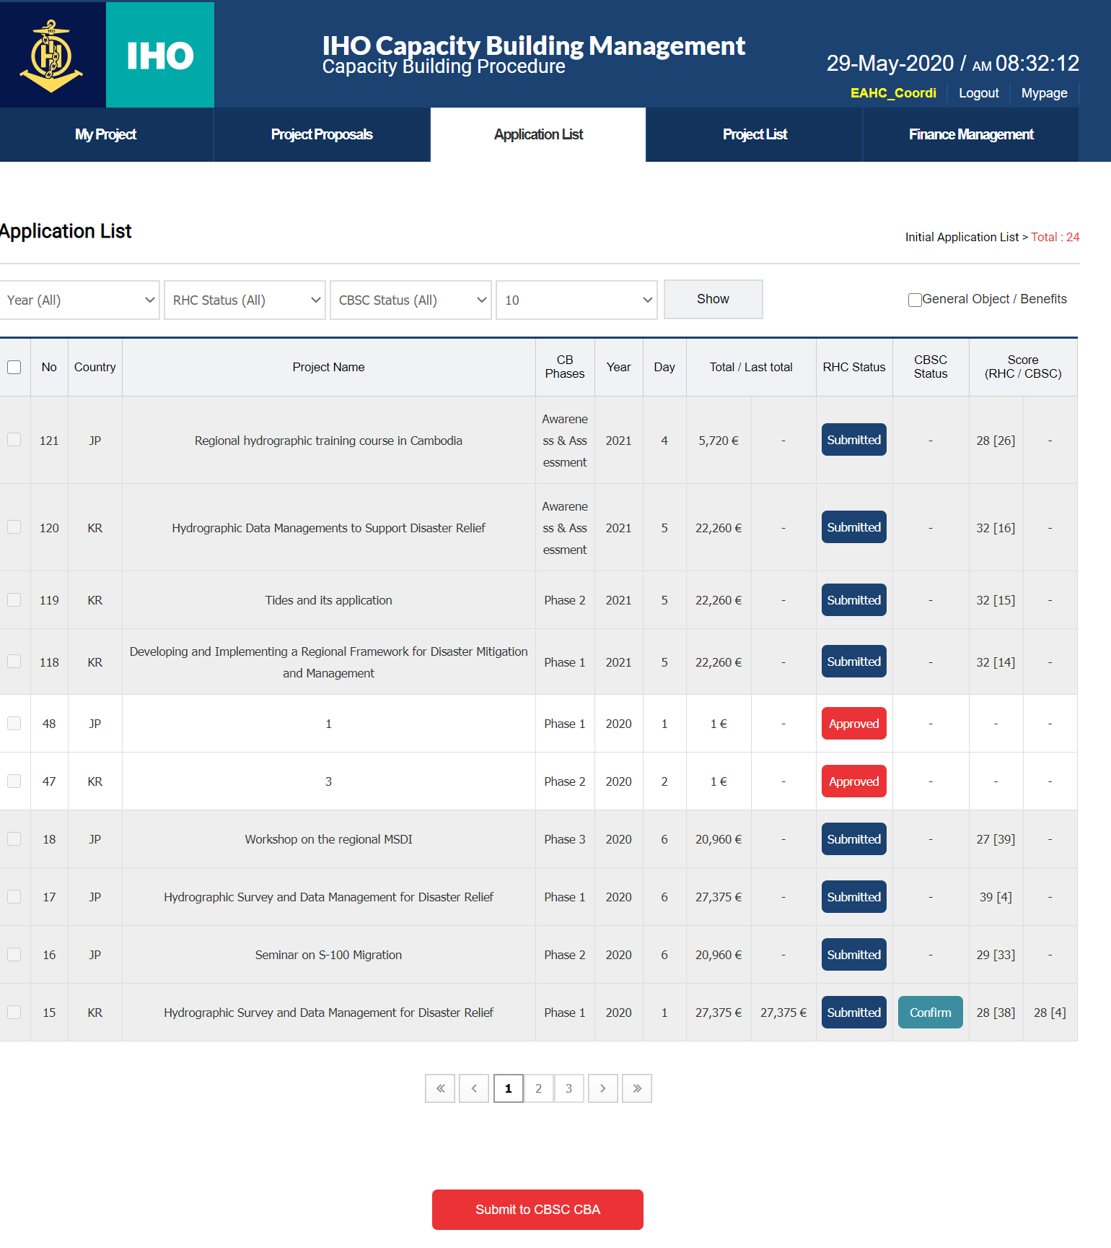
Summary view
1
1
① Added columns for viewing project summary

Slide 19
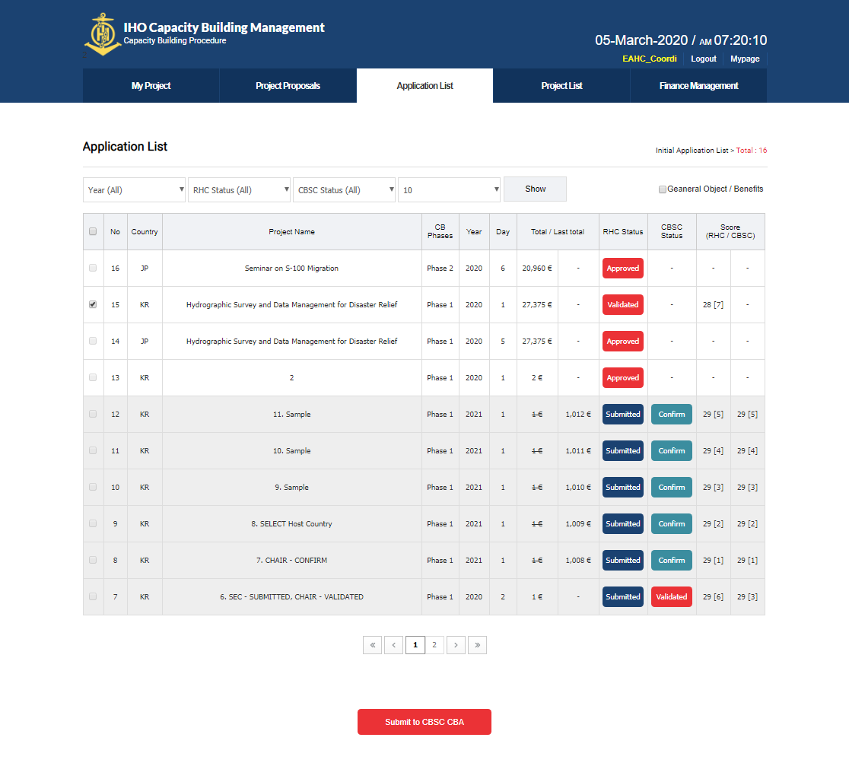
Submit the Project (Local User) (1)
①② Click on Application List button
③ Move page
1
2

Slide 20
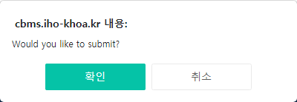
Submit the Project (Local User) (2)
① Check the evaluation status
② Project Selection
③④ Submit project to CBA
2
1
4
3

Slide 21
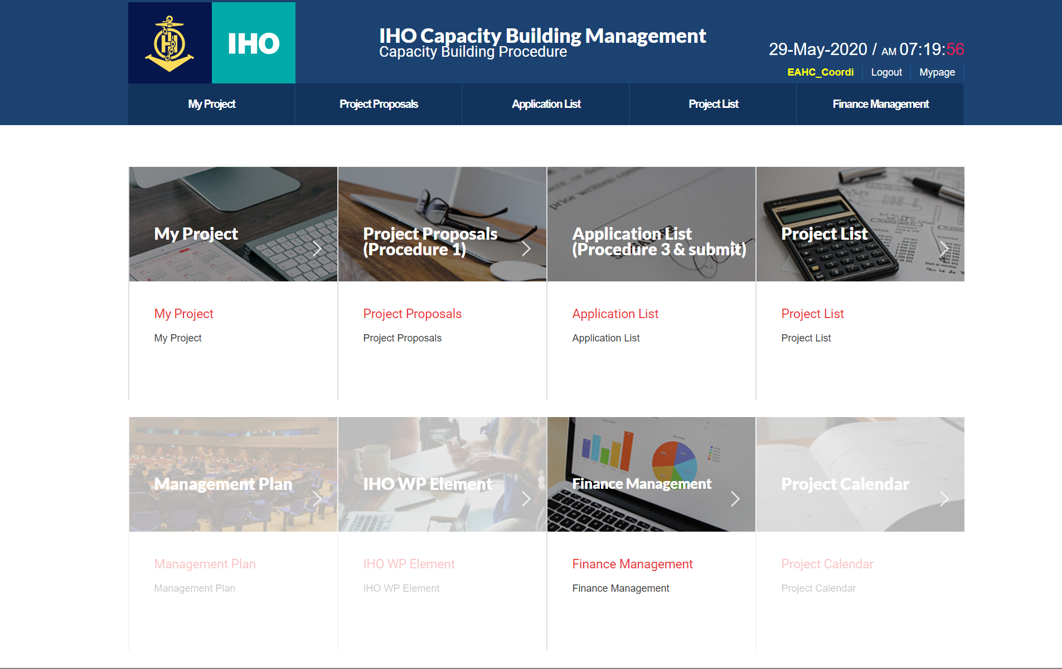
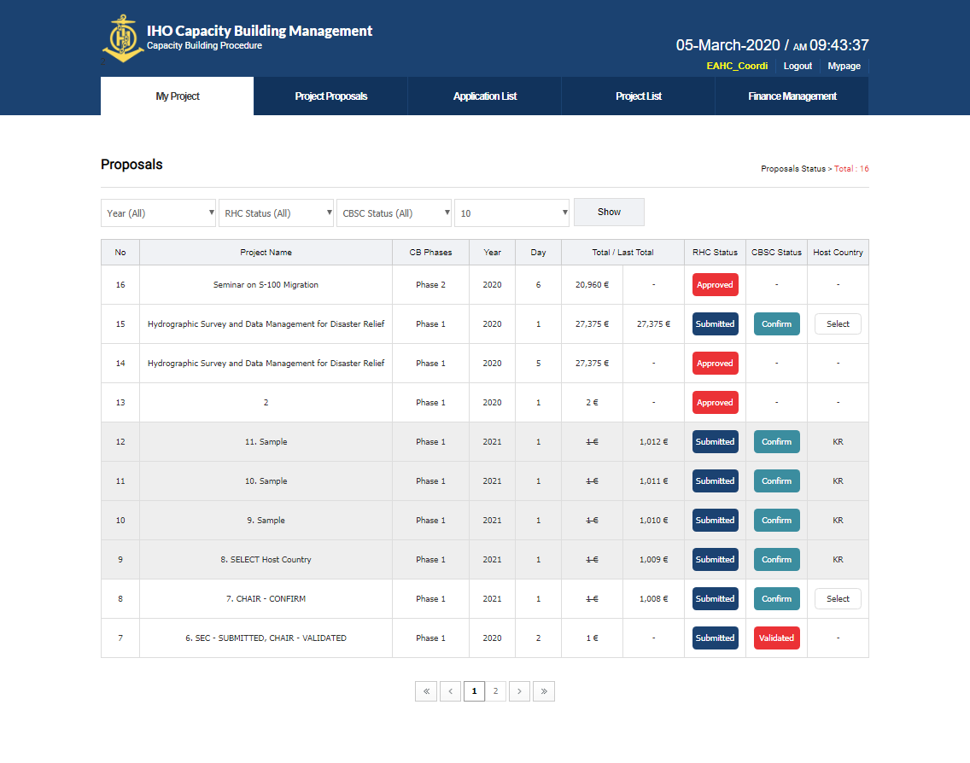
Select the project host country (local users) (1)
①② Click My Project button
③ Move page
1
3
2

Slide 22
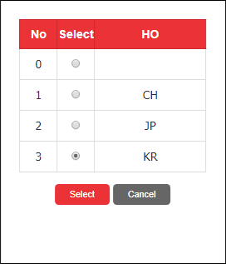
Select project host country (local users) (2)
① Click on the Select button for the final approved project
② Select country
③ Click “Select”
2
3
1

Slide 23
CBA, SEC, CHAIR

Slide 24
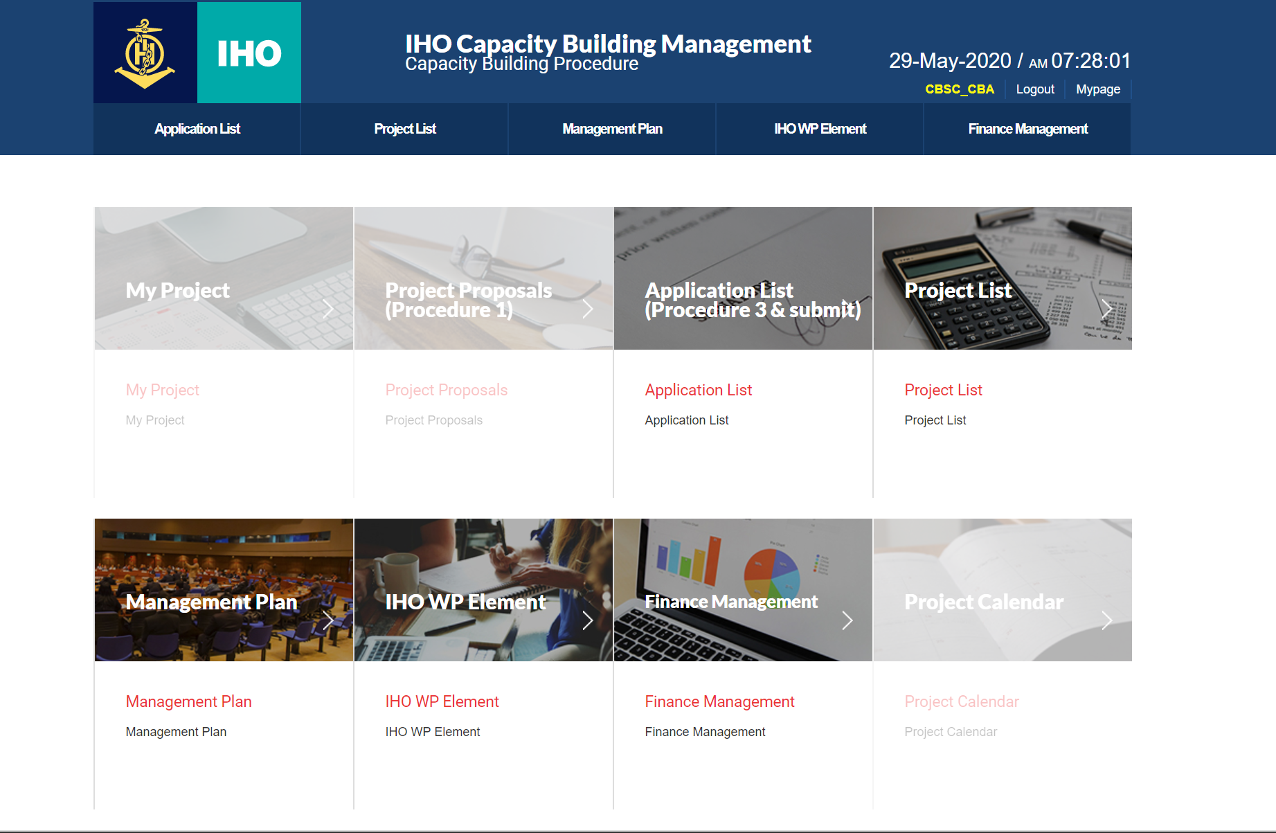
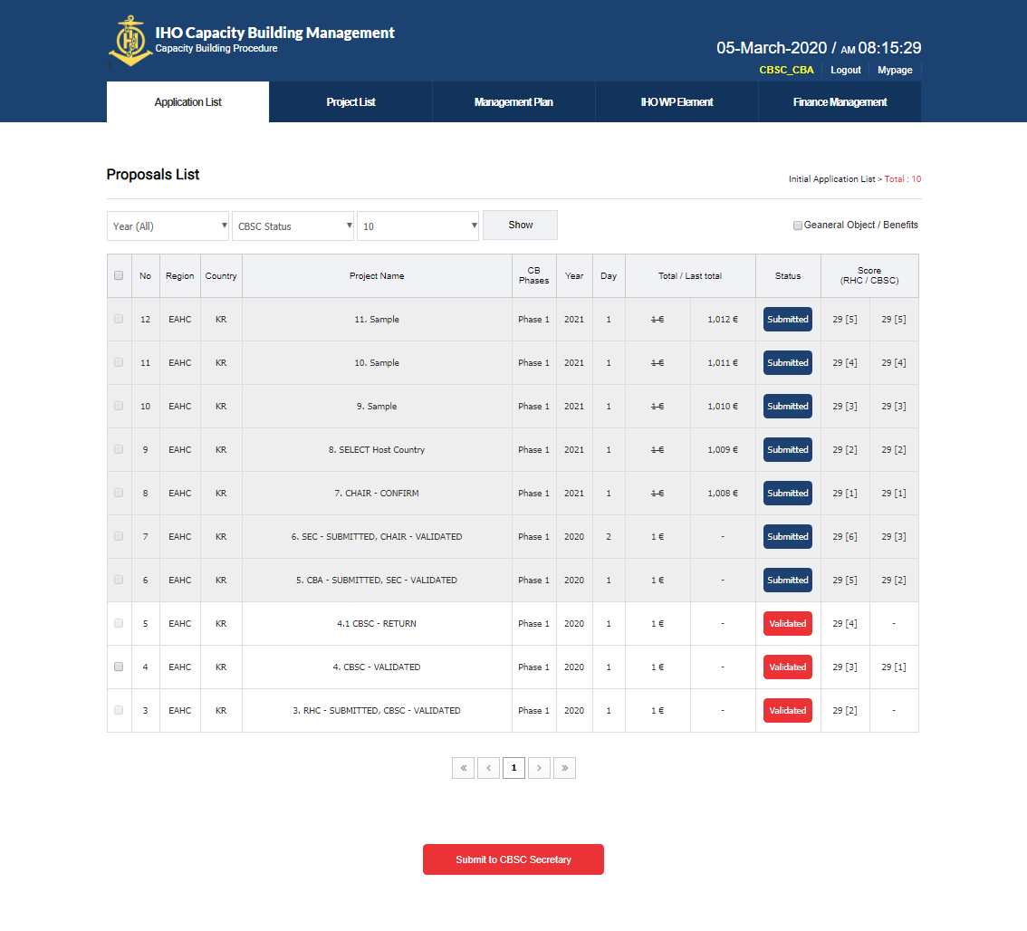
Project Assessment (CBA, SEC, CHAIR) (1)
①② Click on Application List button
③ Move page
1
2
3

Slide 25
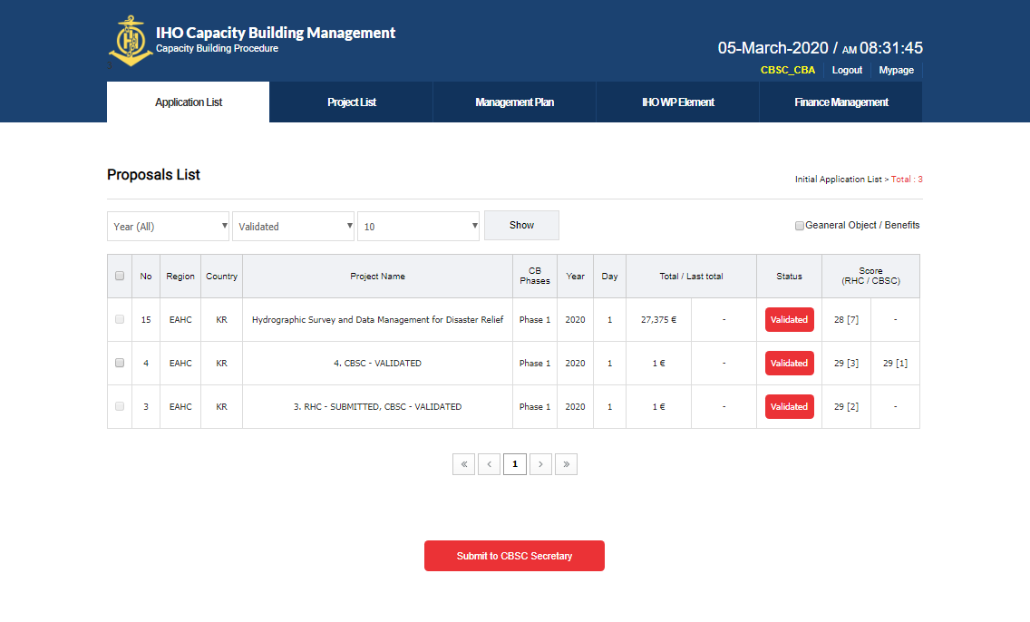
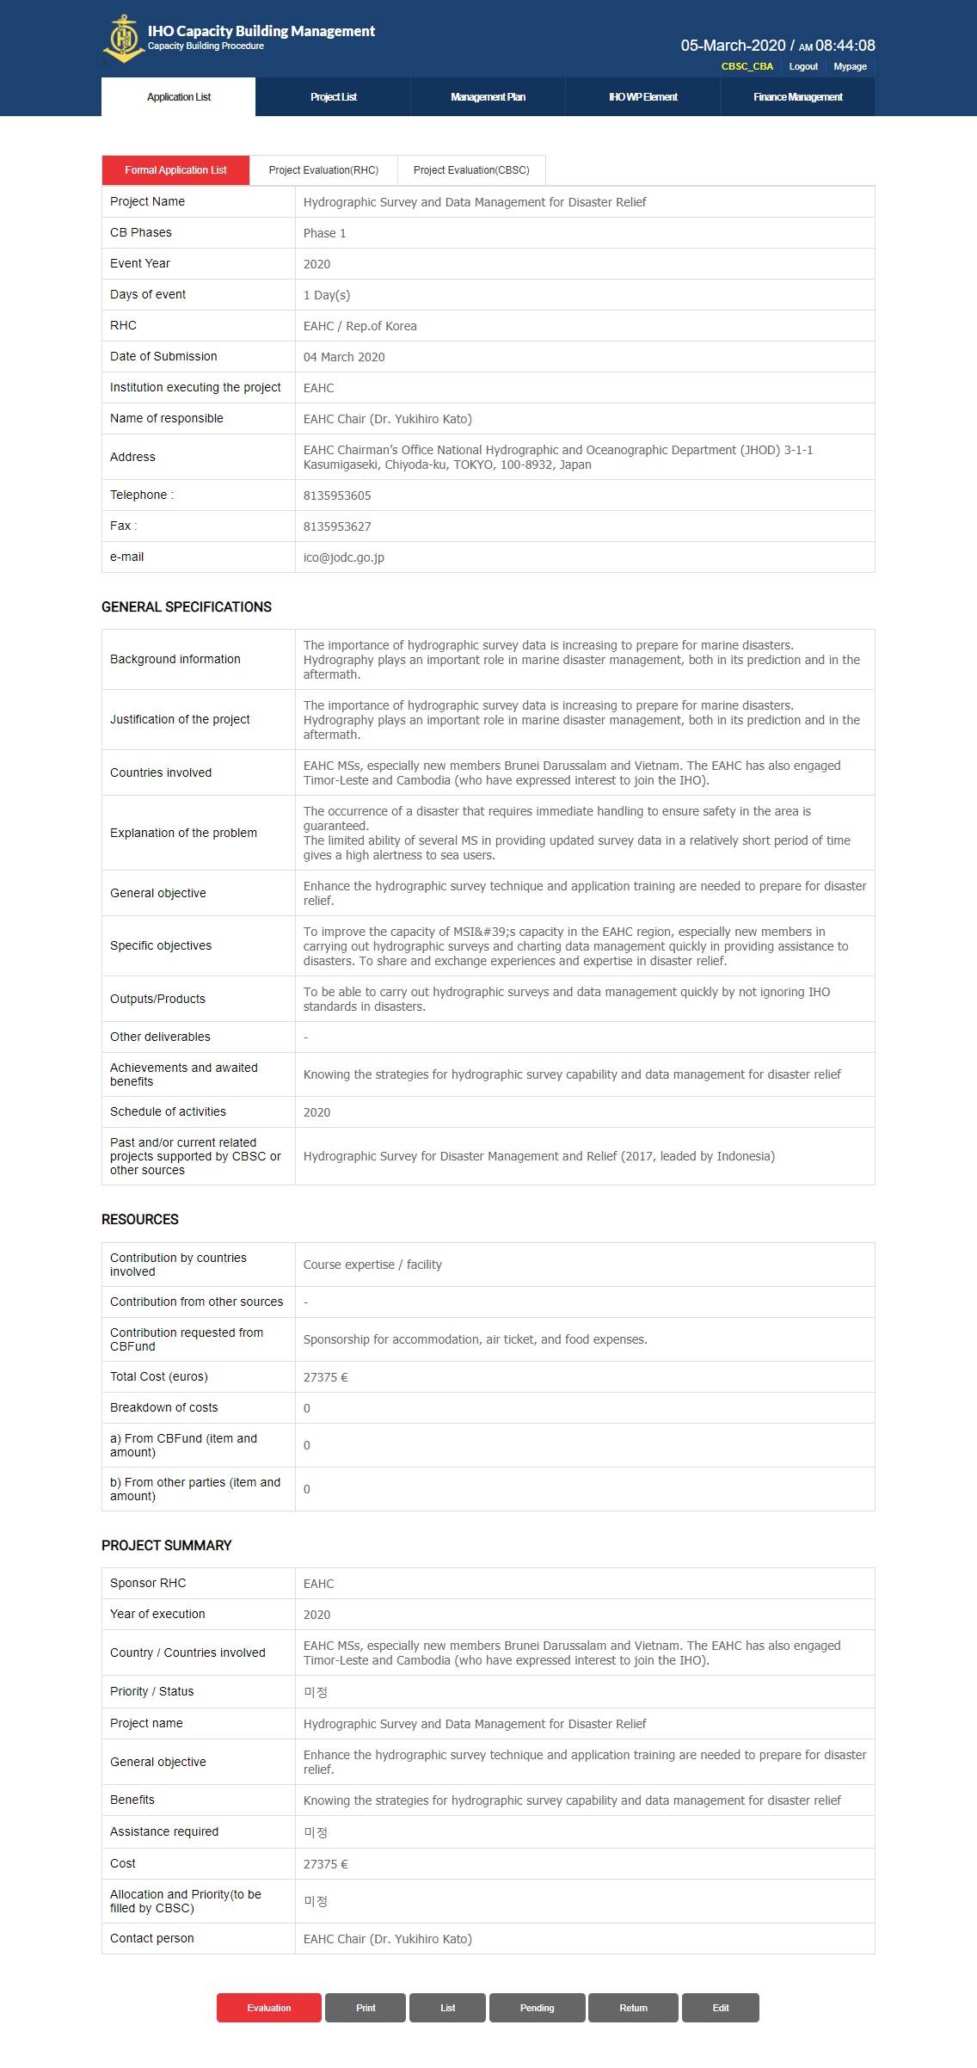
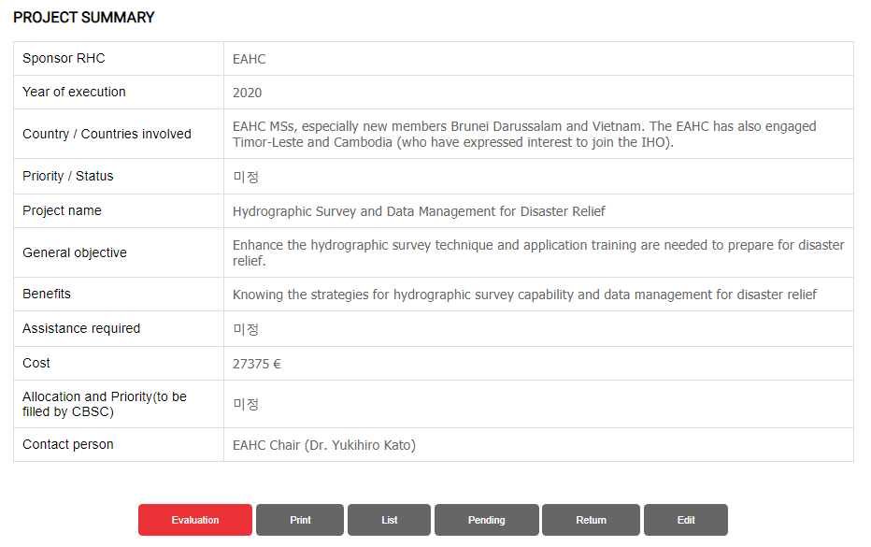
Project Assessment (CBA, SEC, CHAIR) (2)
2
① Click on the evaluation item name
② Move page
③ Move to the bottom of the page
1
3

Slide 26
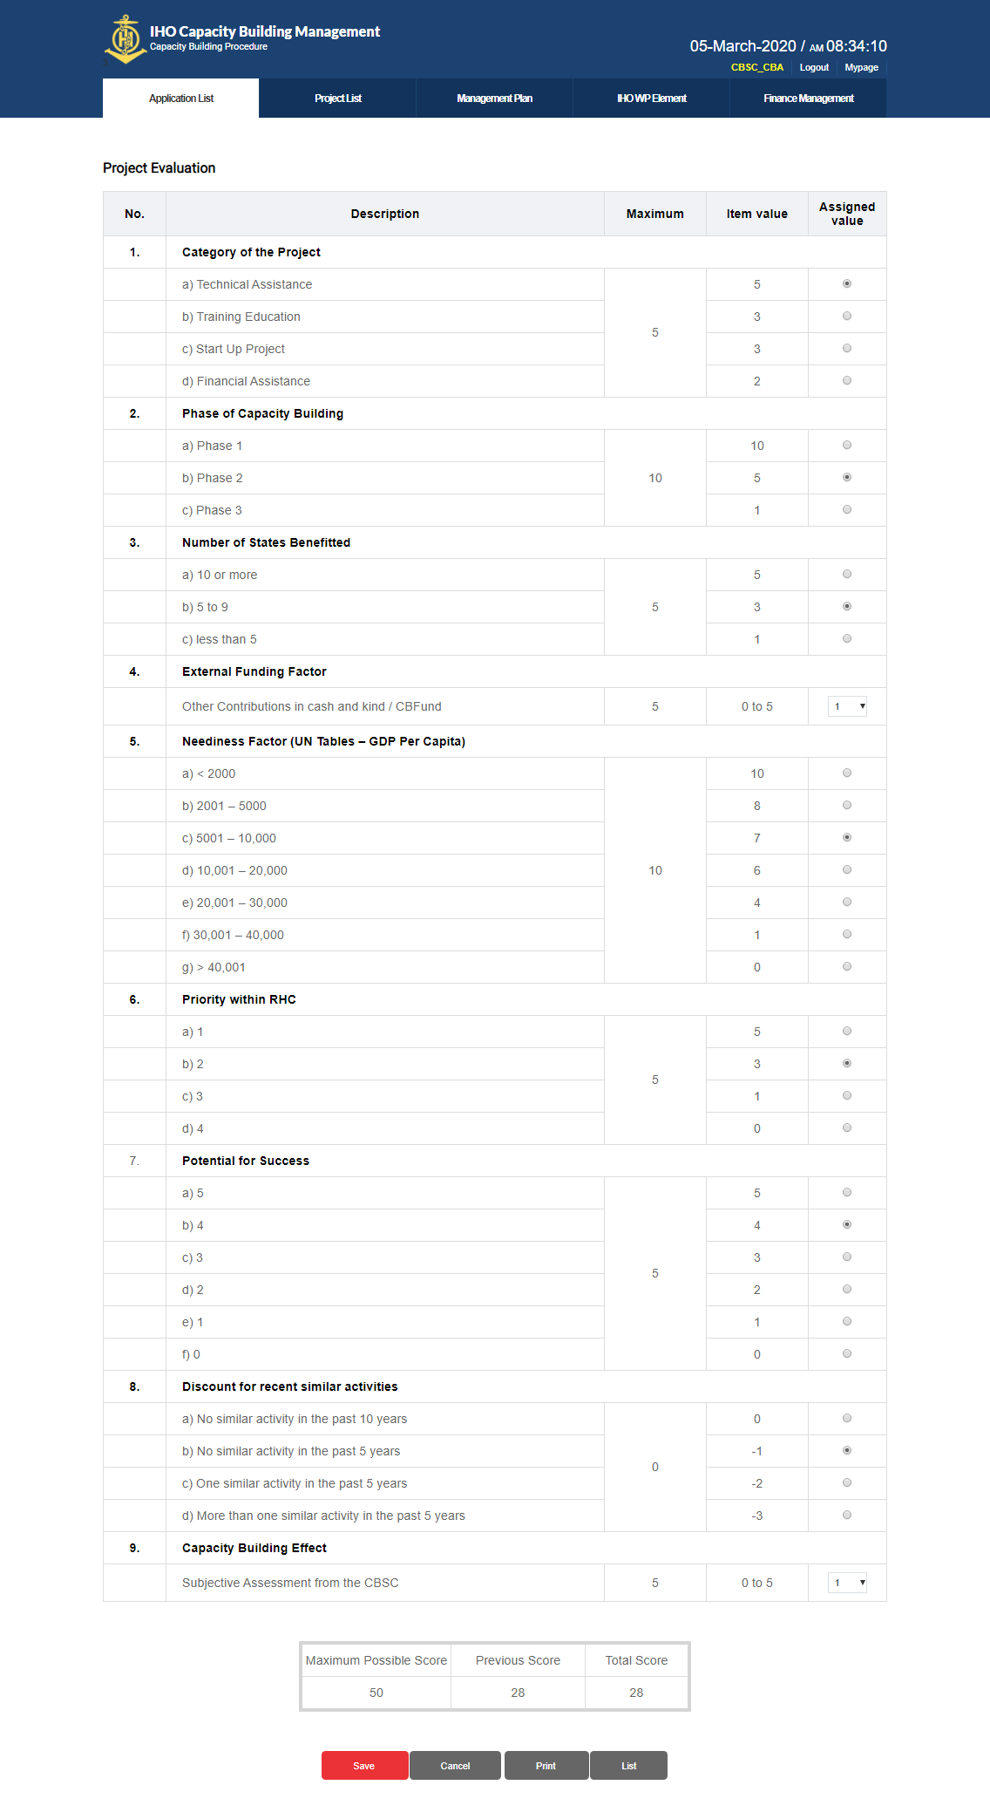
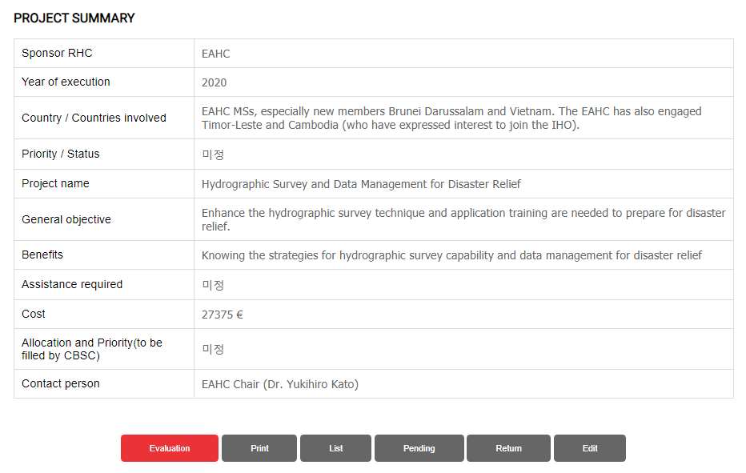
Project Assessment (CBA, SEC, CHAIR) (3)
① Click the evaluation button at the bottom of the page
② Go to the evaluation page
1

Slide 27
Project Assessment (CBA, SEC, CHAIR) (4)
① Evaluate all items
(CBA evaluates local user evaluations as initial values, and CBA, SEC, and CHAIR are evaluated as CBSC items.)
② Save Assessment
1
2

Slide 28
Pending the Project (CBA) (1)
①② Click on Application List button
③ Move page
1
2
3

Slide 29
Pending the Project(CBA) (2)
2
① Click on the evaluation item name
② Move page
③ Move to the bottom of the page
1
3

Slide 30
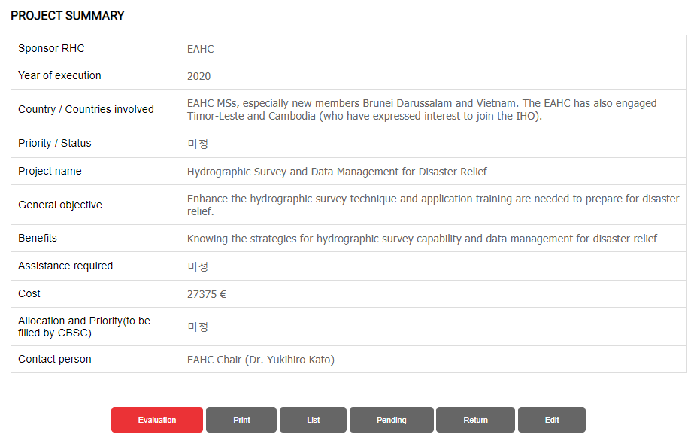
Pending the Project(CBA) (3)
① Click the Pending button
② Write a reason for reservation
③ Click the OK button to hold the project
2
3
1

Slide 31
Pending the Project(CBA) (1)
①② Click on Application List button
③ Move page
1
2
3

Slide 32
Pending the Project(CBA) (2)
2
① Click on the evaluation item name
② Move page
③ Move to the bottom of the page
1
3

Slide 33
Reject the Project (CBA)
① Click the Return button
② Write the reason for refusal
③ Click OK button to reject the project
2
3
1

Slide 34
Submit project to SEC after approval (CBA) (1)
①② Click on Application List button
③ Move page
1
2
3

Slide 35
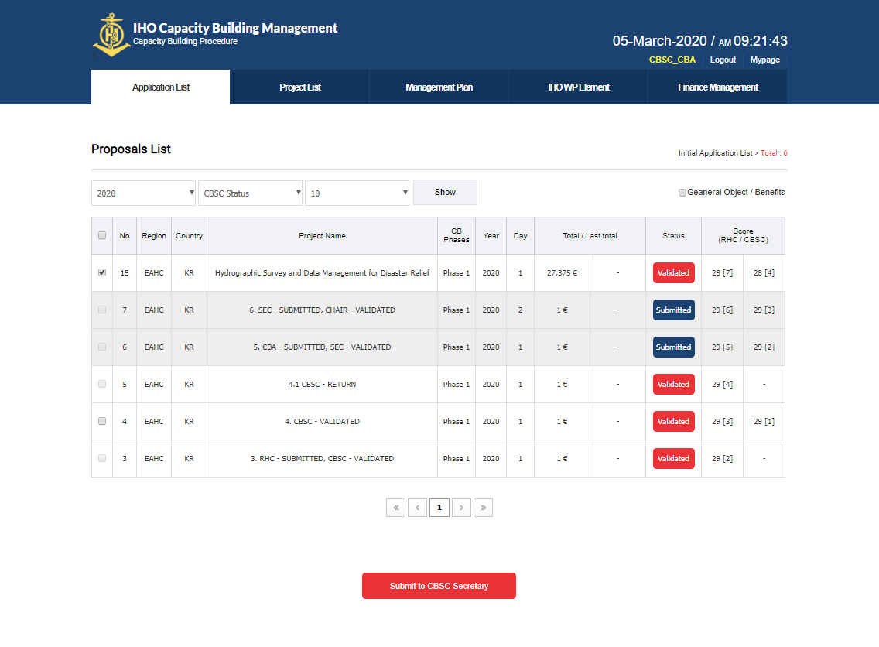
Submit project to SEC after approval (CBA) (2)
① Check the evaluation status
② Project Selection
③④ Approve project and submit project to SEC
2
1
4
3

Slide 36
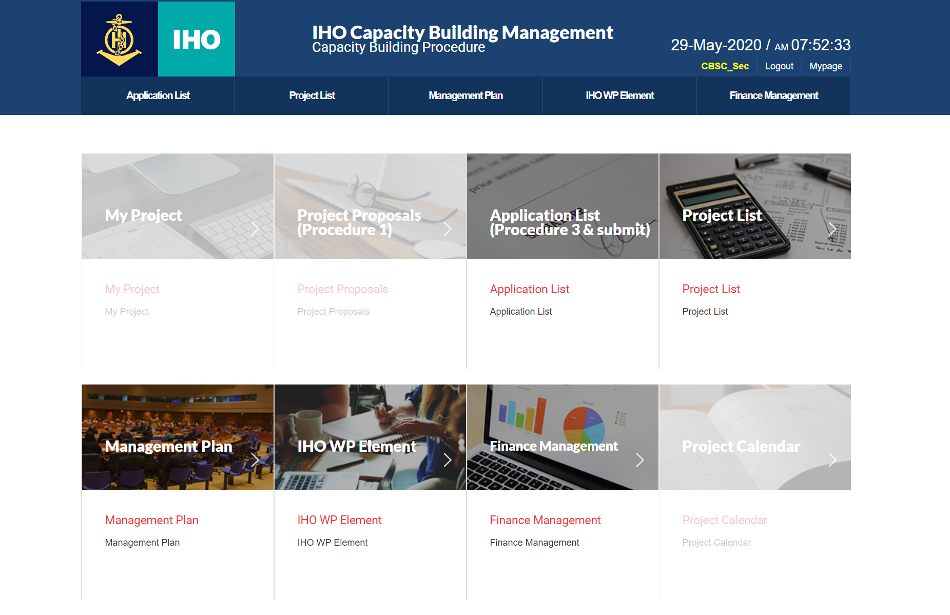
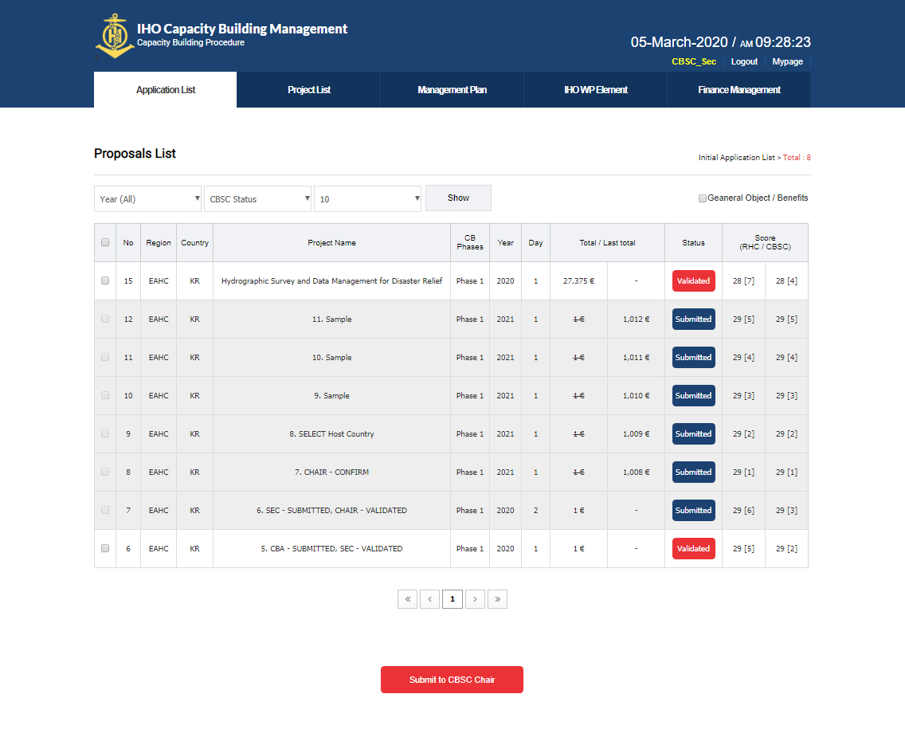
Approved the project and submitted to CHAIR (SEC) (1)
①② Click on Application List button
③ Move page
1
2
3

Slide 37
Approved the project and submitted to CHAIR (SEC) (2)
① Check the evaluation status
② Project Selection
③④ Approve project and submit project to CHAIR
2
1
4
3

Slide 38
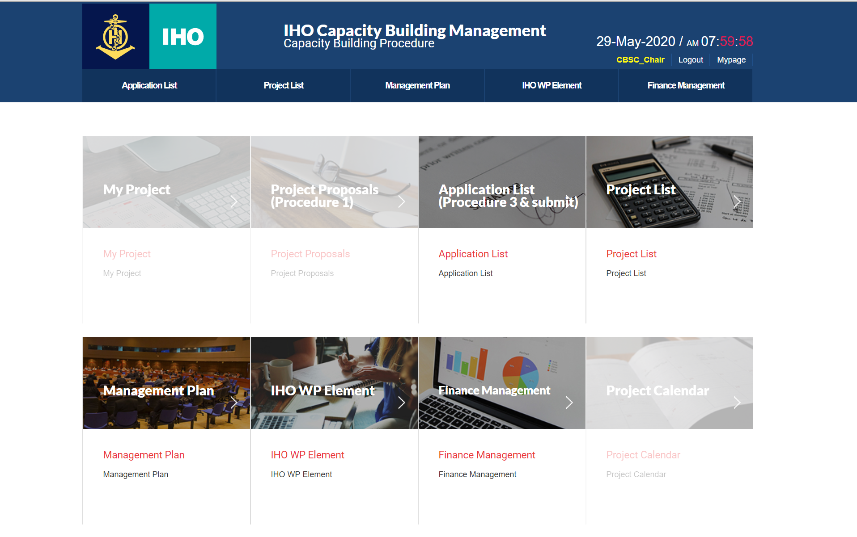
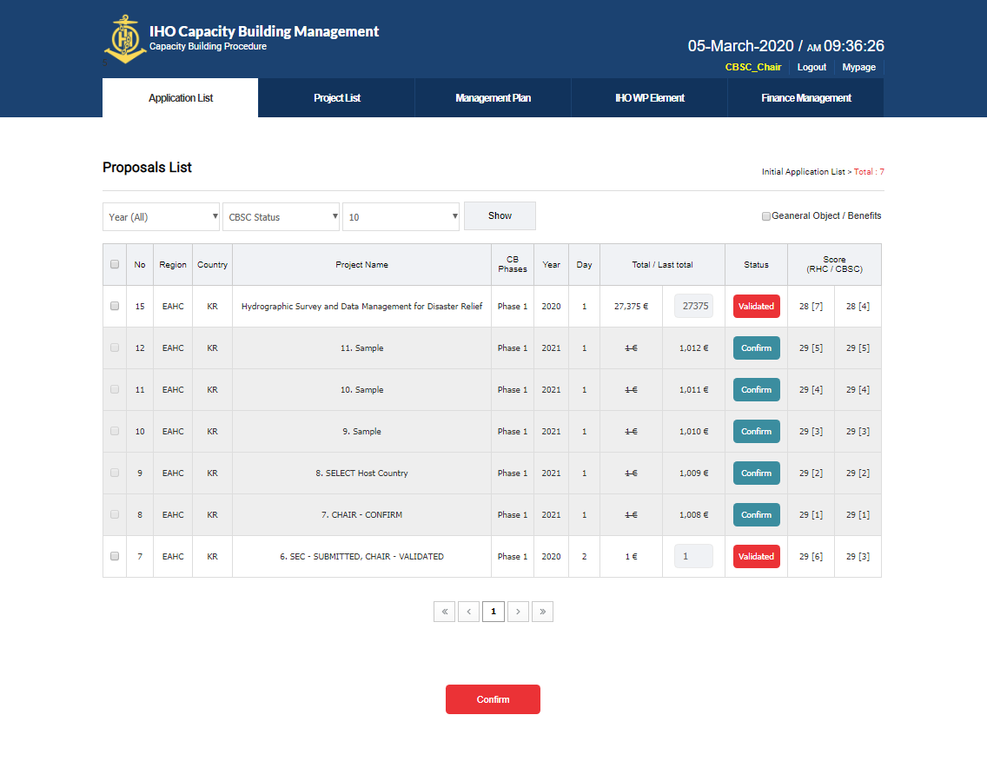
Project Final Approval (CHAIR)(1)
①② Click on Application List button
③ Move page
1
2
3

Slide 39
Project Final Approval (CHAIR) (2)
① Check the evaluation status
② Project Selection
③ Enter final project amount
④⑤ Final approval of the project
2
3
1
5
4

Slide 40
Thank you

