Slide 1



Agenda. 18-08.2 CBMS update
CB Management System Update
Peter YOU (KHOA), Sandrine BRUNEL (IHO), Hoyun KANG (KHRA)
18th Capacity Building Sub-Committee Meeting, Online, 2-3 June 2020

Slide 2
Table of Contents
Ⅰ. Overview of CBMS
Ⅱ. Main Improvements
Ⅲ. User Manual
Ⅲ. System Applied to Work for Testing
Ⅴ. Future Plan & Actions Required
2/12

Slide 3



What is CBMS?
Ⅰ. Overview of CBMS
A system for managing CB activities which had been previously done through emails and documents
+
As-is
To-be
By correspondence
(e-mail)
Online business
(web system)
Systematic data management
Difficulty in management
Low efficiency
High efficiency
Prototype CBMS was developed between 2015 and 2017 by KHOA & IHO Sec.
System applied to work for testing; ccontinuous update to reflect improvements (up until now)
3/12

Slide 4

Ⅱ. Main Improvements
Features of CBMS
Existing CBSC CB Procedure
By correspondence
Improved procedure with CBMS
Online method
RHC
- Priority -
HO1
End of April
End of May
End of June
One month
before
One month
One month
after the meeting
RHC
CB Coordinator
CBSC_CBA
Review & Evaluation -
CBSC_SEC
Final Review & Evaluation -
Request
CB Coordinator
- Review -
Submit
CBSC Sec.
- Evaluation -
CBSC
annual meeting
- Evaluation -
HO2
Submit
Input Proc. 1 and evaluate Proc. 4
Review and amend Proc. 1,
Review and evaluate Proc. 4
Final review of Proc. 1 & 4
Review Management Plan
HO3
Notice
The year
Institute
- Assessment/
final report -
Institute
- Execution -
CB Coordinator
- Management -
Submit
Report to CBSC
Regional Commission Decision
Regional CB meeting
IHB
(CB Sec.)
Request CB Fund
RHC
- Host Institute -
End of the year
CBSC Annual Meeting
Approval -
RHC
CB Coordinator
- Management -
RHC
- Host Institute -
CBSC
- Assessment -
CBSC Sec.
- Final touch -
Notice
Regional CB meeting
Final approval of
CB activity
Implementation of
CB activity
4/12

Slide 5
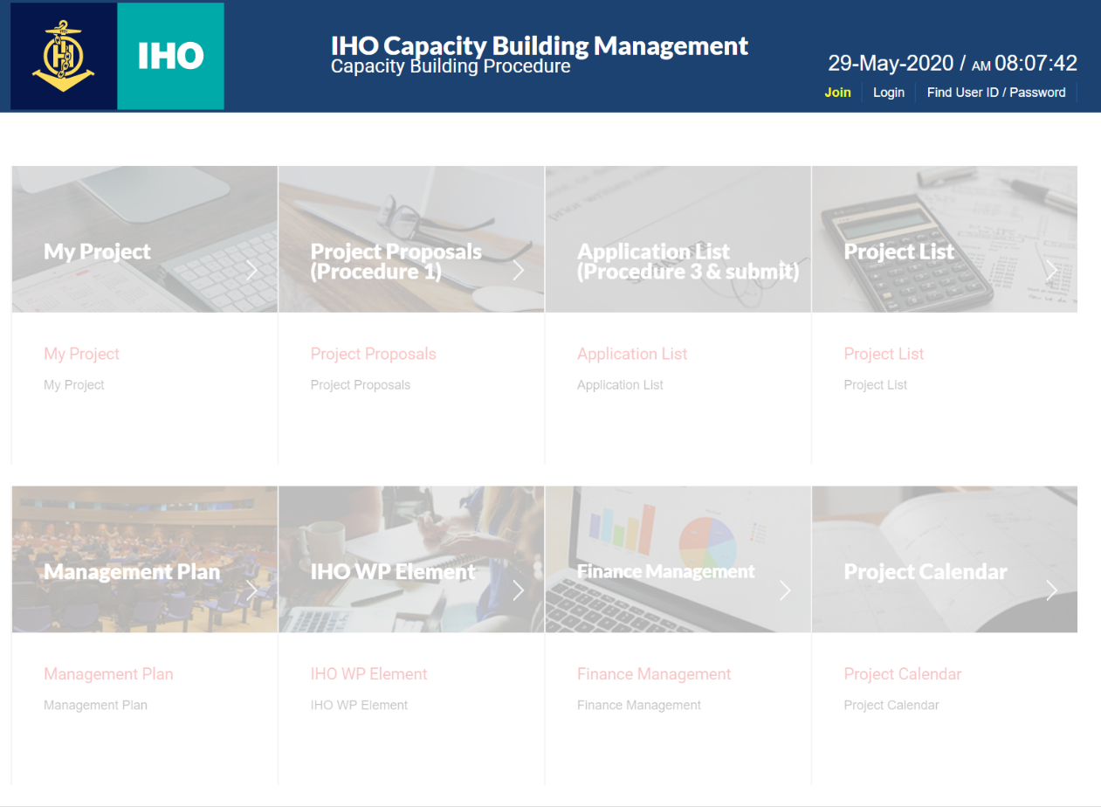
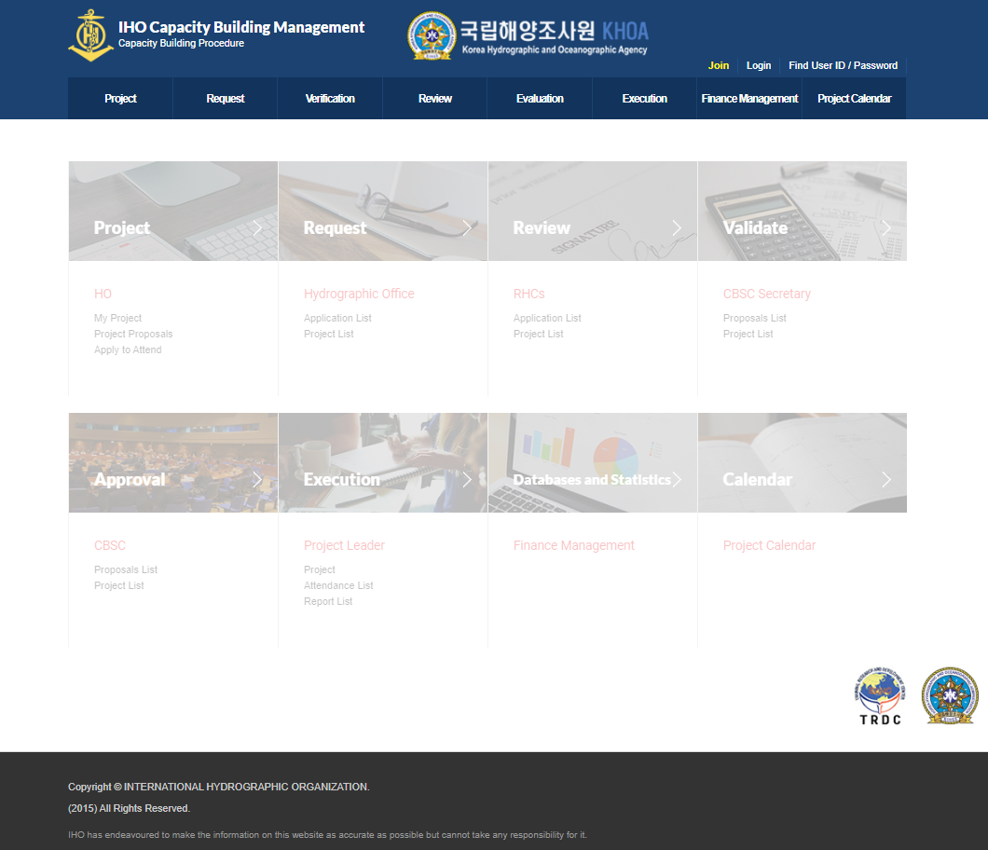
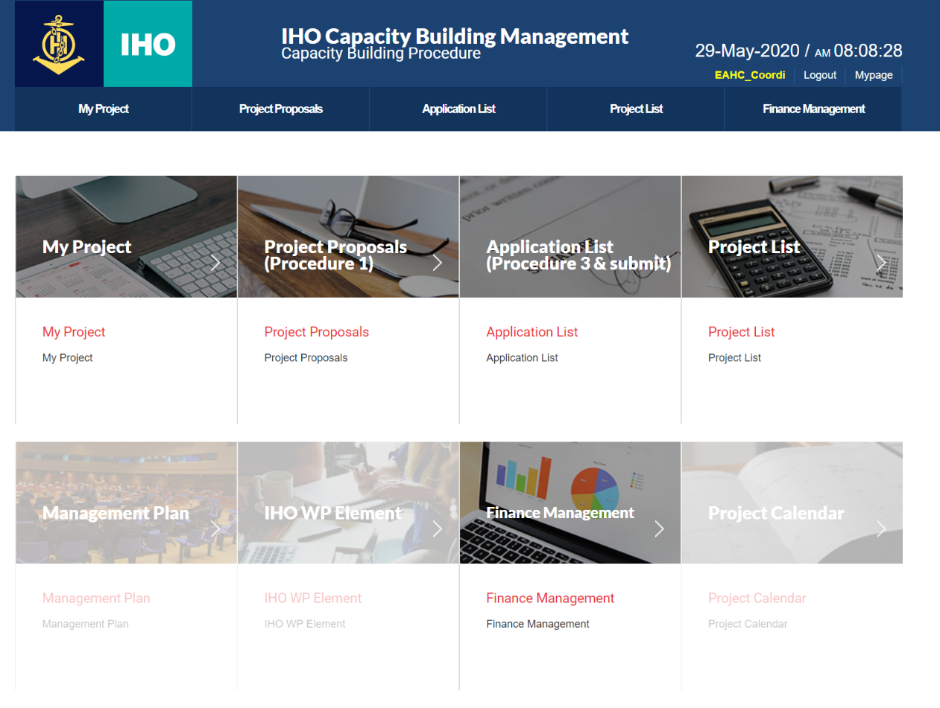
Simplified Home Page
Ⅱ. Main Improvements
Simplified the menu on the home page
+
5/12

Slide 6
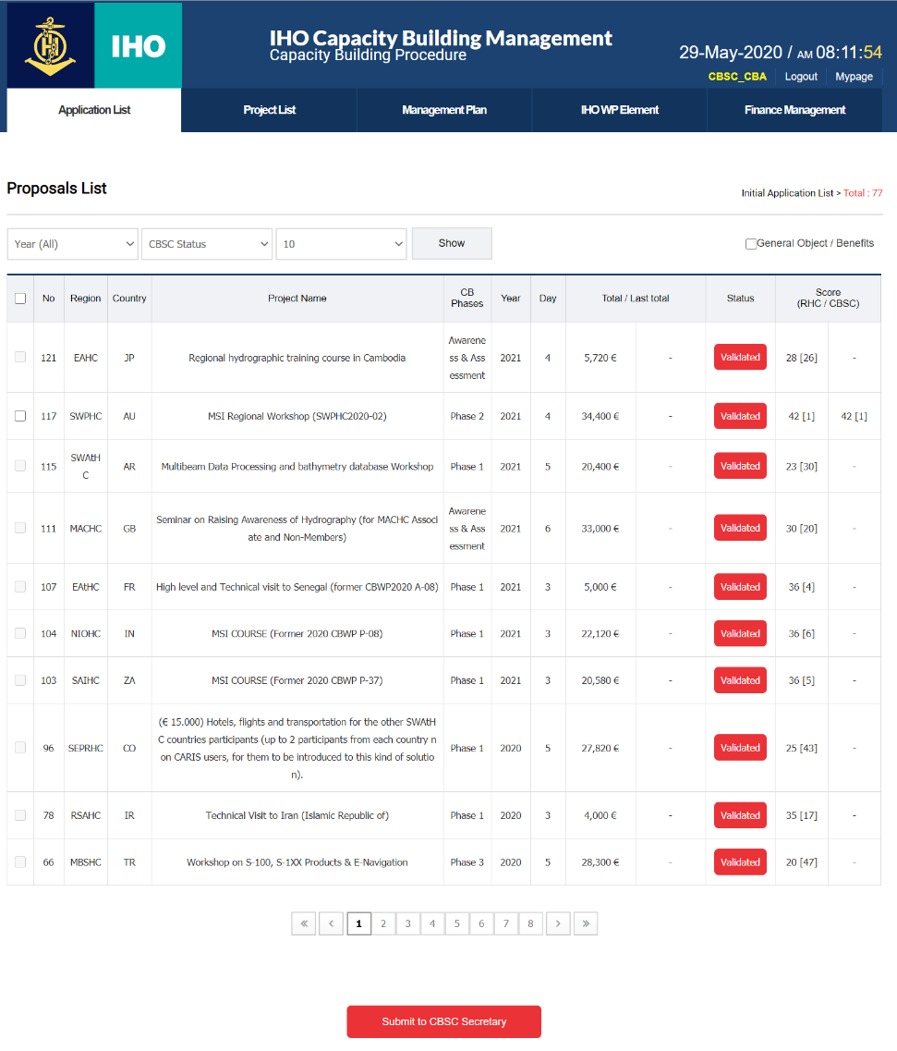
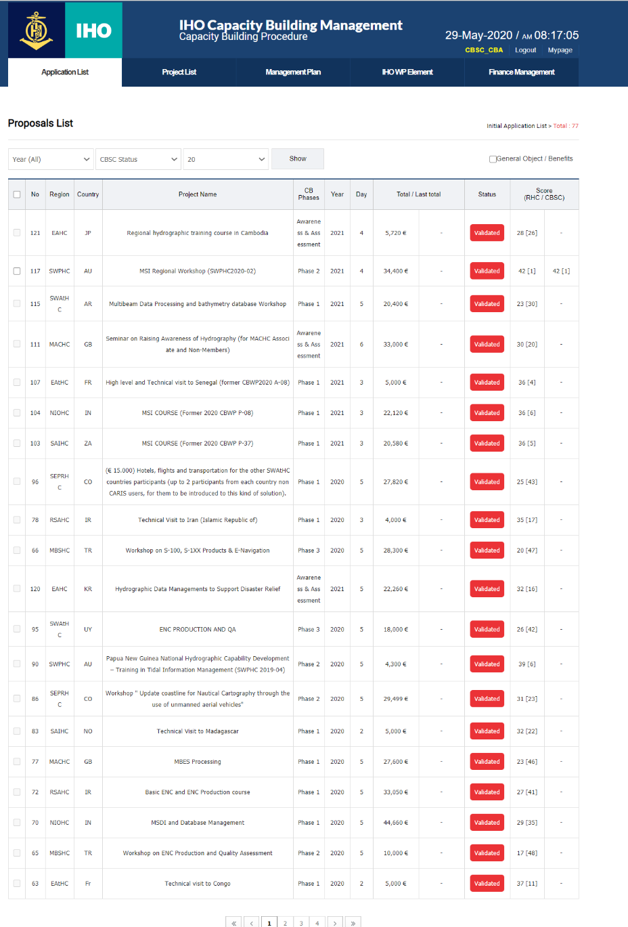
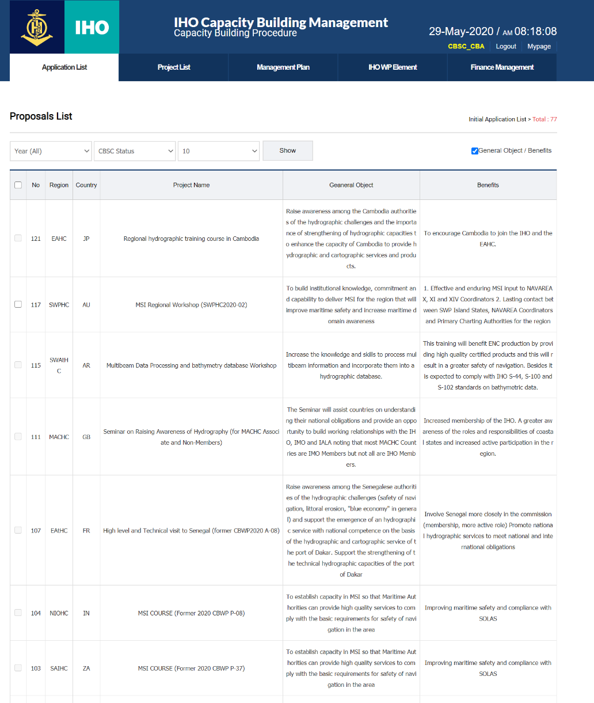
Proc.1 Added Project Summary
1
1
3
2
1
Select the number of proposals to show in one page (10, 20, 50)
Check the proposed and approved costs at the same time
Added columns for viewing project summary
2
3
6/12

Slide 7
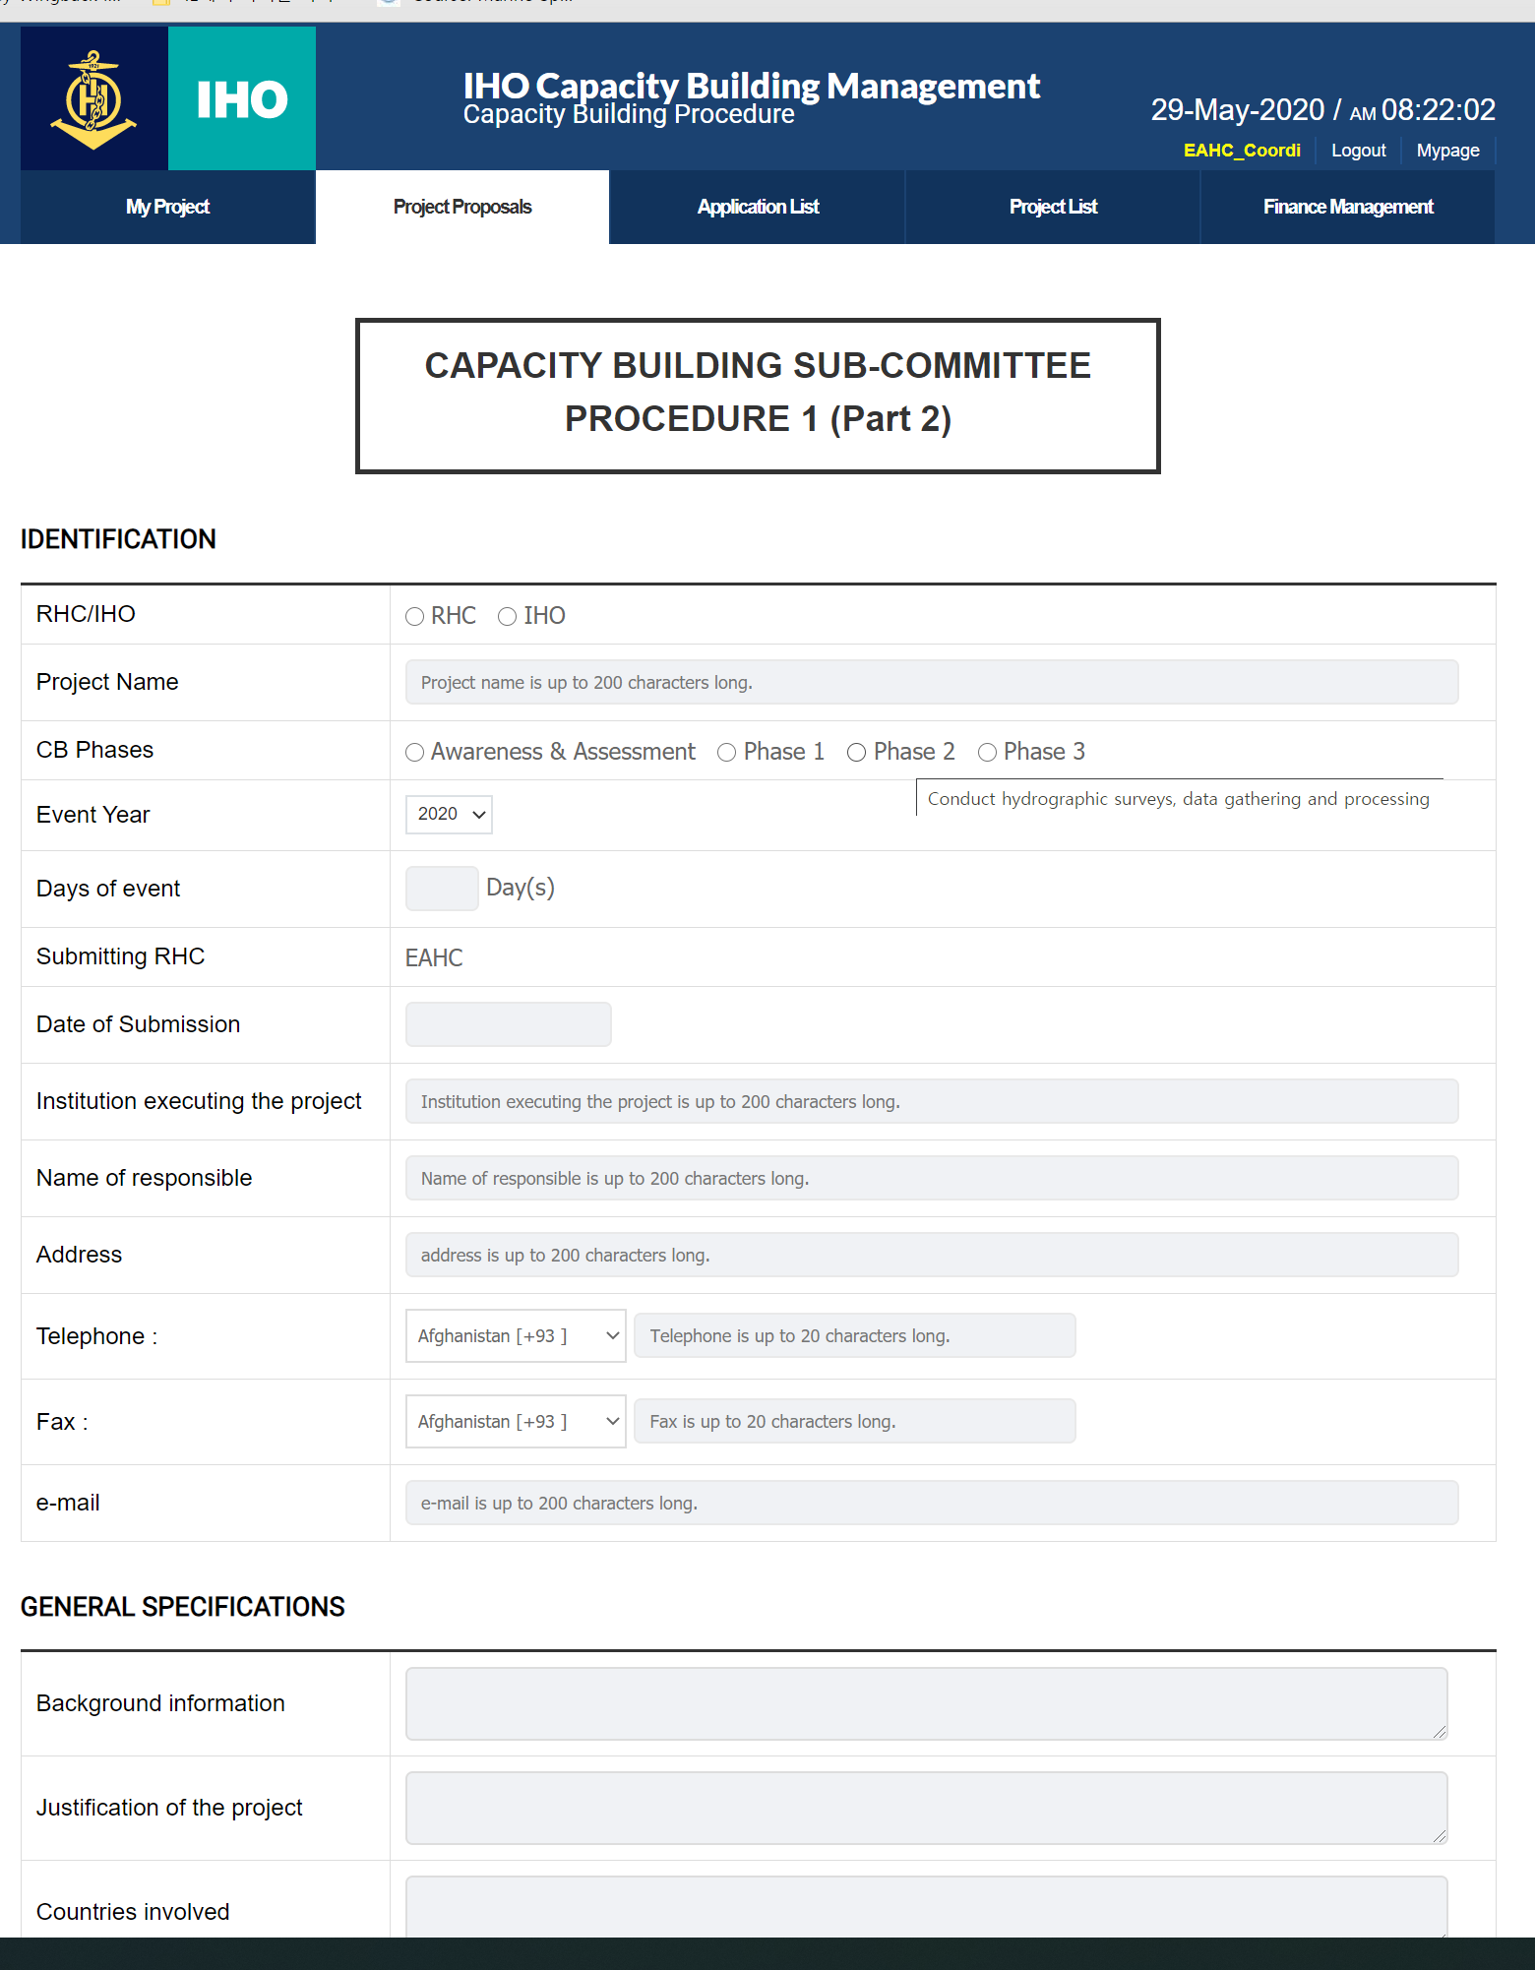
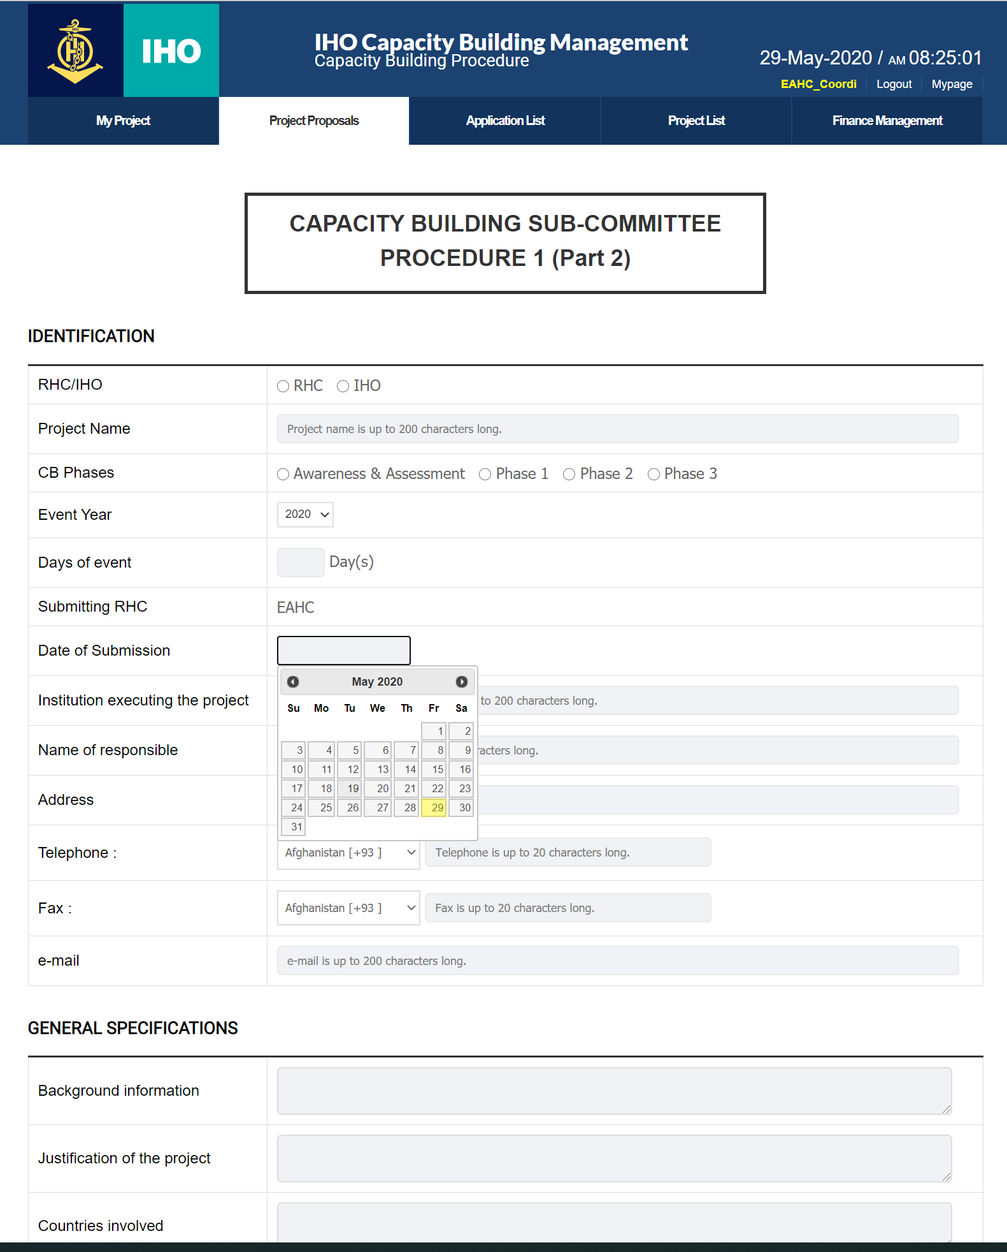
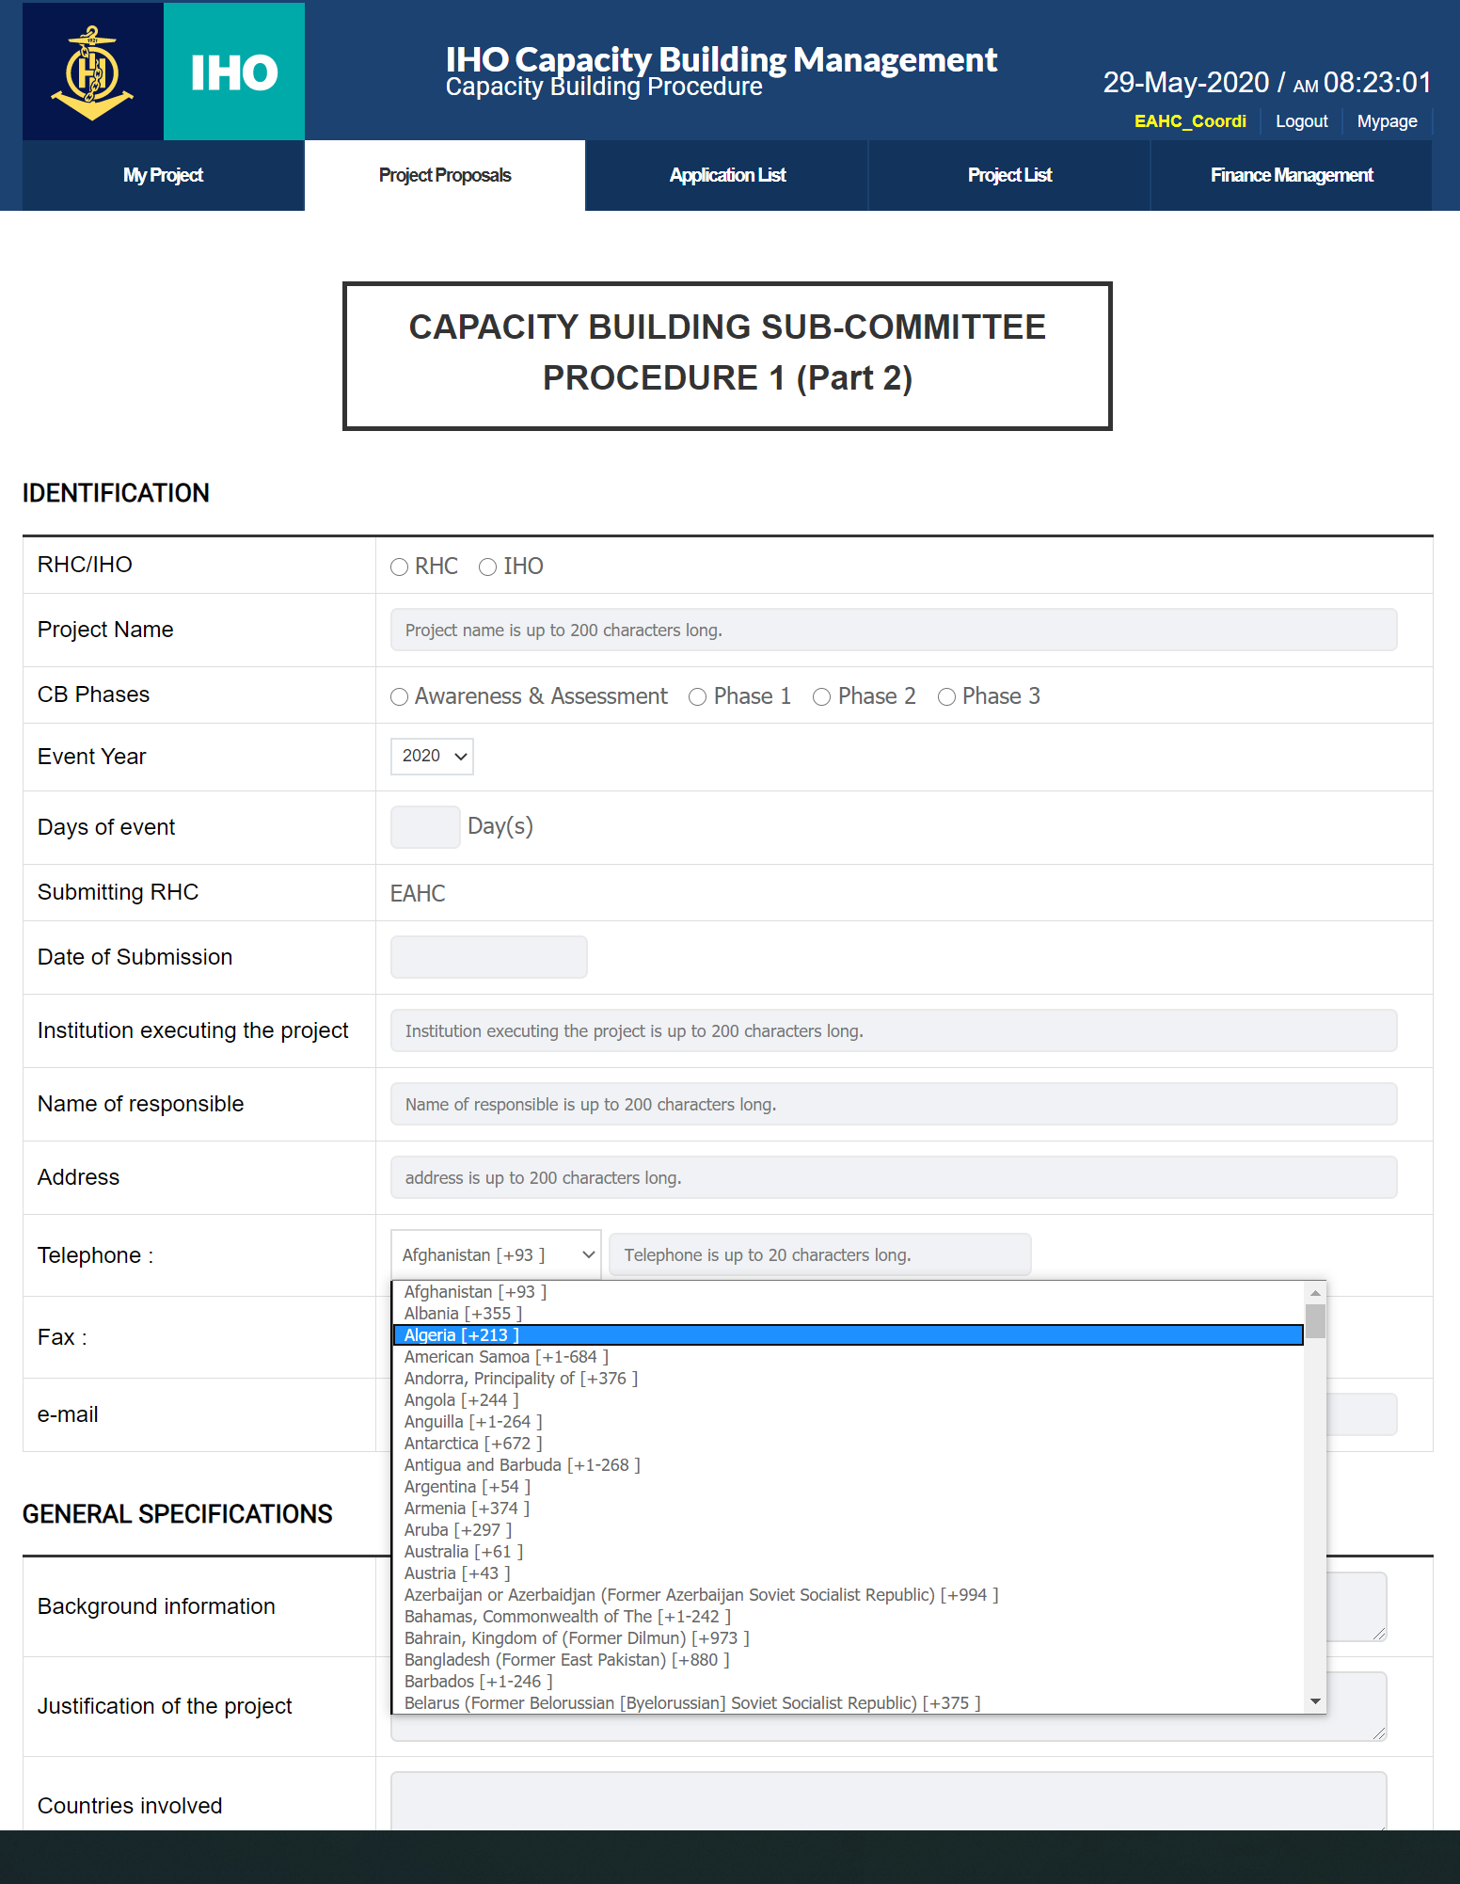
Enhanced convenience for users
Added explanations for each CB Phase
Select the date with a calendar and show today’s date
Country is automatically selected with country code

Slide 8
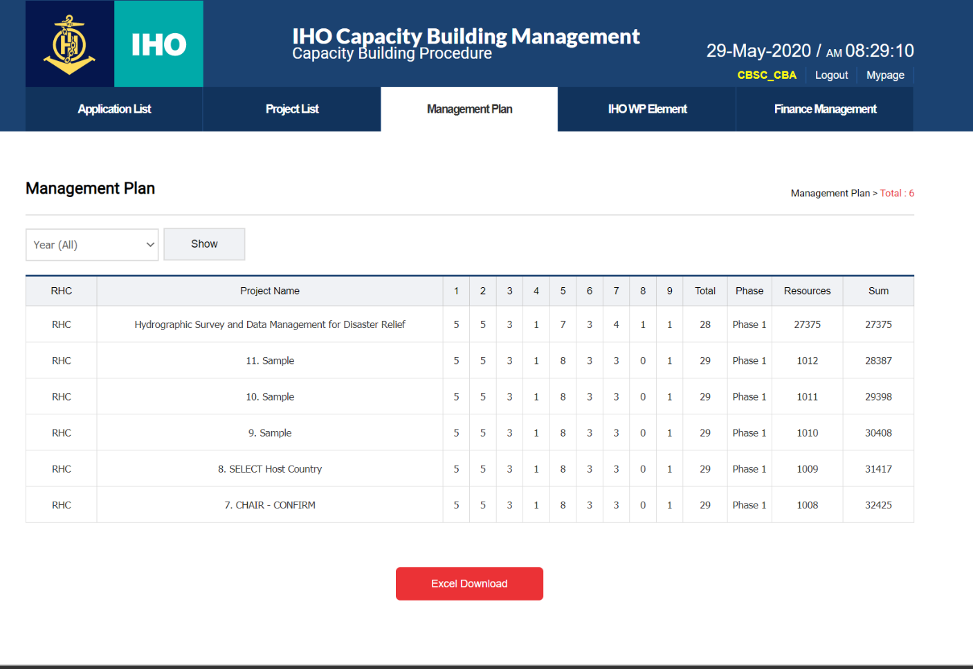
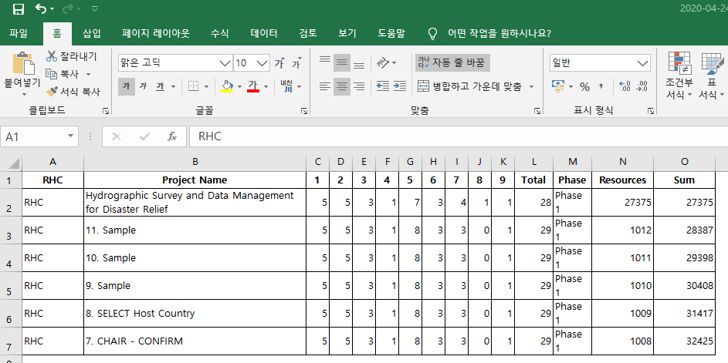
Download Management Plan
When “Excel Download” is clicked, Management Plan is downloaded as Procedure 4 format.
+
8/12

Slide 9
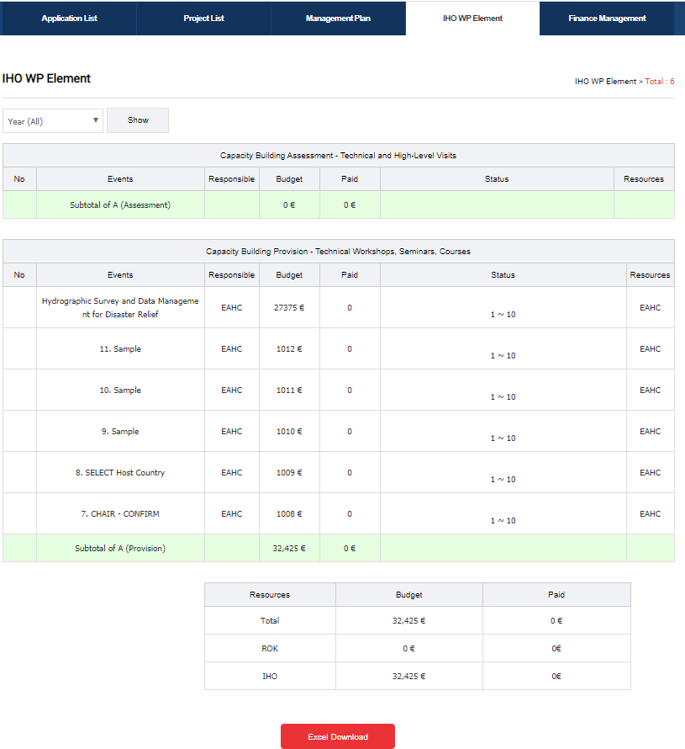
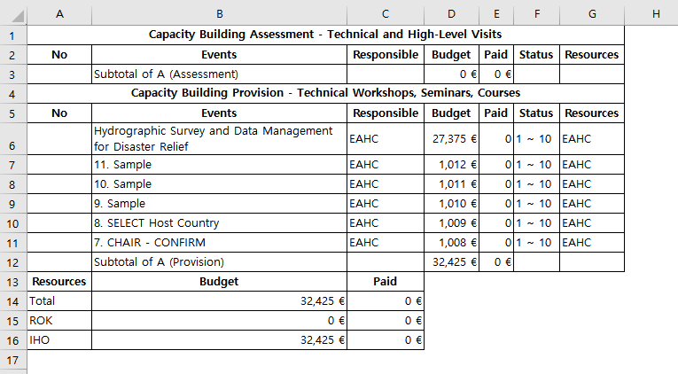
Download IHO WP Element
+
When “Excel Download” is clicked, WP Element is downloaded in excel format.
9/12

Slide 10
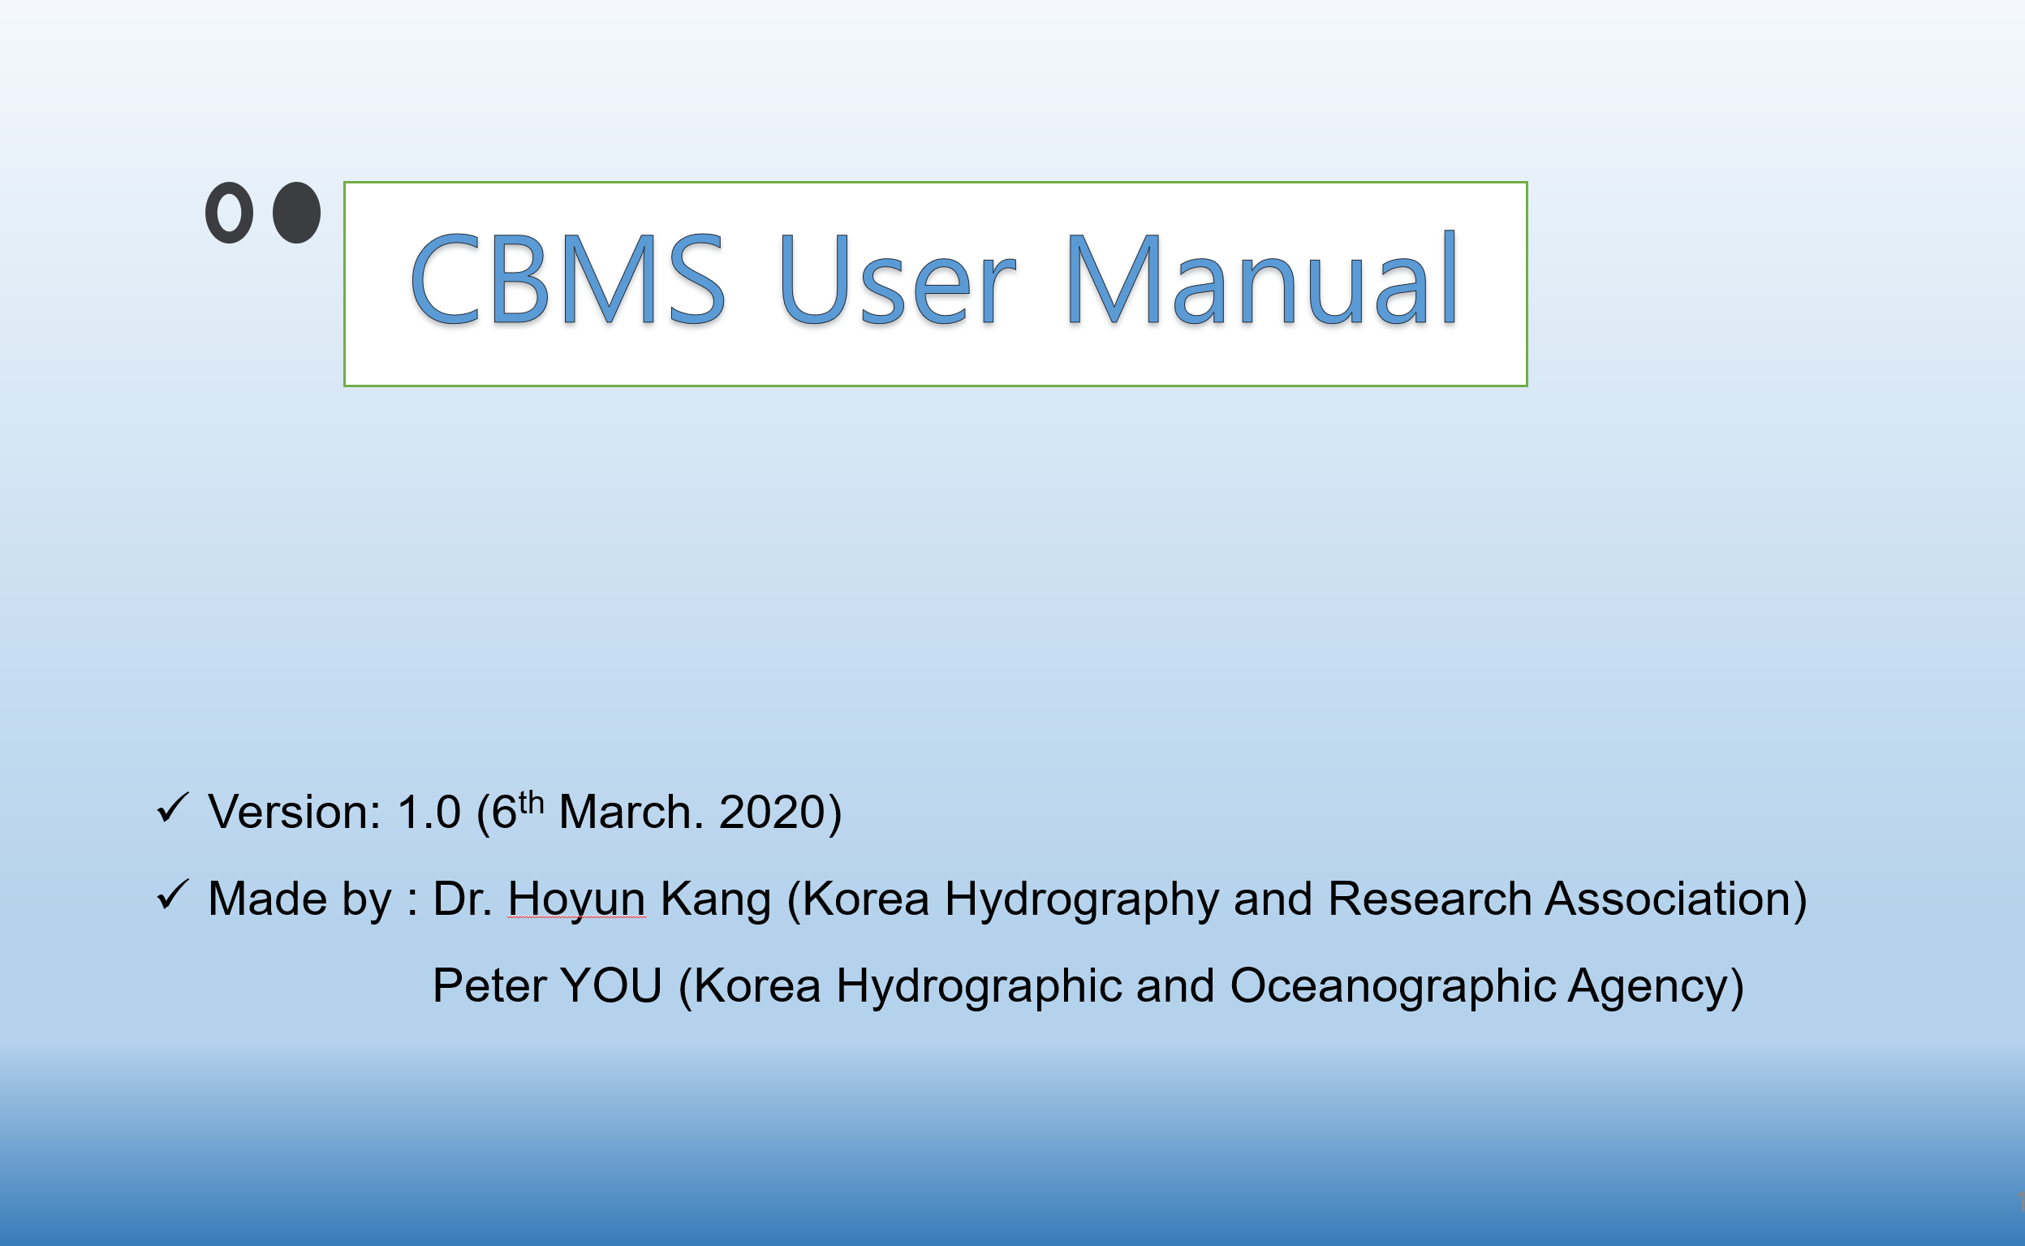
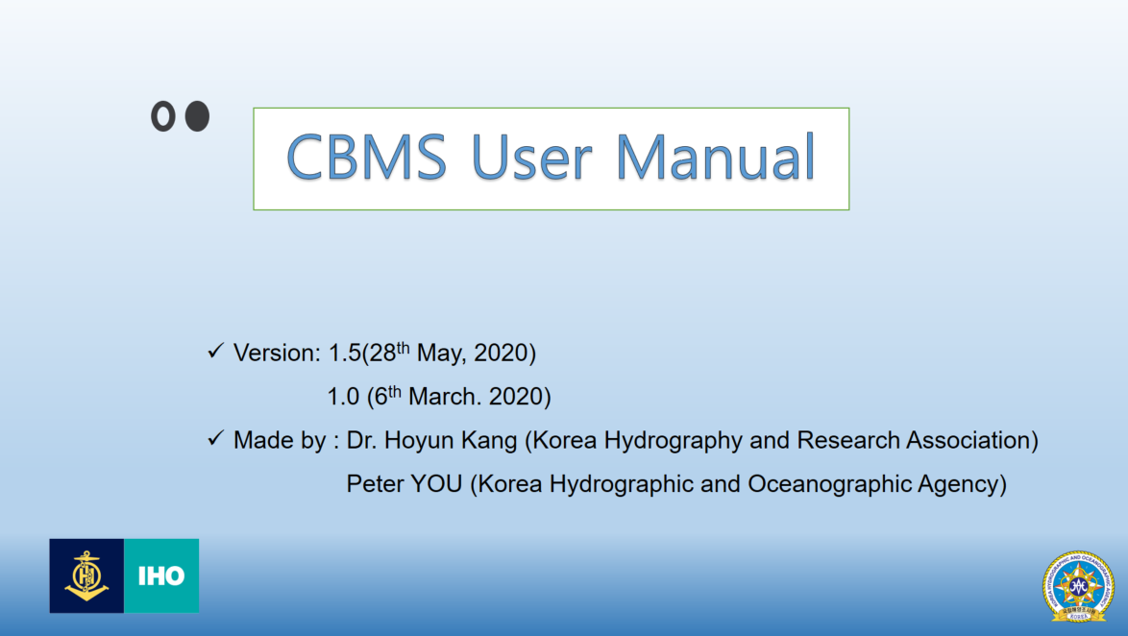
Ⅲ. User Manual
CBMS User Manual
Version - 1.0
Version - 1.5
The manual will be continuously updated and uploaded to the CBMS.
10/12

Slide 11
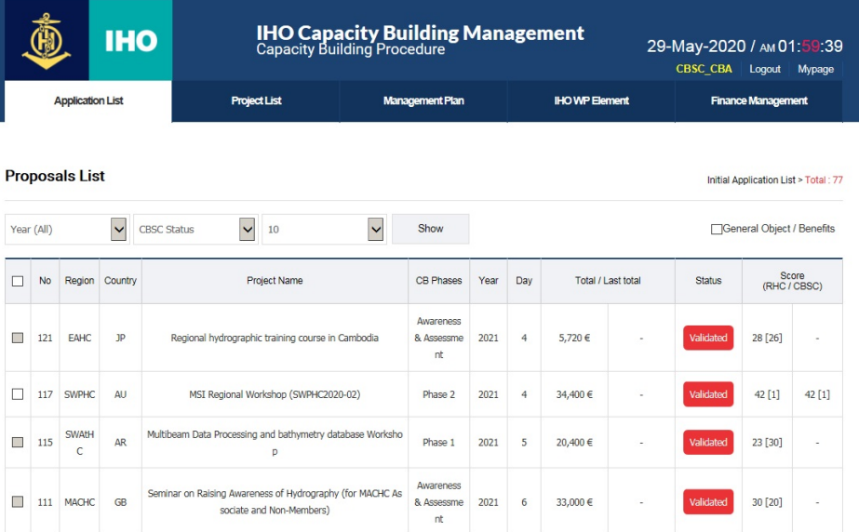
Ⅲ. System Applied to Work for Testing
Tested 67 proposals submitted for 2020 and 2021
It is concluded that the CBMS is now available for receiving submissions from all RHCs.
11/12

Slide 12
Ⅴ. Future Plan & Actions Required
Develop additional functions
Manage reports of CB activities implemented by RHCs; create a space for sharing CB achievements and training material
Improve convenience for CB Coordinators
Automatic input of repeated information; improve convenience for users
Management Plan
Request comments from IHO Sec; improve CB Management function
Continuous maintenance
KHOA will provide continuous maintenance support to run the CBMS stably
1. CB Coordinators to use the CBMS themselves and provide feedback.
2. Decide to use the CBMS for submissions from CBSC-19 (2021).
Actions Required
12/12

